Slide 1

Woodlands
NOTE: Everything in this presentation is for ideation purposes only, fonts, colors, and app name are all open to discussion.

Slide 2
App Icon
For ideation purposes only
Confidential and Proprietary

Slide 3


Color Theme and Branding
For ideation purposes only
Primary
#008200
RGB: 0, 130, 0
Secondary
#88C32C
RGB: 136, 195, 44
Tertiary
#4E342E
RGB: 78, 52, 46
Confidential and Proprietary

Slide 4
How to play the game
For ideation purposes only
Plant trees
Grow the trees
Unlock new trees to plant and grow
Eventually unlock new landscapes which offers new trees to plant and grow
Natural disasters will set you back
Confidential and Proprietary

Slide 5

Log-On Screen View
For ideation purposes only
Confidential and Proprietary

Slide 6



Home Screen Viewing
For ideation purposes only
Ad space
This is the landing page once logged in.
You can pinch and zoom endlessly throughout the landscape
This is where most time is spent in the app.
Light green trees are fully grown.
Tapping dark green saplings will allow them to grow
Point of the game is to plant and grow as many trees as possible.
Click here.
Confidential and Proprietary

Slide 7
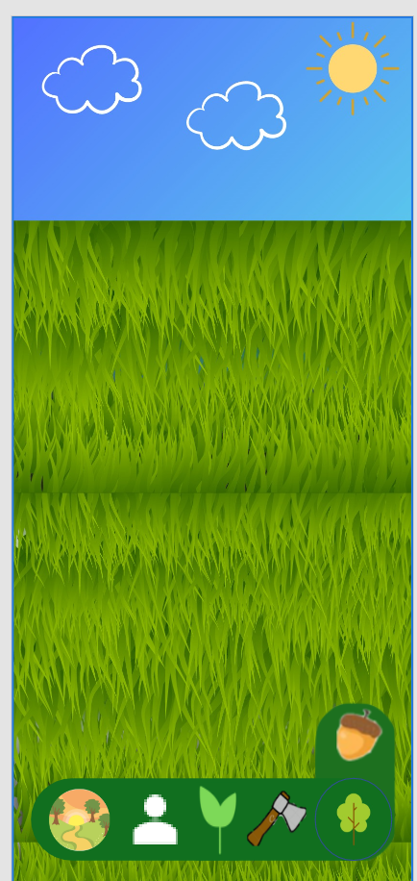
Home Screen Viewing
For ideation purposes only
Ad space
Clicking the circle in the bottom right extends the option of icons to click.
The Person Icon takes you to your account information.
The sapling icon allows you to click around on the screen and plant saplings.
The axe icon allows you two swipe to clear trees and saplings.
The landscape icon allows you to navigate between landscapes when the user achieves them
The acorn button let’s you see your acorn amount and make purchases using them
Click sapling.
Exposes icons to click.
Confidential and Proprietary

Slide 8
Home Screen Viewing
For ideation purposes only
Ad space
Double tapping on the screen now allows new saplings to be planted.
When finished planting, to exit this function, click on the circle sapling icon again to expose the control bar.
Click on the icon again when finished planting.
Icons collapse and operating icon stays in the circle.
In this case, the sapling icon.
Confidential and Proprietary

Slide 9
Home Screen Viewing
For ideation purposes only
Ad space
In this case, we are going to go from planting saplings to clearing trees with the axe.
Click axe icon in this case now.
Control dock is now re-exposed. To exit any of the icons and go back to the home view, click the tree (app) icon again.
Confidential and Proprietary

Slide 10


Home Screen Viewing
For ideation purposes only
Ad space
Now there is an axe icon on the screen.
Hold down on it with a finger and swing it around the screen.
Doing so will clear trees and saplings from the area.
They will fall over and then disappear.
Click the axe icon again.
To exit chopping with the axe, the process is the same.
Confidential and Proprietary

Slide 11
Home Screen Viewing
For ideation purposes only
Ad space
We have clicked back on the icon to exit the axe function. We can click on any icon now or go to the main screen by clicking on the app icon.
Click the user icon in this case now.
Once again, the control dock is now re-exposed. We will now explore the user profile icon by clicking on it.
Confidential and Proprietary

Slide 12


User Profile Screen
For ideation purposes only
Trees Planted: 432
Trees Grown: 385
Trees Cleared: 15
Natural Disasters: 3
Here the user can see what they have accomplished in the game.
The ‘Trending’ icon will show users with the most accomplished and those who are growing their forests the fastest.
Trending
Once again, clicking the main button will allow users to select an option from the control dock.
Confidential and Proprietary

Slide 13
Home Screen Viewing
For ideation purposes only
Ad space
We have clicked back on the icon to exit the axe function. We can click on any icon now or go to the main screen by clicking on the app icon.
Click the landscape icon in this case now.
Once again, the control dock is now re-exposed. We will now explore the landscape profile icon by clicking on it.
Confidential and Proprietary

Slide 14
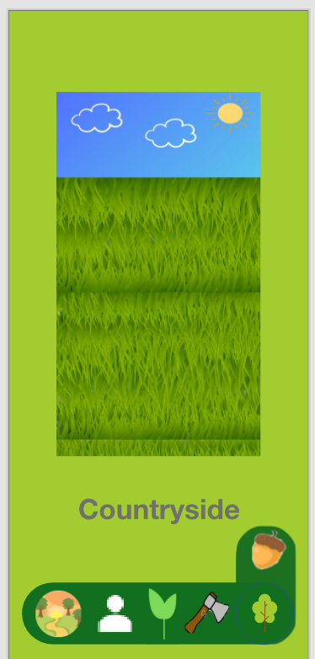
Home Screen Viewing
For ideation purposes only
Ad space
Swiping left on the countryside image allows the users to scroll through the different landscapes. Landscapes are blurred out until the user has unlocked them.
Clicking on the landscape will allow the user to go to it.
Swipe left
Confidential and Proprietary

Slide 15
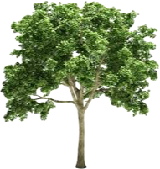

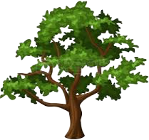
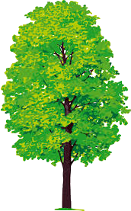
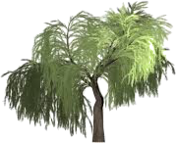
Countryside Trees
For ideation purposes only
Oak
Hickory
5
Elm
1
3
2
Maple
4
Willow
Confidential and Proprietary

Slide 16
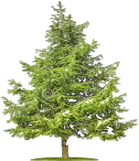


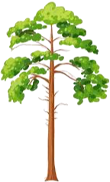

Mountain Trees
For ideation purposes only
Pine
Beech
Cedar
5
1
3
Poplar
2
Birch
4
Confidential and Proprietary

Slide 17

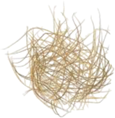
Desert Trees
For ideation purposes only
Tumbleweed
Cactus
2
1
Confidential and Proprietary

Slide 18
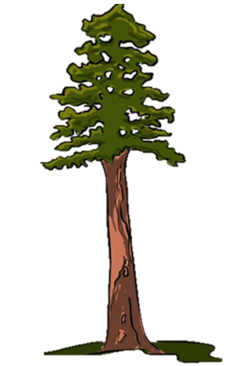

Beach Trees
For ideation purposes only
Palm
Redwood
1
2
Confidential and Proprietary

Slide 19
Jungle Trees
For ideation purposes only
Xae
1
Kapok
3
Ipe
Ramon
4
2
Confidential and Proprietary

Slide 20
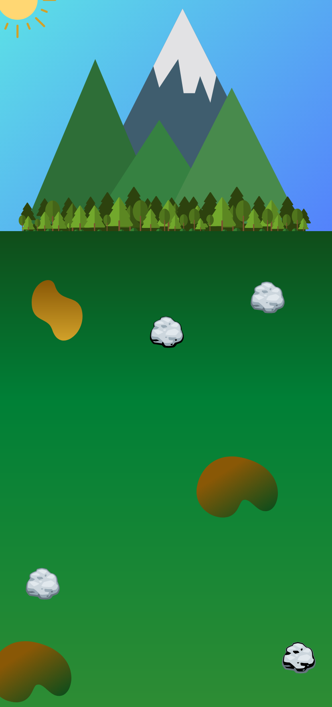



Landscapes
For ideation purposes only
Countryside
Mountain
Desert
Beach
Jungle
1.
2.
3.
4.
5.
Confidential and Proprietary

Slide 21


Natural Disasters
For ideation purposes only
Natural Disasters will occur randomly while the user is not in the app.
There are two possible disasters:
Fire
Destroys trees in a certain circular area
Applicable to all landscapes but desert
Tornado
Destroys tress in a linear path
Applicable to all landscapes but beach and desert
Hurricane
Wipes out trees in the beach landscape
Users are notified when they log on if a natural disaster struck while they were away by a short graphic and a given number of trees destroyed.
Confidential and Proprietary

Slide 22
Monetization
For ideation purposes only
Ads in the app
Full screen when you log in
Full screen at periodic times
At the top of the screen as you play the game
Pay to purchase acorns
Acorns buy
Access to new trees without having to meet the required threshold
Access to a new landscape without having to meet the required threshold
Someone to plant trees for you
Someone to grow trees for you
Insurance from natural disaster
Insurance comes for different lengths of time for varying costs
Confidential and Proprietary

