Slide 1
ZYNGRAM · CAMPUS HUB
Your campus journey,
from sign-in to dashboard.
A visual walkthrough of the Zyngram Campus Hub prototype
PORTAL SELECTION → STUDENT SIGN-IN → SAMPLE ACCESS → DASHBOARD

Slide 2
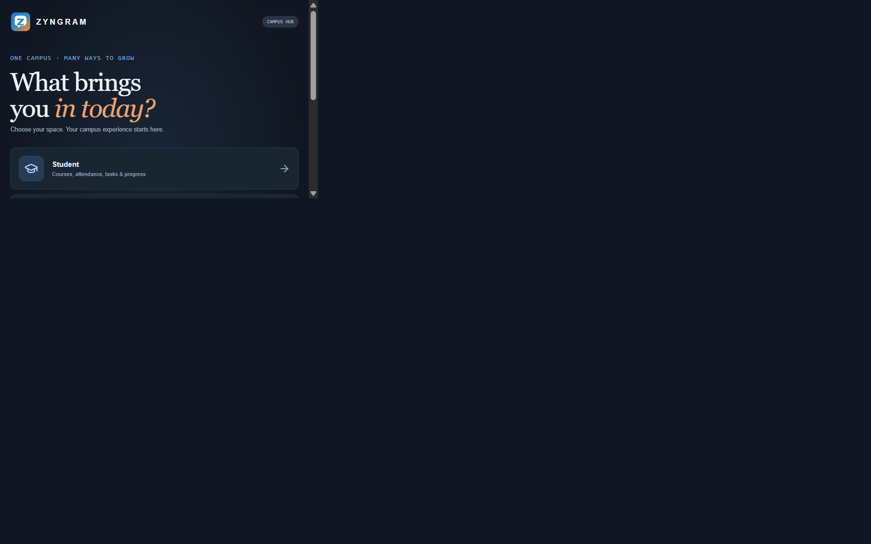
CAMPUS HUB · 01 / 04
Choose a campus portal
Start by selecting the right space: Student, Trainer, Campus Coordinator, or Administration.
ZYNGRAM · CAMPUS HUB

Slide 3
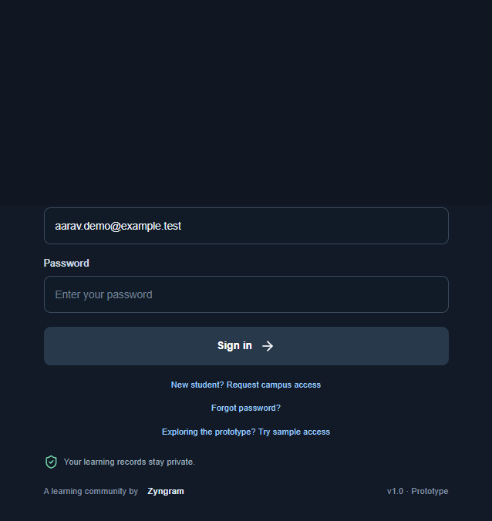
CAMPUS HUB · 02 / 04
Student sign-in
Students enter their campus account details to access their learning workspace.
ZYNGRAM · CAMPUS HUB

Slide 4
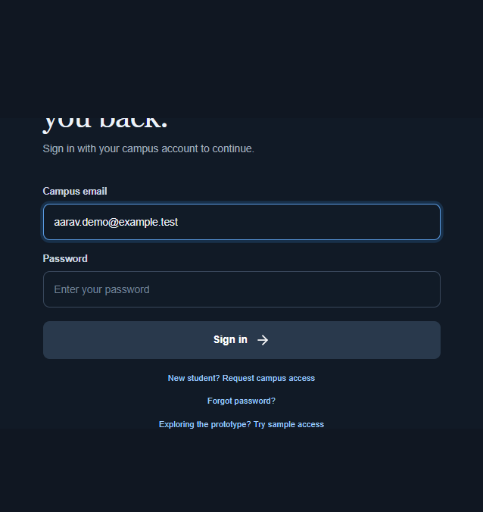
CAMPUS HUB · 03 / 04
Explore with sample access
Development-only sample access lets people explore the prototype without a real account.
ZYNGRAM · CAMPUS HUB

Slide 5
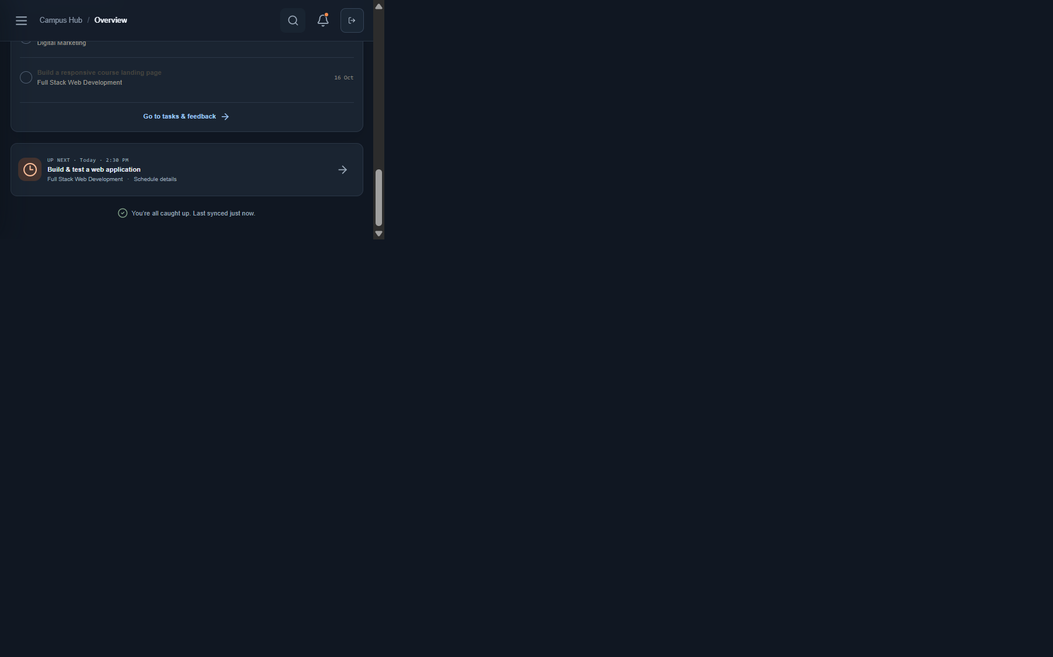
CAMPUS HUB · 04 / 04
Student dashboard
The dashboard brings learning progress, attendance, tasks, and upcoming work together.
ZYNGRAM · CAMPUS HUB

Slide 6
A clearer path through campus.
Zyngram Campus Hub · Working local prototype

