Slide 1


Smart Warehouse Management System
Team 19:
-Md Saidur Rahman
-Anh Phuc Dang
-Hai Dang Duong

Slide 2
Task Distribution
Anh Phuc Dang
Package:
Hai Dang Duong
Package:
Md Saidur Rahman
Package:
Maven
resources (JavaFX), logger
application,
equipmentManager,
taskManager
Warehouse
taskManager

Slide 3

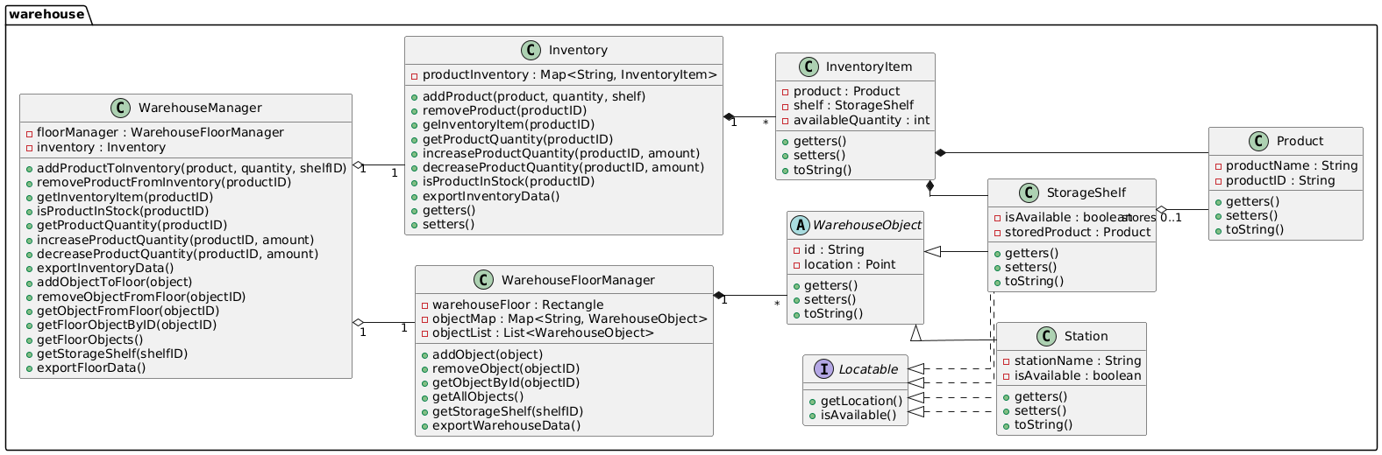
Storage Management System
inventory.csv
floorplan.csv

Slide 4
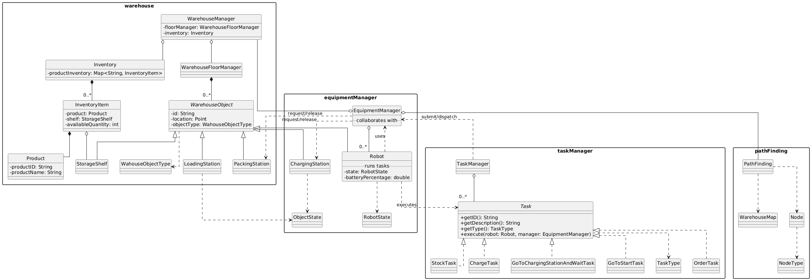
Storage Management System

Slide 5
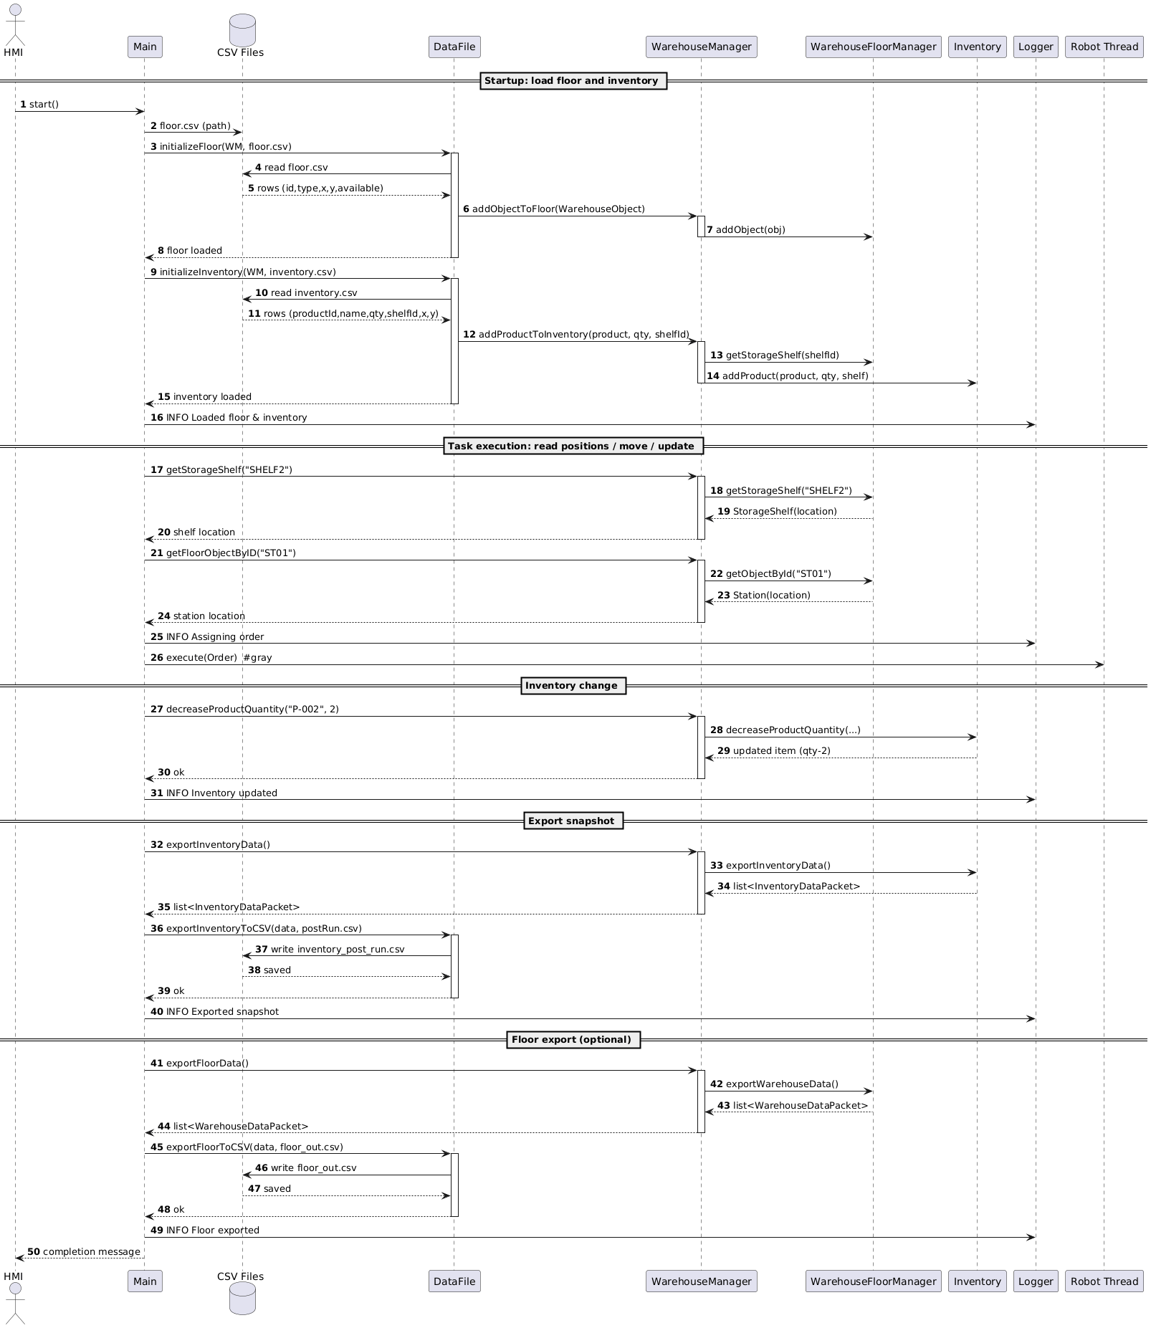
Storage Management System: INIT

Slide 6
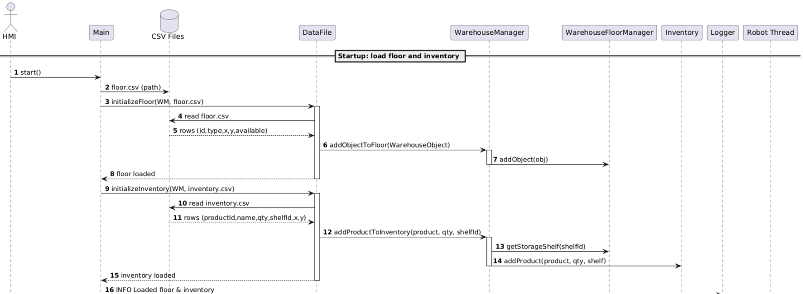
Storage Management System: Data Flow

Slide 7
Storage Management System: Data Save

Slide 8
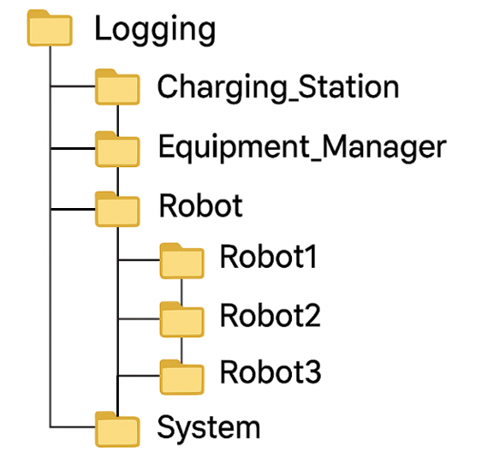
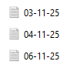
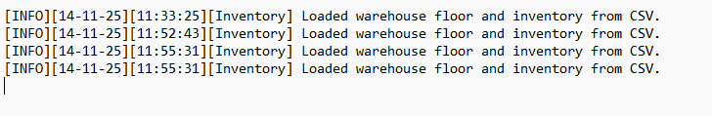
Group 19

Slide 9
Overall Interaction
Main
Screen
Inventory Button
Inventory
Screen
Inventory Controller
Return
Warehouse Button
Floor
Screen
Floor Controller
Return
Robot Button
Robot
Screen
Robot Controller
Return
Log Button
Log
Screen
Log Controller
Return
Stock Button
Stock Controller
Stock
Screen
Return
Order Button
Order Controller
Order
Screen
Return
Group 19

Slide 10
Logger Functions:
Record warehouse data.
Summarize warehouse activities.
Manage and track all warehouse operations.
Group 19

Slide 11
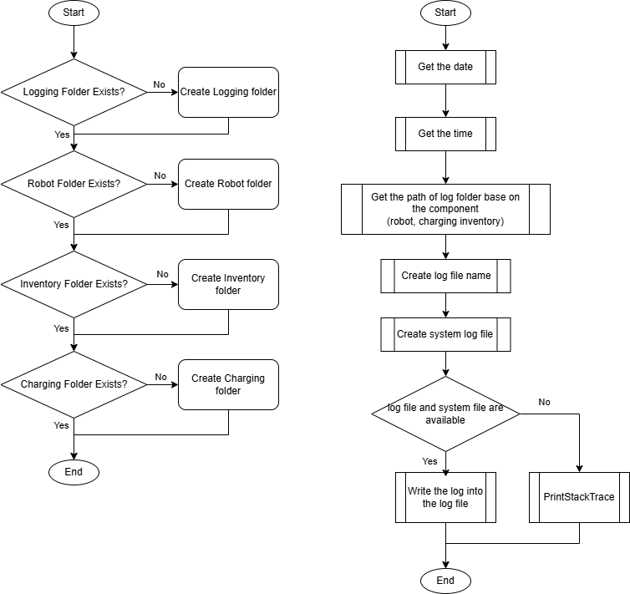
Flow Chart
Group 19

Slide 12
log_print (String type, String component, String message)
Method:
[INFO]
[WARNING]
[ERROR]
[Robot(1, 3)]
[Inventory]
[Charging]
Message
[Equipmentmanager]
Group 19

Slide 13
HMI (Human-Machine Interface) effect:
Ease of Management.
Increased Productivity.
Approachable, Assertive, and Visible.
Time and Cost Efficiency and Minimizes Error.
Group 19

Slide 14
HMI (Human-Machine Interface) effect:
Ease of Management.
Increased Productivity.
Approachable, Assertive, and Visible.
Time and Cost Efficiency and Minimizes Error.
Group 19

Slide 15
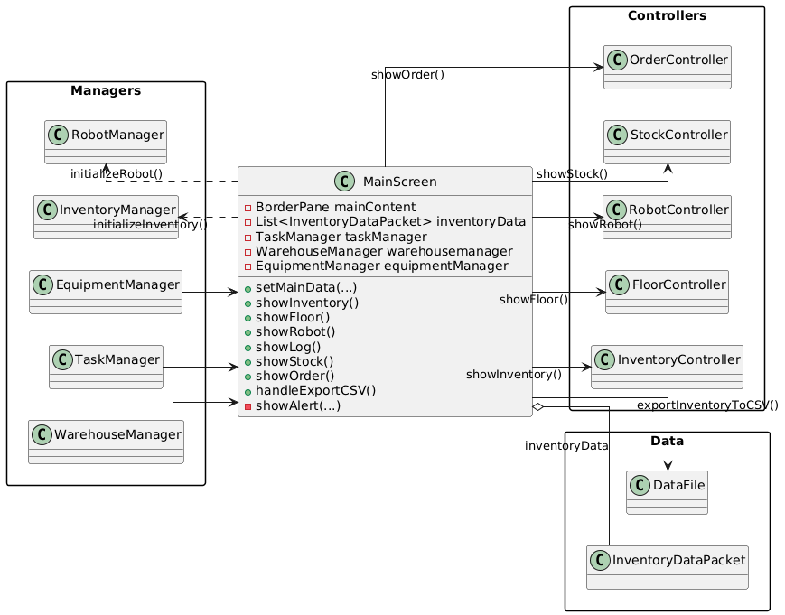
Class
Diagram
Group 19

Slide 16
HMI (Human-Machine Interface) effect:
Ease of Management.
Increased Productivity.
Approachable, Assertive, and Visible.
Time and Cost Efficiency and Minimizes Error.
Group 19

Slide 17
Data Flow
Add Stock
from Stock screen
Inventory
Screen
Inventory Manager
Data from Main
Floor
Screen
Robot Manager
Create Order
from Stock screen
Robot
Screen
Group 19

Slide 18
Tasks overview
Task Manager
Equipment Manager
Robot

Slide 19
1. Task Manager
ReceiveS tasks from HMI.
Create task objects, send TO equipment manager queue.
Defines different tasks AND script for how THEY can run.
Returns exceptions when getting errors when creating task.

Slide 20
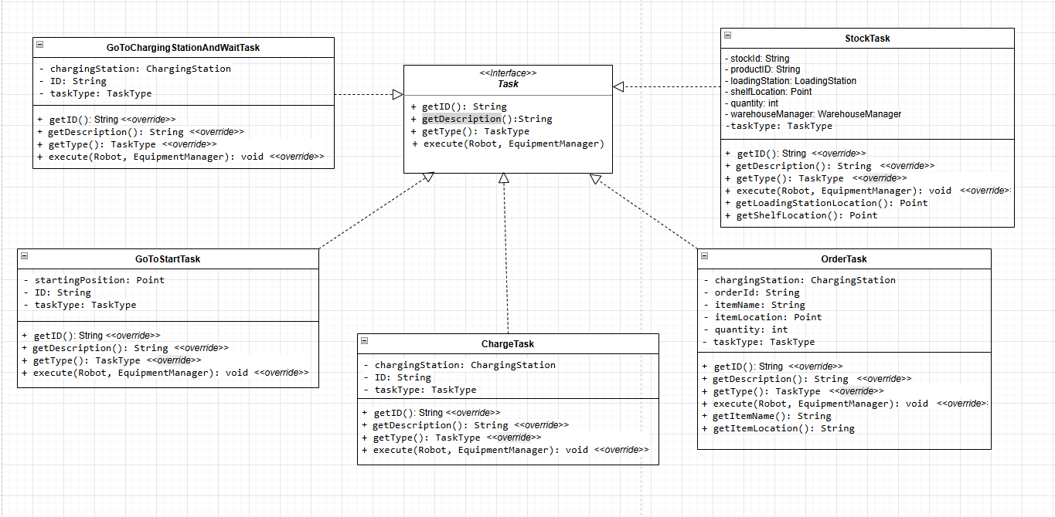
1.1. Task classes

Slide 21
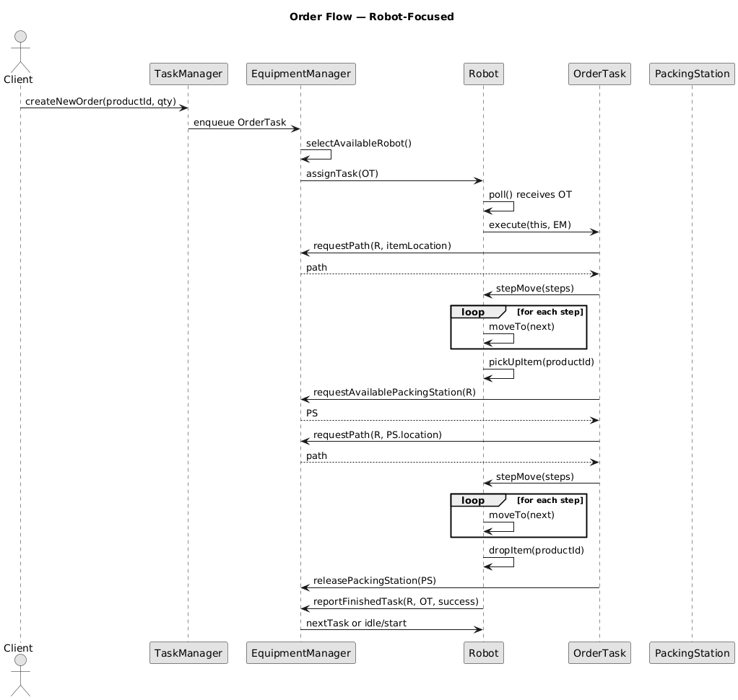
1.1. Relation overview

Slide 22
2. Equipment Manager
RUNS AS A THREAD.
DISTRIBUTES TASKS TO THE MOST SUITABLE ROBOT.
DECIDES WHICH TASKS A ROBOT SHOULD DO WHEN IT FINISHES ITS TASK.

Slide 23
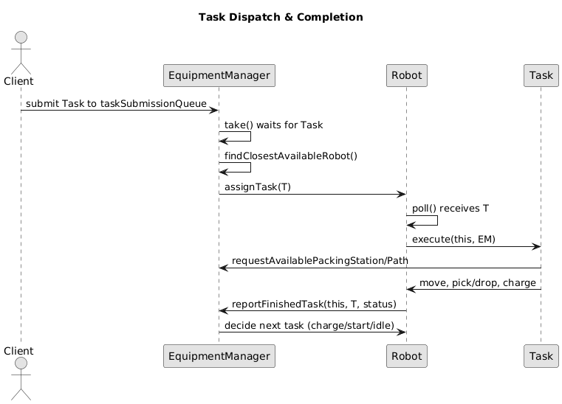
2.1. Equipment Manager and Robot relation

Slide 24
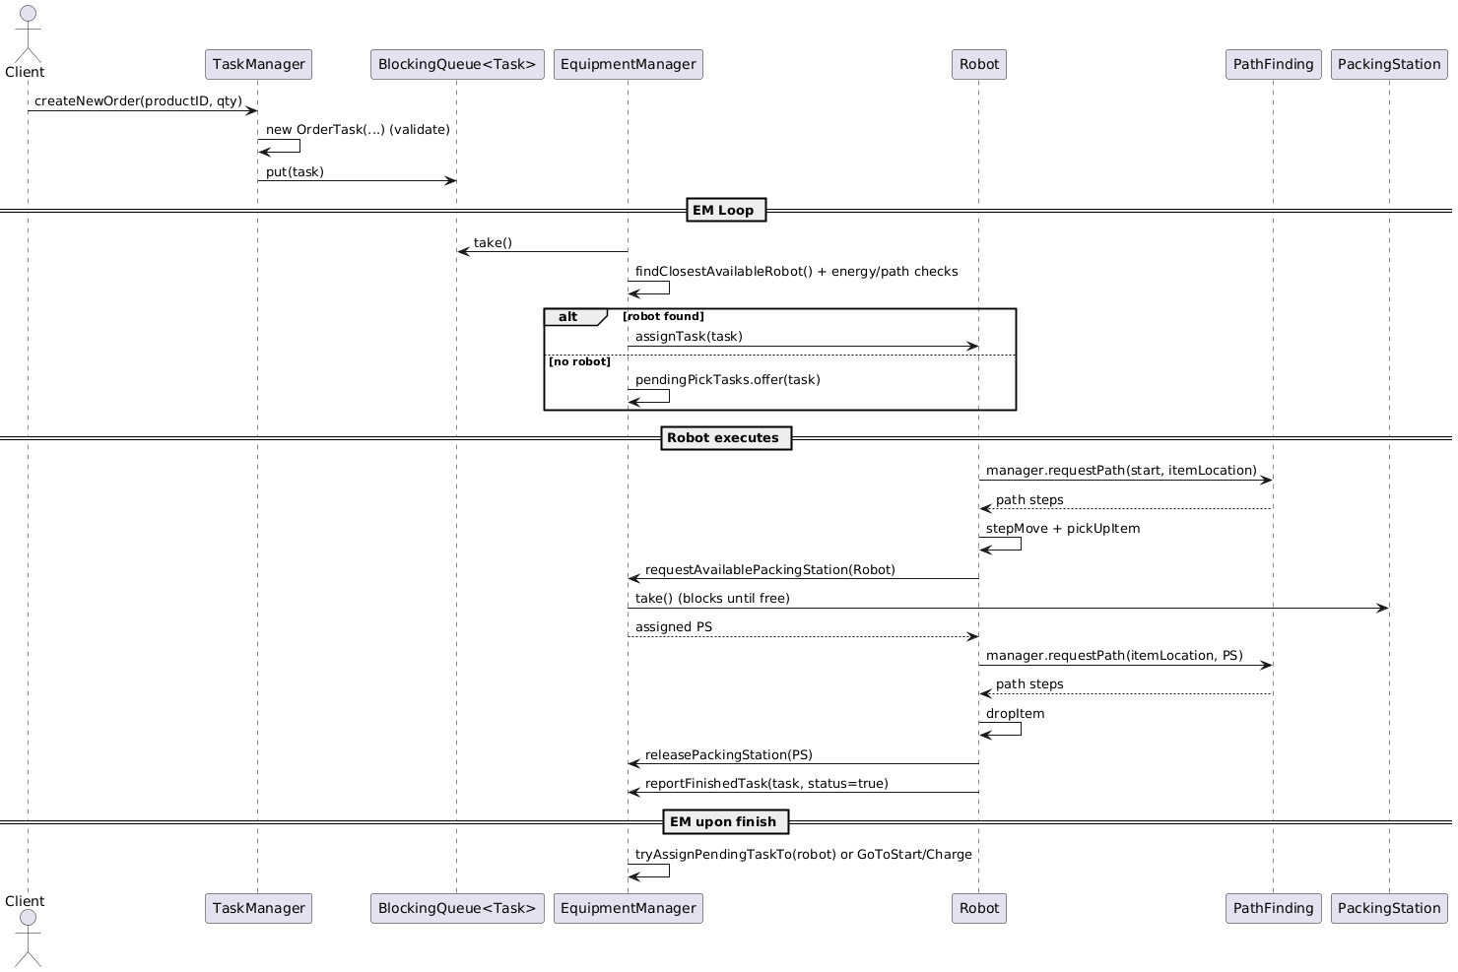
2.2. Sequence Diagram

Slide 25
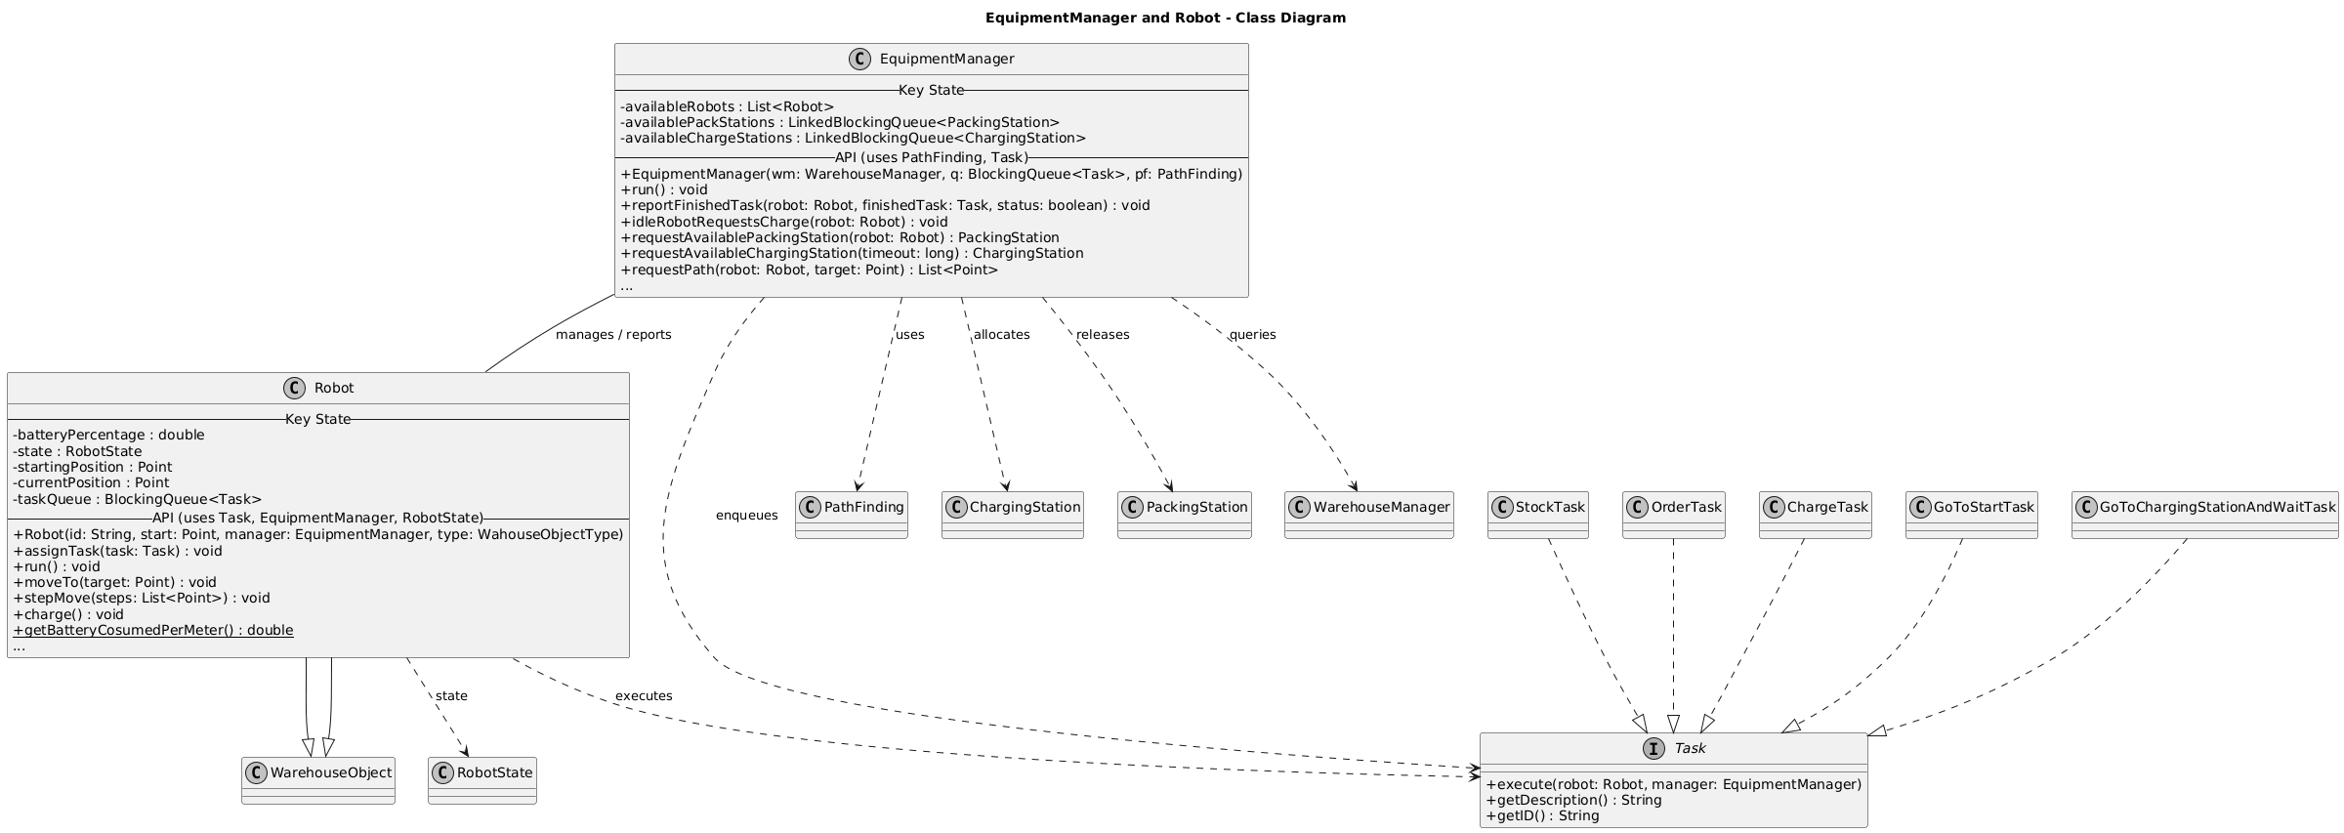
2.3. UML Diagram

Slide 26
3. Robot
Does assigned tasks.
Waiting for tasks distributed from equipment manager.
Report whenever it finished its task.

Slide 27
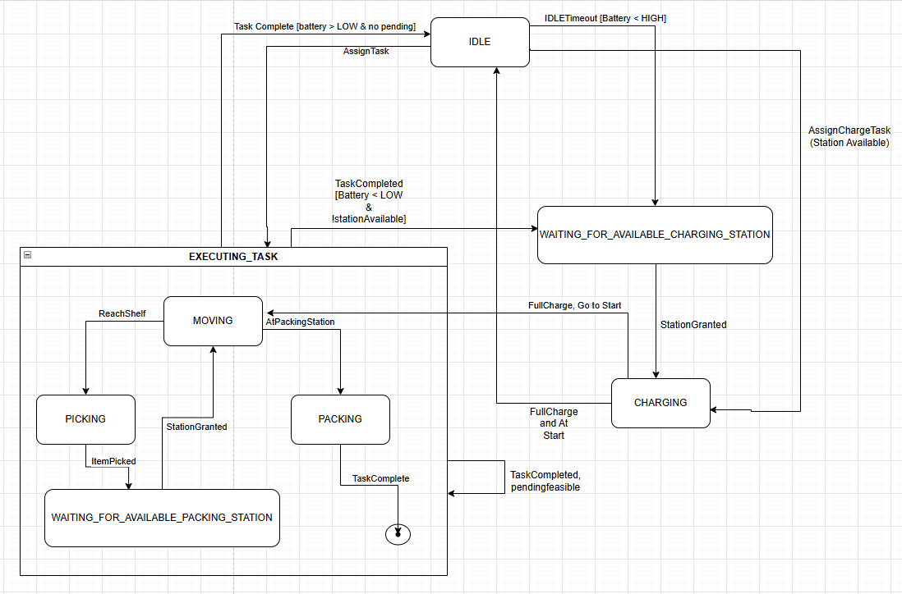
3.1. Robot states

Slide 28
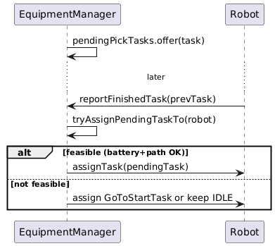
3.2. Robot finishes task

Slide 29
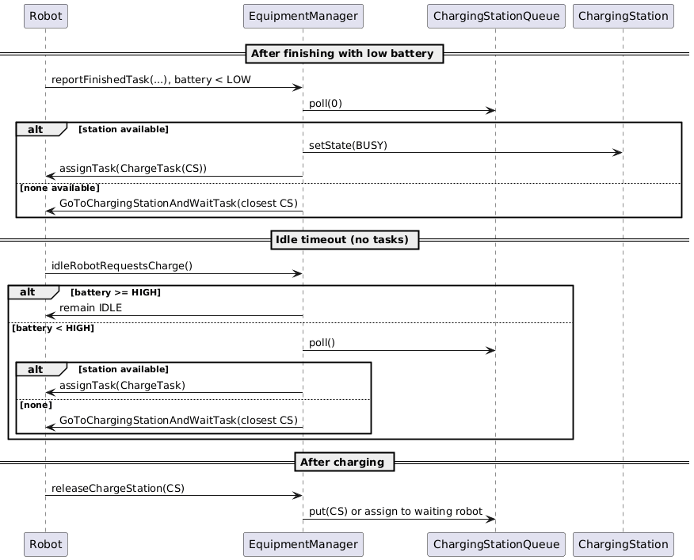
3.3. Robot charging sequence

Slide 30
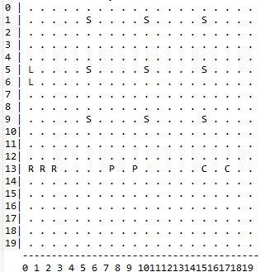
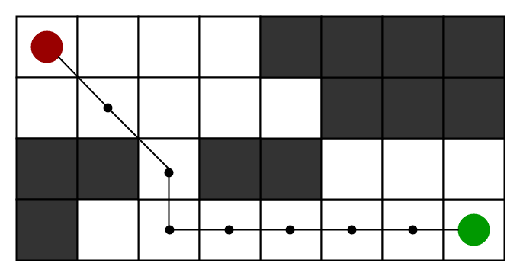
3.4. A* Algorithm

Slide 31

Thanks for listening!

