Slide 1

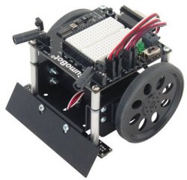
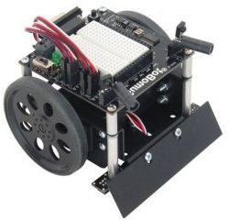
In association with
ICT ShowRoom
8th of March 2012
A tournament of
Autonomous
Sumo Robots
Students of ”Embedded Systems 1” –course
Degree Programme in Information Technology
Turku University of Applied Sciences
Notes:
1

Slide 2
Organization
Student driven project work
No lectures, and no exam
5 credits = 5 * 27 h = 135 h work load
Class room reservations;
Monday: 13.15 – 16.00
Thursday: 8.15 – 16.00
Teachers will check the project milestones
Availability for technical consultations
Vesa: Thursdays at 8.15-12.00
JP: Thursdays, no permanent time
Tapani: Thursdays, no permanent time

Slide 3
Sumo Robot tournament in ICT ShowRoom
Will use Mini Sumo rules from the BalticRobotSumo event
http://www.balticrobotsumo.org/
ICT-ShowRoom 2012
Registration open till the end of January 2012
http://www.facebook.com/ictshowroom
https://xprog28.cs.abo.fi/register.nsf/

Slide 4
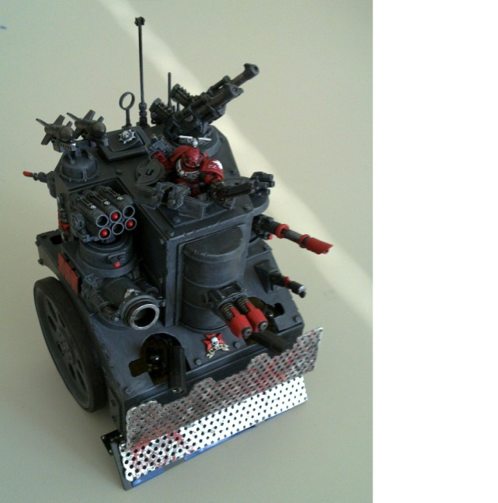
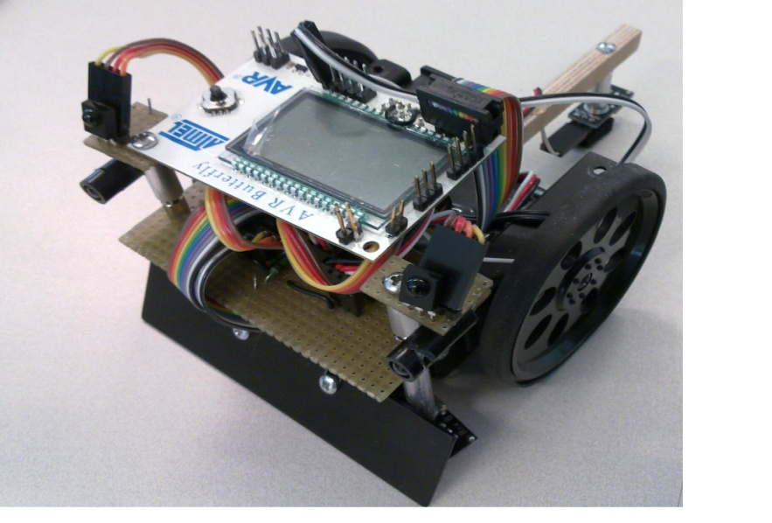
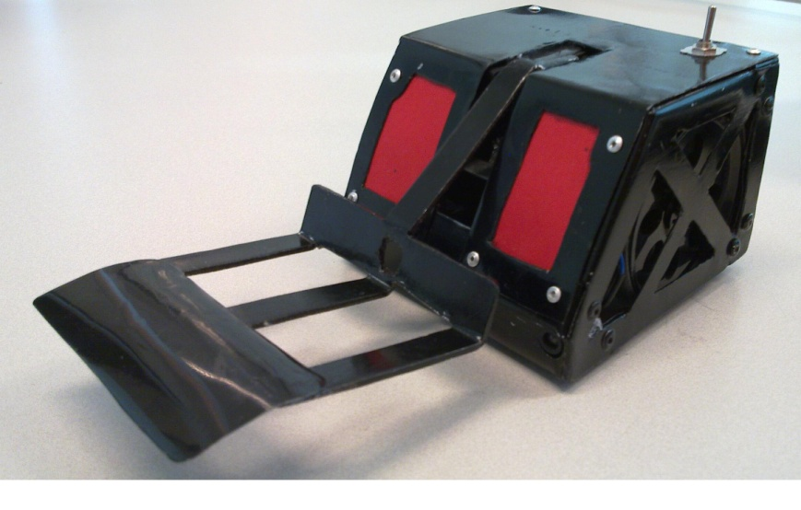
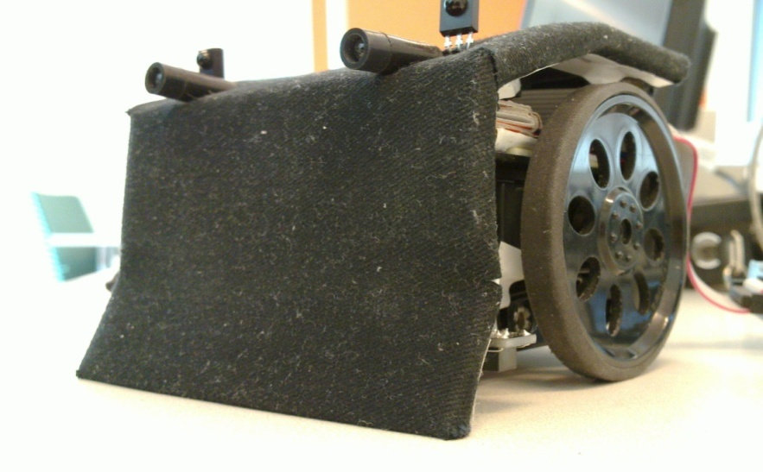
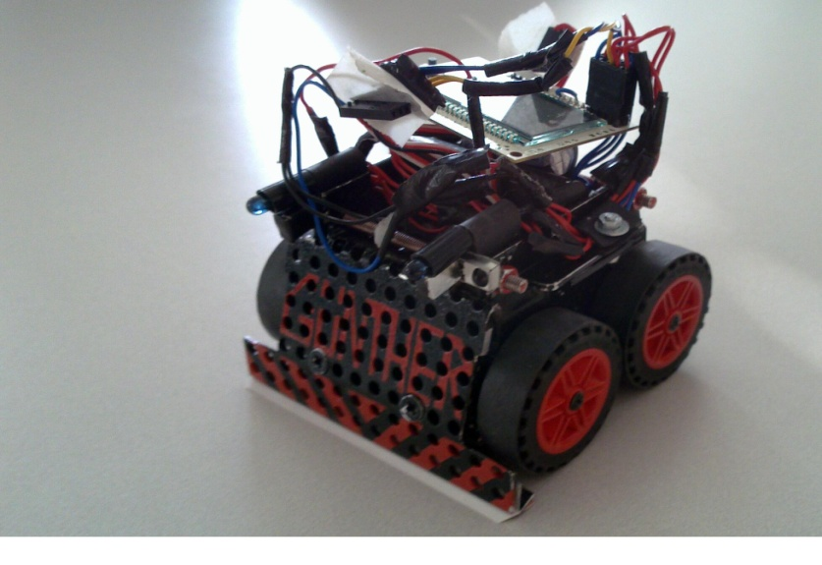
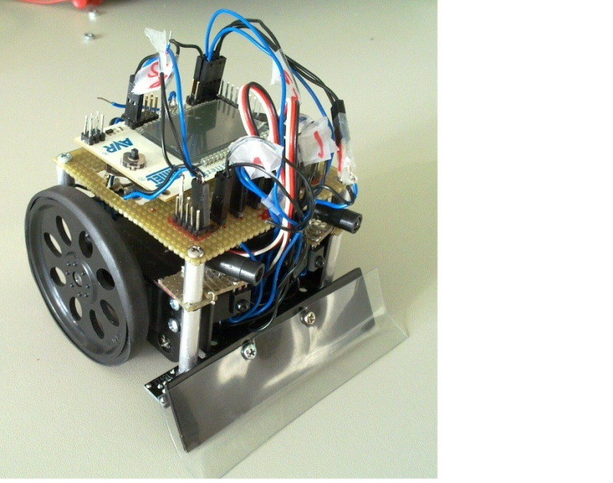
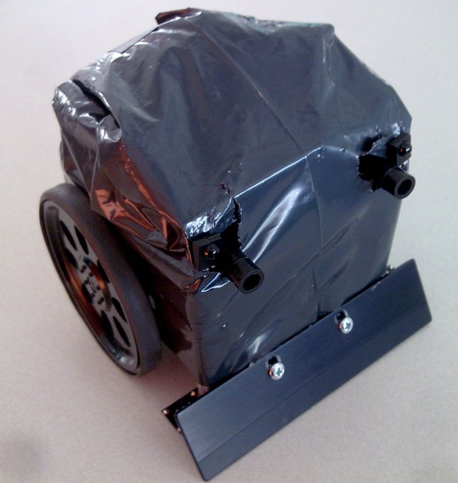
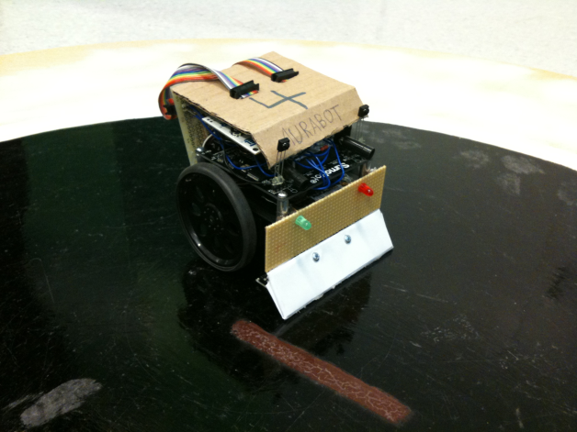
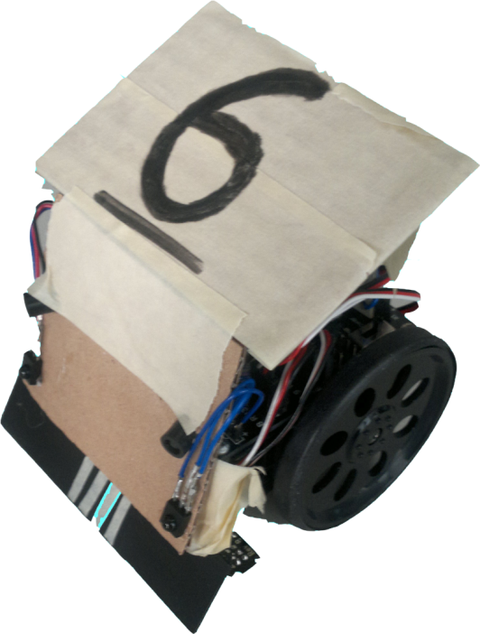
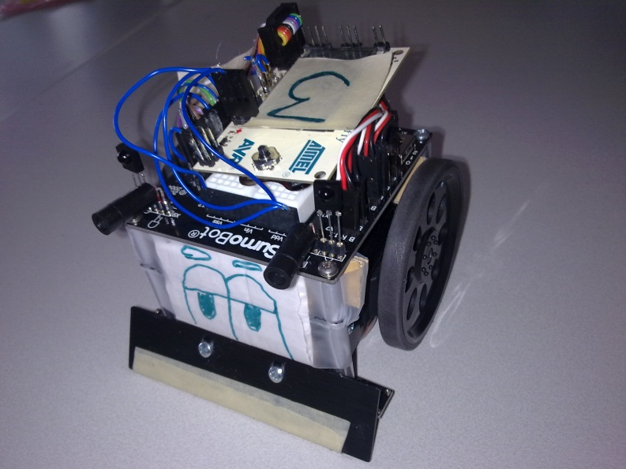
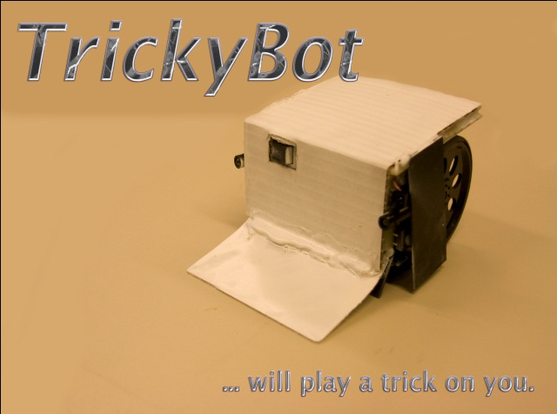

Slide 5
Material available
Parallax SumoBot® Robot toolkit
Can not use the microcontroller and the programming environment
Can use all other parts, e.g. robot body, battery holder, servos, sensors
Atmel AVR Butterfly Starterkit (battery empowered demo with ATmega169)
You must modify it in order to program it
Extra components, sensors or actuators based on your own design
Some available already, some requires separate purshase orders

Slide 6
Assessment
The grade accumulates from the milestones, and ”the things that are appreciated” (see later).
Teachers may suggest different grade for different participants (based on perceived contribution)
The group can re-divide the grade (e.g. three members getting all grade 4 can give 5 to one member if one takes 3)

Slide 7
Milestones (1/2)
Milestone 1: Initial design, and project plan
Hardware design e.g. which AVR ports are used
Development environment design
Separate test hardware? Use of version control system? Implementation and testing plan?
Software design e.g. statemachine, function prototypes
Milestone 2: Project review
Progress is demonstrated, and potential problems and/or good solutions are discussed

Slide 8
Milestones (2/2)
Milestone 3: Ready for ICT ShowRoom
Enrollment done, poster ready, robot named
Do you have an extra ”product story”?
If you really want to compete for the ICT ShowRoom price, you probably need to present your robot as something else than sumobot
Milestone 4: ICT ShowRoom and Tournament

Slide 9
”Things that are appreciated” (1/2)
Well-managed project in which all participants have a clear role, and equal work-load
Good final product, and success in the tournament
Good presence in ICT ShowRoom, and informative poster
Appropriate documentation (not necessarily much)
Well-managed software development process (e.g. the use of version control system)

Slide 10
”Things that are appreciated” (2/2)
Special technical challenge: usage of extra components, real-time considerations, etc
Well-managed software and hardware testing
Active participation, and presence in class room
Intelligent playing strategy
Clear, short, high-quality code (e.g. several implementations of the same functionality)

Slide 11
Support lectures
19.1. at 12.30
JP Paalassalo: ”Debugging and test design”
26.1. at 8.15
Vesa Torvinen: ”Using version control system”
2.2. at 12.30
JP Paalassalo: ”Poster design”

Slide 12
Purchase Orders
If you need extra components, sensors or actuators for your design
Check available parts in www.elfa.se
Send shopping cart information to jp.paalassalo@turkuamk.fi
In the best case, the parts arrive the next day
Other distributors and vendors may take longer time
Especially non-EU purchases may take several weeks

Slide 13
Teams and tutor teachers
Jules Debra and Julien Meichelbeck (JP)
Davide Berdin and Till Riemer (Vesa)
Lukas Kern and Niko Nieminen (JP)
Jere Sinisalo and Joonas Kuusela (Vesa)
Tomohito Kato and Tomi Leppälehto (JP)
Juha Mäkelä, Raine Kuusisto and Jari Knuutila (Vesa)
Vesa Torvinen and Tapani Männistö

