Slide 1
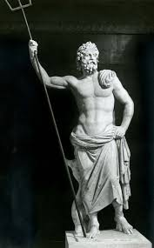
Poseidon – God of Disasters

Slide 2
Natural disasters and our current understanding

Slide 3
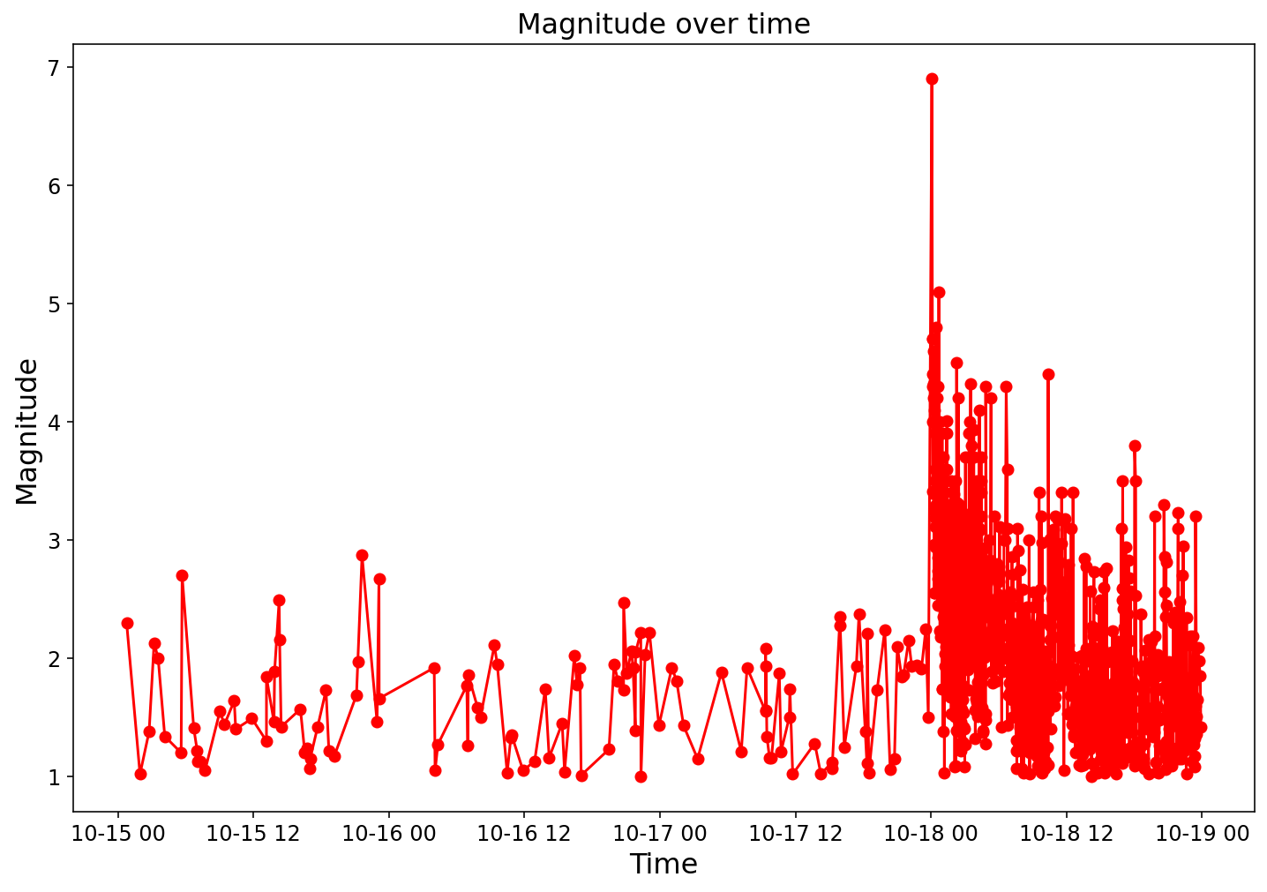
Why earthquake is difficult? (Loma Prieta EQ)
300 deaths!
Notes:
When we hear about time-series prediction, we tend to think about stiock process, however, earthquakes are anomalies, as yuyocan see here, who woul’d ve predicted Loma Prita earhqtuake?

Slide 4
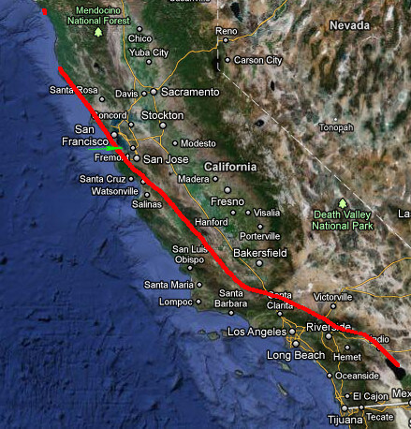
Interesting facts
If the San Andreas Fault were to rupture end-to-end (~1400km), with ~10m of average slip, it would produce an earthquake of Mw 8.47.
Image source: Montclair

