Slide 1
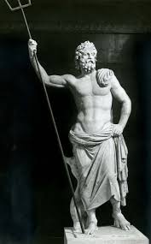
Poseidon – God of Disasters

Slide 2
Natural disasters and our current understanding
The best we have in market, is 20-second system, which is not prediction, but physic-based from p-waves.
Say that time-series of earthquake is not linear, it’s complicated.
We need to look for different way of modeling.
We look look into anomalies in time-series using deep-learning, but not enough data. So, better use domain knowledge.
I picked san andreas fault, as California is necessary
Picked only data points from this fault to make a focused dataset.
Loma Prieta and parkfield, which was not expected based on our physical understanding.
Show the link and show the gmap data
Back to data, when earthquake happens, the long-lat concentrates but depth not
So, let’s use unsupervised clustering (DBSCAN) to define some features, and see when things cluster leading to main earthquake.
Sho how clustering evolves towards failure for loma prieta as training.
And, the fact that these can introduce the non-linearity that we were looking for.

Slide 3
Natural disasters and our current understanding
So, let's take this model into test dataset, which is parkfield.
We are now looking beyond this fault system, and maybe in the future with enough data we can apply deep learning methods.
Then, show the last 10 days of California earthquakes, and apply clustering and see whether we expect earthquakes. If not, we can use this model as 10-dya forecast thing.
Finally, show the fun-fact.

Slide 4
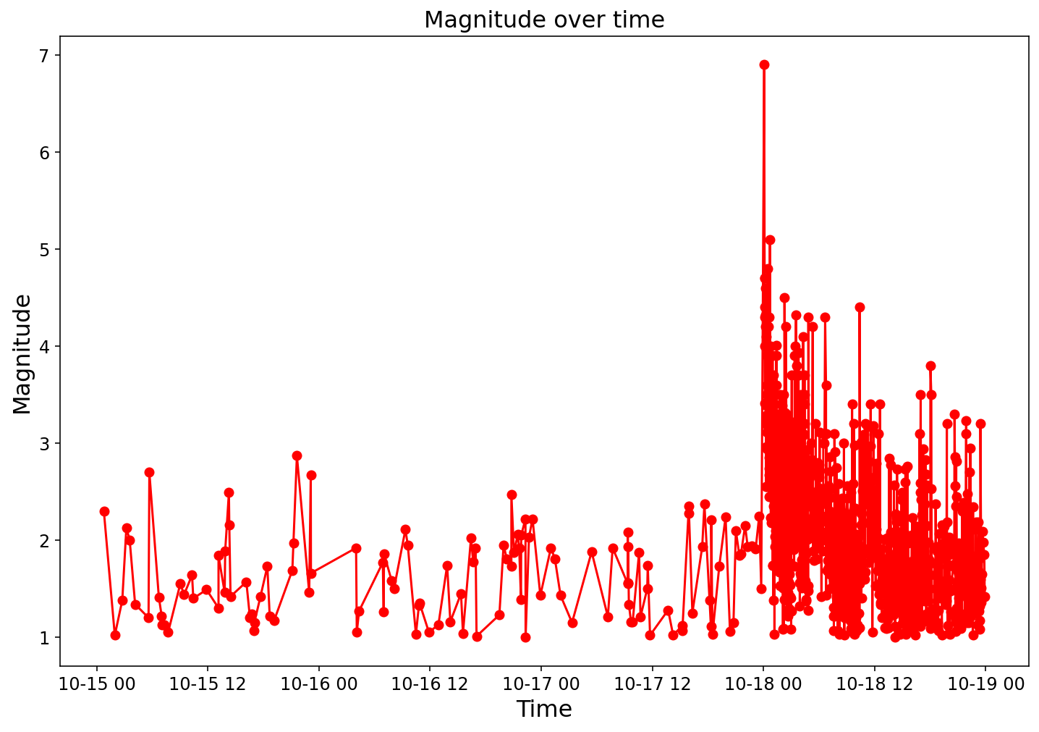
Why earthquake is difficult? (Loma Prieta EQ)
300 deaths!
Notes:
When we hear about time-series prediction, we tend to think about stiock process, however, earthquakes are anomalies, as yuyocan see here, who woul’d ve predicted Loma Prita earhqtuake?

Slide 5
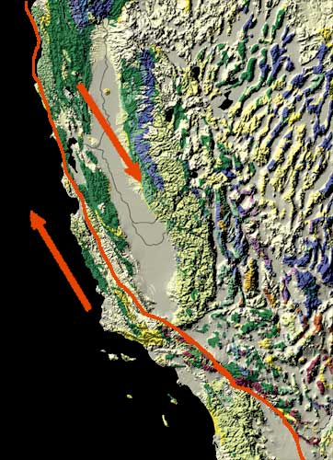
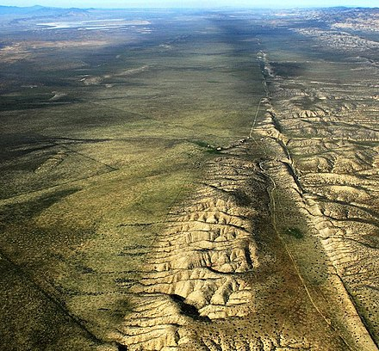
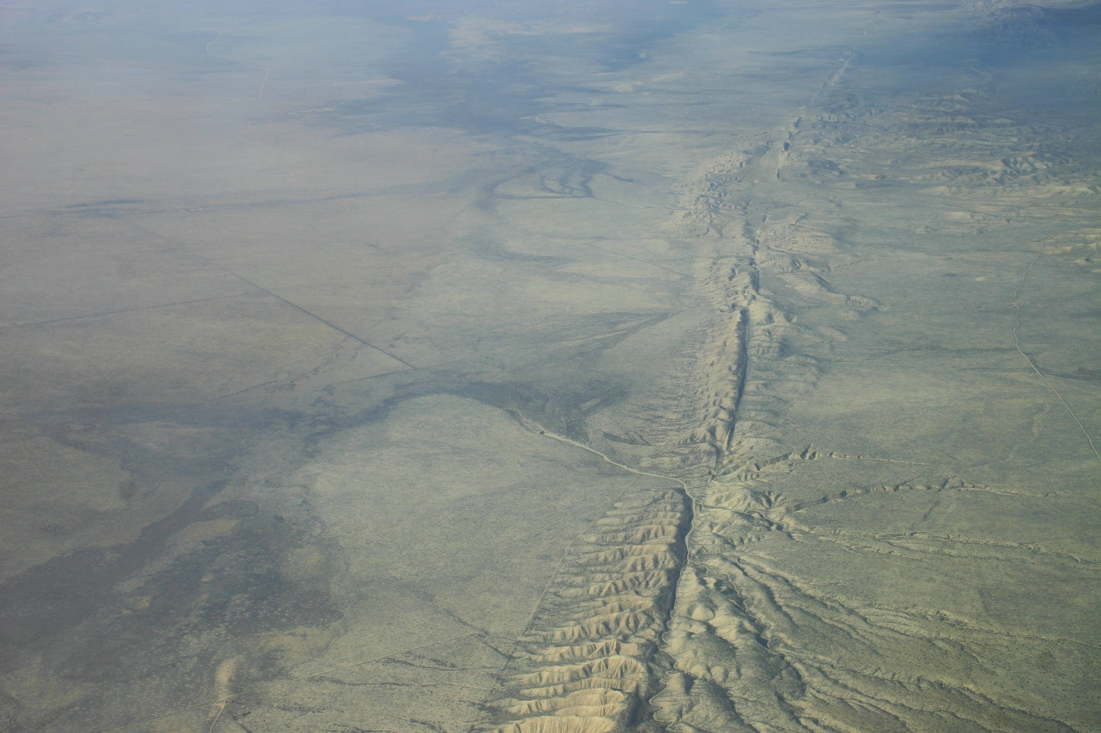
San Andreas fault: Where Californians are susceptible.

Slide 6
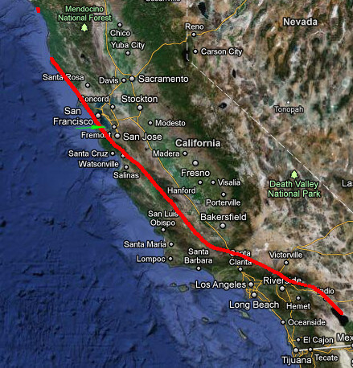
Interesting facts
If the San Andreas Fault were to rupture end-to-end (~1400km), with ~10m of average slip, it would produce an earthquake of Mw 8.47.
Image source: Montclair

