Slide 1

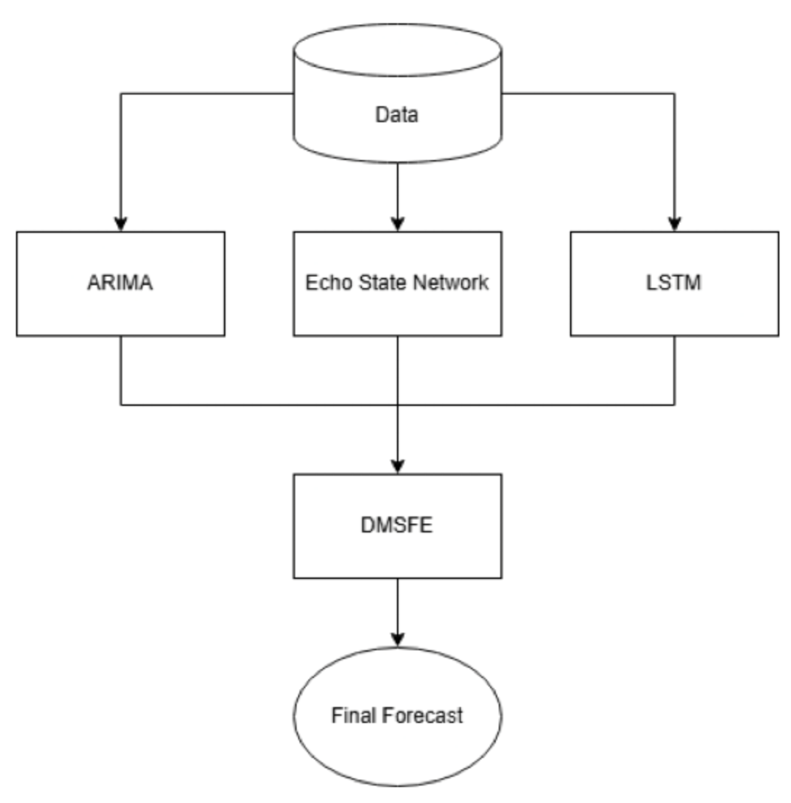
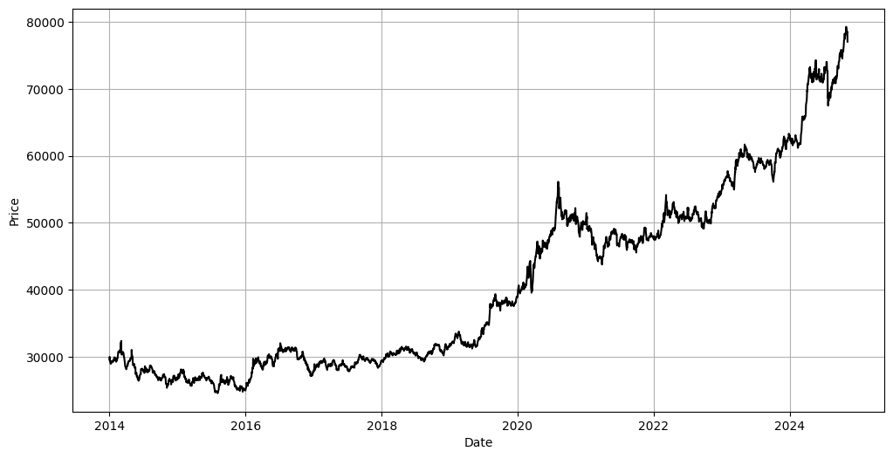
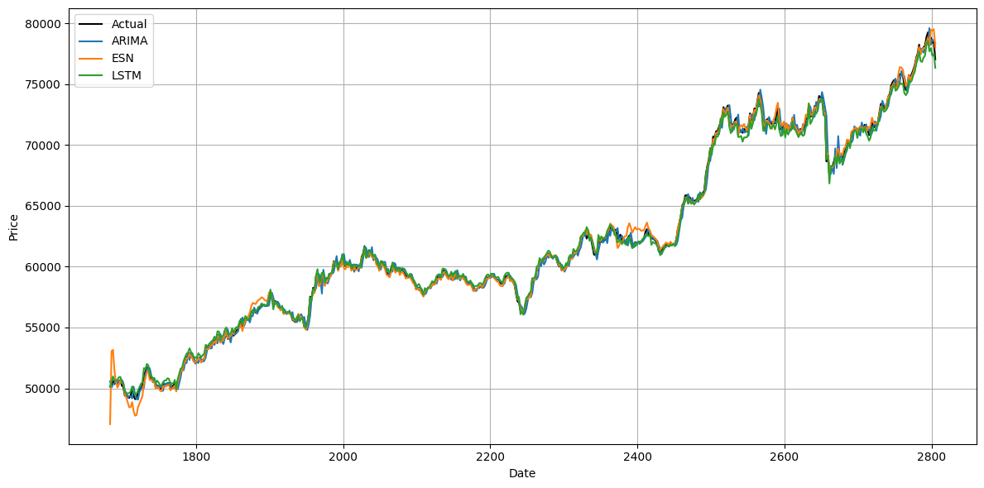
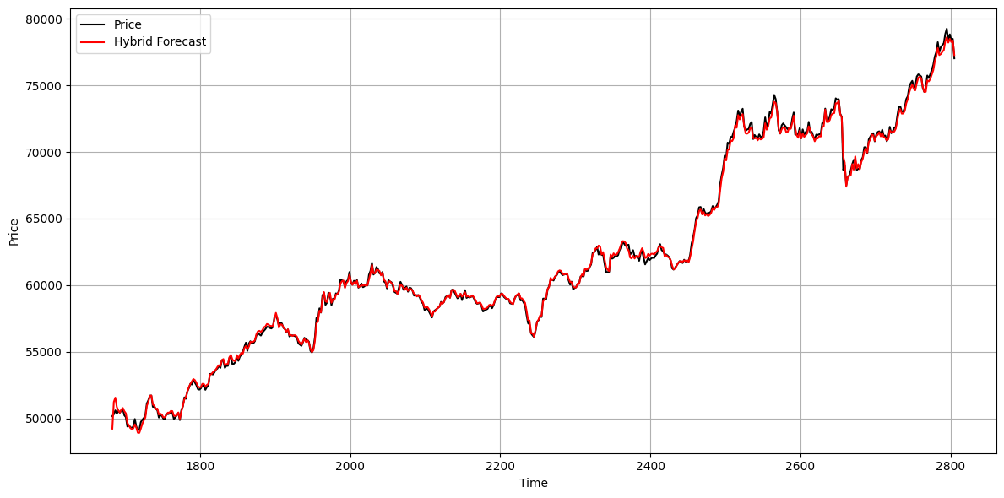
Hybrid Time Series Forecasting with ARIMA, Echo State Networks, and LSTM
Sai Eeshwar D
VIT – AP, Amaravati
Abstract
Methods and Materials
Discussion
Recently, Echo State Networks (ESNs) have been applied to time series forecasting due to their computational efficiency and effectiveness on chaotic non-stationary time series data. However, their performance can be limited by instability in reservoir dynamics and sensitivity to hyperparameter selection. In this study, a novel hybrid model is proposed by integrating Auto Regressive Integrated Moving Average (ARIMA), ESNs, and Long Short-Term Memory (LSTM) networks, with Discount Mean Square Forecast Error (DMSFE) applied for adaptive weighting. ARIMA is used to model linear dependencies, while ESNs and LSTMs are effective for non-linear patterns. The proposed hybrid model achieves the best evaluation scores, outperforming every individual model.
We propose a hybrid forecasting model combining ARIMA, Echo State Networks (ESN), and LSTM. ARIMA captures linear trends, while ESN models short-term nonlinear dependencies using a reservoir of dynamic states. LSTM further refines predictions by learning long-term dependencies. The final forecast integrates outputs from all three models using a weighted fusion technique. Data preprocessing includes date-based feature extraction and normalization. Model performance is evaluated using MAE and RMSE. This approach leverages ARIMA’s trend analysis, ESN’s dynamic adaptability, and LSTM’s sequence learning to enhance time series prediction accuracy.
Our evaluation reveals that while individual models—ARIMA, LSTM, and ESN—each capture unique aspects of chaotic, non-stationary time series data, they also exhibit distinct limitations: ARIMA struggles with abrupt changes due to its linearity, LSTM suffers from error accumulation over longer horizons, and ESN’s performance is affected by random reservoir initialization. The proposed hybrid model addresses these issues by integrating the strengths of each approach and dynamically weighting their forecasts using Discount Mean Square Forecast Error (DMSFE), resulting in significantly improved accuracy and robustness across both gold and crude oil price datasets.
Introduction
Figure 1. Proposed Hybrid Model
Figure 2. Data Plot
Conclusions
A body of research has sought to improve models for chaotic, non-stationary time series data, with the Echo State Network (ESN) as a key method. Enhancements include replacing the Gaussian distribution with a Laplacian one (LAESN/LEESN) to better predict outliers and mitigate limited training samples—sometimes further optimized with genetic algorithms—while heavy-tailed Gaussian distributions have been proposed as superior likelihood approximators. Other innovations involve Modified ESNs (M-ESN) with hybrid regularization and additive decomposition methods in Deep ESNs. Given ESNs' sensitivity to parameter selection and inherent randomness, techniques such as particle swarm optimization, singular value decomposition, and evolutionary strategies have been used to pre-train these networks. Although hybrid models combining statistical, machine learning, and deep learning methods are common in time series forecasting, their integration with ESNs—
especially using discount mean square forecast error (DMSFE)—remains underexplored; this research proposes a hybrid model that leverages ESNs while mitigating their limitations with complementary methods.
Time series forecasting for chaotic, non-stationary data poses significant challenges. While Echo State Networks (ESNs) effectively capture nonlinear dependencies, their random reservoir initialization and sensitivity to hyperparameters limit consistency. Similarly, Long Short-Term Memory networks (LSTMs) can capture short-term trends but often suffer from error accumulation in long-term forecasts, especially when data distributions evolve.
To address these issues, we propose a novel hybrid model that integrates ARIMA, ESNs, and LSTMs, using Discount Mean Square Forecast Error (DMSFE) for dynamic weighting. This structured framework leverages the strengths of each method—enhancing ESN robustness and alleviating LSTM's late-stage prediction errors—resulting in improved overall forecasting accuracy. Experimental evaluations on real-world datasets validate the superior performance of our approach over individual models.
Results
Gold Price Prediction:
The gold price time series (2014–2024, INR) represents chaotic, non-stationary data. Individual models—ARIMA, LSTM, and ESN—capture overall trends but show minor errors at inflection points and near the boundaries of the test set. Overlapping predictions highlight these subtle differences. In contrast, the proposed hybrid model, which integrates ARIMA, ESN, and LSTM using DMSFE for dynamic weighting, significantly improves accuracy. Performance metrics confirm that the hybrid model outperforms each individual method.
Crude Oil Price Prediction:
For Brent crude oil prices (1987–2022, USD), similar experiments reveal that while ARIMA, LSTM, and ESN models perform reasonably well on their own, their predictions differ notably. The hybrid model achieves the best overall performance, as shown by the evaluation metrics, demonstrating robustness across datasets.
Table Model Predictions for Oil and Gold Price
Table 1.. Performance comparison of models for Gold Price and Crude Oil Price data
Model | Gold Price (INR) |  |  |  | Crude Oil Price (USD)
 | MAE | MSE | RMSE | R² | MAE | MSE | RMSE | R²
ARIMA | 361.83 | 237331.31 | 487.17 | 1.00 | 1.13 | 2.87 | 1.69 | 0.99
LSTM | 293.22 | 164063.76 | 405.05 | 1.00 | 1.43 | 4.05 | 2.01 | 0.99
ESN | 224.14 | 143961.69 | 379.42 | 1.00 | 0.05 | 0.02 | 0.15 | 1.00
Hybrid | 162.72 | 46988.16 | 216.77 | 0.99916 | 0.03 | 0.003 | 0.05 | 0.99999
Future Directions
Future work will explore alternative weighting strategies, clustering methods, and additional neural network architectures to further improve forecasting accuracy and robustness for chaotic, non-stationary data.
Contact Information
References
Acknowledgements
Sai Eeshwar D
VIT-AP
Email: saieeshwar03@gmail.com
Website: https://eeshwar-portfolio.vercel.app/
Phone: +91 7338223233
D. Li, M. Han, and J. Wang, “Chaotic time series prediction based on a novel robust echo state network,” IEEE Trans. Neural Networks and Learning Systems, vol. 23, no. 5, pp. 787–799, 2012.
M. Han and M. Xu, “Laplacian echo state network for multivariate time series prediction,” IEEE Trans. Neural Networks and Learning Systems, vol. 29, no. 1, pp. 238–244, 2018.
Y. Pan, L. Deng, P. Zhou, and W. J. Lee, “Laplacian echo-state networks for production analysis and forecasting in unconventional reservoirs,” J. Pet. Sci. Eng., vol. 207, p. 109068, 2021. [Online]. Available: https://www.sciencedirect.com/science/article/pii/S0920410521007257
Y. Lu, Y. Liao, L. Xu, Y. Liu, and Y. Liu, “Laplacian deep echo state network optimized by genetic algorithm,” in 2021 IEEE Int. Conf. on Information Communication and Software Engineering (ICICSE), 2021, pp. 107–111.
L. Shen, J. Chen, Z. Zeng, J. Yang, and J. Jin, “A novel echo state network for multivariate and nonlinear time series prediction,” Appl. Soft Comput., vol. 62, pp. 524–535, 2018. [Online]. Available: https://www.sciencedirect.com/science/article/pii/S1568494617306439
Y. Sui and H. Gao, “Modified echo state network for prediction of nonlinear chaotic time series,” Nonlinear Dyn., vol. 110, no. 4, pp. 3581–3603, Dec. 2022.
T. Kim and B. R. King, “Time series prediction using deep echo state networks,” Neural Comput. Appl., vol. 32, no. 23, pp. 17769–17787, Dec. 2020.
N. Chouikhi, B. Ammar, N. Rokbani, and A. M. Alimi, “PSO-based analysis of echo state network parameters for time series forecasting,” Appl. Soft Comput., vol. 55, pp. 211–225, 2017. [Online]. Available: https://www.sciencedirect.com/science/article/pii/S1568494617300649
We sincerely thank VIT-AP for providing the necessary resources and support for this research. We also appreciate the guidance of our mentors and colleagues, whose valuable insights enhanced this work. Additionally, we acknowledge the use of computational tools and datasets that facilitated the implementation and evaluation of our hybrid forecasting model.

