Slide 1
UNIVERSITY
Project
Hatem Arrar & Saief Eddine EZaier & Rached Fares

Slide 2

For what this project can be used for ?
We as IT TBS students have noticed that the administration in TBS doesn’t use a database for extracting student/teacher information and for the scheduling of time tables and exams weeks.
That is why we thought about creating a Database Management System that is easy to use for a non IT user (Administrator ) to enter student and teacher information and to dispaly some important information.
Of course this project is not a complete project but we believe that is a first step toward updating the system

Slide 3


Summary
Time saving
GPA
Extract
& Insert
Student /
Teacher information
Honor
student
Clubs
Students & Teachers
Satisfaction

Slide 4
Procedures
Student who leave the school for many reasons
To facilitate the communication with student’s club leaders Mr Pedro can extract the information of each club leader
Add student
Honor students
Porfessors
Delete student
Clubs leaders
When Student came to TBS they must be registred using this function
In order to honor them at the end of the year Honor students must be known
-Modify their departments
-display them by adress

Slide 5
Functions/Triggers
Function that give us the number of courses that one teacher is responsible of
Prevent the delete of a student after the working hours for security issues
Trigger
probation
Trigger
age
Gpa
Teacher course
Tigger delete
Calculate the student GPA on this semster
Insert the student with 2 or less gpa in probation list
Prevent the insertion of <18 years student

Slide 6
Work
Skype meetings:
Easy parts
80%
85%
Real meetings
Hard parts
20%
15%
Working hours : 14 hours

Slide 7
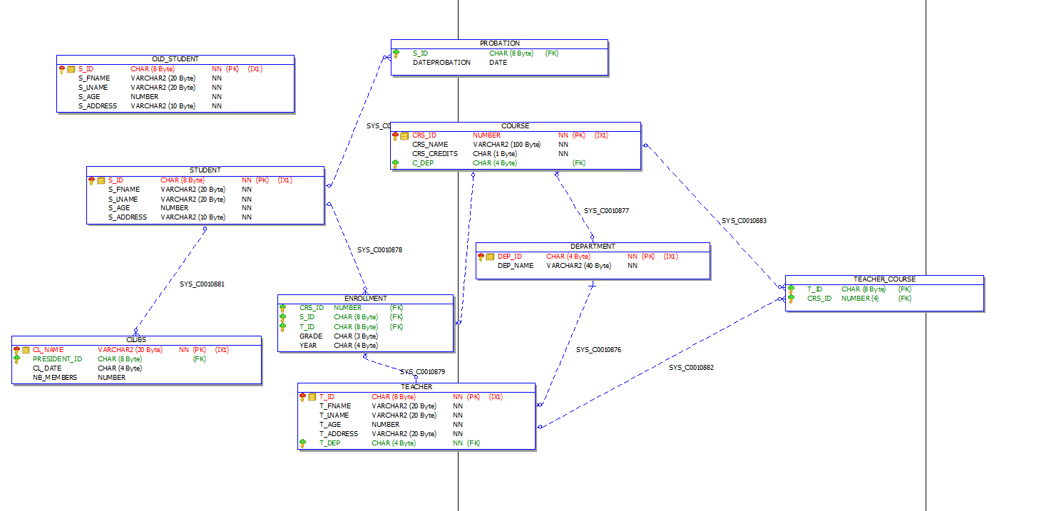

Slide 8

The difficulties&Possible enhacements
We encountred some difficulties :
1- Trying to work with the menu and the interactions with the user
There are many possible enhancements in this database system as we can add some procedures to modify already existing students and teachers and maybe students also can access this database with lmitied use ( gpa calculation, probation list )

Slide 9
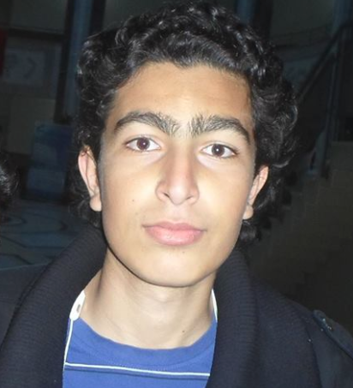
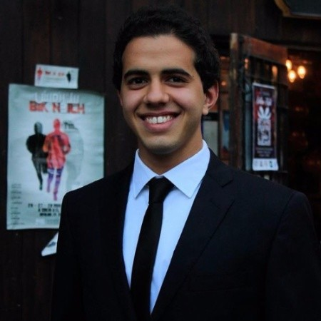
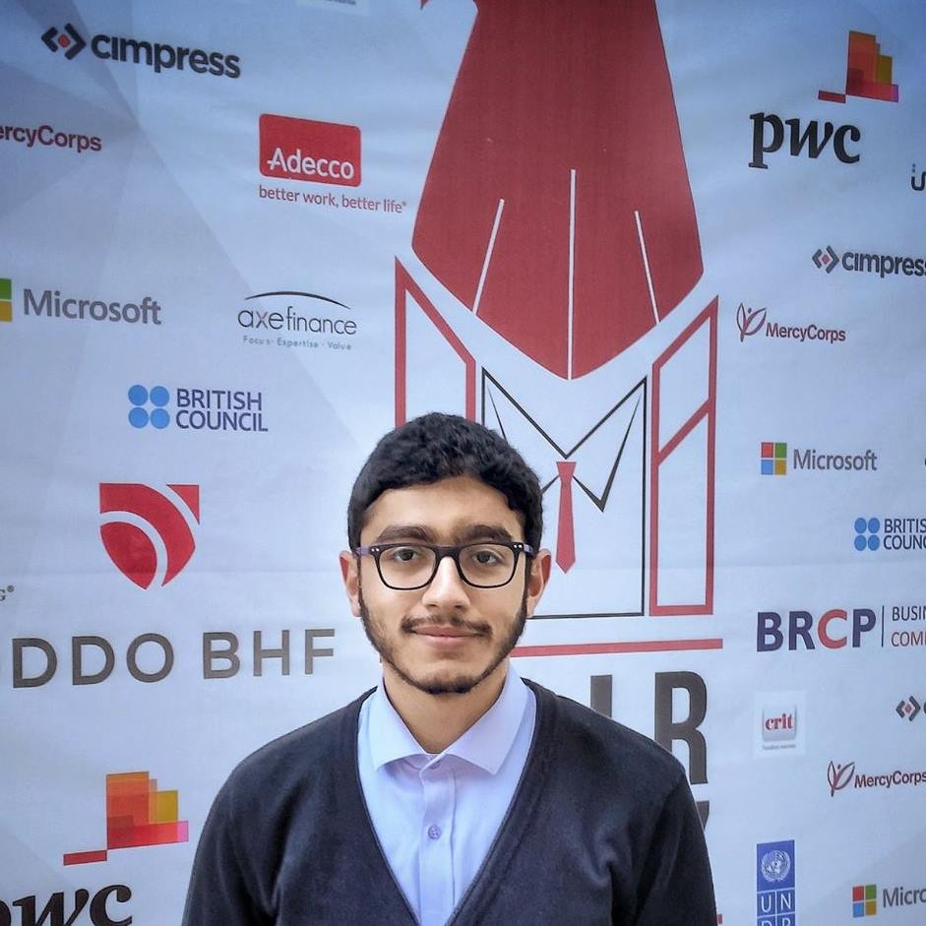
Les FONDATEURS
01
02
03
Saief Eddine E
Zaier
Hatem arrar
Rached Fares

Slide 10

Thank you for your attention

