Slide 1
COMP90054 AI Planning for Autonomy Workshop Week4

Slide 2
Reminder:
Bring your laptop next week for PDDL.
Access to Slides:
https://github.com/SiaHuo/COMP90007Workshops
If there is any error in slides, please point it out.
Please refer to solution on LMS for standard answers

Slide 3
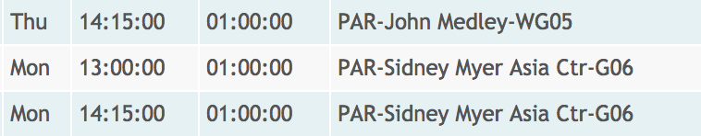

Slide 4
Objectives
Last Week
Execution of Heuristic Search Algorithms (A*, WA*, Greedy Best First Search): Fill in the form
4 Properties of Heuristic Search Algorithms and there relationship: safe, goal-aware, consistent, admissible.
State Model
This Week
Reopen in A*
State Model => Strips
Define Heuristic Function

Slide 5
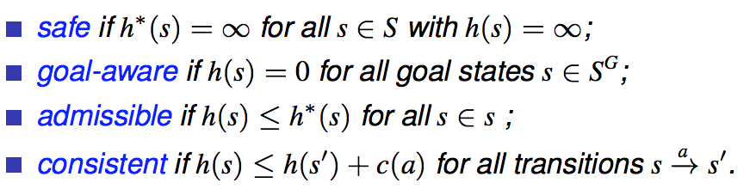
Properties of Heuristic Functions
consistent
goal-aware
admissible
goal-aware
safe

Slide 6
Heuristic Search Algorithms :
Additionally use heuristic functions which estimate the distance (or remaining cost) to the goal.
A*
WA*
Enforced hill-climbing
Greedy Best First Search
Most popular algorithm in optimal planning
3 most popular algorithms in satisficing planning
If h is admissible, then we can guarantee the solution found by A* (that includes reopen in algorithm) is optimal
If h is admissible and consistent, then we can guarantee the solution found by A* (that doesn’t include reopen) is optimal

Slide 7
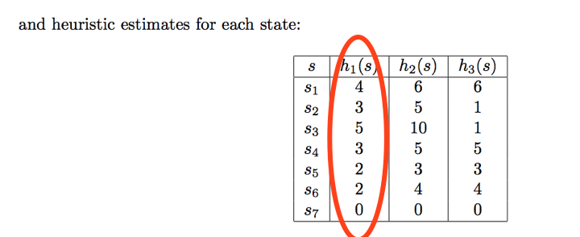
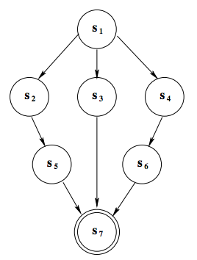
Example: (Last Week)
A* h1
2
2
1
2
1
10
 | Iteration 1 | Iteration 2 | Iteration 3 | Iteration 4
OPEN
CLOSED
3
4
h1 is admissible and consistent
no reopen

Slide 8
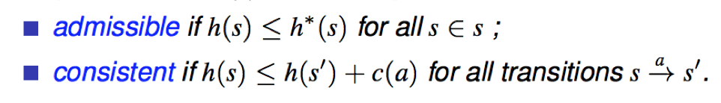
Reopen in A*
s1
4
1
3
s2
1
s3
7
3
10
admissible but not consistent
reopen
s4
0

Slide 9
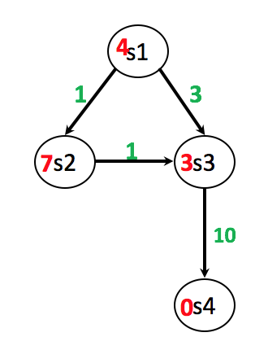
Reopen in A*
 | Iteration 1 | Iteration 2 | Iteration 3 | Iteration 4
OPEN
CLOSED

Slide 10
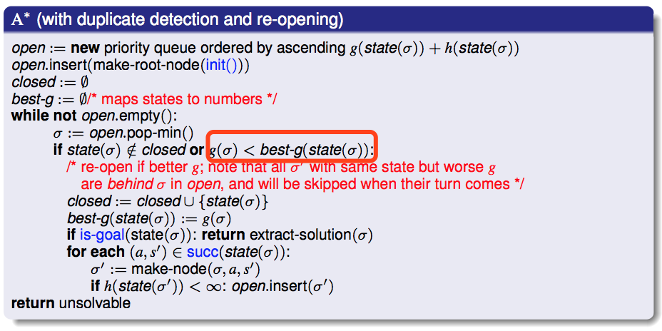
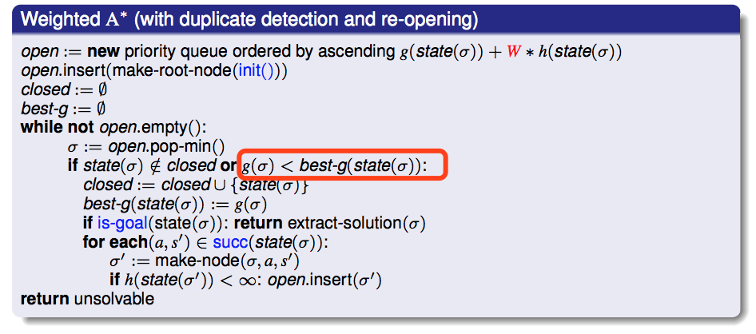
WA*， A* may have reopen
Greedy Best First Search doesn‘t have

Slide 11
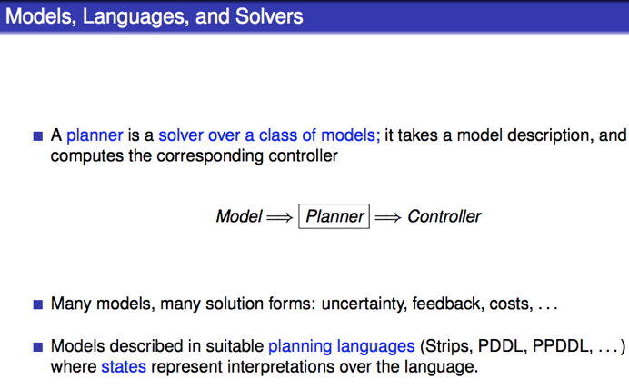

Slide 12
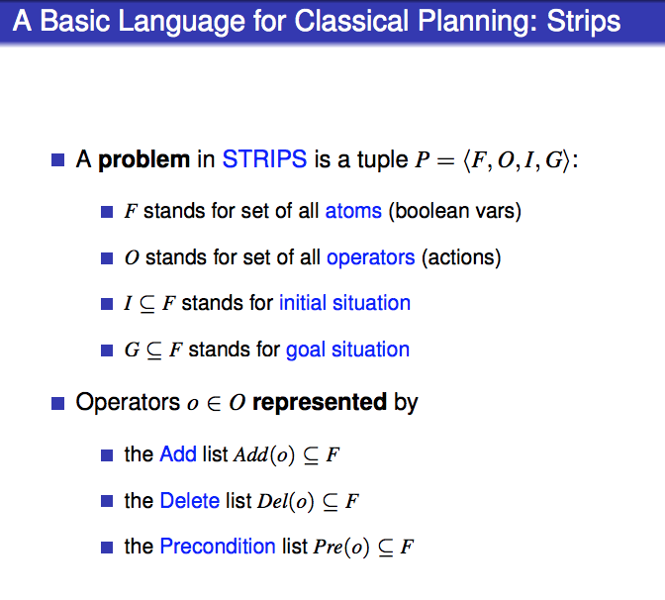

Slide 13
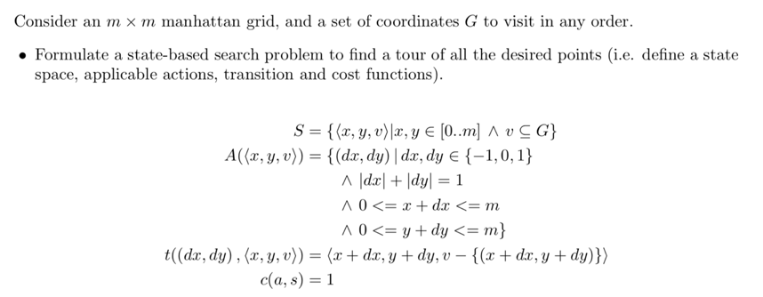
State Model
Reformulate
State model
STRIPS problem P = < F, O, I, G >

Slide 14
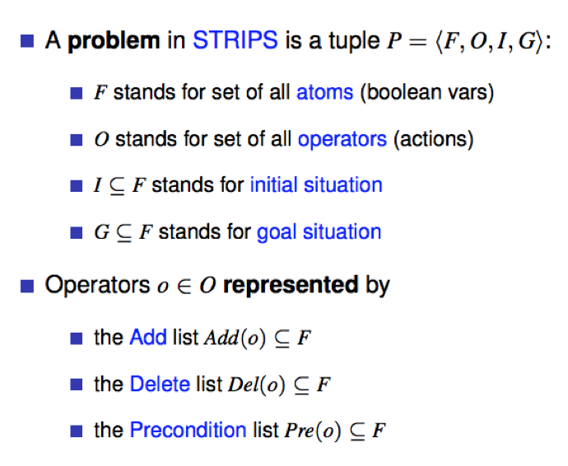
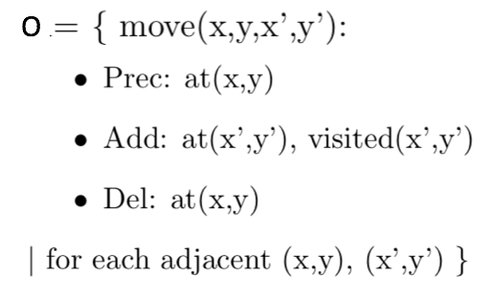


STRIPS

Slide 15
Question: Define 3 different heuristic functions for this problem
Heuristic Function
Heuristic searches require a heuristic function to estimate remaining cost.
Its value h(s) for a state s is referred to as the state’s heuristic value, or h-value
Remaining Cost (h∗) : is the cost of an optimal plan for s, or ∞ if there exists no plan for s, it is the perfect heuristic for a planning task

Slide 16
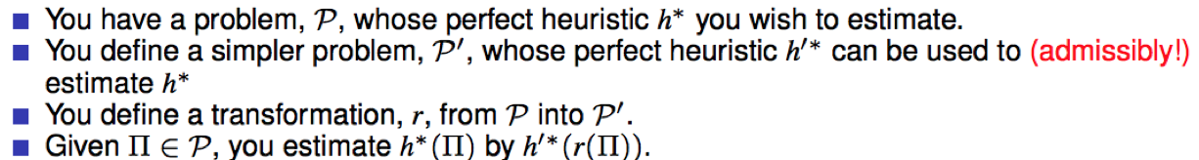
How to construct heuristic functions -Relaxing
How to Relax

Slide 17
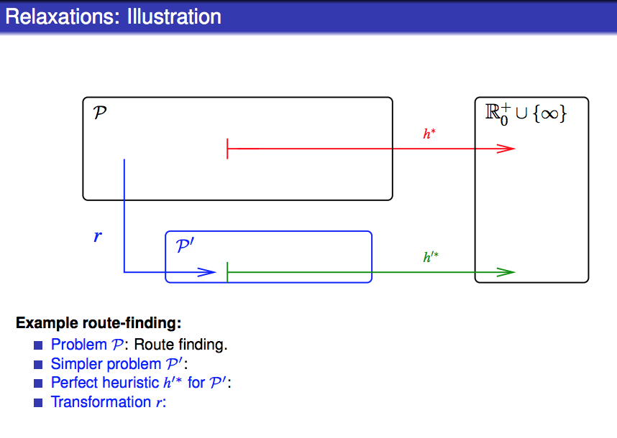

Slide 18
Solution 1: Find the distance to closest unvisited goal
Admissible and consistent
Complexity of computing h: O(g)
Notes:
3

Slide 19
Solution 2: Find the distance to farthest unvisited goal
Admissible and consistent
Complexity of computing h: O(g)
Notes:
5

Slide 20
Solution 3: sum of distance to each unvisited goal
Not Admissible
Not consistent
Complexity of computing h: O(g)
Notes:
5+3=8 > 7
8 – 4 = 4 > actual cost 3

Slide 21
Solution 4: all zero
h(s) = 0 for all s
Admissible and consistent
But provide no information at all
Bad heuristic function
Complexity of computing h: O(1)

Slide 22
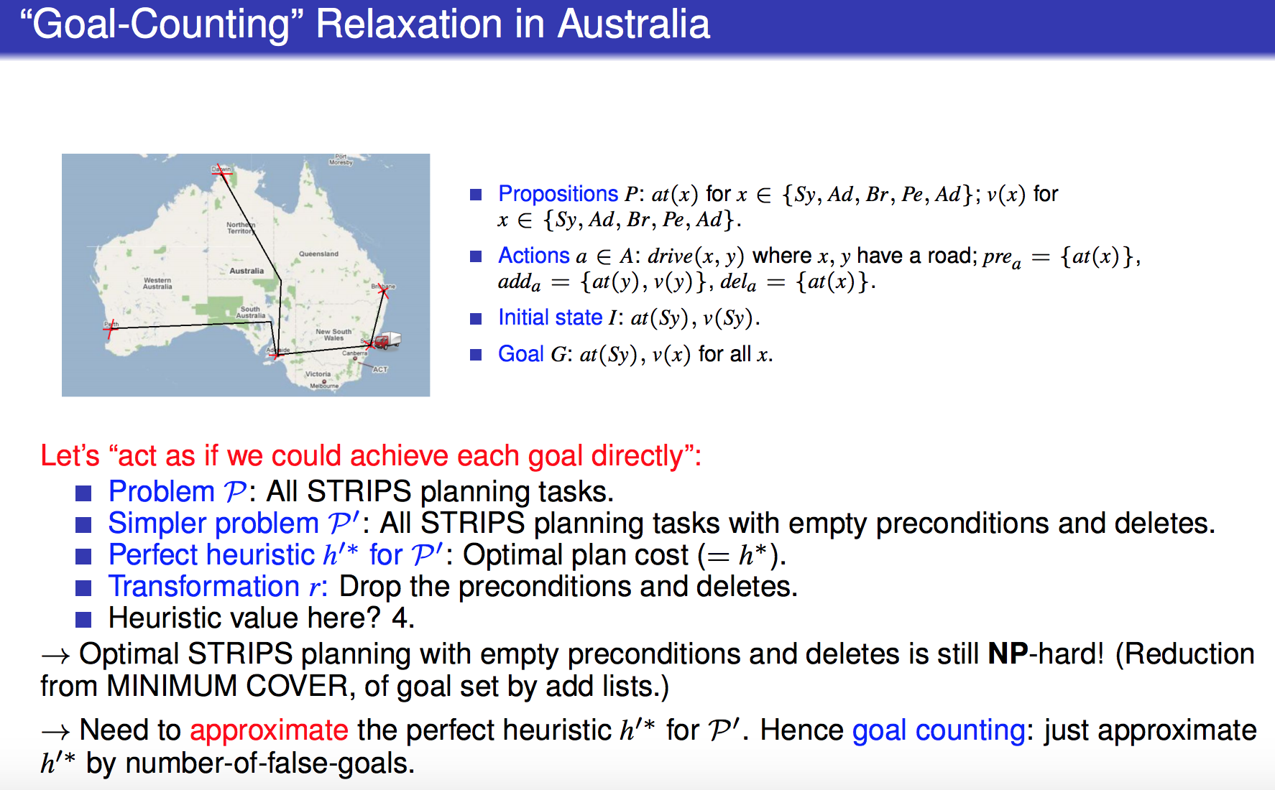
Solution 5: Drop preconditions and deletes (and then use goal counting to approximate h’*)

Slide 23
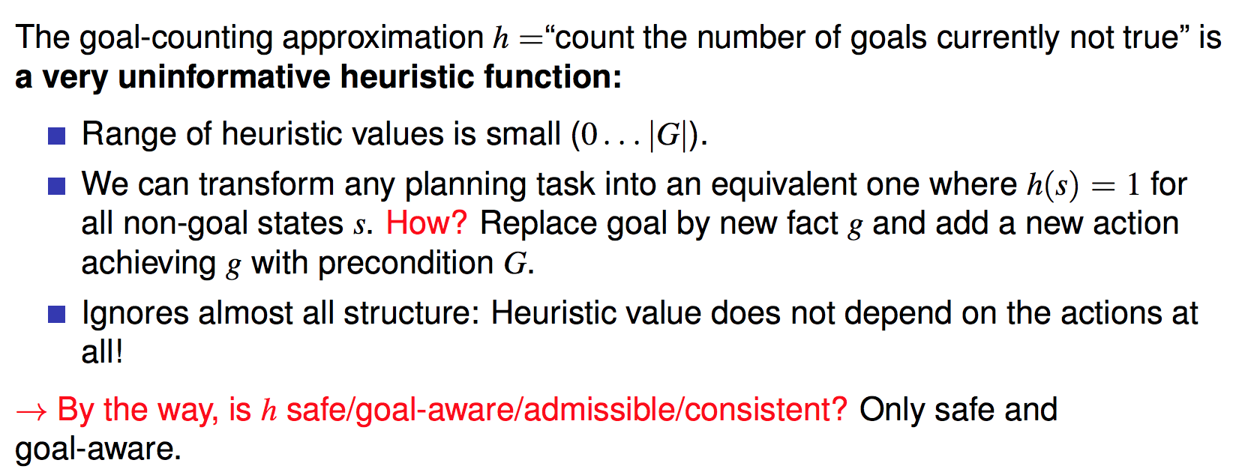
Goal counting is not admissible, not consistent
Complexity of computing h: O(g)

Slide 24
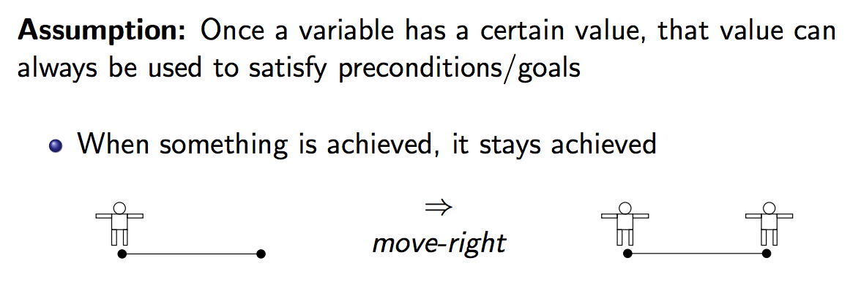
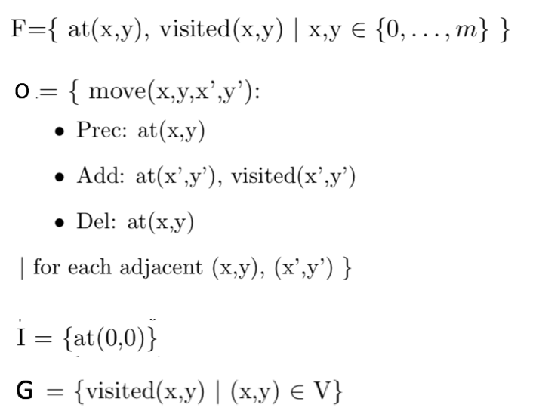

Solution 6: Delete Relaxation
Admissible and consistent

Slide 25
Solution 7: Minimum Spanning Tree
hMST= 10
h*= 11
Admissible but not consistent

Slide 26
Dominate?
h_{mst} dominates h_{farthest} dominates h_{closest}
h_{mst} dominates h_{goal-counting}

Slide 27
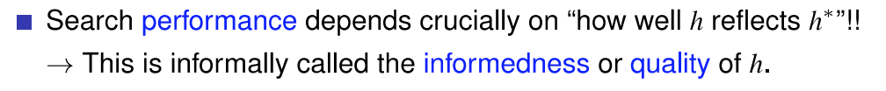
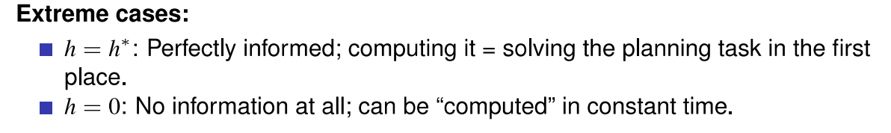
What is a good heuristic function?

Slide 28
Q. Which heuristic function is a better one? h1 or h2?
h1 < h2 < h*
There are 2 things we need to consider:
Search performance.
h2 is better than h1.
Total time
Computational overhead
But it may be harder for us to compute h2

