Slide 1
COMP90054 AI Planning for Autonomy Workshop Week8
Ruixi
huor@student.unimelb.edu.au

Slide 2
Objectives
Markov Decision Processes (MDPs)
2. How to solve MDPs
Value Iteration
Policy Iteration

Slide 3
MDPs has 2 Type:
1. Goal-Cost MDPs
2. Discounted Reward MDPs
Notes:
But in our lectures and workshops, we only talk about the 2nd one.
For Discounted reward MDPs, there is no goal, there is no cost. Goals and cost are just modelld as positive reward or negative reward

Slide 4
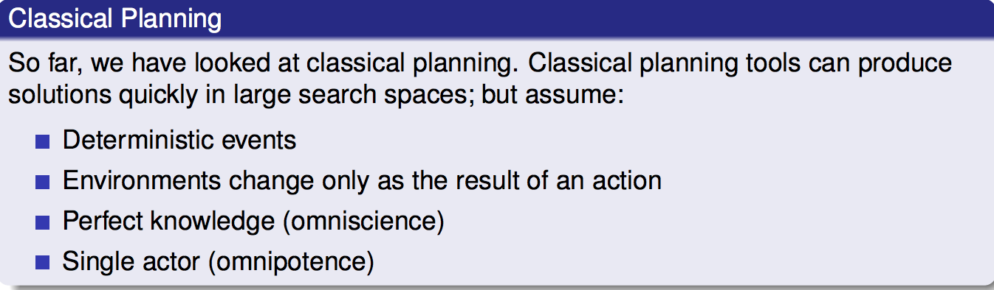
Classical Planning VS MDPs
Markov Decision Processes (MDPs) remove the assumption of deterministic events.
Instead MDPs assume that each action could have multiple outcomes, with each outcome associated with a probability.
For example:

Slide 5
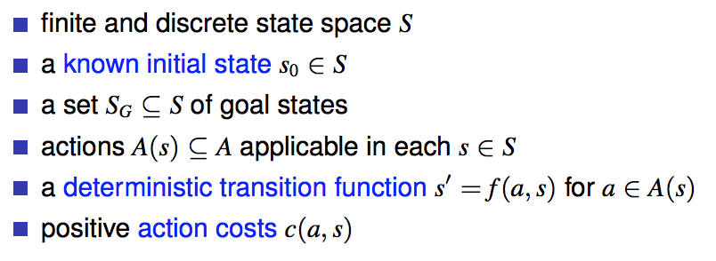
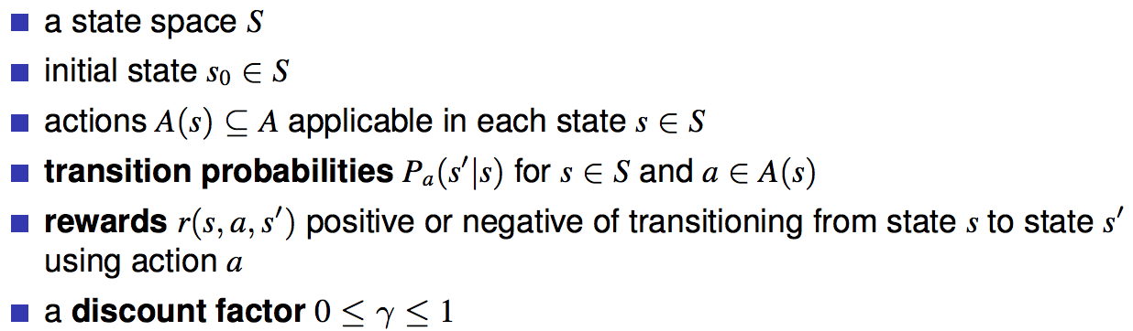
State Model
Classical Planning
MDPs
What is different from classical planning?
The discount factor determines how much a future reward should be discounted compared to a current reward.

Slide 6
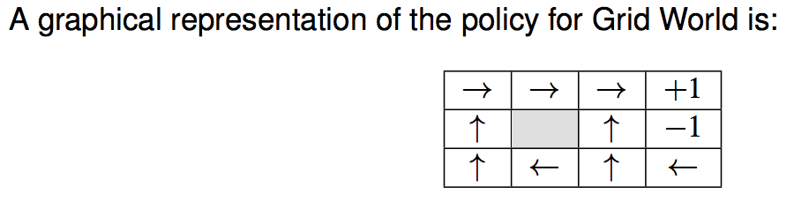
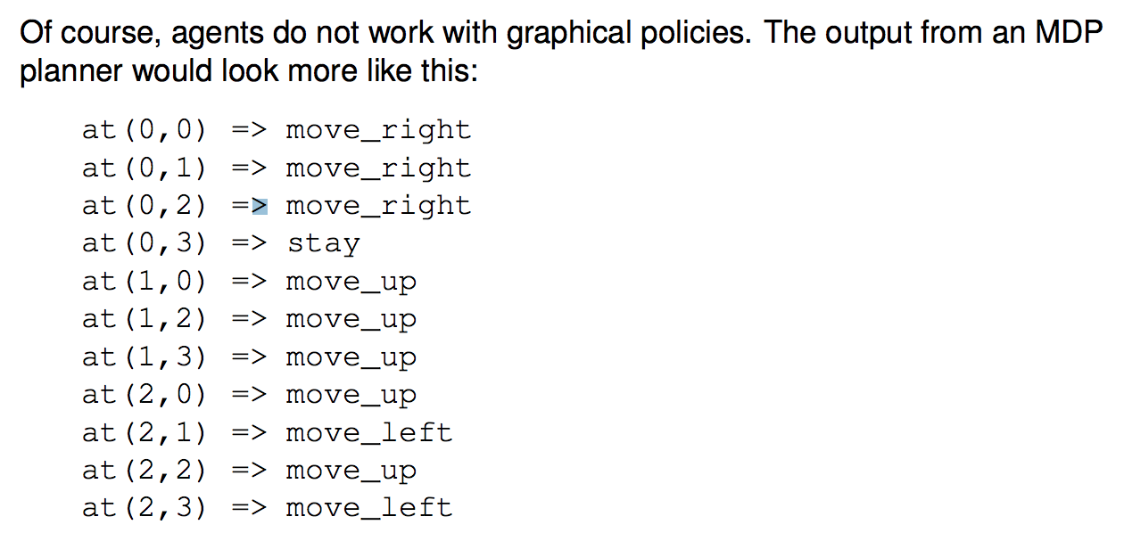
Solution for Classical Planning:
Action Sequence
(from initial state to goal state)
Solution for MDPs:
Policy

Slide 7
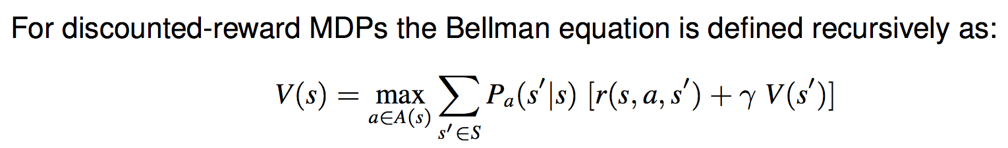

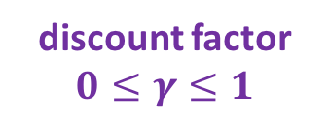
How to solve MDPs?
Q(s,a)
Q-value of being in a state s, choosing action a
Bellman equations
the probability of that action occurring
immediate reward resulting from that action
discounted future reward
discount factor
$$0≤γ≤1$$
Expected value of being in state s and acting optimally according to our policy

Slide 8
How to solve MDPs?
1.Value Iteration

Slide 9
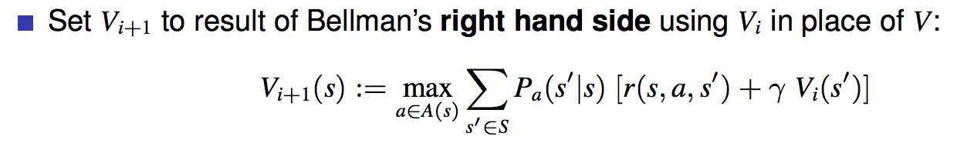
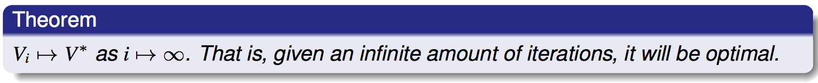
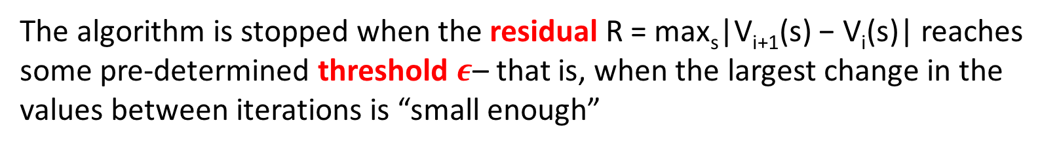
Value Iteration
Step1:
Step2:
In practice, we set a threshold $ε$.
The algorithm is stopped when the residual R = max_{s}|V_{i+1}(s) − V_{i}(s)| reaches some pre-determined threshold $ε$– that is, when the largest change in the values between iterations is “small enough”

Slide 10
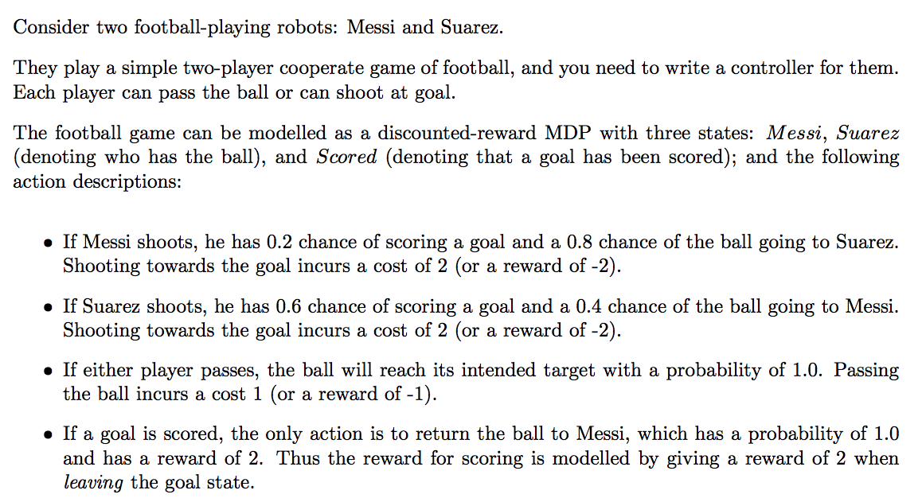
Scored
Return P(1)
r = 2
Shoot P(0.2)
r = -2
Shoot P(0.6)
r = -2
Shoot P(0.8)
r = -2
Messi
Suarez
Pass P(1.0)
r = -1
Shoot P(0.4)
r = -2

Slide 11
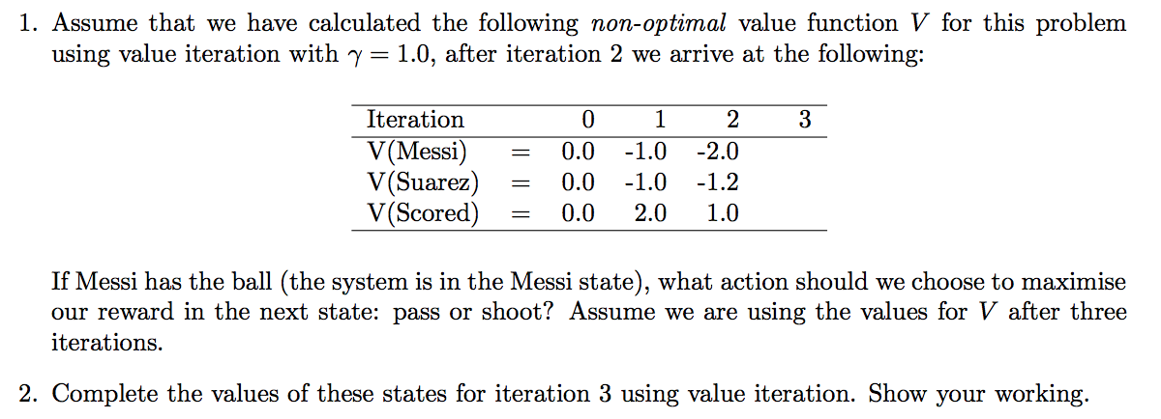
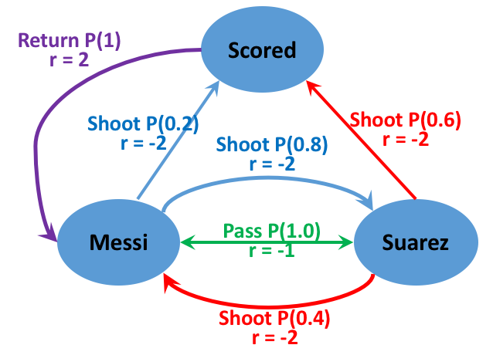
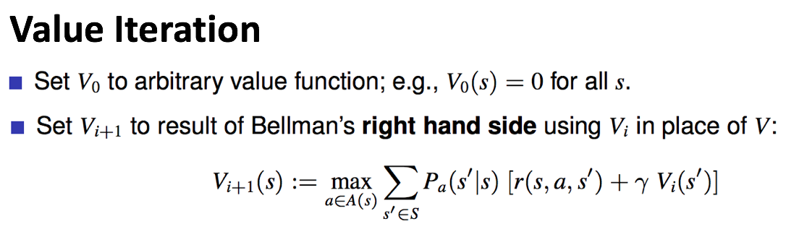

Slide 12

How to do value iteration?
$$γ=1$$
 | Iteration0 | Iteration1 | Iteration2 | Iteration3
V(Messi)
V(Suarez)
V(Scored)
0
0
0
V₀ (Messi) = 0, V₀ (Suarez) = 0, V₀ (Scored) = 0
How to calculate V1(Messi) ?
Question: What actions can Messi take?
Shoot Pass

Slide 13
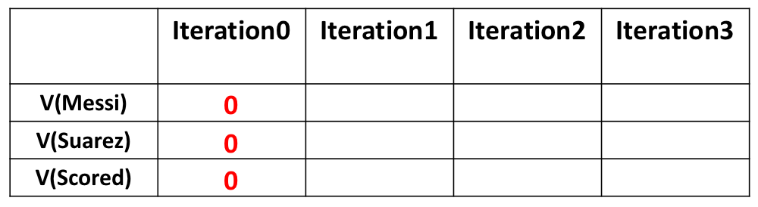
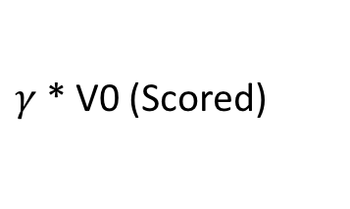


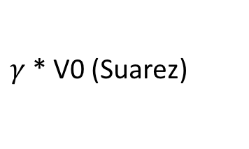

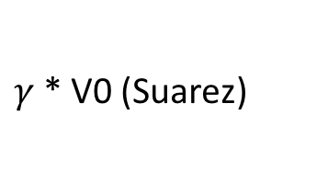
How to do value iteration?
$$γ=1$$
-1
V₀ (Messi) = 0, V₀ (Suarez) = 0, V₀ (Scored) = 0
$$Σ$$
（
immediate
reward
+
future
reward
）
action
Q-value(s,a) =
probability
*
0.2
（
-2
+
）
shoot
-2
*
$γ$* V0 (Scored)
= -0.4
$$Σ$$
0.8
*
（
-2
+
）
= -1.6
V1(Messi)
$γ$* V0 (Suarez)
pass
-1
1
*
（
-1
+
）
$γ$* V0 (Suarez)
= -1

Slide 14
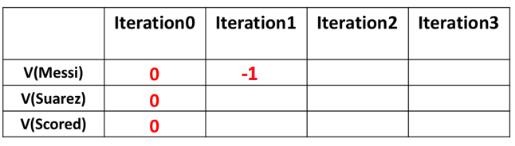

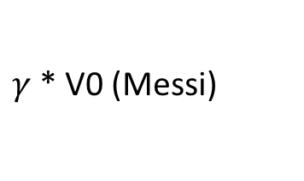
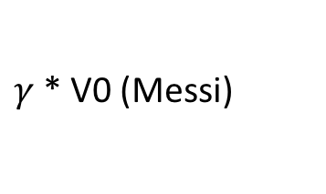
How to do value iteration?
$$γ=1$$
-1
V₀ (Messi) = 0, V₀ (Suarez) = 0, V₀ (Scored) = 0
$$Σ$$
（
immediate
reward
+
future
reward
）
action
Q-value(s,a) =
probability
*
0.6
（
-2
+
）
shoot
-2
*
$γ$* V0 (Scored)
= -1.2
$$Σ$$
0.4
*
（
-2
+
）
= -0.8
V1(Suarez)
$γ$* V0 (Messi)
pass
-1
1
*
（
-1
+
）
$γ$* V0 (Messi)
= -1

Slide 15
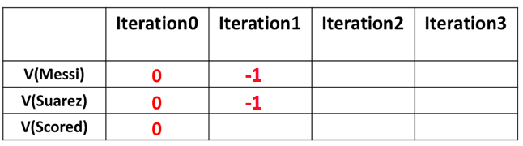
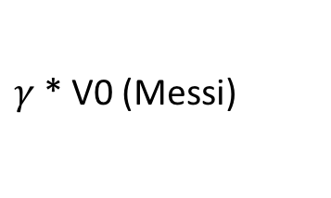
How to do value iteration?
$$γ=1$$
2
V₀ (Messi) = 0, V₀ (Suarez) = 0, V₀ (Scored) = 0
$$Σ$$
（
immediate
reward
+
future
reward
）
action
Q-value(s,a) =
probability
*
2
*
（
+
）
V1(Scored)
return
1
2
$γ$* V0 (Messi)
= 2

Slide 16
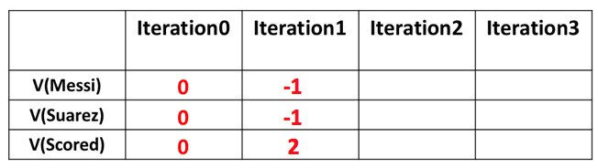
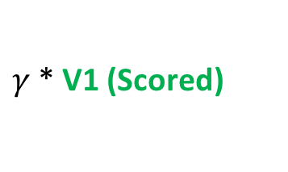
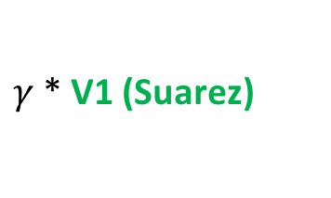

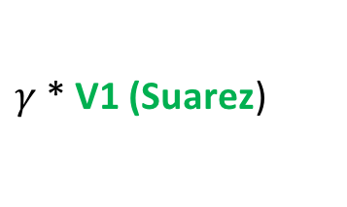
-2
-1.2
1
V₀ (Messi) = 0, V₀ (Suarez) = 0, V₀ (Scored) = 0
V1(Messi) = -1, V1(Suarez) = -1, V1(Scored) = 2
$$Σ$$
（
immediate
reward
+
future
reward
）
action
Q-value(s,a) =
probability
*
0.2
（
-2
+
）
shoot
-2.4
*
$γ$* V1 (Scored)
= 0
$$Σ$$
0.8
*
（
-2
+
）
= -2.4
V2(Messi)
$γ$* V1 (Suarez)
pass
-2
1
*
（
-1
+
）
$γ$* V1 (Suarez)
= -2

Slide 17
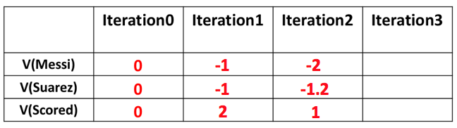
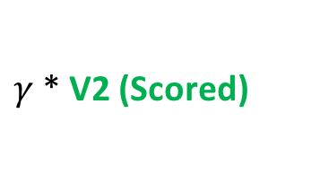
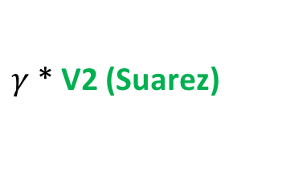
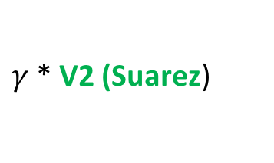
-2.2
V₀ (Messi) = 0, V₀ (Suarez) = 0, V₀ (Scored) = 0
V1(Messi) = -1, V1(Suarez) = -1, V1(Scored) = 2
V2(Messi) = -2, V2(Suarez) = -1.2, V2(Scored) = 1
$$Σ$$
（
immediate
reward
+
future
reward
）
action
Q-value(s,a) =
probability
*
0.2
（
-2
+
）
shoot
-2.76
*
$γ$* V2 (Scored)
= -0.2
$$Σ$$
0.8
*
（
-2
+
）
= -2.56
V3(Messi)
$γ$* V2 (Suarez)
pass
-2.2
1
*
（
-1
+
）
$γ$* V2 (Suarez)
= -2.2

Slide 18
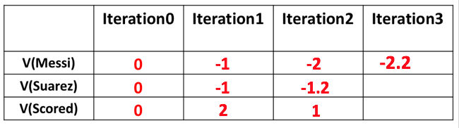
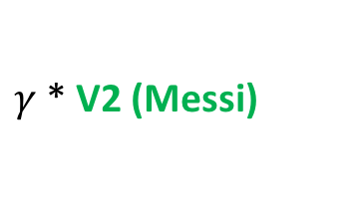
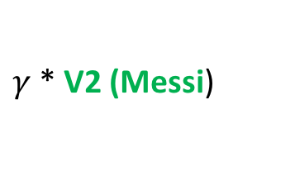
-2.2
V₀ (Messi) = 0, V₀ (Suarez) = 0, V₀ (Scored) = 0
V1(Messi) = -1, V1(Suarez) = -1, V1(Scored) = 2
V2(Messi) = -2, V2(Suarez) = -1.2, V2(Scored) = 1
$$Σ$$
（
immediate
reward
+
future
reward
）
action
Q-value(s,a) =
probability
*
0.6
（
-2
+
）
shoot
-2.2
*
$γ$* V2 (Scored)
= -0.6
$$Σ$$
0.4
*
（
-2
+
）
= -1.6
V3(Suarez)
$γ$* V2 (Messi)
pass
-3
1
*
（
-1
+
）
$γ$* V2 (Messi)
= -3

Slide 19
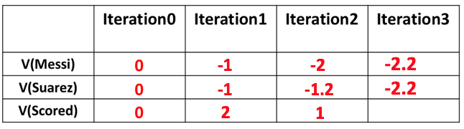


0
V₀ (Messi) = 0, V₀ (Suarez) = 0, V₀ (Scored) = 0
V1(Messi) = -1, V1(Suarez) = -1, V1(Scored) = 2
V2(Messi) = -2, V2(Suarez) = -1.2, V2(Scored) = 1
$$Σ$$
（
immediate
reward
+
future
reward
）
action
Q-value(s,a) =
probability
*
0
*
（
+
）
V3(Scored)
return
1
2
$γ$* V2 (Messi)
= 0

Slide 20
0
Question: If we just do 3 iterations, what action did we take to maximize the reward of each state in iteration 3?
Messi Pass,
Suarez Shoot,
Scored Return
Notes:
This is a policy for now, it maybe not optimal.

Slide 21
How to solve MDPs?
2.Policy Iteration

Slide 22


Policy Iteration
While value iteration iterates over value functions,
policy iteration iterates over policies themselves, creating a strictly improved policy in each iteration (except if the iterated policy is already optimal).
Step1: Start with a random policy $π$
Step2: policy evaluation (Linear Equations)
Calculate the value of each state V$π$(s) of the MDP given that policy $π$
Step3: improvement
Improve policy $π$ by setting
Step4: If policy $π$ changed in Step3, then go back to Step2, else finish

Slide 23
Compare Policy Iteration and Value Iteration
Policy Iteration finishes with an optimal policy π ∗ after a finite number of iterations, because the number of policies is finite, bounded by O(|A||S| ),
unlike value iteration, which can theoretically require infinite iterations.
Notes:
It Converge quicker than value iteration.

Slide 24
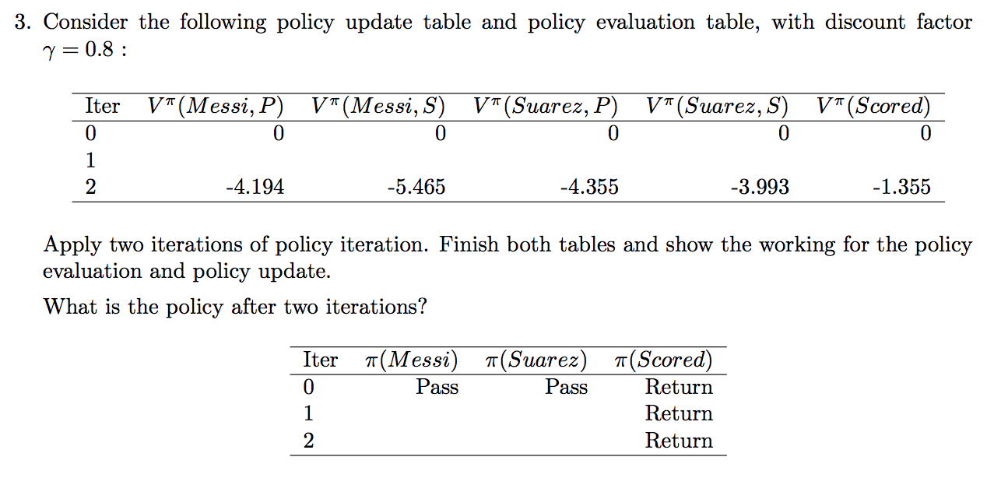

Slide 25
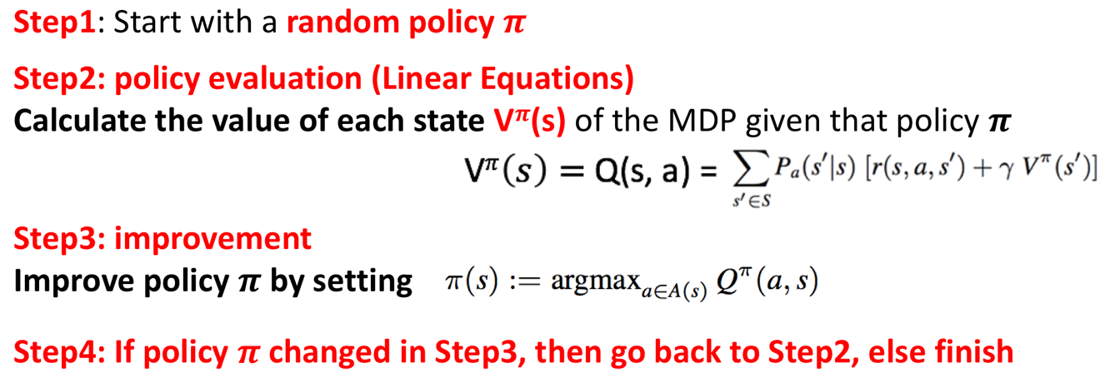
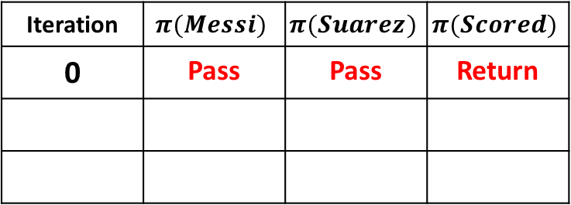
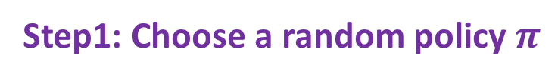
How to do policy iteration?
Step1: Choose a random policy $π$
Iteration | $$π(Messi)$$ | $$π(Suarez)$$ | $$π(Scored)$$
0 | Pass | Pass | Return
Step2: Policy Evaluation
V^{𝝅}(𝑴𝒆𝒔𝒔𝒊) V^{𝝅}(Suarez) V^{𝝅}(Scored)
Q^{𝝅}(𝑴𝒆𝒔𝒔𝒊,Pass) Q^{𝝅}(Suarez,Pass) Q^{𝝅}(Scored,Return)
a b c

Slide 26
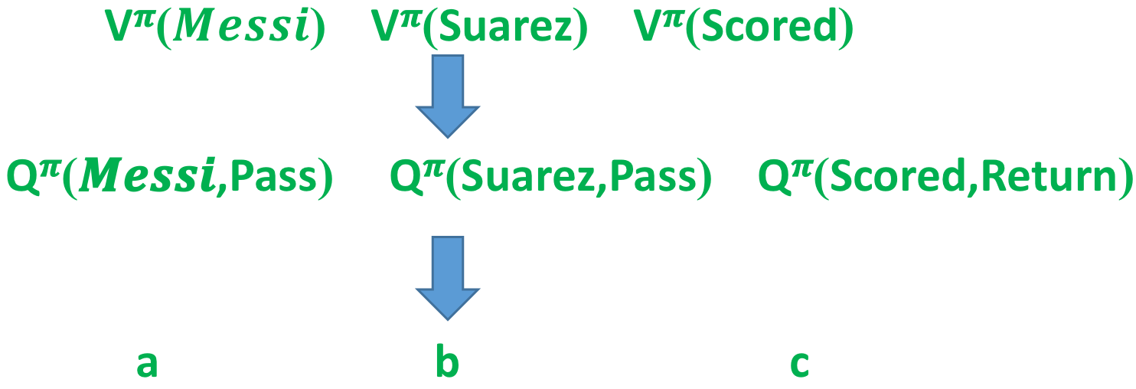
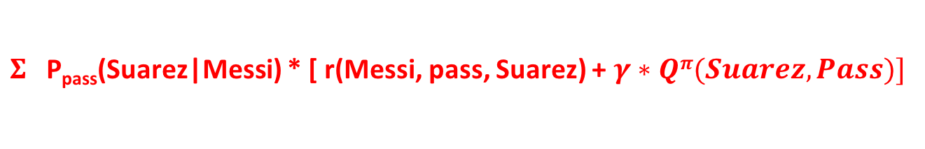
Step2: Policy Evaluation
Q^{𝝅}(𝑴𝒆𝒔𝒔𝒊,Pass) =
$Σ$P_{pass}(Suarez|Messi) * [ r(Messi, pass, Suarez) + $γ∗Qπ(Suarez,Pass)]$
a
1
-1
0.8
b
a = 1* ( -1 + 0.8*b)

Slide 27

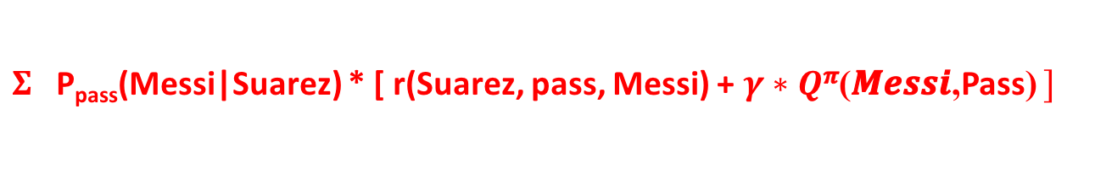
Step2: Policy Evaluation
Q^{𝝅}(𝑴𝒆𝒔𝒔𝒊,Pass) =
$Σ$P_{pass}(Suarez|Messi) * [ r(Messi, pass, Suarez) + $γ∗Qπ(Suarez,Pass)]$
a = 1* ( -1 + 0.8*b)
$Qπ(Suarez,Pass)$=
$Σ$P_{pass}(Messi|Suarez) * [ r(Suarez, pass, Messi) + $γ∗Q$^{𝝅}(𝑴𝒆𝒔𝒔𝒊,Pass) $]$
b
1
-1
0.8
a
b = 1* ( -1 + 0.8*a)

Slide 28
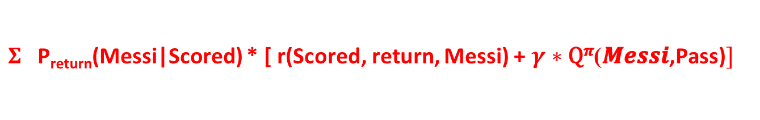
Step2: Policy Evaluation
Q^{𝝅}(𝑴𝒆𝒔𝒔𝒊,Pass) =
$Σ$P_{pass}(Suarez|Messi) * [ r(Messi, pass, Suarez) + $γ∗Qπ(Suarez,Pass)]$
a = 1* ( -1 + 0.8*b)
$Qπ(Suarez,Pass)$=
$Σ$P_{pass}(Messi|Suarez) * [ r(Suarez, pass, Messi) + $γ∗Q$^{𝝅}(𝑴𝒆𝒔𝒔𝒊,Pass) $]$
b = 1* ( -1 + 0.8*a)
Q^{𝝅}(Scored,Return) =
$Σ$P_{return}(Messi|Scored) * [ r(Scored, return, Messi) + $γ∗\text{Q}\text{π}\text{(}\text{Messi}\text{,}\text{Pass}\text{)}]$
c
1
2
0.8
a
c = 1* ( 2 + 0.8*a)

Slide 29
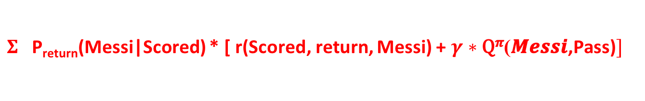
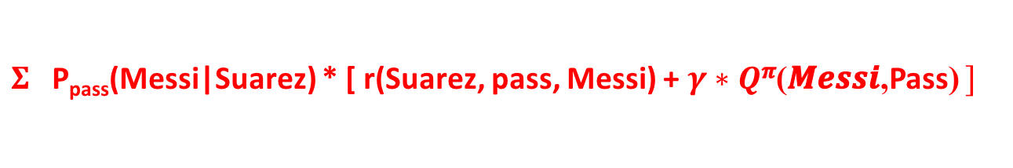
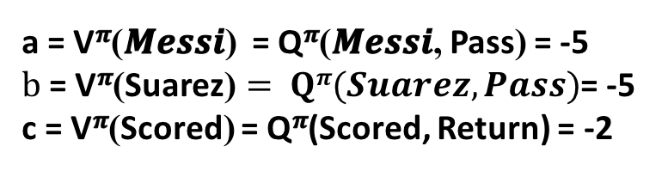
Step2: Policy Evaluation
Q^{𝝅}(𝑴𝒆𝒔𝒔𝒊,Pass) =
$Σ$P_{pass}(Suarez|Messi) * [ r(Messi, pass, Suarez) + $γ∗Qπ(Suarez,Pass)]$
a = 1* ( -1 + 0.8*b)
$Qπ(Suarez,Pass)$=
$Σ$P_{pass}(Messi|Suarez) * [ r(Suarez, pass, Messi) + $γ∗Q$^{𝝅}(𝑴𝒆𝒔𝒔𝒊,Pass) $]$
b = 1* ( -1 + 0.8*a)
Q^{𝝅}(Scored,Return) =
$Σ$P_{return}(Messi|Scored) * [ r(Scored, return, Messi) + $γ∗\text{Q}\text{π}\text{(}\text{Messi}\text{,}\text{Pass}\text{)}]$
c = 1* ( 2 + 0.8*a)
a = -5, b = -5, c = -2
a = V^{𝝅}(𝑴𝒆𝒔𝒔𝒊) = Q^{𝝅}(𝑴𝒆𝒔𝒔𝒊, Pass) = -5
$b \text{= }\text{V}\text{π}\text{(}\text{Suarez}\text{)}= Qπ(Suarez,Pass)$= -5
c = V^{𝝅}(Scored) = Q^{𝝅}(Scored, Return) = -2

Slide 30
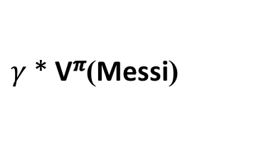

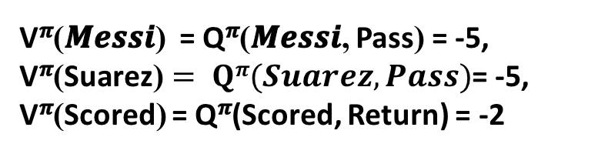
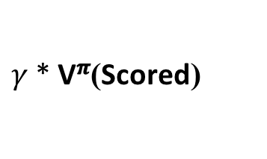
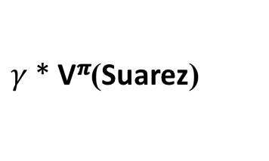



Iteration | $$π(Messi)$$ | $$π(Suarez)$$ | $$π(Scored)$$
0 | Pass | Pass | Return
Step3: Improvement
V^{𝝅}(𝑴𝒆𝒔𝒔𝒊) = Q^{𝝅}(𝑴𝒆𝒔𝒔𝒊, Pass) = -5,
$\text{V}\text{π}\text{(}\text{Suarez}\text{)}= Qπ(Suarez,Pass)$= -5,
V^{𝝅}(Scored) = Q^{𝝅}(Scored, Return) = -2
1
Pass
Shoot
Return
0.2
（
-2
+
）
*
$γ$* V^{𝝅}(Scored)
= -0.72
Q^{𝝅}(𝑴𝒆𝒔𝒔𝒊, Shoot) =
$$Σ$$
0.8
（
-2
+
）
= -4.8
*
$γ$* $\text{V}\text{π}\text{(}\text{Suarez}\text{)}$
-5.52
0.6
（
-2
+
）
*
$γ$* V^{𝝅}(Scored)
= -2.16
Q^{𝝅}(Suarez, Shoot) =
$$Σ$$
0.4
（
-2
+
）
= -2.4
*
$γ$* $\text{V}\text{π}\text{(}\text{Messi}\text{)}$
-4.56

Slide 31

Step4: Go back to Step 2 and Step3
Policy Evaluation
V^{𝝅}(𝑴𝒆𝒔𝒔𝒊) V^{𝝅}(Suarez) V^{𝝅}(Scored)
Q^{𝝅}(𝑴𝒆𝒔𝒔𝒊,Pass) Q^{𝝅}(Suarez,Shoot) Q^{𝝅}(Scored,Return)
a b c

Slide 32






Step2: Policy Evaluation
Q^{𝝅}(𝑴𝒆𝒔𝒔𝒊,Pass) =
$Σ$P_{pass}(Suarez|Messi) * [ r(Messi, pass, Suarez) + $γ∗Qπ(Suarez,Shoot)]$
a = 1* ( -1 + 0.8*b)
$Qπ(Suarez, Shoot)$=
$$Σ$$
P_{shoot}(Scored|Suarez) * [ r(Suarez, shoot, Scored) + $γ∗Q$^{𝝅}(Scored, Return) $]$
P_{shoot}(Messi|Suarez) * [ r(Suarez, shoot, Messi) + $γ∗Q$^{𝝅}(Messi, Pass) $]$
b = 0.6* ( -2 + 0.8*c) + 0.4* (-2 + 0.8a)
Q^{𝝅}(Scored,Return) =
$Σ$P_{return}(Messi|Scored) * [ r(Scored, return, Messi) + $γ∗\text{Q}\text{π}\text{(}\text{Messi}\text{,}\text{Pass}\text{)}]$
c = 1* ( 2 + 0.8*a)
a = -4.194, b = -3.993, c = -1.355
a = V^{𝝅}(𝑴𝒆𝒔𝒔𝒊) = Q^{𝝅}(𝑴𝒆𝒔𝒔𝒊, Pass) = -4.194
$b \text{= }\text{V}\text{π}\text{(}\text{Suarez}\text{)}= Qπ(Suarez,Shoot)$= -3.993
c = V^{𝝅}(Scored) = Q^{𝝅}(Scored, Return) = -1.355

Slide 33


Iteration | $$π(Messi)$$ | $$π(Suarez)$$ | $$π(Scored)$$
0 | Pass | Pass | Return
Step3: Improvement
a = V^{𝝅}(𝑴𝒆𝒔𝒔𝒊) = Q^{𝝅}(𝑴𝒆𝒔𝒔𝒊, Pass) = -4.194
$b \text{= }\text{V}\text{π}\text{(}\text{Suarez}\text{)}= Qπ(Suarez,Shoot)$= -3.993
c = V^{𝝅}(Scored) = Q^{𝝅}(Scored, Return) = -1.355
1
Pass
Shoot
Return
2
Pass
Shoot
Return
0.2
（
-2
+
）
*
$γ$* V^{𝝅}(Scored)
= -0.617
Q^{𝝅}(𝑴𝒆𝒔𝒔𝒊, Shoot) =
$$Σ$$
0.8
（
-2
+
）
= -4.156
*
$γ$* $\text{V}\text{π}\text{(}\text{Suarez}\text{)}$
-4.77
Q^{𝝅}(Suarez, Pass) =
1
（
-1
+
）
*
$γ$* V^{𝝅}(Messi)
= -4.355
-4.355
So, after 2 iterations,
the policy is Messi Pass, Suarez Shoot, Scored Return.

Slide 34


