Slide 1
Wine Quality Analysis
Saier Gong (sg3772)
GR5291

Slide 2
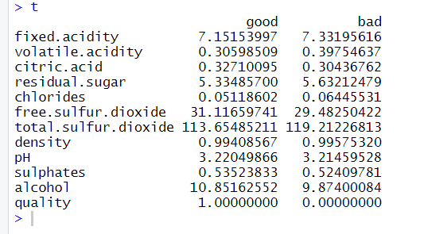
Data Introduction
Variables | Type
quality (y) | {0,1} response
type | Categorical-2levels(red,white)
fixed acidity | Quantitative
volatile acidity | Quantitative
citric acid | Quantitative
residual sugar | Quantitative
chlorides | Quantitative
free sulfur dioxide | Quantitative
total sulfur dioxide | Quantitative
density | Quantitative
pH | Quantitative
sulphates | Quantitative
alcohol | Quantitative
This wine quality data set is downloaded from Kaggle.
After cleaning the data set, it has 6463 observations.

Slide 3
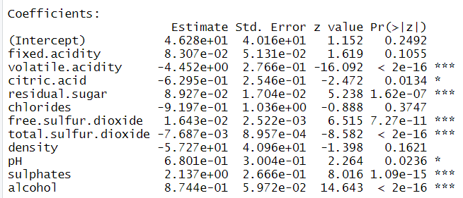
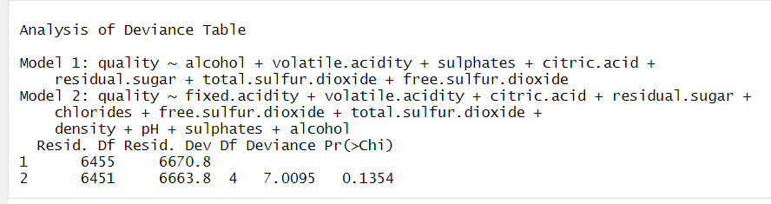
Build a Model
For each observation, the value of quality variable is either 1 (high quality) or 0 (low quality), so I plan to use logistic regression model to analyze the data set.
Firstly, I only consider the significance of quantitative variables.
Set null hypothesis: Reduced Model: without fixed acidity, density, chlorides and pH variables.
After doing the likelihood ratio inference, the p-value is 0.1354, which is much bigger than 0.01, so we cannot reject the null hypothesis, and accept that the reduced model (remain 7 quantitative variables) can explain the data well.

Slide 4
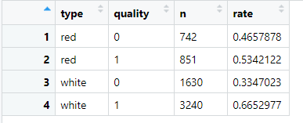
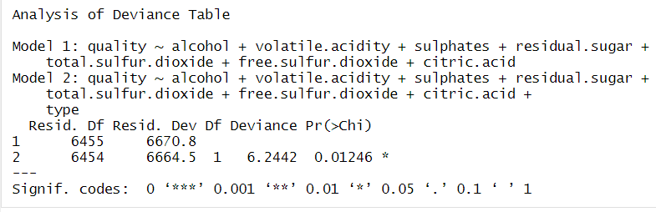
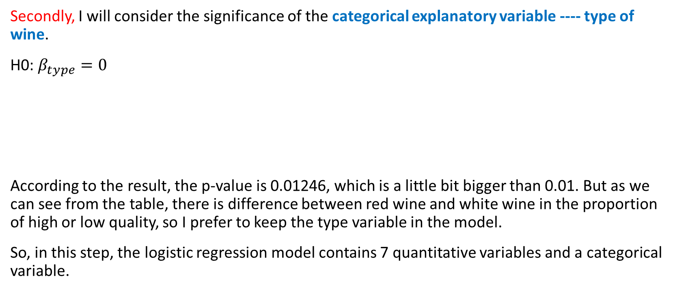
Build a Model
Secondly, I will consider the significance of the categorical explanatory variable ---- type of wine.
H0: $β_{type}=0$
According to the result, the p-value is 0.01246, which is a little bit bigger than 0.01. But as we can see from the table, there is difference between red wine and white wine in the proportion of high or low quality, so I prefer to keep the type variable in the model.
So, in this step, the logistic regression model contains 7 quantitative variables and a categorical variable.

Slide 5
Build a Model
Thirdly, I will consider the interaction terms in the model.
After test the significance of each interaction term , I plan to keep 4 interaction terms: type*volatile.acidity+ type*citric.acid+ type*total.sulfur.dioxide+ type*free.sulfur.dioxide.
So, the final model is

Slide 6
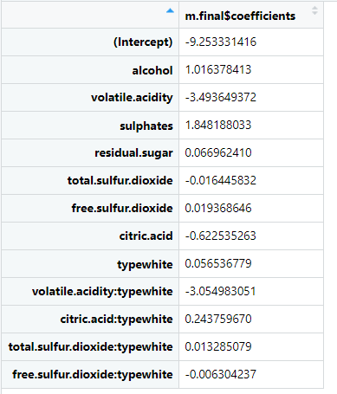
Conclusions:
We can see that the absolute value of the volatile. Acidity parameter is the greatest, which means it may cause more change in the odds of high quality in the wine when it changes.
Based on the result obtained from this data set,
Given other quantitative variables the same, the estimated odds of high quality of white wine is about 6% of the estimated odds of high quality of red wine. So, to the people who is not an expert in wine and do not have a preference in the type of wine, I suggest the red wine.(since it is more likely to choose fake white wine.)

Slide 7
Conclusions(cont.)
For the people who prefer the white wine, I suggest to choose the white wine with a little bit higher alcohol, sulphates and residual sugar but with lower volatile acidity. Other variables seem not as important as these.
For the people who prefer the red wine, I suggest to choose the wine with a little bit higher alcohol and sulphates but with lower volatile acidity. Other variables seem not as important as these.
For the wine factory, to make better wine, reduce the total sulfur dioxide and citric acidity.

Slide 8
Thank you very much!

