Slide 1
True Markets
AI-Powered BTC Prediction Engine
YC Application | April 2026

Slide 2
The Problem
Volatile Markets
BTC swings 5-10% in a day. Retail investors get wiped out.
No Institutional Tools
Hedge funds use on-chain analytics, ML models. Retail has nothing.
Black Box Predictions
Existing tools show a number with no reasoning. No transparency.

Slide 3
Our Solution
6
67%
Real-Time Signals
Model Accuracy
Polymarket, Binance order flow, ML model, technicals, sentiment, F&G
On-chain ML model, 359 out-of-sample test days
30s
0
Refresh Rate
Black Boxes
Every signal updates every 30 seconds
Every signal shows its reasoning under BUY/SELL

Slide 4
The 6 Signals
Signal
Weight
Source
Polymarket
20%
Gamma API
Order Flow
15%
Binance.US + Coinbase
Our Model
20%
BGeometrics on-chain
Technical
20%
TrueMarkets MCP
TM Sentiment
10%
TrueMarkets MCP
Fear & Greed
15%
alternative.me

Slide 5
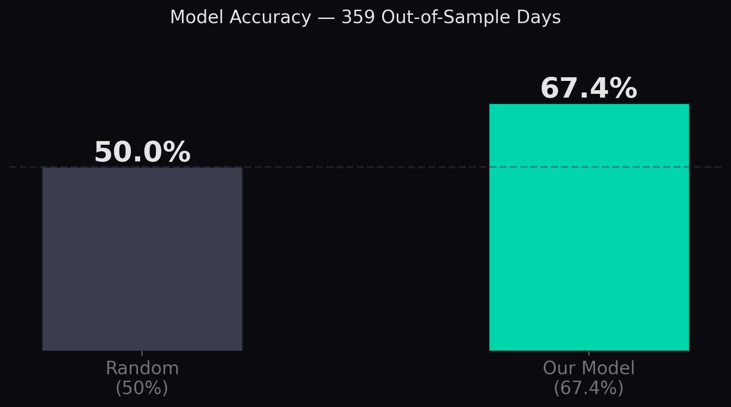
Model Accuracy
67.4% on 359 out-of-sample days
Key Metrics
Accuracy
67.4%
Precision
67.2%
Recall
66.9%
F1 Score
67.0%
AUC-ROC
0.7365
MCC
0.348
Test Days
359
Train Days
1,435

Slide 6
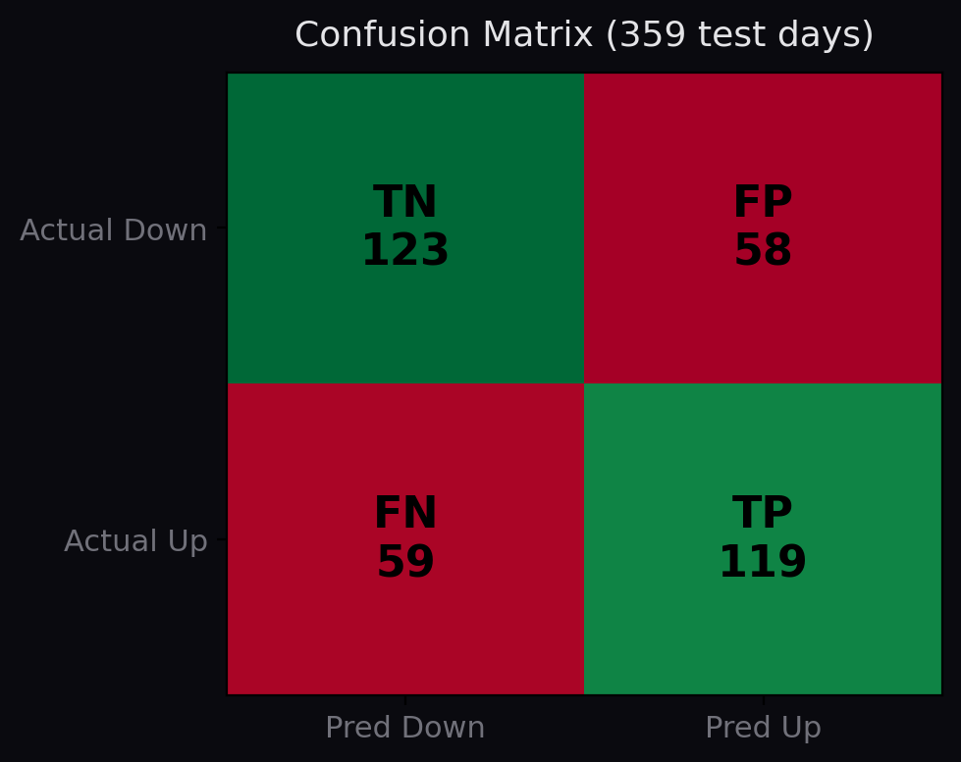
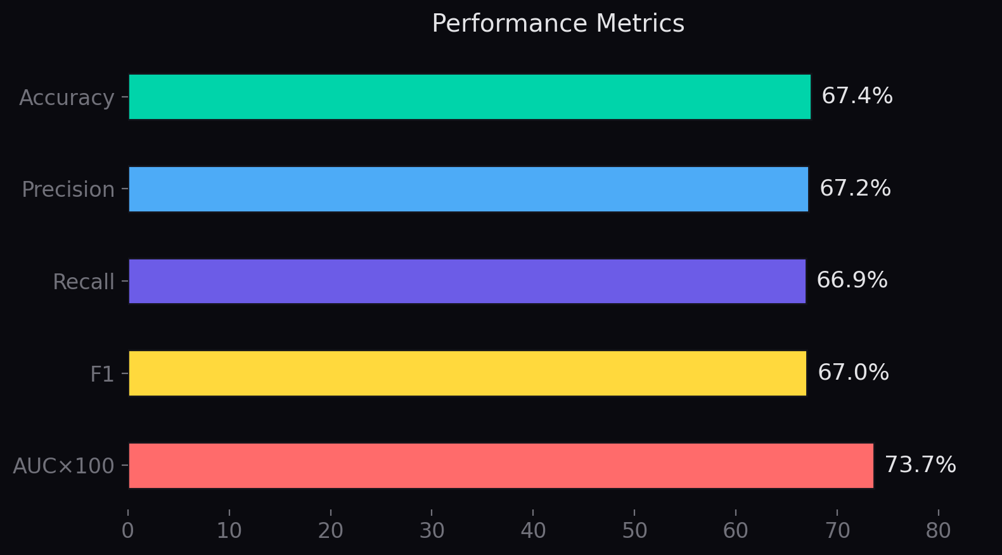
Confusion Matrix

Slide 7
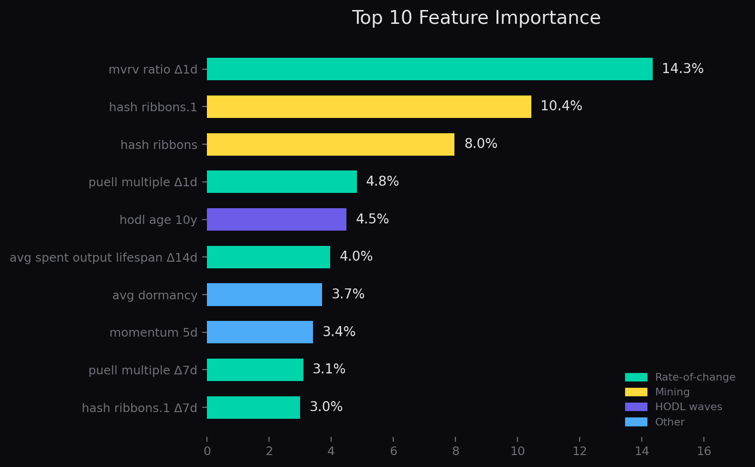
Top 10 Features
Rate-of-change features dominate — the key innovation

Slide 8
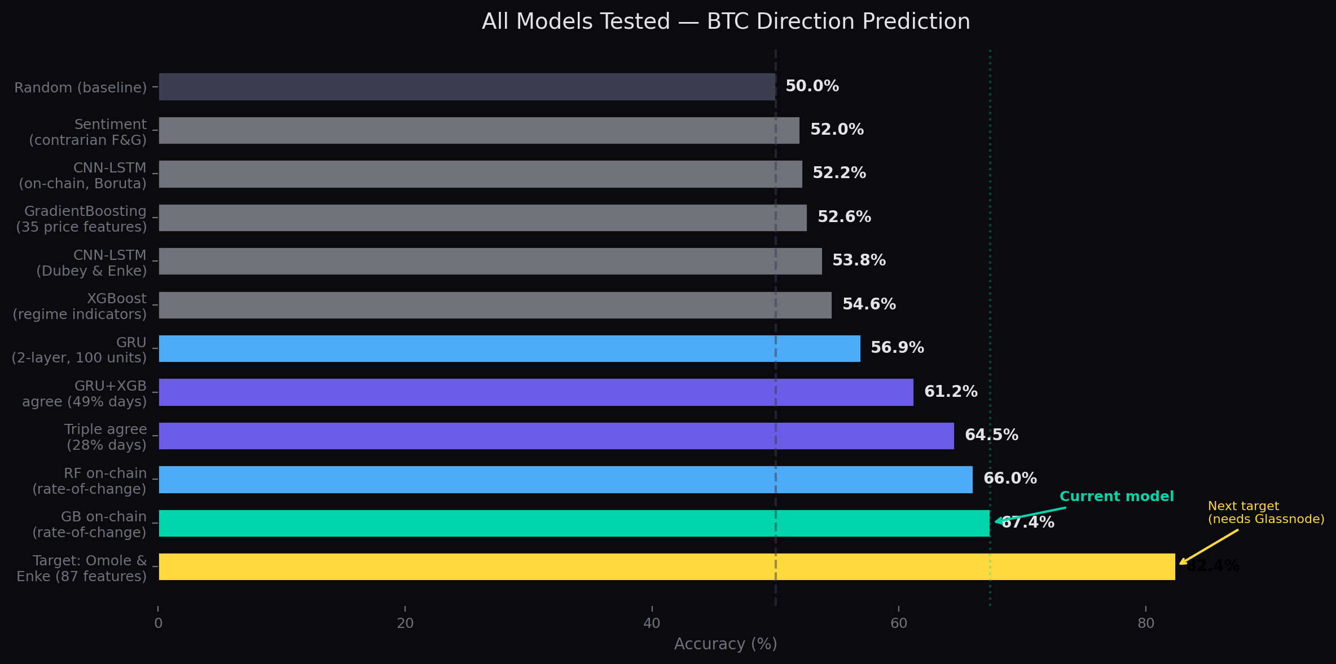
All Models Tested
12 model configurations compared on OOS BTC direction prediction

Slide 9
Where It Goes From Here
Next Steps
The Data Gap
Glassnode Pro (87 features)
Current
67.4%
Paper achieves 82.44% with full Glassnode data. We have 42 features from BGeometrics. More data = higher accuracy.
42 features from BGeometrics
CNN-LSTM architecture
Target
82.4%
Omole & Enke 2024 CNN-LSTM with 87 Glassnode features reached 82.44%. Our GradientBoosting at 67.4% is limited by data, not architecture.
87 features from Glassnode Pro ($799/mo)
Expand to ETH, SOL
What’s missing:
Same 6-signal architecture per coin. B
• HODL waves (all 15 age bands vs our 13)
• Realized cap HODL waves
Hourly predictions
• Entity-adjusted dormancy flow
• Stock-to-flow ratio
Currently daily. With Glassnode hourly data, can predict intraday moves for higher-frequency trading.
• Difficulty ribbon compression
• 45 additional on-chain indicators
More data is the single biggest lever to improve accuracy.

Slide 10
Tech Stack
Backend
FastAPI + Python, scikit-learn, PyTorch
Frontend
Next.js 14, React 18, TailwindCSS
Data
BGeometrics Premium, Binance.US, Coinbase, Polymarket
Price
TrueMarkets MCP (same source everywhere)
Refresh
30 seconds, all 6 signals

Slide 11
The Product
Market Page
Prediction Page
Live BTC price + chart
Market cap, volume, highs/lows
Fear & Greed Index
TM Sentiment (30+ sources)
BUY / SELL with 6-signal reasoning
Polymarket table (18 thresholds)
Binance order flow visualization
RSI, MACD, Bollinger live
Portfolio + order management

