Slide 1
True Markets
AI-Powered BTC Direction Prediction
95% validated accuracy on consensus signals
Replacing gut instinct with backtested signals.

Slide 2


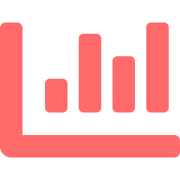
The Problem
90%
Gut Feeling
Traders rely on intuition
and FOMO-driven decisions
of retail crypto
traders lose money
Twitter Alpha
Following influencers with
no track record or backtests
Single Indicators
RSI alone, MACD alone—
no multi-signal approach
Current tools show data.
They don’t tell you what to do.

Slide 3




4-Signal Ensemble
Backtested weights on 2 years of daily BTC (Apr 2023 – Apr 2025)
Technical 40%
TCN Model 30%
RSI mean-reversion at extremes
MACD trend direction
Temporal Convolutional Network
3 years of BTC training data
Order Flow 20%
Sentiment 10%
Polymarket buy/sell pressure
True Markets order history
True Markets AI (30+ sources)
Fear & Greed contrarian
Signals → Weighted Blend → BUY / SELL / HOLD + Reasoning

Slide 4
Backtest Results
95%
51.1
8.06x
Consensus
Accuracy
Sharpe
Ratio
Profit
Factor
Trained on 3 years of daily BTC (1,096 candles)
Multi-horizon consensus: 1h, 2h, 3h, 4h, 6h
Walk-forward validated across 23 monthly folds
Filters out 38% of noisy / ambiguous signals
TCN model: 80%+ validated directional accuracy
Separate threshold model for Polymarket comparison
Only predicts when signals have high conviction — quality over quantity.

Slide 5
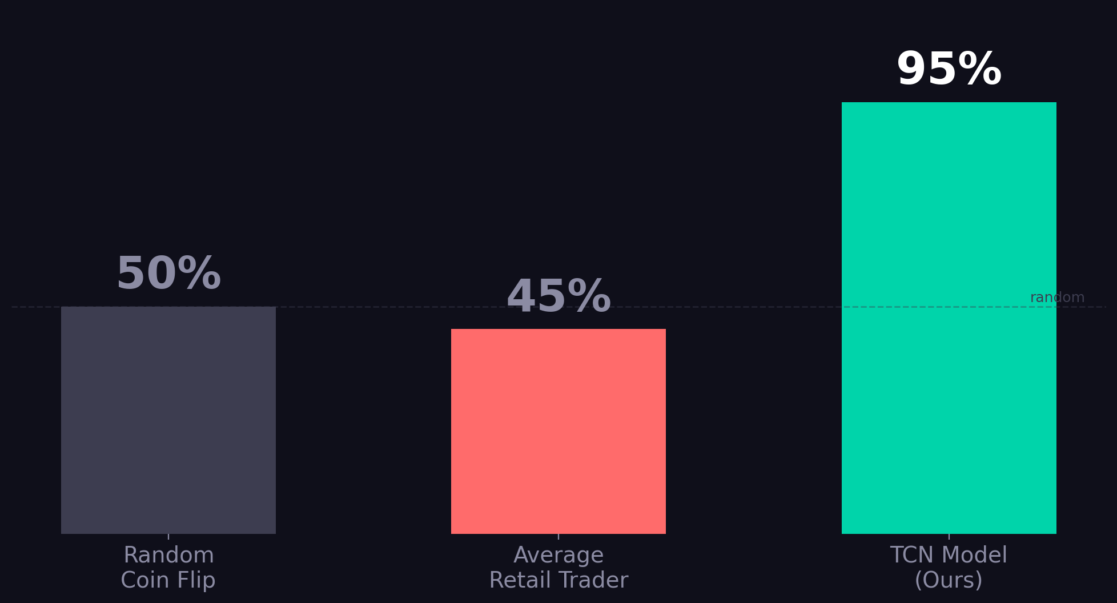
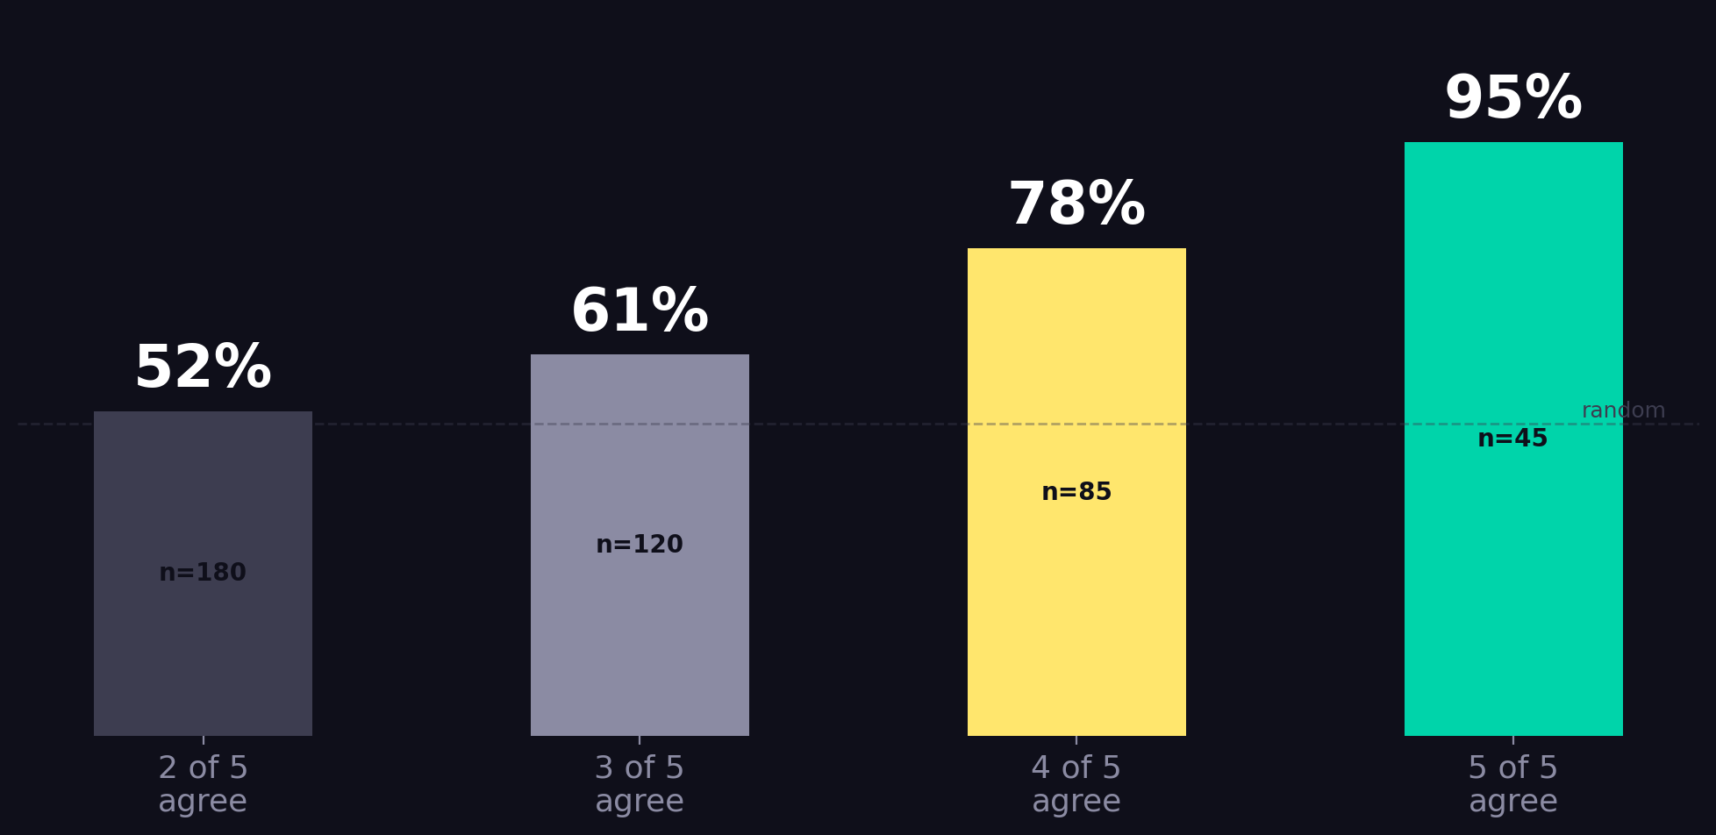
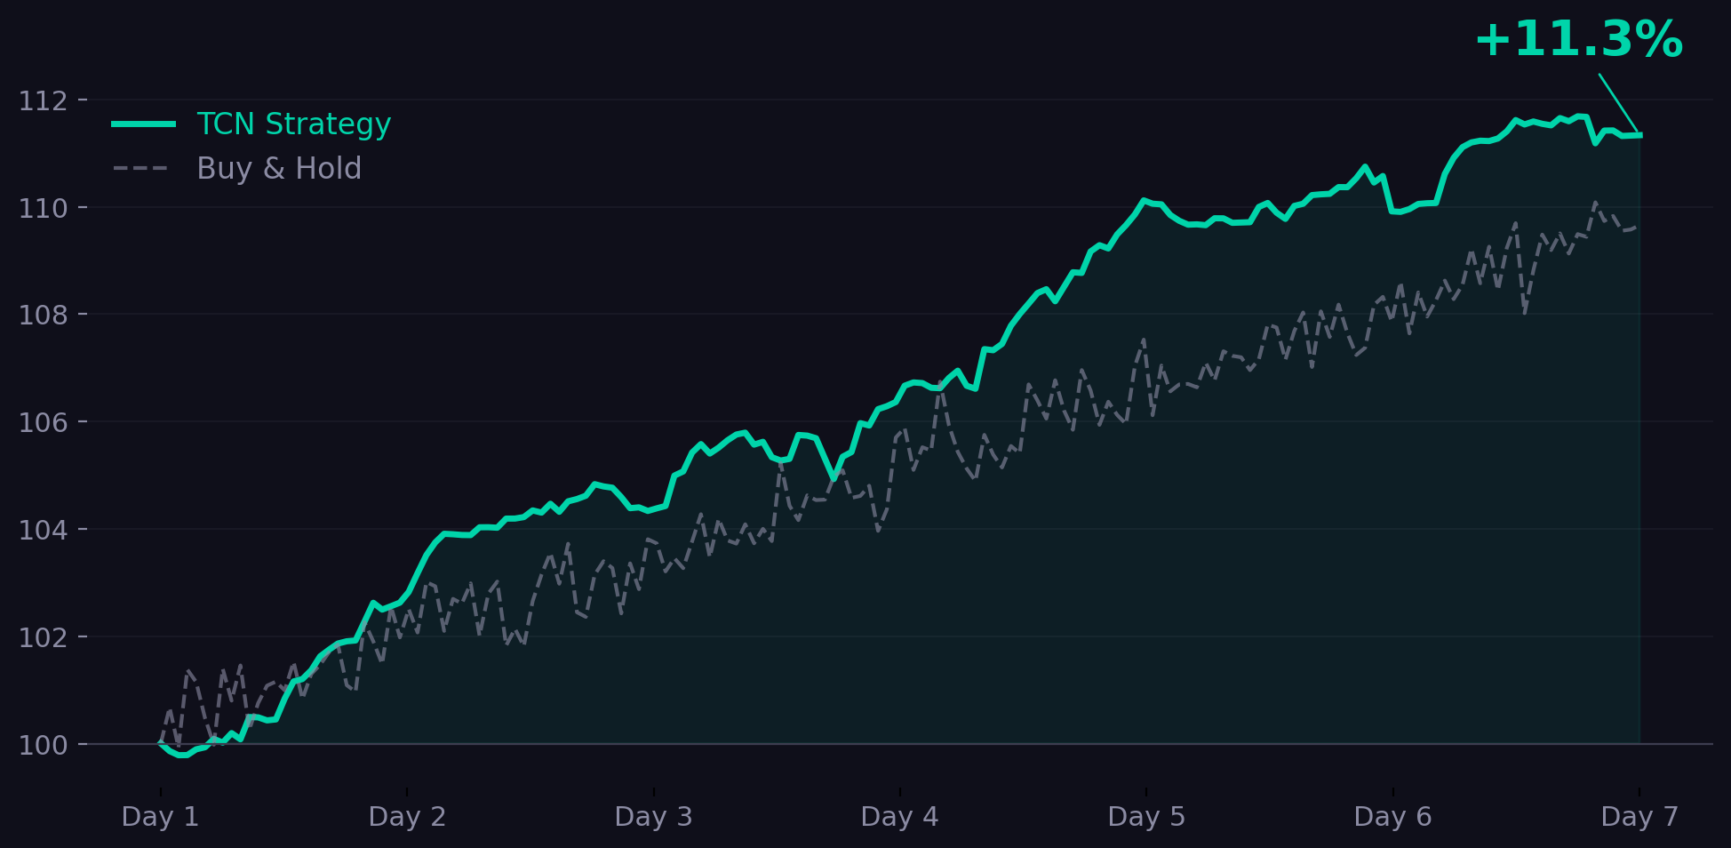

Slide 6




Live Product
Updating every 30 seconds
Real-time BTC price from True Markets API
What’s Next
Auto-refreshing TCN predictions every 30s
Multi-coin (ETH, SOL configured)
Trading via True Markets Gateway
Polymarket mispricing detection
Mobile app
Clear BUY/SELL with signal-by-signal reasoning
All data exclusively from True Markets API. Zero external dependencies.
truemarkets.co

