Slide 1


Home Credit Default Risk
Abinav Yadamani
Rawali Male
Michael Mendoza
Sai Eshwar Tadepalli

Slide 2






AGENDA
Business Problem
Project Objectives
Dataset Explanation
High Level Preprocessing
Modelling
Final Takeaways

Slide 3
Business problem
Lack of Credit History
Vulnerability to Predatory Lenders
Need for Alternative Data Use
Risk of Misjudged Creditworthiness

Slide 4
AGENDA
Business Problem
Project Objectives
Dataset Explanation
High Level Preprocessing
Modelling
Final Takeaways

Slide 5
PROBJECT OBJECTIVES
Perform Extensive EDA, Test for Hypothesis and Derive Insights
Supervised Predictive Classification Models to predict loan default
Obtain Test AUC & Kaggle Score
XAI libraries to interpret the predictions of best model
Final Takeaways for Home Credit

Slide 6
AGENDA
Business Problem
Project Objectives
Dataset Explanation
High Level Preprocessing
Modelling
Final Takeaways

Slide 7
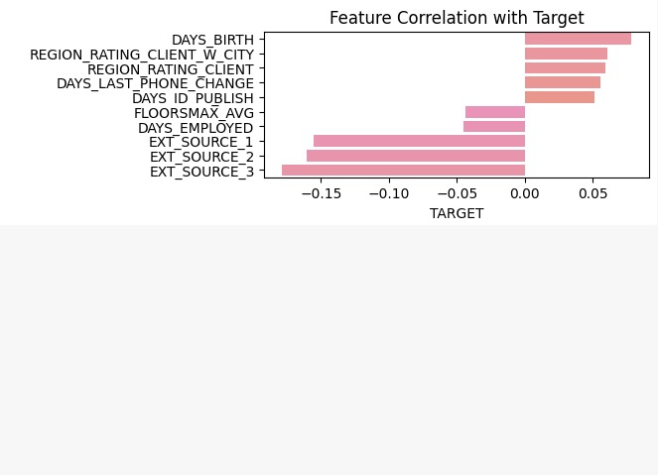
DATASET Overview
Dataset
Application Train
Dimensions
Features: 122
Applications: 307k
Target Variable
Repaid on time: 91.92%
Default: 8.08%

Slide 8
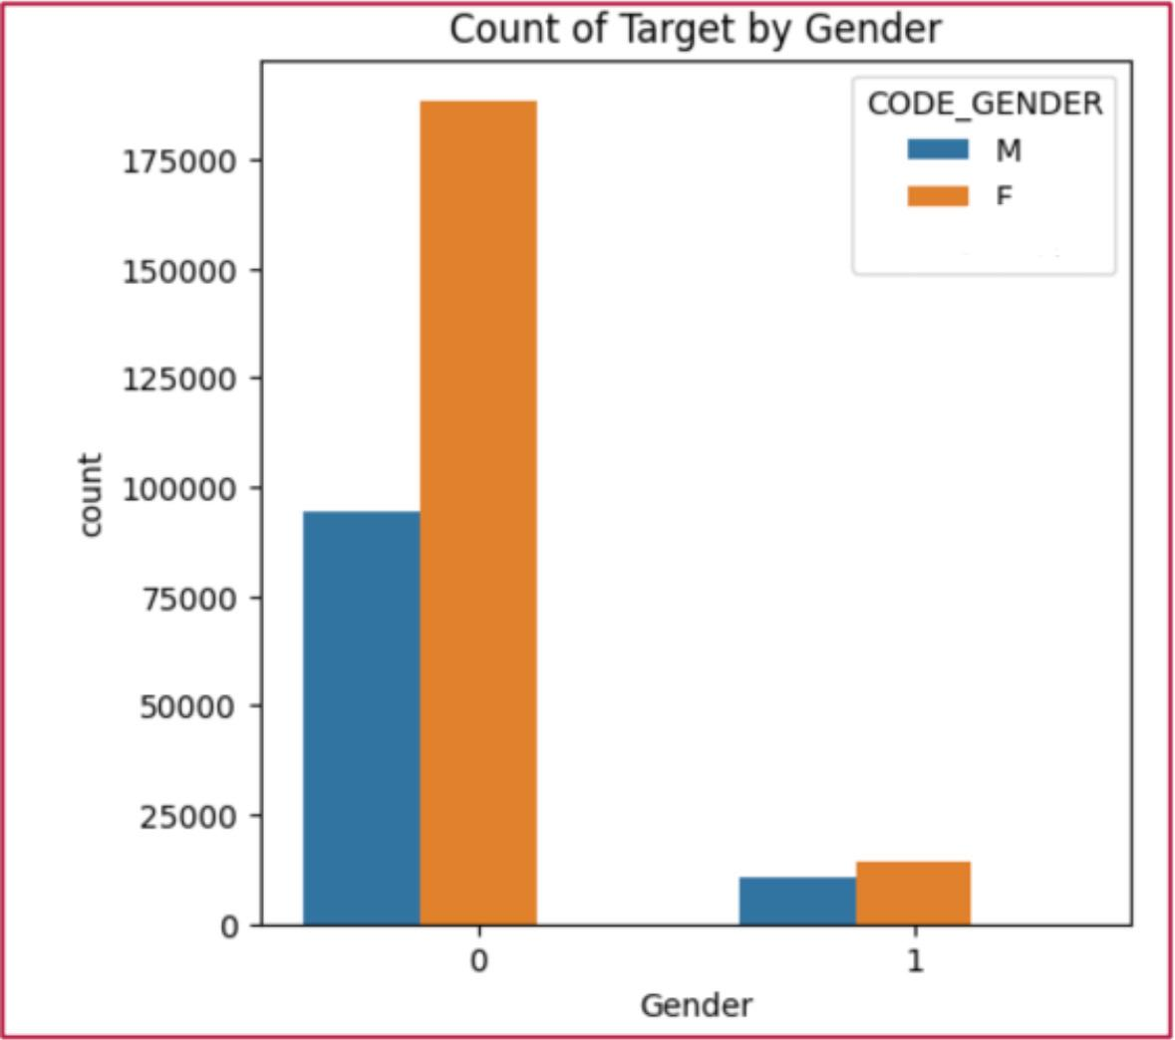
Business INSIGHTS FROM EDA
Hypothesis – 1
Loan Distribution:
Females double non-defaulters
Repayment Challenges:
Females slightly more

Slide 9
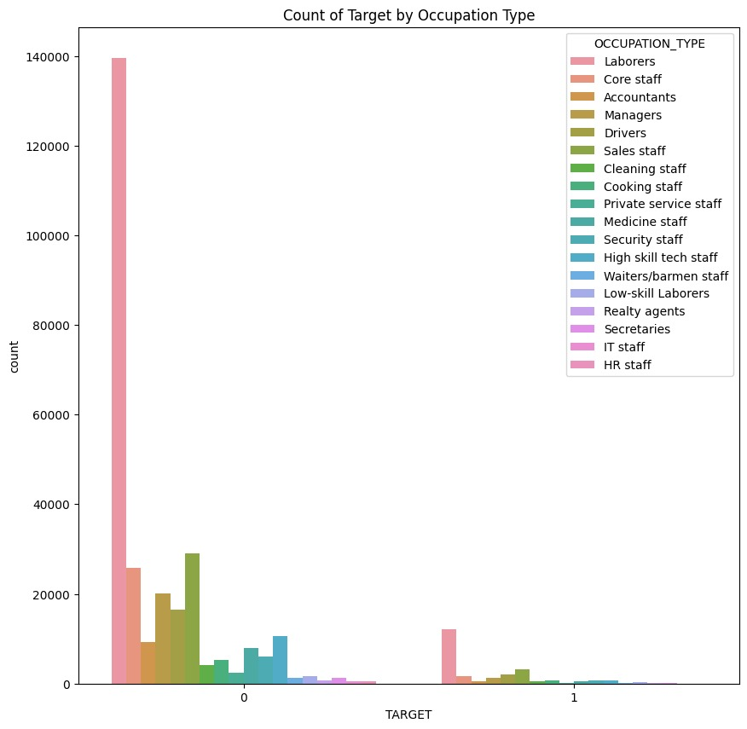
Business INSIGHTS FROM EDA
Hypothesis – 2
High Default Rates:
Laborers, Drivers, Sales Staff

Slide 10
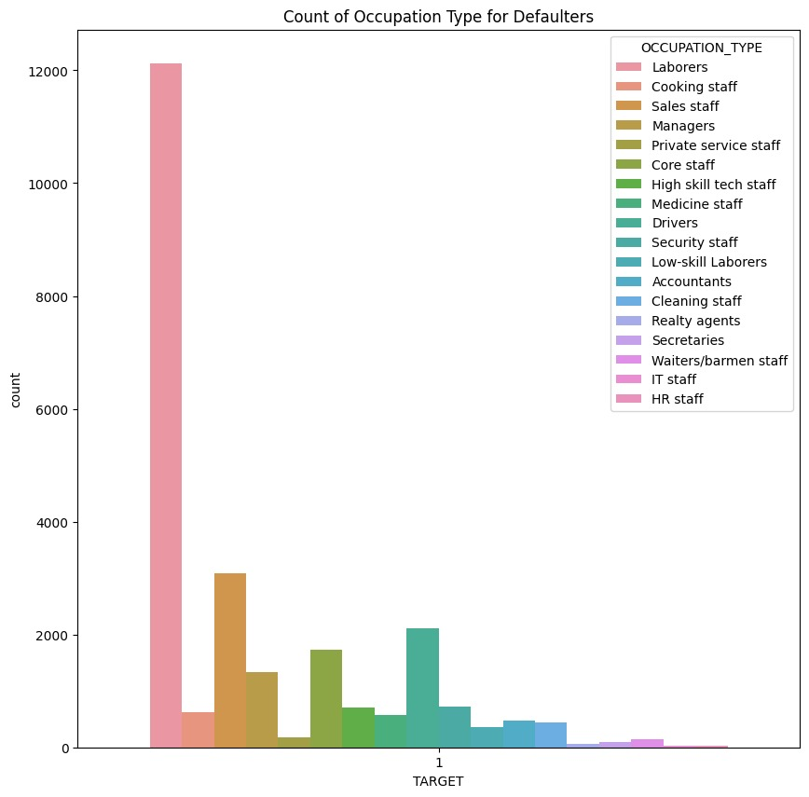
Business INSIGHTS FROM EDA
Hypothesis – 2
Loan Repayment Challenges:
Common among Low-Skilled
Workers

Slide 11
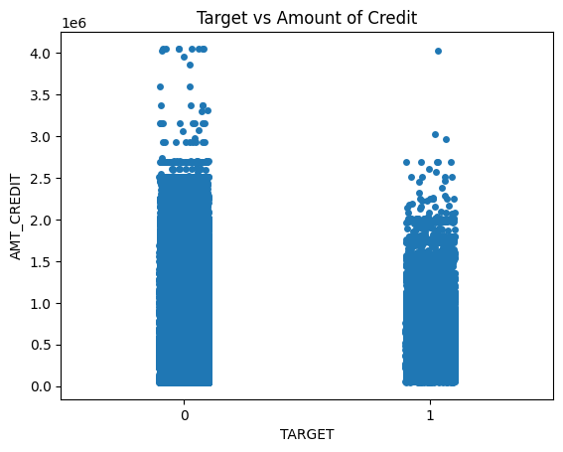
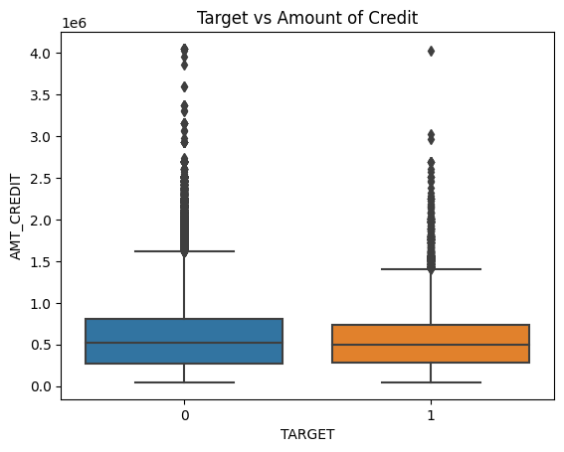
Business INSIGHTS FROM EDA
Hypothesis – 3
Default Trend:
Increases with Loan Amount
Surprising Insight:
High Repayment in High Amounts

Slide 12
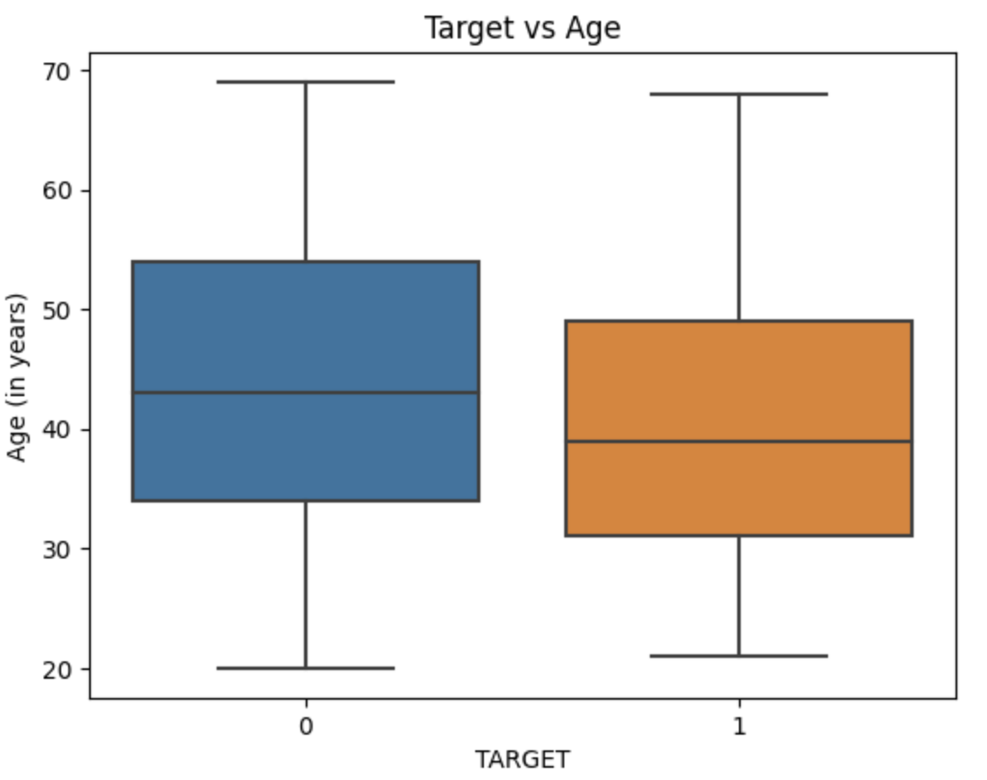
Business INSIGHTS FROM EDA
Hypothesis – 4
Age and Default:
Higher Age, Lower Default
Confirmed Hypothesis:
Strong Correlation Observed

Slide 13
AGENDA
Business Problem
Project Objectives
Dataset Explanation
High Level Preprocessing
Modelling
Final Takeaways

Slide 14
HIGH LEVEL PREPROCESSING
Handling Missing Values
Dropped columns with 48%
missing values, excluding
External Source 1
Imputation Strategy
Object Type: Mode
Numeric Type: Median
Treating Multi-collinearity
Correlation threshold set at 0.03
Excluded ‘Count of Family Members’ and ‘Amount Annuity’
Column Imbalance
Low Variability was observed
21 Columns were dropped

Slide 15
FEATURE ENGINEERING
CREDIT_INCOME_PERCENT
AMT_CREDIT / AMT_INCOME_TOTAL
ANNUITY_INCOME_PERCENT
AMT_ANNUITY / AMT_INCOME_TOTAL
CREDIT_TERM
AMT_ANNUITY / AMT_CREDIT
DAYS_EMPLOYED_PERCENT
DAYS_EMPLOYED / DAYS_BIRTH

Slide 16
AGENDA
Business Problem
Project Objectives
Dataset Explanation
High Level Preprocessing
Modelling
Final Takeaways

Slide 17
MODELLING
Selected Models
Logistic Regression
Random Forest
XG Boost
Neural Network
Light GBM
Evaluation Metrics
ROC-AUC
Accuracy

Slide 18
PRE-MODELLING TECHNIQUES
Train Test Split
80/20
Scaling
Logistic Regression
Cross Validation (Grid Search)
5-Fold
Under (down) Sampling
Smote Sampling

Slide 19

MODELLINg SCORES
Logistic Regression
Random Forest
XGBoost
Neural Net
Kaggle : 0.63
Accuracy: 0.82
AUC : 0.68
Kaggle : 0.735
Accuracy: 0.82
AUC : 0.75
Kaggle : 0.758
Accuracy: 0.83
AUC : 0.77
Kaggle : 0.734
Not Considered

Slide 20
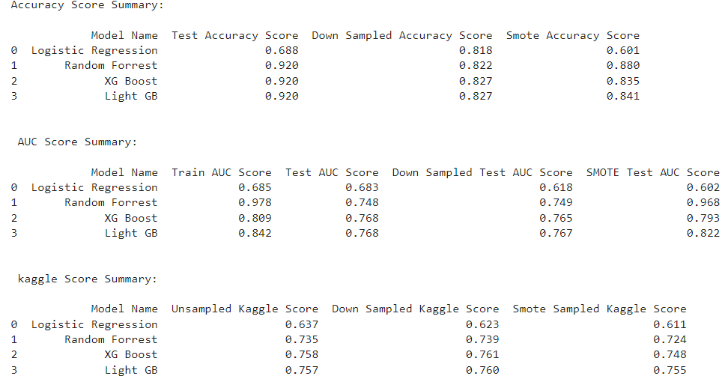
SUMMARY
Superior Performance
Light GBM
Train ROC-AUC: 0.84
Test ROC-AUC: 0.77
Test Accuracy: 0.83

Slide 21
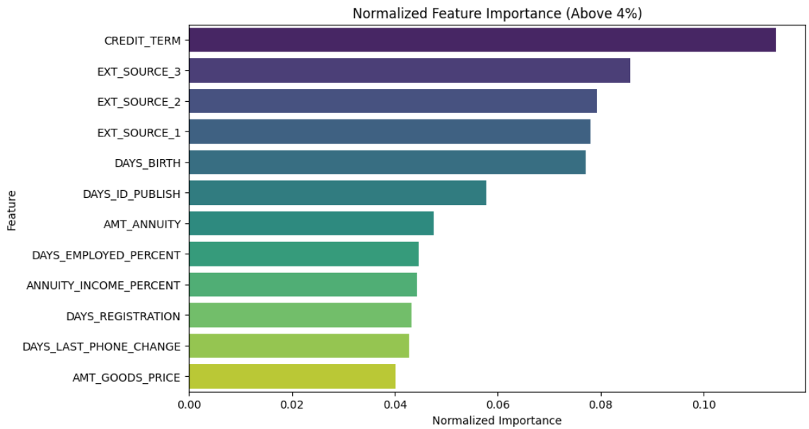
FEATURE IMPORTANCE

Slide 22
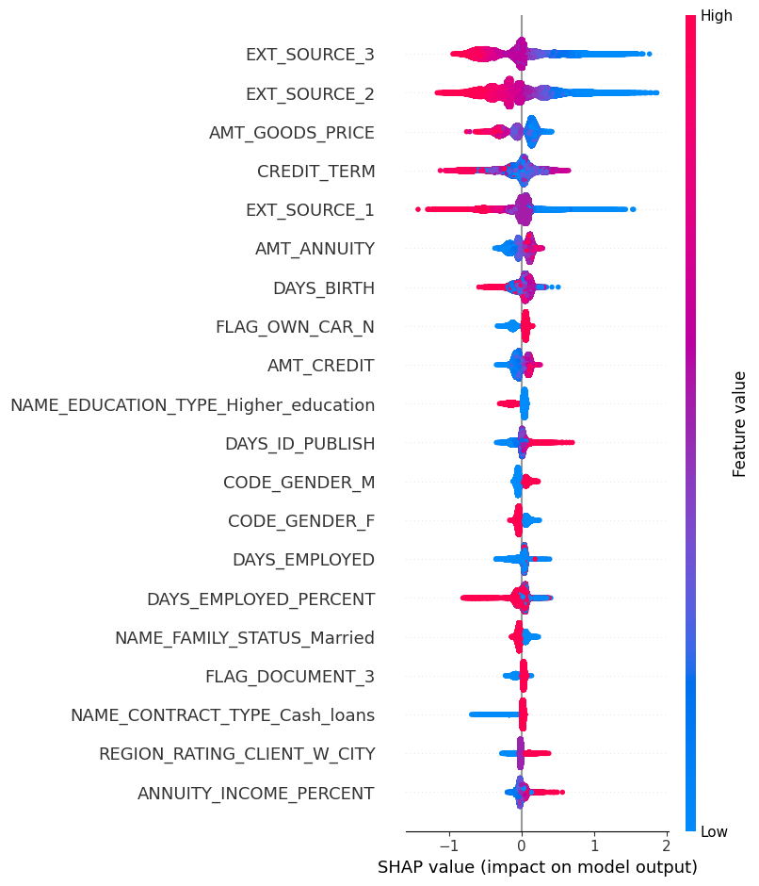
FEATURE IMPORTANCE
Higher Repayment Risk:
Low External Sources
High Days ID Publish
Low Repayment Risk:
High Credit Term
High Days Employed %

Slide 23
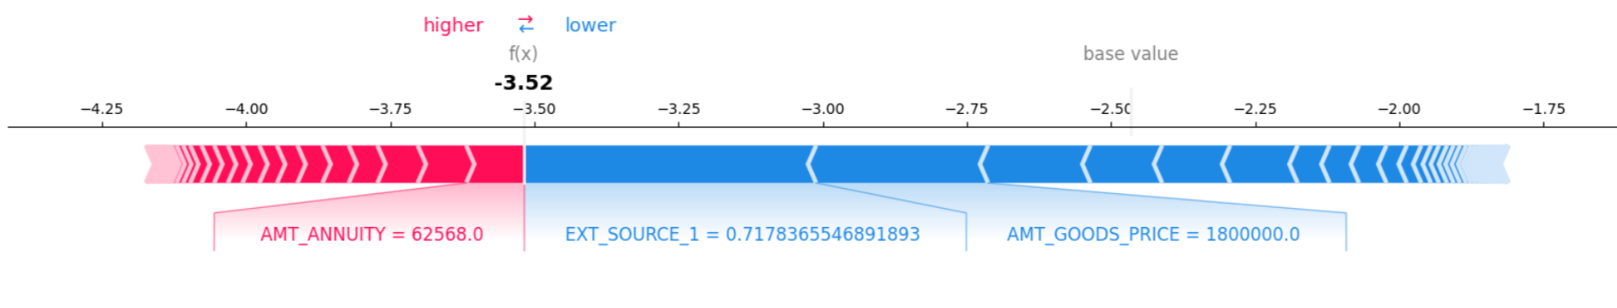
BREAKDOWN OF MODEL PREDICTION
SHAP value < Base Value
Model predicts 0 (no repayment difficulty)

Slide 24
AGENDA
Business Problem
Project Objectives
Dataset Explanation
High Level Preprocessing
Modelling
Final Takeaways

Slide 25
FINAL TAKEAWAYS
Used model predictions along with Tree Explainer
Improved decision making => low risk & NPA
Automated, faster, efficient & streamlined loan approval process
Tailored credit limits, interest rates based on risk
Pro-active measures for active applications to prevent defaults
Notes:
Feature engineering Sampling Techniques EDA & Hypothesis summary SHAP

Slide 26
THANK YOU
&
QUESTIONS ??

Slide 27
APPENDIX: Feature engineering
CREDIT_INCOME_PERCENT
Ratio of the credit amount(AMT_CREDIT) relative to a client’s total income(AMT_INCOME_TOTAL)
ANNUITY_INCOME_PERCENT
Ratio of loan annuity(AMT_ANNUITY) relative to a client’s total income(AMT_INCOME_TOTAL)
CREDIT_TERM
Ratio of monthly amount due (AMT_ANNUITY) to credit amount(AMT_CREDIT)
DAYS_EMPLOYED_PERCENT
Ratio of days employed(DAYS_EMPLOYED) relative to the client's age(DAYS_BIRTH)

Slide 28
APPENDIX:
Future Scope for Home Credit
Portfolio diversification: Right balance between Low, Medium & High Risk Portfolio
Model Improvement: adapt to changing economic conditions ensuring it remains accurate and effective over time.
Compliance with industry laws & regulations
Feature Engineering for fraudulent applications

