Slide 1
SAI SIVAA V
au412721205040
3/21/2024 Annual Review

Slide 2
PROJECT TITLE IMAGE COLOURIZATION USING GAN MODEL
3/21/2024 Annual Review

Slide 3


AGENDA
The agenda for the session on image colorization using GAN model will cover several key points. We will begin with an introduction to image colorization, highlighting its importance in computer vision tasks. Following that, there will be an overview of Generative Adversarial Networks (GANs) and their role in generating realistic data. We will then delve into dataset preparation, discussing the dataset used and various preprocessing techniques. Next, we will detail the architecture of the GAN model, including the design of the generator and discriminator networks, as well as the loss functions employed. The training process will be explained, covering aspects such as data feeding, hyperparameter tuning, and monitoring training progress. Moving forward, we will explore the implementation of image colorization using the trained GAN model, including techniques for generating realistic colors and handling edge cases. Evaluation metrics for assessing the quality of colorized images will also be discussed. Additionally, optimization techniques for improving model performance, deployment considerations, and real-world applications will be addressed. We will conclude with future directions and potential advancements in GAN-based image colorization.
3/21/2024 Annual Review

Slide 4

PROBLEM STATEMENT
The primary objective of this project is to address these limitations by leveraging Generative Adversarial Networks (GANs) to develop an automated image colorization system. The key challenge lies in training a GAN model that can effectively learn meaningful color representations from training data and generate high-quality colorized images that closely resemble their true colors. This involves overcoming various technical challenges, including optimizing the architecture of the GAN model
By addressing these challenges, the proposed image colorization system has the potential to revolutionize the way grayscale images are transformed into colorized masterpieces, unlocking new creative possibilities and applications across various industries and domains
3/21/2024 Annual Review

Slide 5
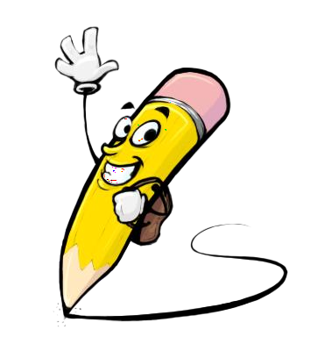
PROJECT OVERVIEW
The project aims to develop an automated image colorization system leveraging Generative Adversarial Networks (GANs) to enrich grayscale images with vibrant and realistic colors. Traditional colorization methods often require manual intervention and may produce inaccurate results. Thus, the project seeks to address this limitation by training a GAN model capable of learning meaningful color representations from a dataset of grayscale images and generating high-quality colorized versions. The project begins with dataset collection and preprocessing, followed by the design and implementation of the GAN model architecture. The training process involves fine-tuning the model parameters and monitoring its progress to ensure optimal performance. Upon successful training, the GAN model is integrated into the colorization system, which applies learned color representations to grayscale images. Evaluation metrics such as Structural Similarity Index (SSIM) and Peak Signal-to-Noise Ratio (PSNR) are used to assess the quality of colorized images.
3/21/2024 Annual Review

Slide 6

WHO ARE THE END USERS?
Photographers and Graphic Designers
Media and Entertainment Industry
Archivists and Historians
Medical Professionals
Marketing and Advertising Agencies
Educators and Researchers
General Public
3/21/2024 Annual Review

Slide 7

YOUR SOLUTION AND ITS VALUE PROPOSITION
our image colorization solution using GAN model combines cutting-edge technology with user-centric design to offer a seamless, efficient, and versatile tool for automating the colorization process and unlocking new creative possibilities. Whether used for historical preservation, artistic expression, or personal enjoyment, our solution empowers users to breathe new life into grayscale images with vibrant colors.
3/21/2024 Annual Review

Slide 8

THE WOW IN YOUR SOLUTION
The "wow" factor in our solution for image colorization using GAN (Generative Adversarial Network) model lies in its ability to seamlessly blend advanced technology with practical utility, resulting in a transformative and captivating user experience.
3/21/2024 Annual Review
8

Slide 9
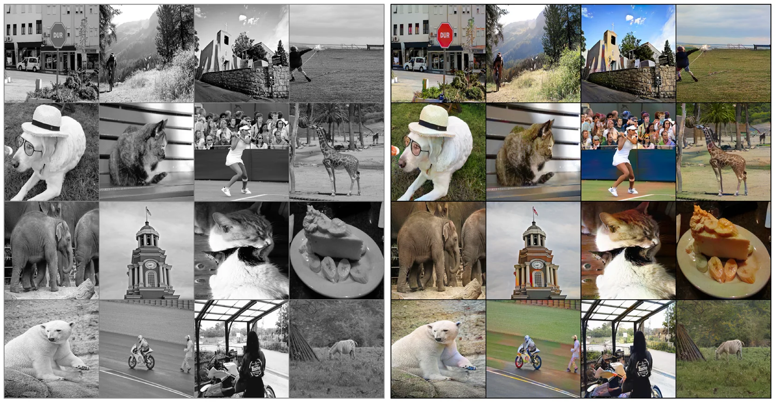
RESULTS
Demo Link
3/21/2024 Annual Review
9

