Slide 1
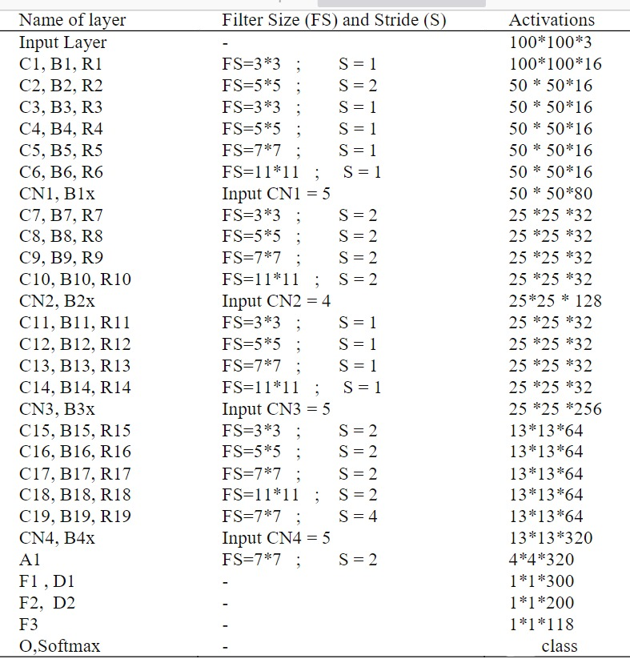
Architecture used in the Paper

Slide 2
Dataset details
A dataset of fruits:
Consists of 240 images in train folder and 60 images in test folder.
It has 4 labels:
Apple
Banana
Orange
Mixed
Link: https://www.kaggle.com/datasets/mbkinaci/fruit-images-for-object-detection

Slide 3
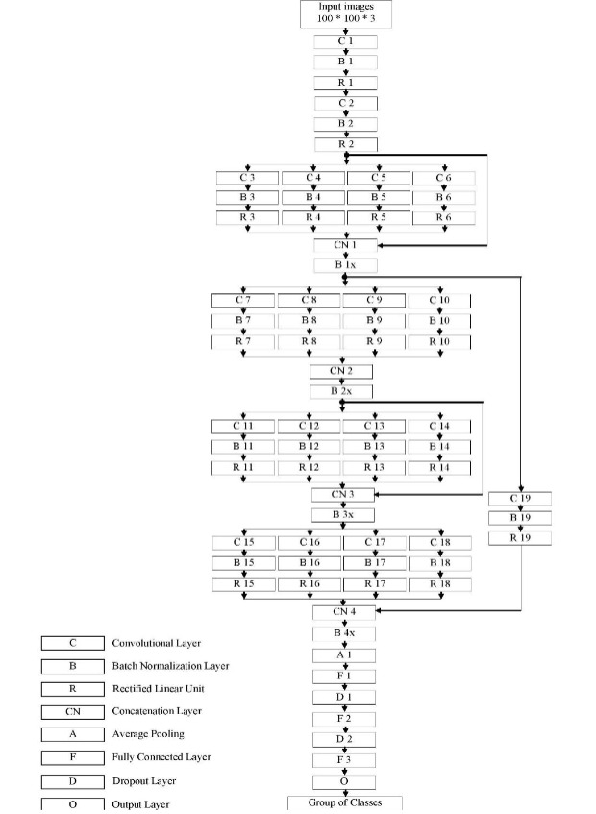
Implementation details
The ratio used for training, validation, and testing :
(0.7,0.1,0.2)
The number of images in each(216,24,60)
hyperparameters used in this model:
Number of epochs:15
Batch size:16

Slide 4
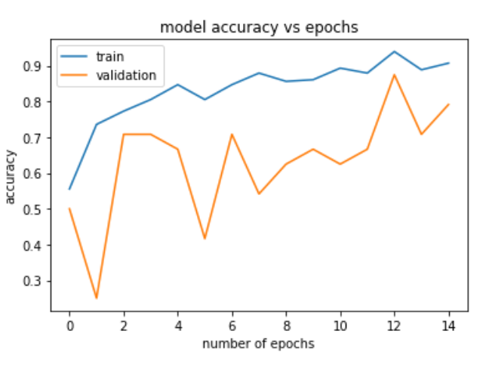
Results and visualizations
The measure is used in evaluation is accuracy :
The Accuracy on test data is :80%

