Slide 1


CHATBOT

Slide 2
OPEN AI MODEL- GPT-3.5
GPT-3.5 models can understand and generate natural language or code.
Within the GPT-3.5 family, we have used text-davinci.
Can do any language task with better quality, longer output, and consistent instruction.
optimized for chat using the Chat completions API.

Slide 3
Llama-index (0.8.43)
LlamaIndex (formerly GPT Index) is a data framework for LLM applications to ingest, structure, and access private or domain-specific data.
Widely available models come pre-trained on huge amounts of publicly available data, from Wikipedia and mailing lists to textbooks and source code.
Applications built on top of LLMs often require augmenting these models with private or domain-specific data. Unfortunately, that data can be distributed across siloed applications and data stores.

Slide 4
LLAMAINDEX
LlamaIndex is a data framework designed to support the development of applications utilizing LLMs (Large Language Models).
It has tools that help you connect and bring in data from different sources like PDFs (our use case).
With a smart interface to search and retrieve your data, we give a prompt to an LLM, and LlamaIndex will give us the related information and improved results with custom knowledge.

Slide 5
STEPS
Load Document
Divide the document into chunks
Index construction
Query

Slide 6
LOADING THE DOCUMENT
The first step is to load the document for performing question-answering using LlamaIndex.
To do this, we can use the “SimpleDirectoryReader” function provided by LlamaIndex.

Slide 7
DIVIDE THE DOCUMENT IN CHUNKS
In this step, we will divide the data into chunks to overcome the token limit imposed by LLM models.
This step is crucial for effectively managing the data by indexing it.

Slide 8
INDEX CONSTRUCTION
LlamaIndex utilizes the LLM model to generate vectors for the database.
These vectors are then stored as the index on the disk, enabling their later use.
We will utilize the GPTVectorStoreIndex to convert the data chunks into an index.
GPTVectorStoreIndex will call the LLM model to create embeddings for the chunks and generate the index.

Slide 9
QUERY
After indexing, we can proceed to query the document index.
First, the query engine creates a vector representation of the input question that we provided.
Then, it matches this vector with the vectors of the indexed data chunks stored in the index, identifying the most relevant chunks based on our question.
Next, the selected chunk along with our question is passed to the LLM model for answer generation.
Additionally, we can customize our query engine according to our specific needs.
We can modify the parameter values of the LLM model, such as temperature, a to influence the output.

Slide 10
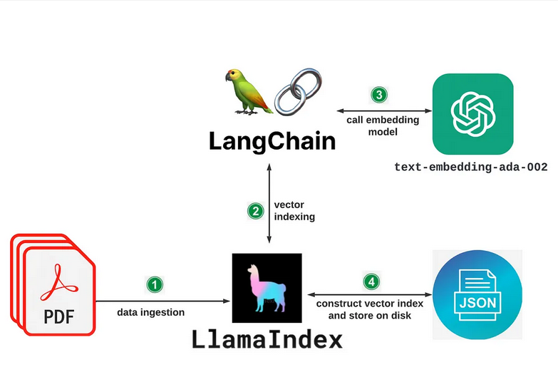
DATA INDEXING

Slide 11
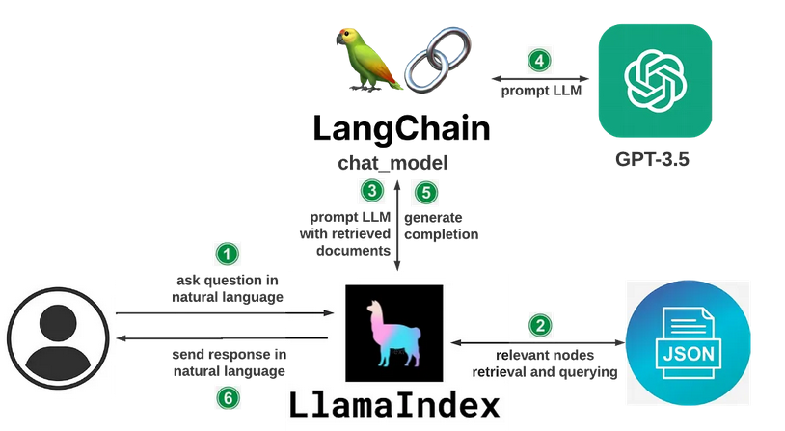
DATA QUERYING

Slide 12
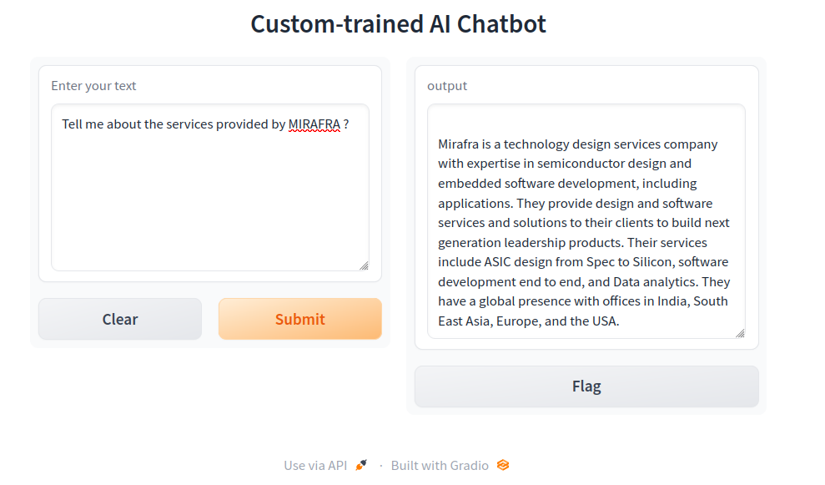
RESULT

