Slide 1
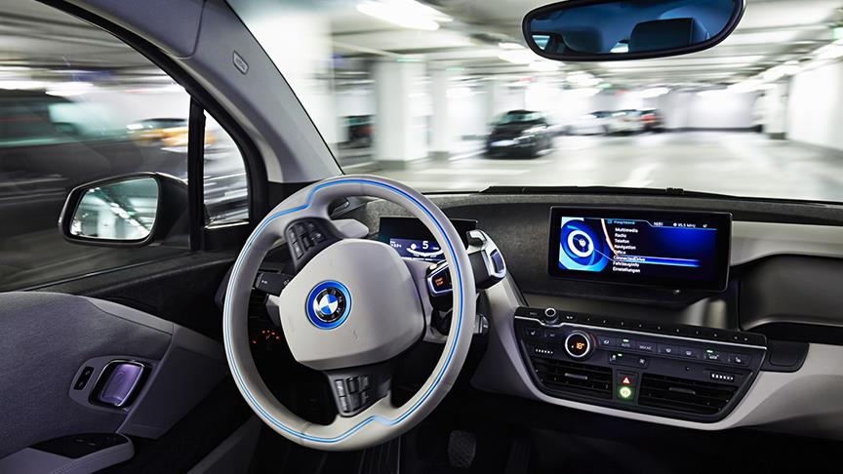
Self-starting Safety Check Procedure of Autonomous Car Using Sensor Technology
Supervised by
Dr. Mohamed El-Sharkawy
Professor
Dept. of ECE, IUPUI
Date : 28 March, 2018
Presented by
Md Saiful Islam
Raj Jatin Shah
Abir Saha

Slide 2
Outlines of Presentation
Literature Review
Project Overview
System Implementation
System Functioning
Result evaluation
Challenges Faced
Conclusion & Future scopes
Motivation & References
Q/A session

Slide 3
Literature Review
According to research by AAA Foundation for Traffic Safety (2016-2017), 87% (or more) of drivers do not take driving seriously.
Unsafe behaviors: driving while drunk, distracted, impaired, drowsy, speeding, running red lights or not wearing a seat belt.
One of the solutions: vehicle immobilization using technology that locks the ignition or prevents ANY person from operating the vehicle.
Alcohol sensors are incorporated into driver’s seat to detect the presence of alcohol in the air inside vehicle.
In the event of a crash, safety belts reduce the risk of fatal injury by 45% by Luxembourg based company, IEE.

Slide 4
Project Overview
Getting data about the driver’s seat-belt and alcohol drunk conditions through sensors.
Implementation of code using NXP S32 Design Studio to perform motor controlling i.e. turning car ON provided the required condition is satisfied.

Slide 5
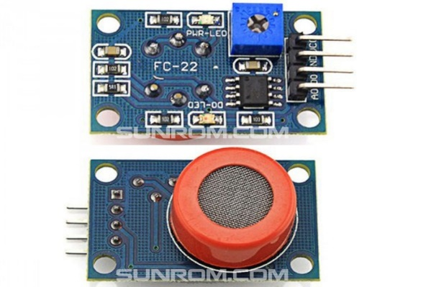
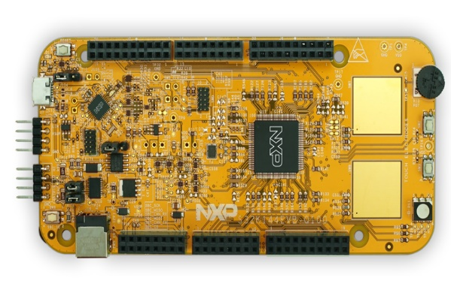
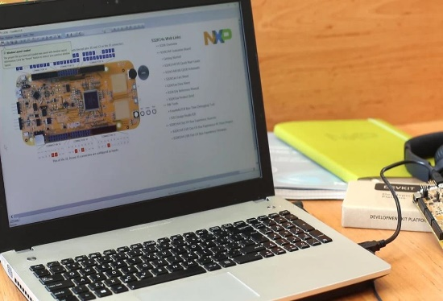
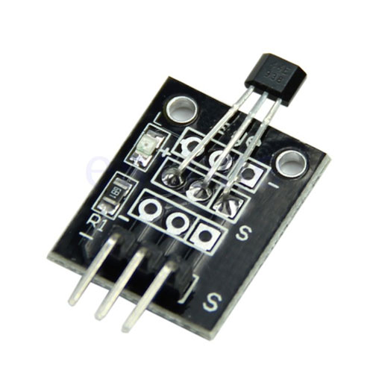
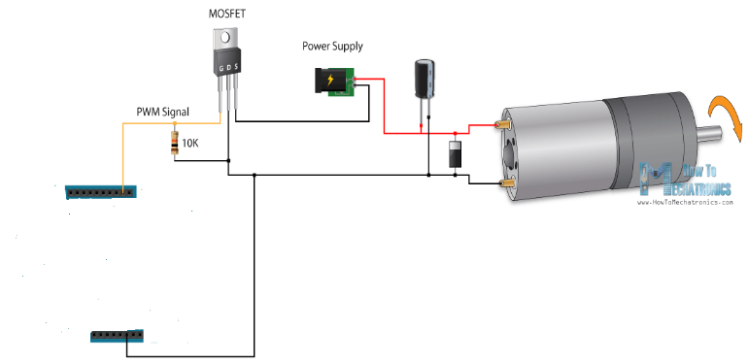
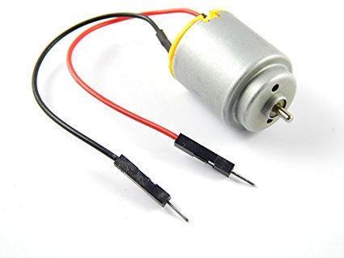
Project Overview

Slide 6
System Implementation
Electrical Assembly:
NXP S32K144EVB Evaluation Board
MQ-3 Alcohol Gas Sensor Module
Hall Effect KY-003 Magnetic Sensor Module
3V~6V DC Motor
BJT - BC547B
Diode – 1N4007
Laptop and Cables
Software development tools:
S32 Design Studio for ARM v.1.3

Slide 7
System Implementation
Alcohol Gas Sensor Module
NXP S32K144 EVB
S32 DS
Hall Effect Sensor Module
Motor Control
Circuit
Motor

Slide 8
System Functioning
Sensor Unit:
MQ-3 Alcohol sensor uses SnO2 to detect alcohol gas concentration.
It takes breathing of driver as input and accordingly gives output voltage.
Hall Effect Magnetic sensor goes to on state when the magnetic flux passing through the Hall sensor exceeds a pre-set value.
Microprocessor Unit:
Take sensor data & logical instructions from S32 DS as input
Depending on input S32K144 Microcontroller gives output command to turn on/off motor.

Slide 9
System Functioning
Motor control Unit:
Switching the motor based on the output from S32k144 output pin
Darlington pair circuit with two N-P-N BJT
Diode for reverse current protection
Motor Unit:
Motor control circuit and S32k144 EVB for running
DC motor running @ (3-6) V and (1000-2000) rpm

Slide 10
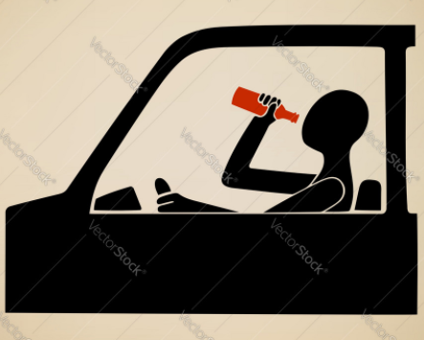

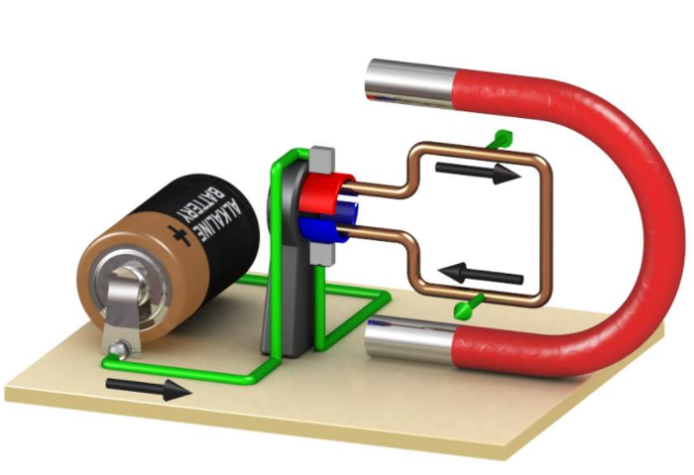

Result Evaluation
Case 1a :
Case 1b :

Slide 11
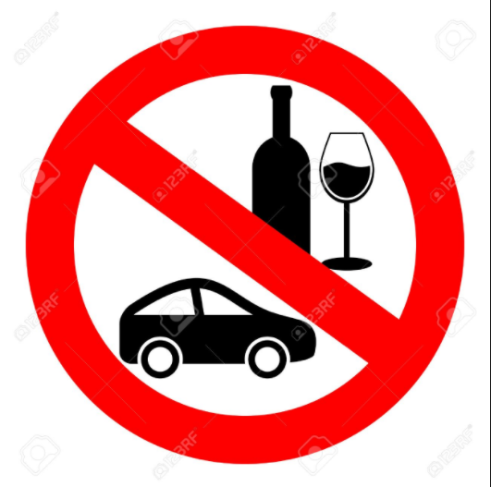
Result Evaluation
Case 2a :
Case 2b :

Slide 12
Challenges Faced
Interfacing Sensors with S32k144 EVB.
Sensitivity of sensors.
Register level coding for S32k144 using Embedded C.

Slide 13
Conclusion & Future scopes
Main idea: Design a working prototype of self starting safety system required to make an automotive system autonomous.
Lots of scopes of improvements for self starting autonomous car:
Add more safety sensors ( tire pressure, fuel level, AC, Heater, wiper, doors lock).
Communication with driver through infotainment system for travelling (google maps).
Speed Control through motor control.

Slide 14
Motivation & References
https://www.alcoholproblemsandsolutions.org/drinking-and-driving/
https://www.nissan-global.com/EN/TECHNOLOGY/OVERVIEW/dpcc.html
https://www.youtube.com/watch?v=yykyT4YRw4A
https://www.youtube.com/watch?v=BgEp4NbusrQ
https://www.youtube.com/watch?v=9BFdGtvo9JE
https://www.youtube.com/watch?v=jqwqY_1xkAc
https://community.nxp.com/
NXP S32K14x Reference Manual
ECE595-Autonomous Embedded System Lab Manual

Slide 15
Q/A session
Thanks for your patience.

