Slide 1
CSE7101- Capstone Project Review-3
Fake Social Media Profile Detection And Reporting
Batch Number: CCS_23
Under the Supervision of,
Guide – MS. Sterlin Minish T N (Assistant Professor)
School of Computer Science and Engineering
Presidency University
( Cyber Security )
Name of the Program:
Name of the HoD: Dr. Anandaraj S.P
Name of the Program Project Coordinator: Dr. Sharmasth Vali
Name of the School Project Coordinators: Dr. Sampath A K , Dr. Geetha A
Roll Number | Student Name
20221CCS0012 | Siddharth
20221CCS0036 | Chinmay
20231CCS3004 | Syed Saifulla H

Slide 2
Problem Statement Number:
public services, sustainability, or governance.
Organization: Category : Software Problem Description
The overarching problem this project intends to address is the absence of available and usable tools that allow for the user-reported, timely reporting and preliminary detection of fake social media profiles. While there are internal processes on respective platforms, there is often a dearth of feedback and transparency in the user's process to report an account, and without some type of preliminary evidence, the user may not feel inclined to report. The goal is to build a user-centric web-based platform that: (a) provides a centralized, simple, usable portal for submitting profiles for analysis; (b) uses a transparent, rule-based set of checks to automate an initial assessment based on empirical research; (c) keeps a secure ledger of all reports made by users; and (d) provides a dashboard for administrators to view, validate, and act on user reports. The platform will serve to enhance the user intuition with data-driven validation and subsequent administrative workflow.

Slide 3
Content
Algorithm Details
Source Code Details (50%)
50% Implementation with Live Demo
50% Report Softcopy Submission-Draft (Abstract, Literature Review, System Design. Architecture, Algorithm Details Module Description)

Slide 4
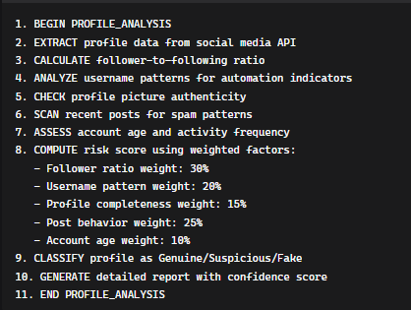
Algorithms Used
Process:
Algorithm 1: Profile Analysis Engine Input:
Social media profile URL
Platform type (Instagram, Facebook, Twitter, TikTok)
Profile metadata (username, bio, profile picture)
Social metrics (followers count, following count, post count)
Recent post content and engagement data
Output:
Risk score (0-100%), Classification result (Genuine/Suspicious/Fake), Detailed breakdown of detected indicators, Confidence level, Timestamp of analysis.

Slide 5
Algorithms Used
Algorithm 2: Rule-Based Detection Engine
Input:
Profile data object containing all extracted information
Predefined rule thresholds and patterns
Historical data for comparison
Process:
Output:
List of triggered rules
Individual rule scores
Composite risk assessment
Recommendation for manual review if needed

Slide 6
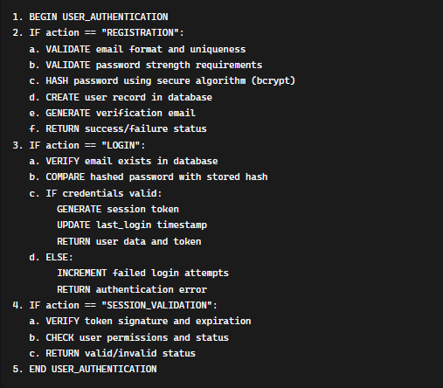
Algorithms Used
Algorithm 3: User Authentication System
Input:
User credentials (email, password)
Registration data (for new users)
Session tokens (for returning users)
Process:
Output:
Authentication status (success/failure)
User session data
Error messages (if applicable)
Security tokens for continued access

Slide 7
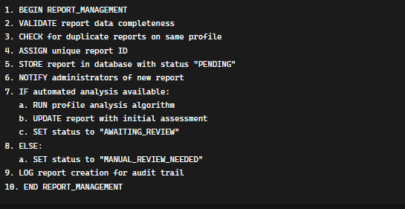
Algorithms Used
Algorithm 4: Report Management System
Input:
User ID and report details
Reported profile information
Evidence and context provided by user
Timestamp and platform information
Output:
Report ID and tracking information
Initial assessment results
Status update
Notification to relevant parties
Process:

Slide 8
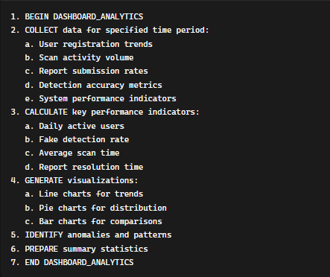
Algorithms Used
Algorithm 5: Administrative Dashboard Analytics
Input:
Time range parameters
User activity data
Report statistics
System performance metrics
Output:
Statistical summaries
Data visualizations
Performance metrics
Trend analysis reports
Process:

Slide 9
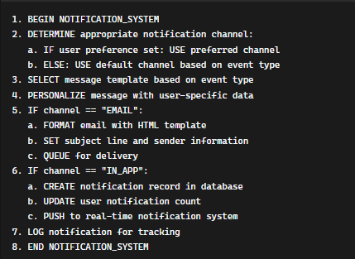
Algorithms Used
Process:
Algorithm 6: Notification System
Input:
Event type (report status change, new scan result, etc.)
Recipient information
Message template and variables
Priority level
Output:
Notification delivery status
User acknowledgment (if required)
Delivery timestamp
Error reports (if delivery fails)

Slide 10
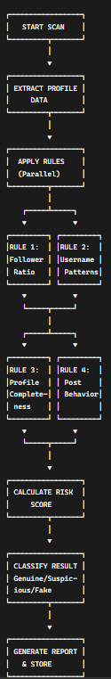
Visual Representation: Rule-Based Detection Flowchart

Slide 11
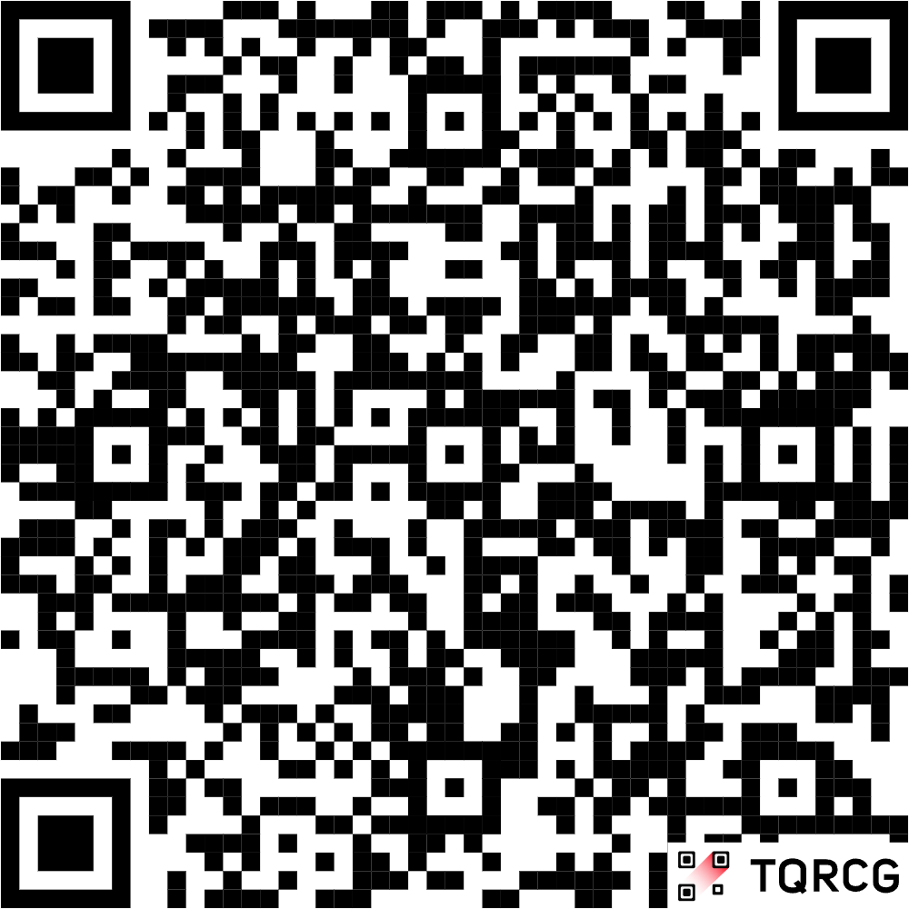
Github Link
The Github link provided should have public access permission.
Github Link
https://github.com/saif8888888888888/Fake-Profile-Detection-By-Saif

Slide 12
References (Development)
Django Software Foundation. (2023). Django Documentation. [Online]. Available: https://www.djangoproject.com/
The PostgreSQL Global Development Group. (2023). PostgreSQL Documentation. [Online]. Available: https://www.postgresql.org/docs/
Python Software Foundation. (2023). Python Language Reference. [Online]. Available: https://docs.python.org/3/
Twitter, Inc. (2023). Twitter API v2 Documentation. [Online]. Available: https://developer.twitter.com/en/docs/twitter-api
Meta Platforms, Inc. (2023). Facebook Graph API Documentation. [Online]. Available: https://developers.facebook.com/docs/graph-api/
Mozilla Developer Network (MDN) contributors. (2023). HTML: HyperText Markup Language. [Online]. Available: https://developer.mozilla.org/en-US/docs/Web/HTML
Mozilla Developer Network (MDN) contributors. (2023). CSS: Cascading Style Sheets. [Online]. Available: https://developer.mozilla.org/en-US/docs/Web/CSS
Mozilla Developer Network (MDN) contributors. (2023). JavaScript. [Online]. Available: https://developer.mozilla.org/en-US/docs/Web/JavaScript

Slide 13
References (IEEE Paper format)
[1] S. Al-Qurishi, M. S. Hossain, et al., "Detecting Fake Accounts in Online Social Networks," IEEE Access, vol. 5, pp. 4761–4770, 2017.
[2] S. Cresci, R. D. Pietro, M. Petrocchi, A. Spognardi, and M. Tesconi, "Fake Followers Detection on Twitter: A Machine Learning Approach," in Proc. 10th Int. Conf. Social Media Society, 2015.
[3] J. Yang, F. Li, and S. W. Lee, "Understanding and Detecting Online Human-Bot Interactions," First Monday, vol. 21, no. 11, Nov. 2016.
[4] A. Ahmed, I. Ahmed, and M. A. Aziz, "Detection of Fake Facebook Accounts Using Machine Learning Approaches," Int. J. Adv. Comput. Sci. Appl. (IJACSA), vol. 8, no. 5, 2017.
[5] M. Egele, G. Stringhini, C. Kruegel, and G. Vigna, "Detecting Compromised Accounts on Social Networks," in Proc. 20th Annu. Netw. Distrib. Syst. Secur. Symp. (NDSS), 2013.
[6] S. Kumar and N. Shah, "False Information on Web and Social Media: A Survey," ACM Comput. Surv. (CSUR), vol. 51, no. 4, Article 83, 2018.
[7] K. Thomas, C. Grier, D. Song, and V. Paxson, "Suspended Accounts in Retrospect: An Analysis of Twitter Spam," in Proc. 2011 ACM SIGCOMM Conf. Internet Meas. Conf., 2011.
[8] A. Gupta, H. Lamba, and P. Kumaraguru, "$1.00 Per RT #BostonMarathon #PrayForBoston: Analyzing Fake Content on Twitter," in *2013 IEEE 2nd Int. Conf. Cyber-Enabled Distrib. Comput. Knowl. Discovery*, 2013.
[9] F. Benevenuto, G. Magno, T. Rodrigues, and V. Almeida, "Detecting Spammers on Twitter," in *Proc. 7th Annu. Collaboration, Electron. Messaging, Anti-Abuse Spam Conf. (CEAS)*, vol. 6, pp. 12–21, 2010.
[10] V. Varol, E. Ferrara, C. A. Davis, F. Menczer, and A. Flammini, "Online Human-Bot Interactions: Detection, Estimation, and Characterization," in Proc. Int. AAAI Conf. Web Soc. Media, vol. 11, no. 1, 2017.

Slide 14


