Slide 1
Session 7
Functions and Joins

Slide 2
Session Objectives
Apply system-defined data types
Understand user-defined data types
Use various SQL functions to query data
Identify and use various types of joins

Slide 3
Data Types
Data types define data values allowed in a variable, or in each column in a table
Two sets of data types include:
System-defined
User-defined

Slide 4
System-defined Data Types
Monetory
Date and Time
Binary
money
smallmoney
datetime
smalldatetime
Numeric
binary
varbinary
image
numeric
decimal
float
real
Text
char
nchar varchar
nvarchar
text
ntext
SQL Server 2000 Data Types
Integer
int
smallint
tinyint
bigint
bit
Other Data Types
timestamp
cursor
Uniqueidentifier (GUID)
table
sql_variant

Slide 5
User-defined Data Types
Created based on system-defined data types
Ensure that columns common in several tables have exactly the same data type, length, and nullability

Slide 6
Functions
Functions work on data, or groups of data, to return a required value.
The categories of functions are:
  aggregate
  conversion
  date
  mathematical
  string
  system
  text and image

Slide 7
Conversion Function
Transforms a value of one data type to another
Syntax
CONVERT(datatype[(length)], expression [,style]) >,….)
Example
SELECT ‘PNR number ’ + CONVERT(CHAR(4), pnr_no)
FROM reservation

Slide 8
Date Functions
Aid in manipulating date values
GETDATE
DATEADD
Date
Functions
DATEDIFF
DATENAME
DATEPART

Slide 9
Mathematical Functions
Perform algebraic operations on numeric values
POWER
ROUND
ABS
Mathematical
Functions
SIGN
CEILING
FLOOR
SQRT

Slide 10
String Functions
Perform operations on character strings, binary data, or expressions
+
ASCII
UPPER
REPLICATE
String
Functions
SUBSTRING
CHARINDEX
STUFF
LEN
RIGHT
LOWER
REVERSE
CHAR

Slide 11
System Functions
Provide information on SQL Server configuration settings
DB_ID
DB_NAME
USER_NAME
System
Functions
HOST_ID
USER_ID
HOST_NAME
SUSER_NAME
ISNULL
SUSER_SNAME
OBJECT_ID
SUSER_ID
OBJECT_NAME
SUSER_SID

Slide 12
Text and Image Functions
Provide commonly needed information about text and image data
Text and
Image
Functions
TEXTPTR
TEXTVALID

Slide 13
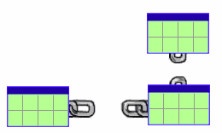
Joins
Joins are used to retrieve data from two or more tables, based on a logical relationship between the tables

Slide 14
Types of Joins
Inner
Outer
Cross

Slide 15
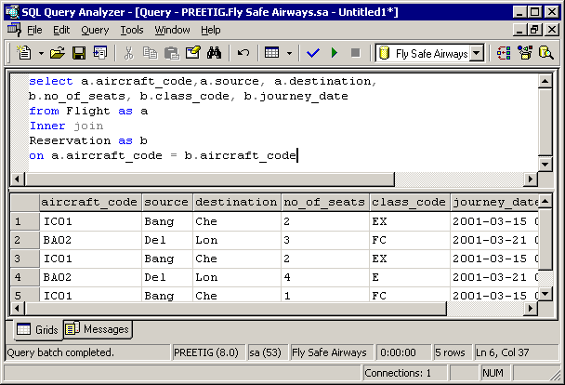
Inner Joins
Records from two tables are combined and added to a query’s result, only if the rows from both the tables match a common column

Slide 16
Outer Joins
Returns all rows from at least one of the tables mentioned in the FROM clause
Types of Outer Joins are:
  Left Outer Join
  Right Outer Join
  Full Outer Join

Slide 17
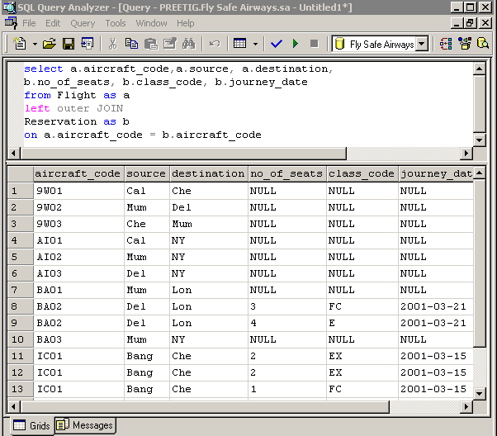
Left Outer Join
Returns all the records from the left table and only matching records from the right table
It shows NULL as there are no tickets booked for these flights.

Slide 18
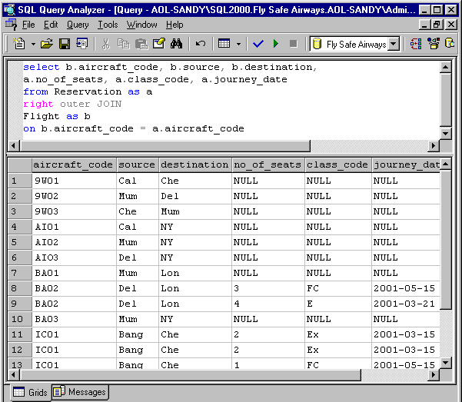
Right Outer Join
Returns all the records from the right table and only matching records from the left table

Slide 19
Full Outer Join
Lists all records from the joined tables
Does not check for a match between the records of the joined tables

Slide 20
Cross Join
Returns a result set that is a combination of all rows of the two joined tables
Number of rows returned is the product of the number of rows in the two tables

Slide 21
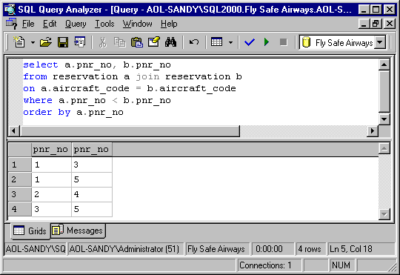
Self Join
Correlates rows of a table with other rows in the same table

