Slide 1


CSC383- Internet of Things Week7 Topic: Embedded Programing for Bluetooth Interfacing and Home Automation Semester- Fall 2020
Waqar Azeem Assistant Professor Department of Computer Science Lahore Garrison University

Slide 2
Overview of previous lecture
Knowledge of Ardinuno Programing.
Embedded Systems serial and parallel ports
I/O ports programing

Slide 3
Preamble
Things related to home automation can be controlled remotely and wirelessly

Slide 4
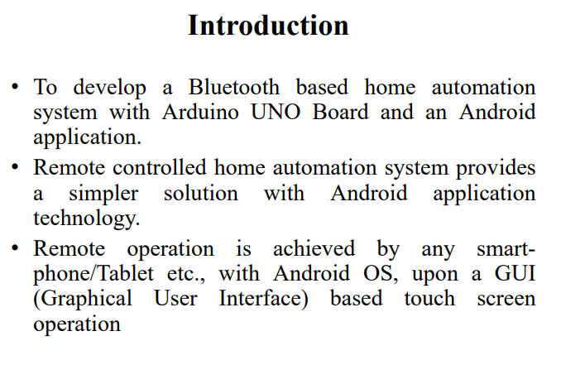

Slide 5
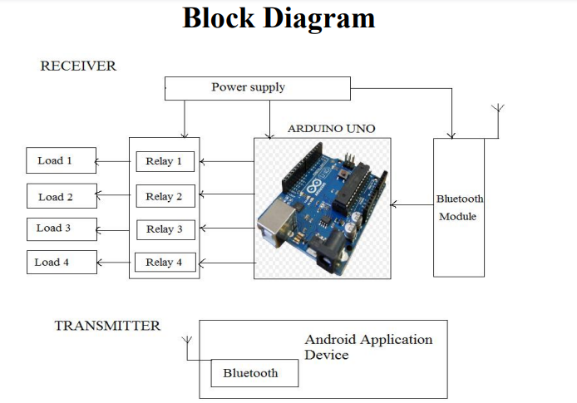

Slide 6
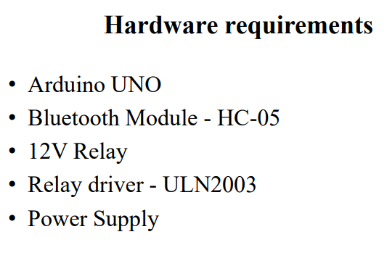

Slide 7
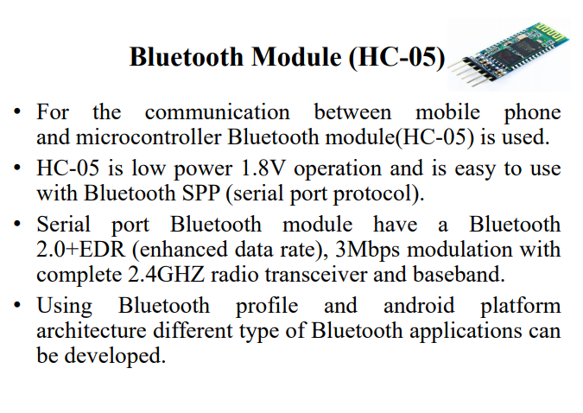

Slide 8
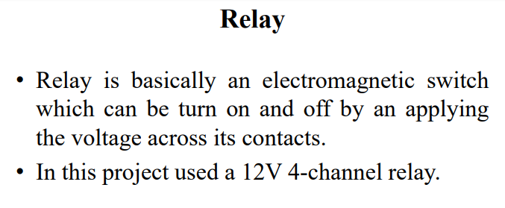

Slide 9
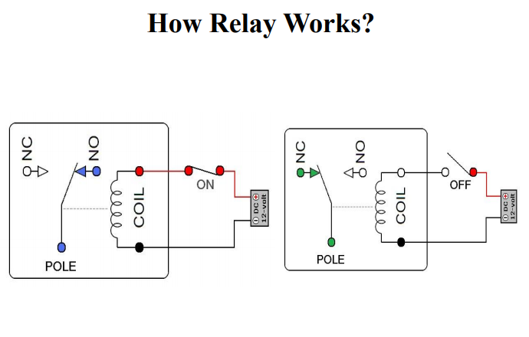

Slide 10
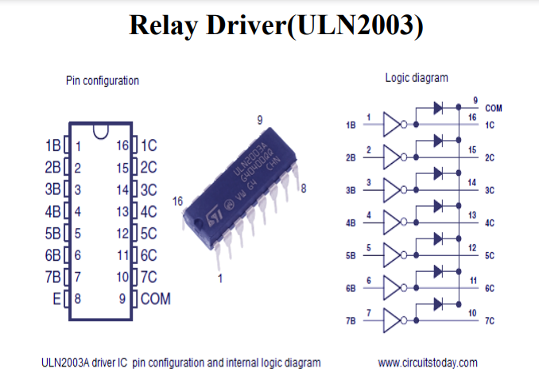

Slide 11
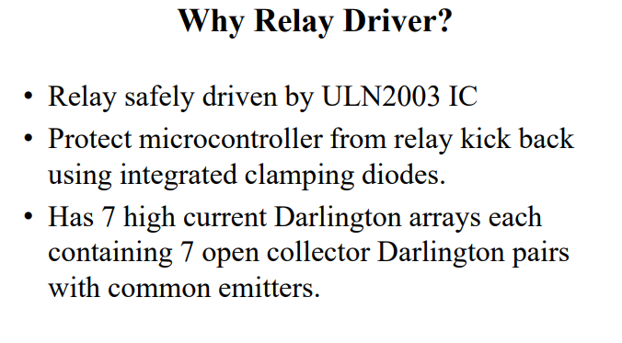

Slide 12
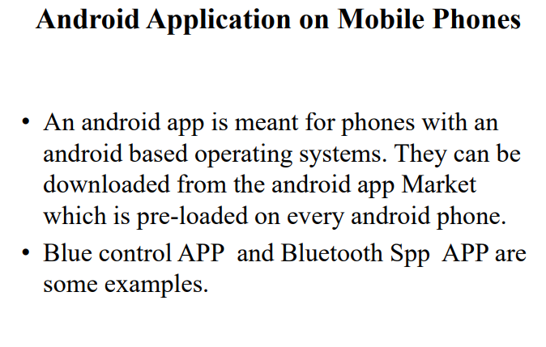

Slide 13
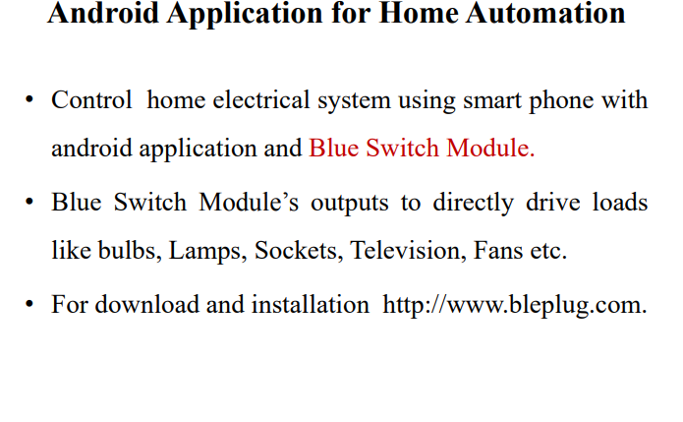

Slide 14
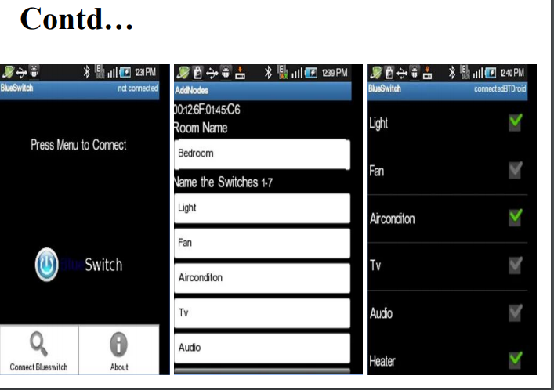

Slide 15
Lecture Outcomes
How Things can be can be controlled remotely and wirelessly

Slide 16
Q & A

Slide 17
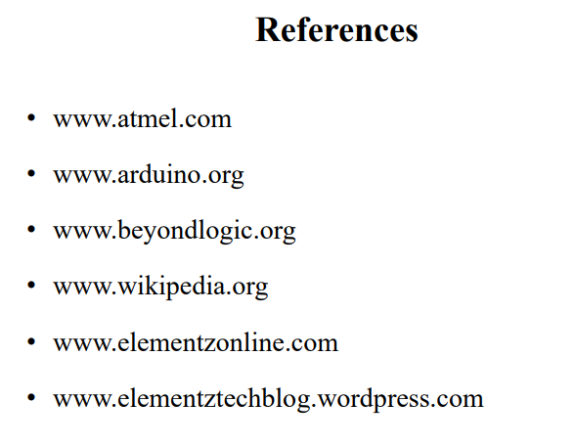
References
These lecture notes were made from following source:

