Slide 1
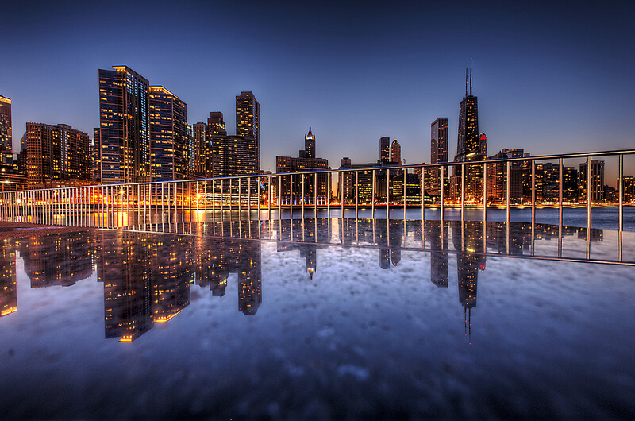


Develop a Deep Learning Algorithm to Generate Realistic Images of Buildings and Cityscapes
Team members:
1. Sahil Jaiswal – R214220993
2. Sagi Raju - R214220990
3. Sakand Panotra – R214220997
4. Md Saif Anjum Khan - R2142201666
5. Sagar Srivastava – R2142201390
Guided by: Sumit Shukla

Slide 2
OVERVIEW
Introduction
Data Collection
Data Preparation
Methodology
Model Summary
Requirements
Conclusion
Future Scope

Slide 3
INTRODUCTION
The generation of realistic images depicting buildings and cityscapes is a burgeoning research field with applications in urban planning, architecture, gaming, and virtual reality.
Traditional methods involve labor-intensive manual creation of lifelike representations.
The project's aim is to develop a deep-learning algorithm for generating realistic building and cityscape images.
Cutting-edge deep generative models like GANs will be leveraged to capture intricate patterns in urban environments and produce visually striking images.
Generative Adversarial Networks (GANs) are neural architectures renowned for their ability to create diverse, high-quality images.

Slide 4
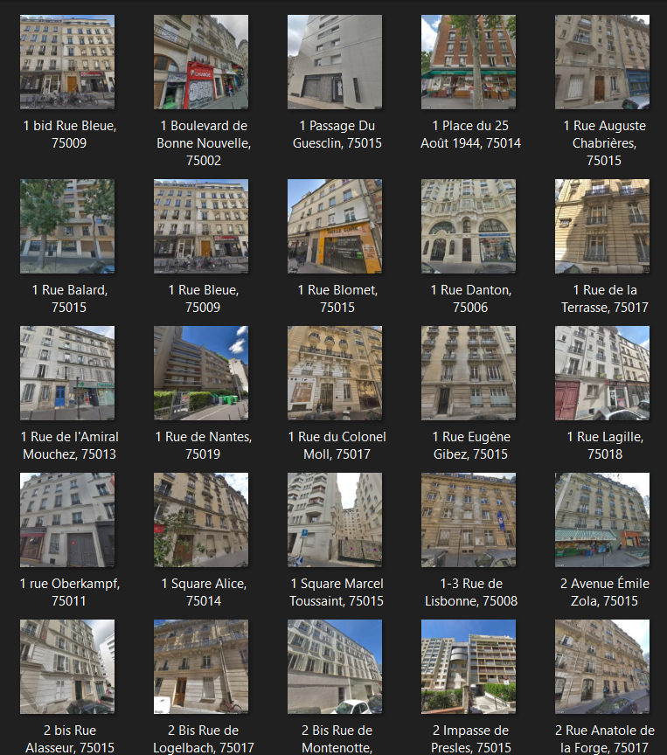
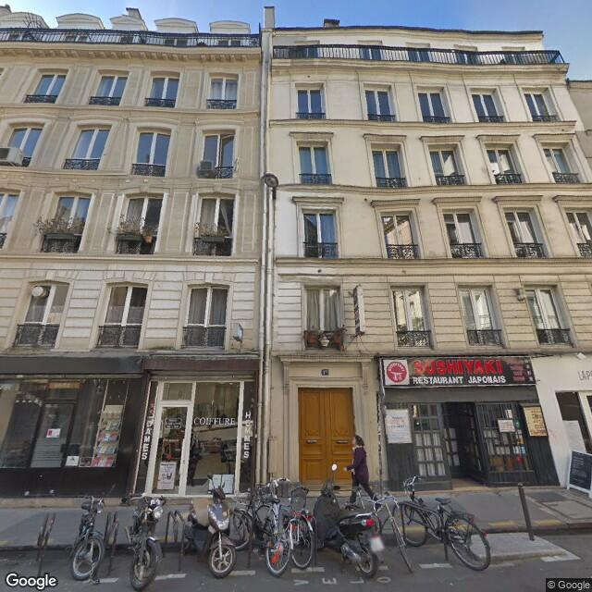
DATA COLLECTION
The dataset that is used to create the model consist of 1000 images of buildings from the streets of Paris. Originally, the size of the images was 640x640 pixels.

Slide 5

DATA PREPARATION
In order to use these images for our model, it was resized to 128x128 size with RGB format.
The dataset is stored in a folder named paris_image which has 1000 images and the size of the folder is 73.8 mb.
The dataset is loaded on Google drive and the called-on Google Colab by connecting Google Drive to Google Colab using the below snippet of code.

Slide 6
METHODOLOGY
Setup the architecture of generator and discriminator and prepare the dataset.
Start the training loop for a predefined number of epochs.
For each batch of real cityscape images, perform the following steps:
Sample random noise vectors from a noise distribution (e.g., Gaussian distribution).
Pass the noise vectors through the generator to produce generated (fake) cityscape images.
For each batch of generated cityscape images and real cityscape images, perform the following steps:
Train the discriminator:
Feed both real and generated cityscape images into the discriminator.
Calculate the discriminator's loss based on its ability to distinguish between real and generated images.
Backpropagate the loss and update the discriminator's weights.
Train the generator:
Feed the generated cityscape images into the discriminator again.
Calculate the generator's loss based on the discriminator's feedback (i.e., how well it fooled the discriminator).
Backpropagate the loss and update the generator's weights.
End the training loop after reaching the desired number of epochs or upon achieving satisfactory results.

Slide 7
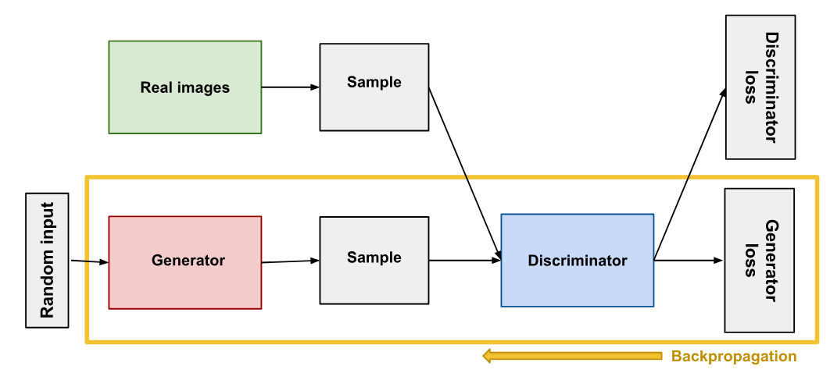
METHODOLOGY

Slide 8
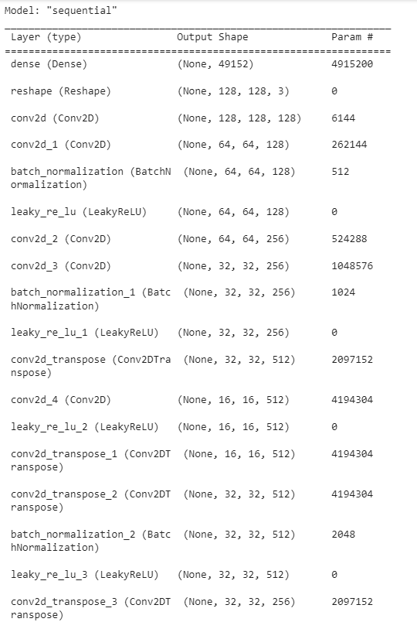
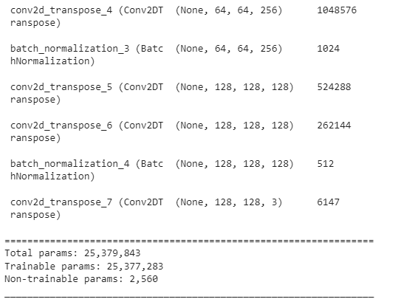
MODEL SUMMARY
Generator Summary

Slide 9
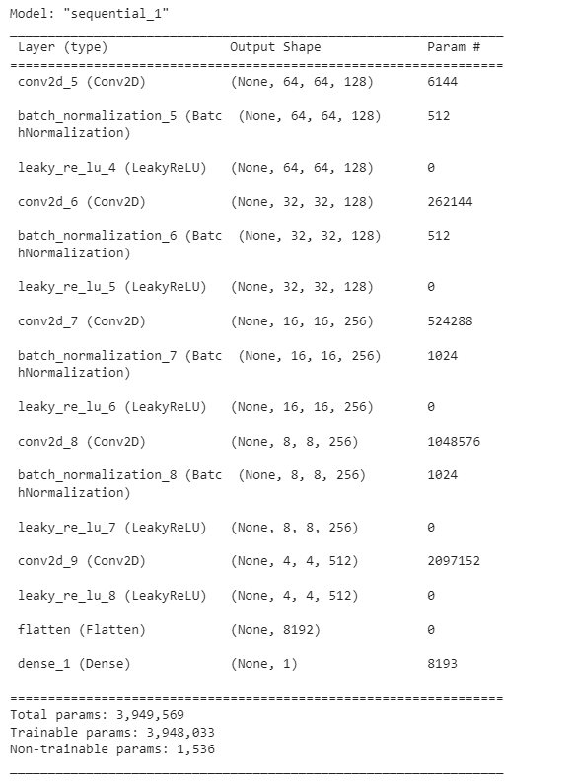
MODEL SUMMARY
Discriminator Summary

Slide 10
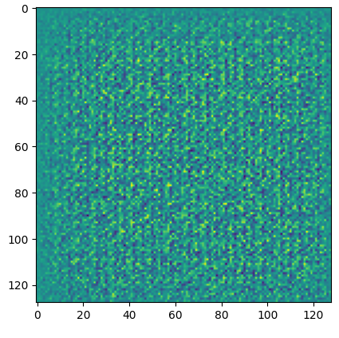
MODEL SUMMARY
Random Noise

Slide 11
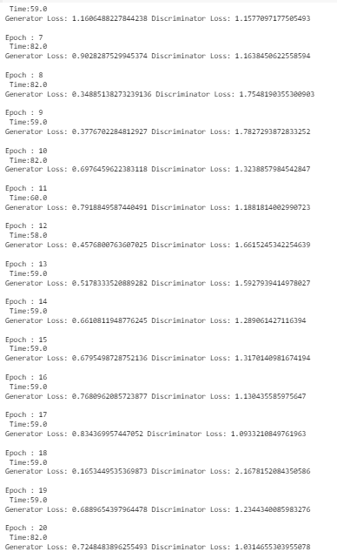
MODEL SUMMARY
Training the model

Slide 12
REQUIREMENTS
Software Requirements:-
Deep Learning Framework: TensorFlow or PyTorch
Image Processing Libraries: OpenCV
GAN (Generative Adversarial Network) Framework
Dataset: Large-scale dataset of buildings and cityscape images
Hardware Requirements:-
High-Performance GPU
Sufficient RAM
CPU: Multi-core processor

Slide 13
CONCLUSION
The development of a deep learning algorithm to generate realistic images of buildings and cityscapes is a multifaceted process that involves meticulous steps to ensure accuracy, diversity, and visual authenticity.
The project entails critical stages such as data preprocessing, where a dataset of street images is resized and normalized. The generator network is designed to transform latent noise vectors into plausible cityscape images, utilizing a U-Net-like structure for down-sampling and up-sampling operations. The discriminator network is responsible for distinguishing between real and generated images, contributing to adversarial training dynamics.
The training process involves iterative steps that refine both the generator and discriminator through gradient-based updates, fostering a competitive process that leads to the generation of more realistic images over time. Finally, after training for 20 Epochs, we got a loss of 1.031 Discriminator loss and 0.72 Generator Loss.

Slide 14
FUTURE SCOPE
Explore more advanced architectures such as Progressive Growing GANs (PGGANs) or StyleGANs, which can generate higher-resolution images with greater detail.
Extend the algorithm to support conditional generation, allowing users to input specific criteria such as architectural styles, urban contexts, and weather conditions to influence the generated images.
Investigate techniques to accelerate the image generation process to achieve real-time or interactive capabilities, enabling applications like virtual urban planning and architectural visualization.

Slide 15


