Slide 1
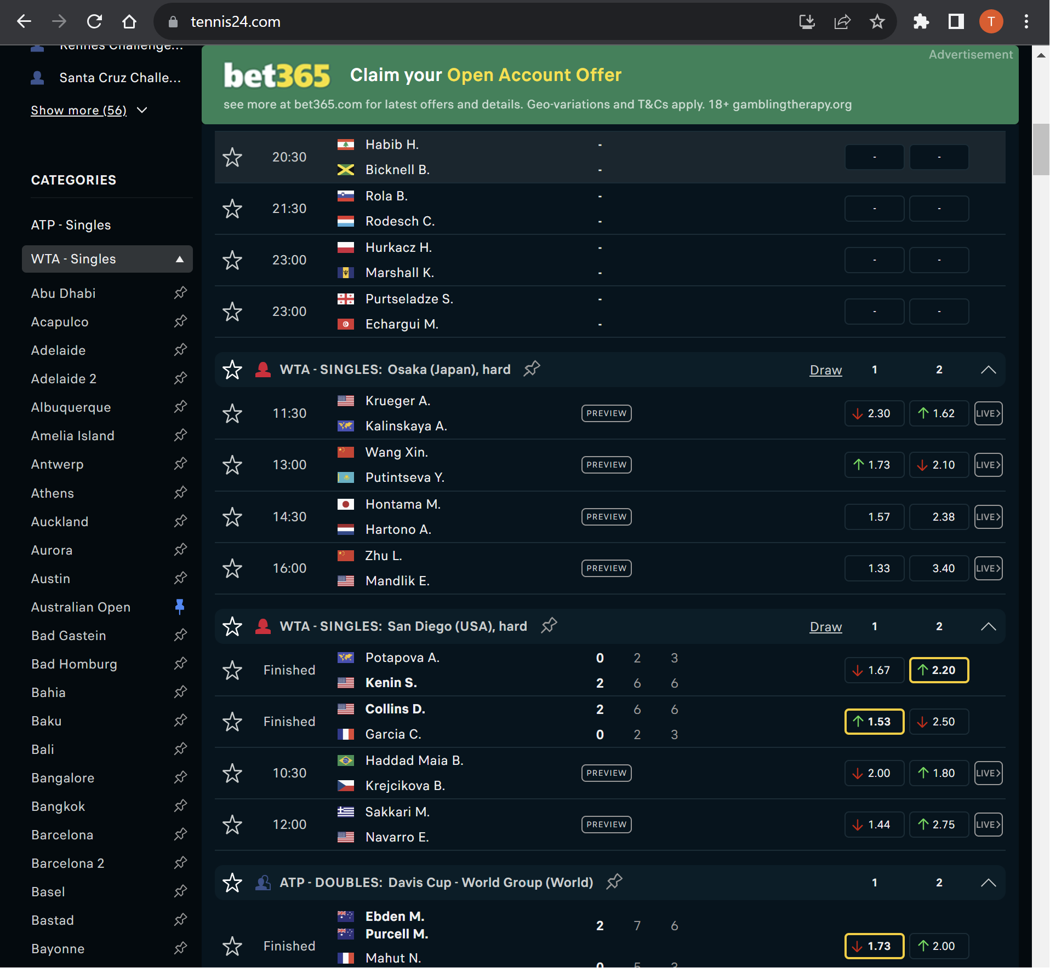
Loop through every tournament under “ATP – Singles” and “WTA – Singles”

Slide 2
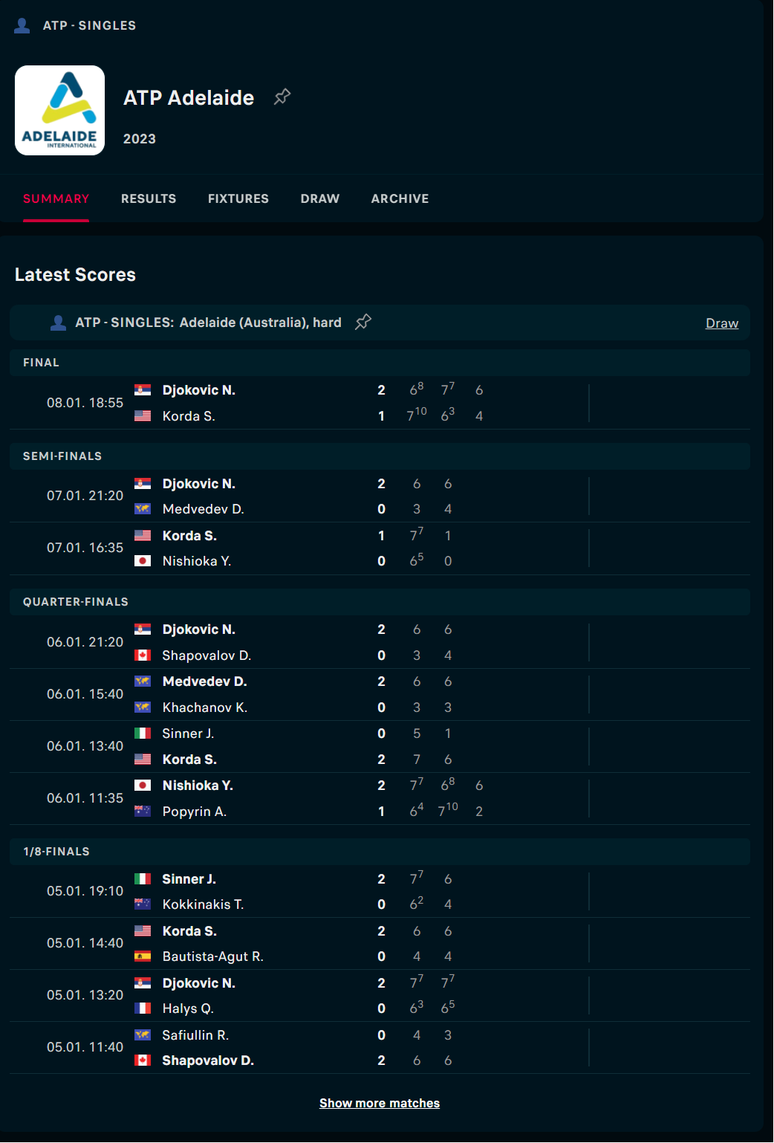
Loop through every match in each tournament
Don’t forget “Show more matches”

Slide 3
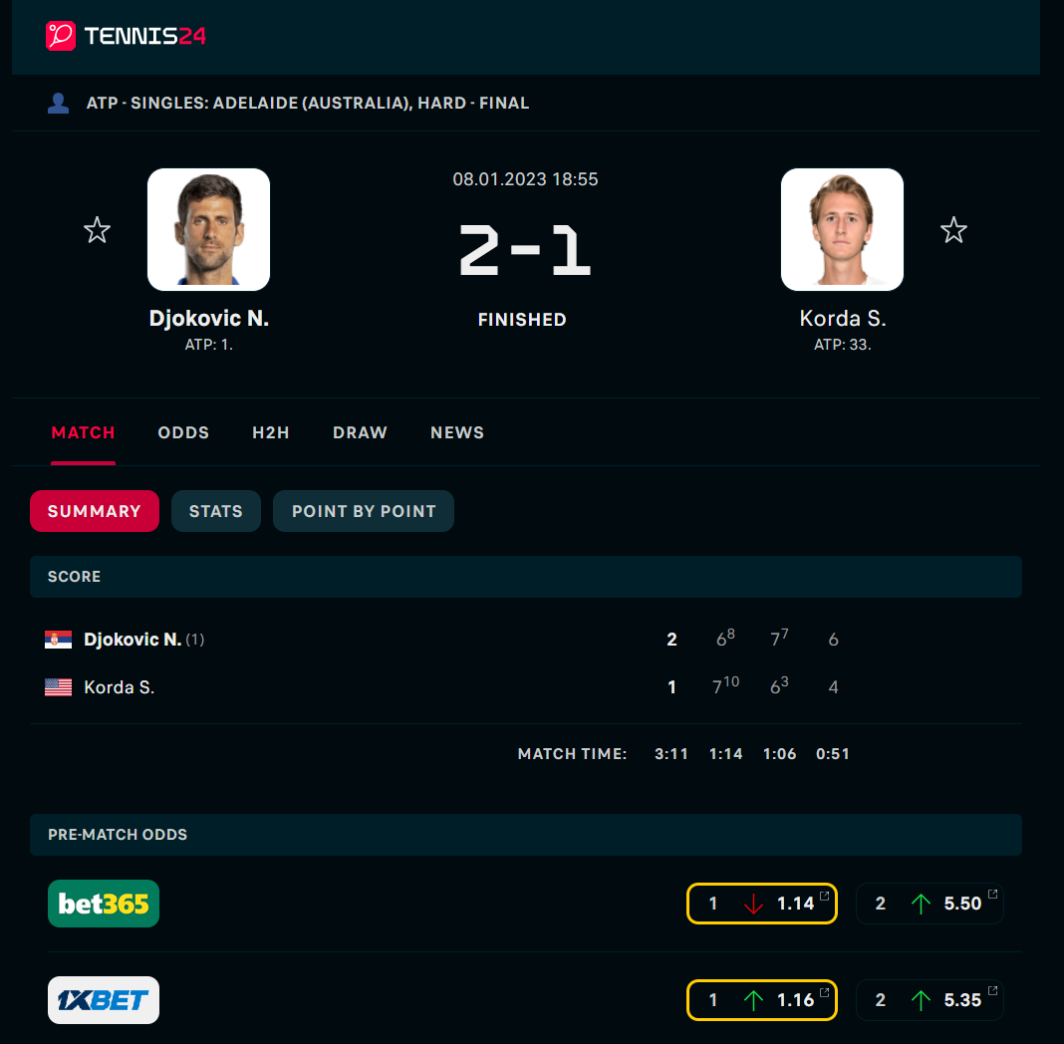
Tournament name (ATP: Singles: Adelaide (Australia))
Surface (Hard)
Tournament Stage (Final)
Tournament time (08.01.2023 18:55)
Player A (N. Djokovic)
Player B (S. Korda)
Player A Rank (1)
Player B Rank (33)
Player A set won (2)
Player B sets won (1)
Player A Set 1 Games won (6)
Player B Set 1 Games won (7)
Player A Set 2 Games won (7)
Player B Set 2 Games won (6)
Player A Set 3 Games won (6)
Player B Set 3 games won (4)
Bet365 Player A Odds (1.14)
Bet365 Player B Odds (5.50)

Slide 4
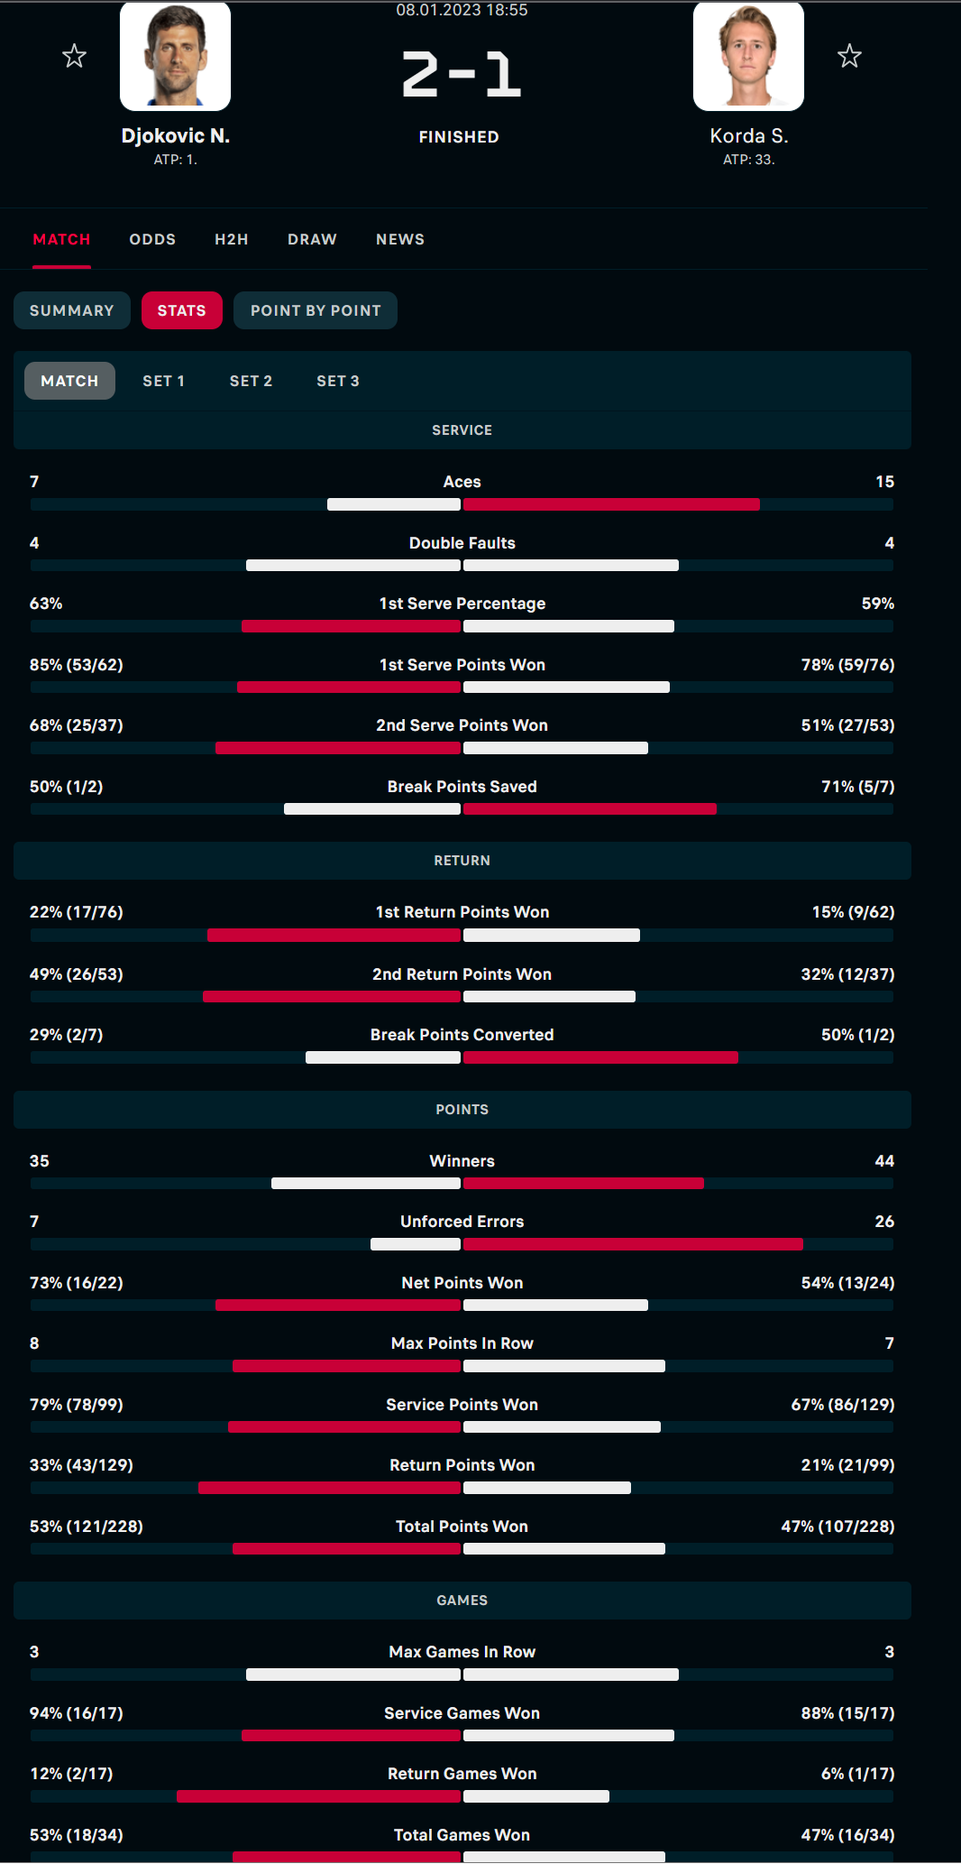
Loop through Match and each Set (Set 1, Set 2 etc)
Every field under stats

Slide 5
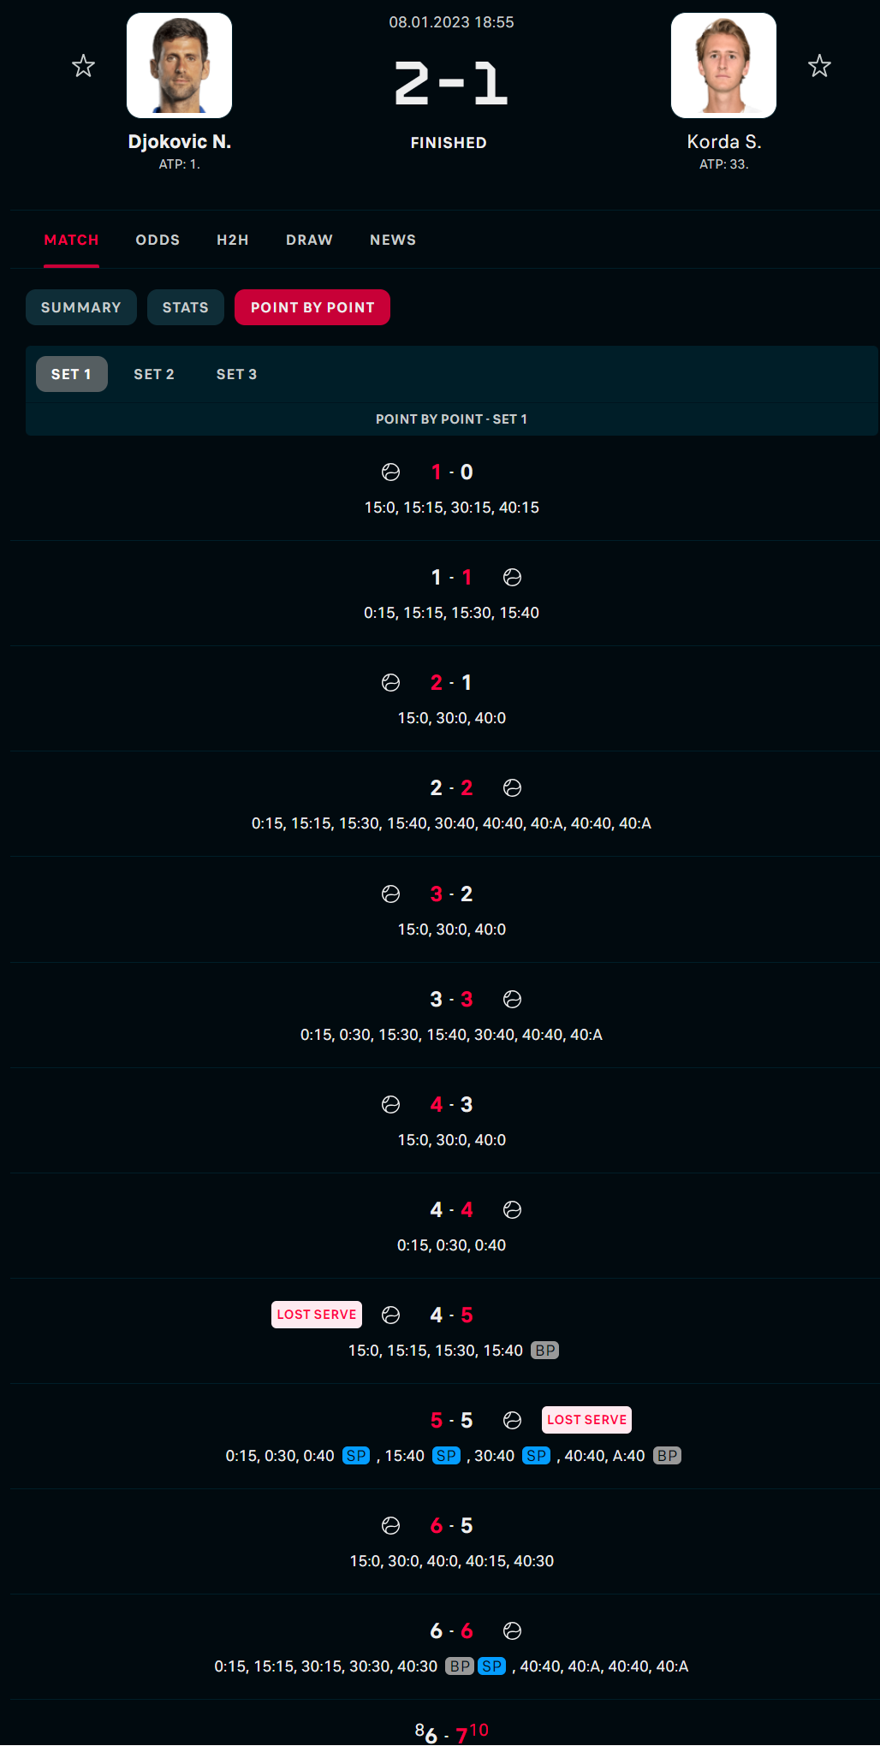
Summary outcome for each game in each set (sample below)
Set 1 Game 1 | Set 1 Game 2 | Set 1 Game 3 | Set 1 Game 4 | Set 1 Game 5 | Set 1 Game 6 | Set 1 Game 7 | Set 1 Game 8 | Set 1 Game 9 | Set 1 Game 10 | Set 1 Game 11 | Set 1 Game 12 | Set 1 Game 13
Player A held to 15 | Player B Held at 15 | Player A held to 0 | Player B held to deuce (2) | Player A held to 0 | Player B held to deuce (1) | Player A held to 0 | Player B held to 0 | Player A broken to 15 | Player B broken to deuce (1) | Player A held to 30 | Player B held to deuce (2) | Player A lost tiebreak to 10

Slide 6
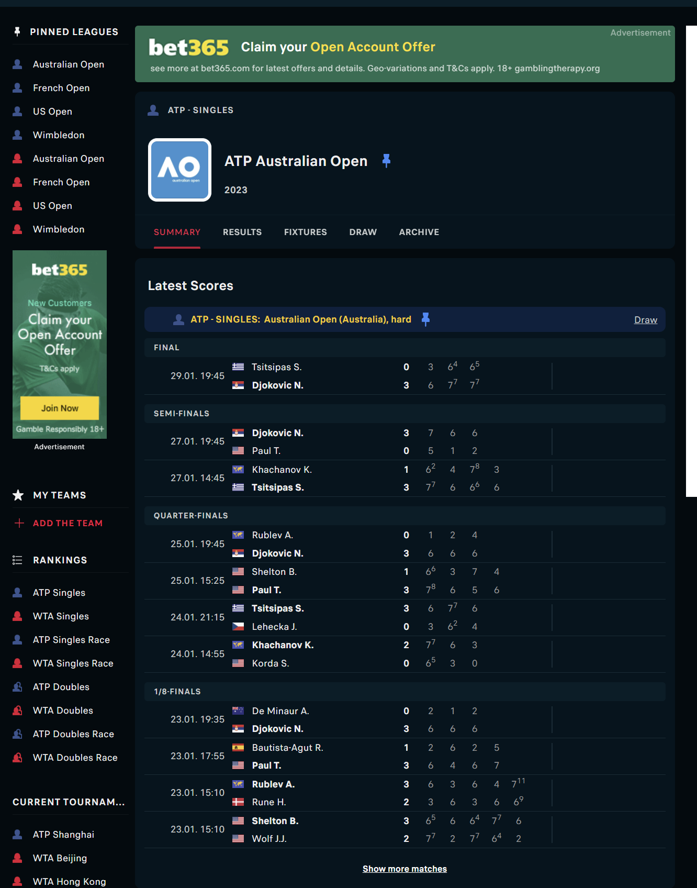
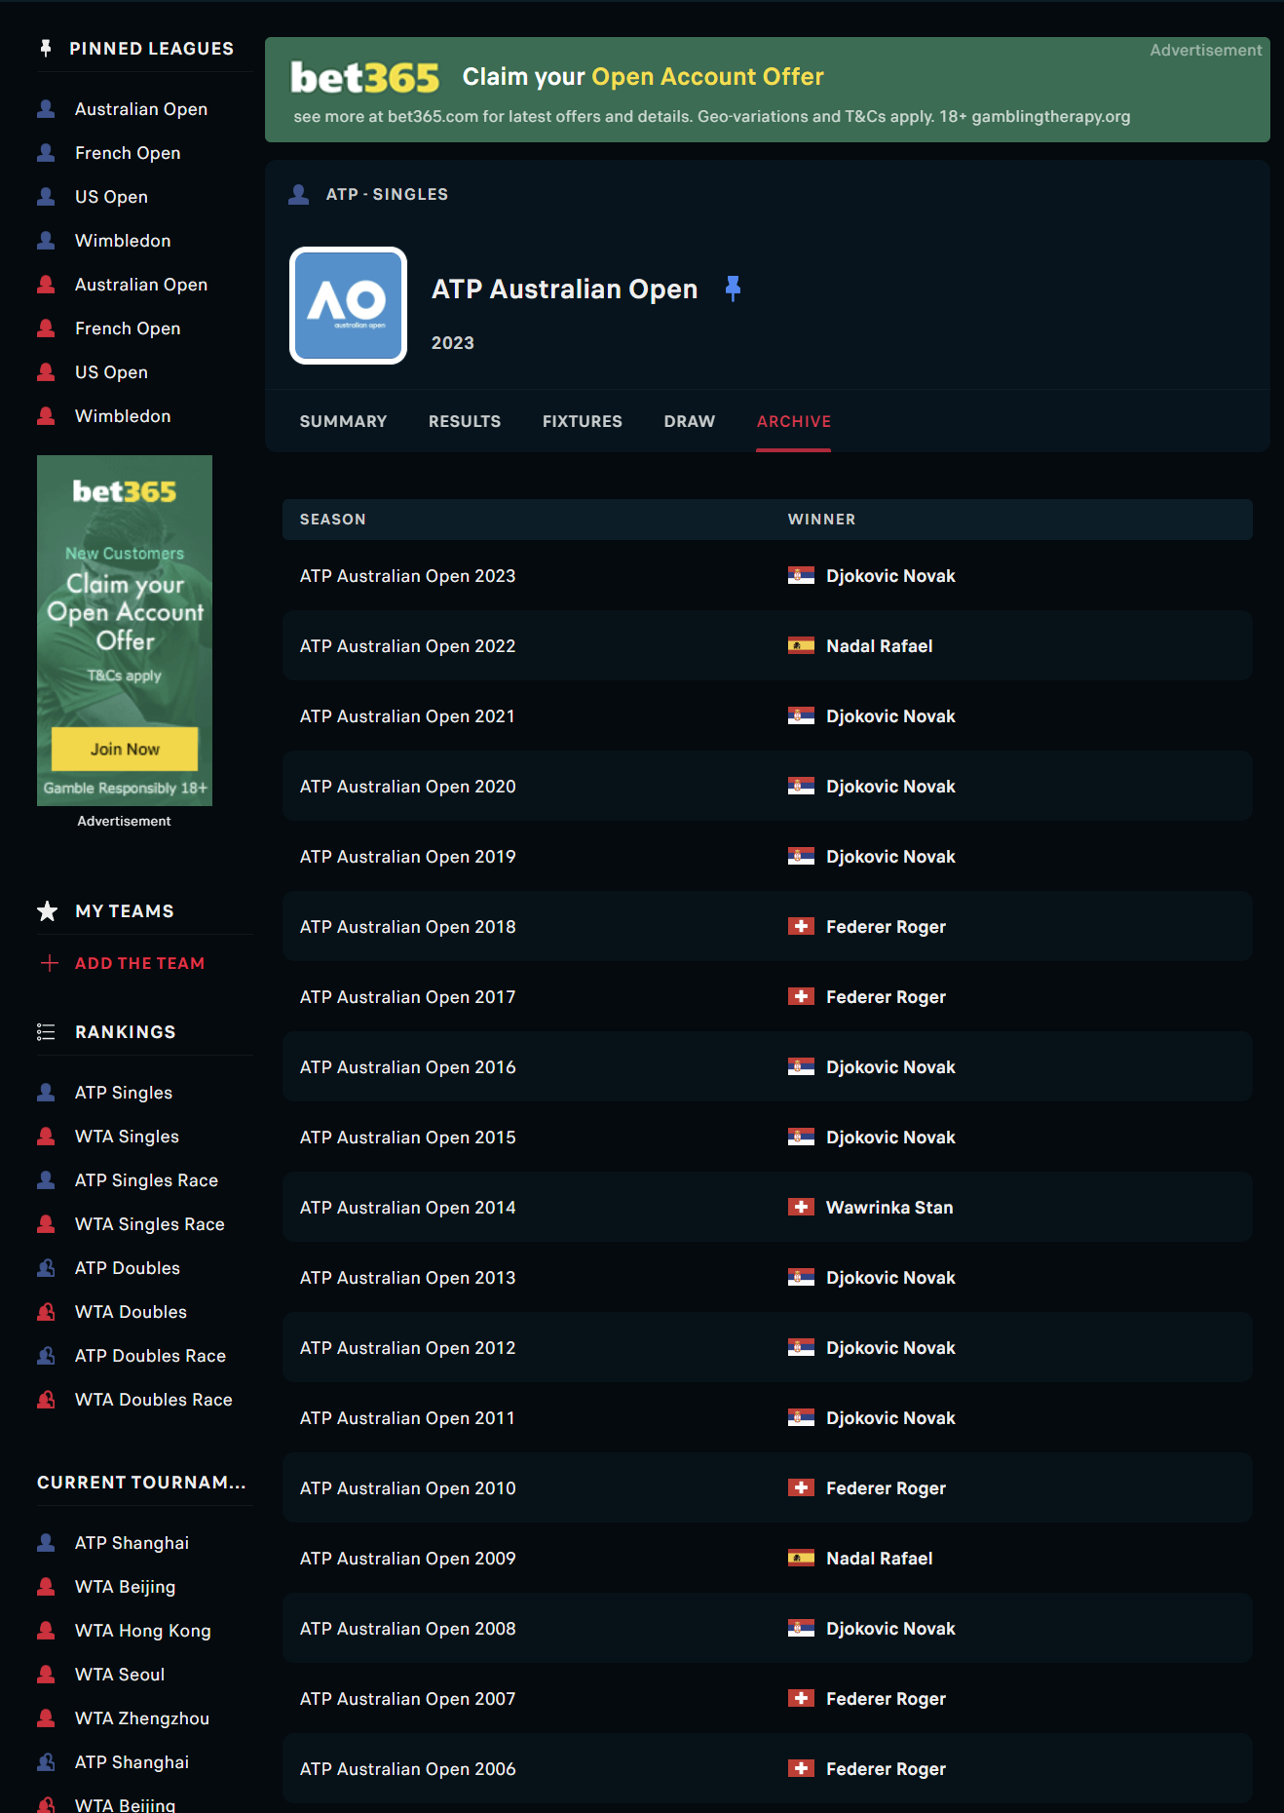
From the tournament page, click on Archive
Loop through each tournament from the last 10 years

