Slide 1
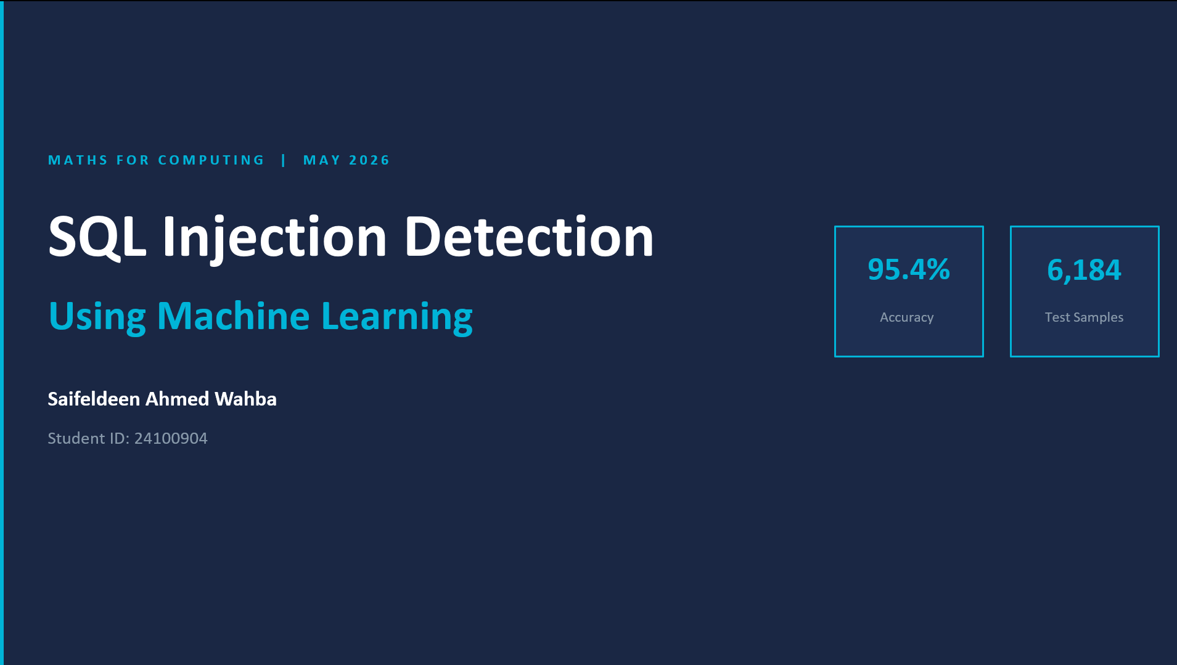

Slide 2

INTRODUCTION
🔴 SQL Injection is a major cyber threat
💀 Attackers can access or destroy data
🤖 Machine Learning helps detect attacks

Slide 3

PROBLEM STATEMENT
🔍
✅
🚨
Classify SQL queries
0 = Normal Query
1 = SQL Injection Attack

Slide 4

DATASET
30,921 SQL Queries
✅
🌐
Normal + Malicious samples
Real attack patterns included

Slide 5

METHODOLOGY
01
🧹 Data Cleaning
02
📐 TF-IDF Vectorization
03
✂️ Train/Test Split
04
🤖 Model Training

Slide 6

MODELS USED
🧮 Multinomial Naive Bayes
🌲 Random Forest
Multinomial Naive Bayes
Random Forest
VS
📊 Performance Comparison

Slide 7

RESULTS
🏆 Naive Bayes Accuracy: 95.42%
🌲 Random Forest Accuracy: 80.99%
95.42%
80.99%
✅ Naive Bayes selected
❌ Not Selected

Slide 8

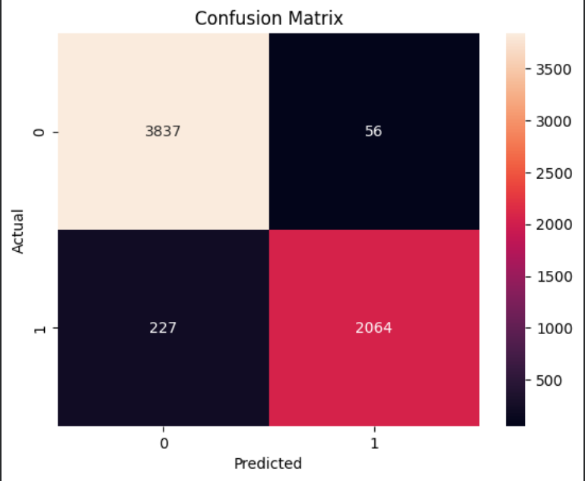
CONFUSION MATRIX
✅
🛡️
High normal query detection
Low false positives

Slide 9

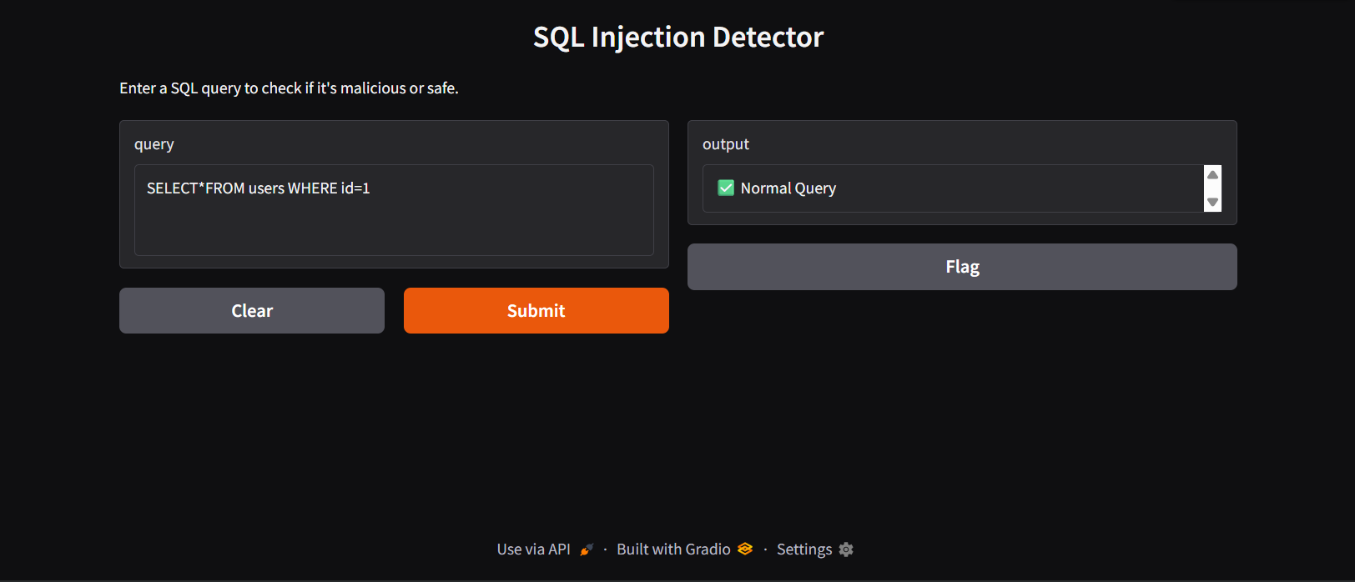
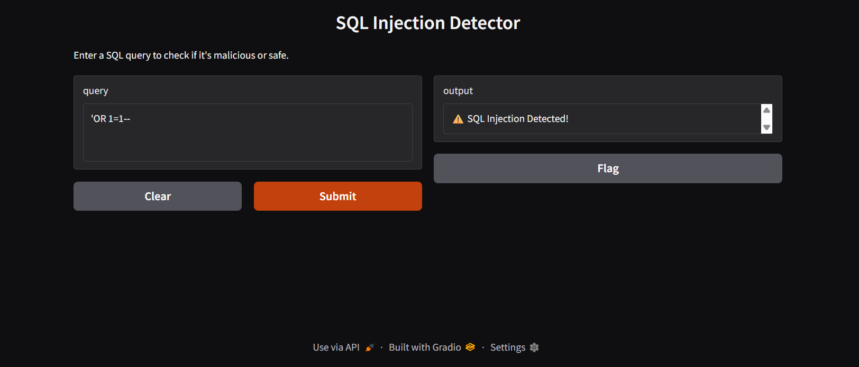
DEMO

Slide 10

CONCLUSION
🤖
ML successfully detects SQL injection
🏆
TF-IDF + Naive Bayes performed best
🚀
Future work: Deep Learning

