Slide 1
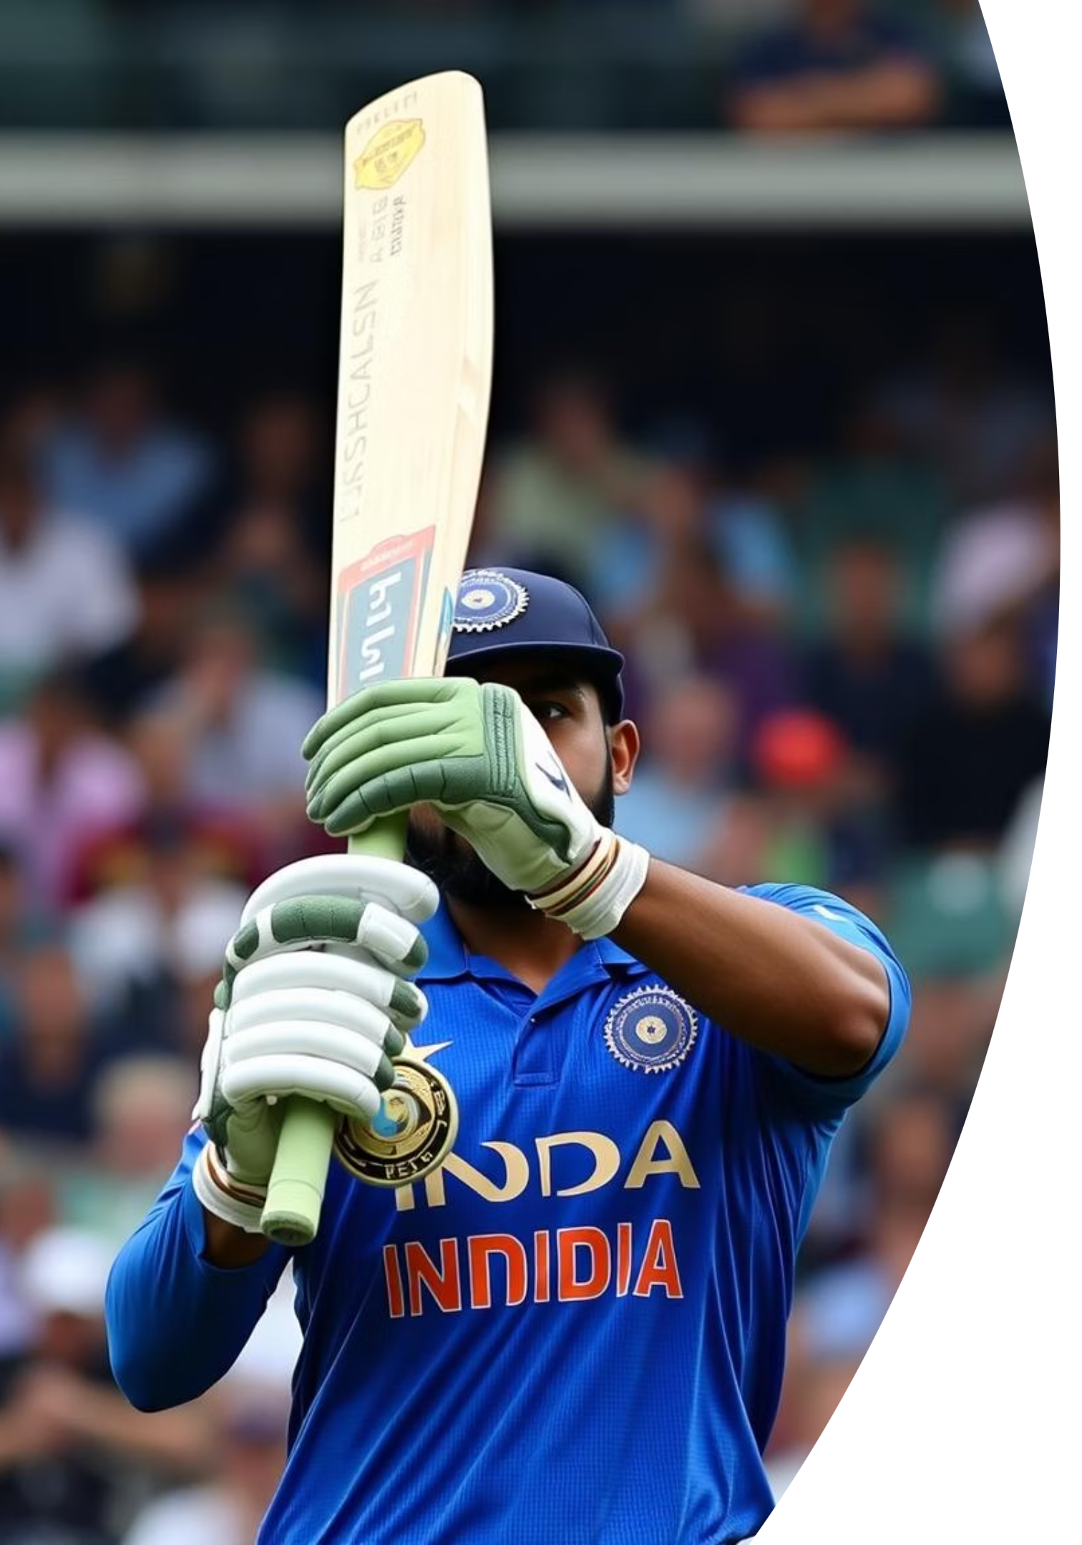
Virat Kohli: The Cricketing Legend
Discover the journey of Virat Kohli, a cricketing icon born on 5 November 1988, in Delhi, India. Known as "King Kohli," "Chase Master," and "Run Machine," this right-handed top-order batsman, also an occasional medium-fast bowler, has redefined modern cricket. He proudly represents Royal Challengers Bangalore in the IPL and Delhi in domestic cricket.

Slide 2
Early Life and Cricketing Beginnings
1998: Training Begins
1
Started training at West Delhi Cricket Academy under the tutelage of Rajkumar Sharma, laying the foundation for his illustrious career.
2
2008: U-19 World Cup Victory
Led the India U-19 team to a glorious World Cup victory in Malaysia, showcasing his leadership skills early on.
2008: ODI Debut
3
Made his international One Day International (ODI) debut against Sri Lanka, marking his entry into senior international cricket.
4
2011: Test Debut
Played his first Test match against West Indies, completing his entry into all formats of international cricket.

Slide 3

Playing Style and Records
Virat Kohli is celebrated for his aggressive

