Slide 1

Soft Computing Concepts

Slide 2
Intelligent systems (ISs)
Intelligence: System must
perform meaningful operations.
interpret information.
comprehend the relations between phenomena or objects.
apply the acquired information to new conditions.

Slide 3
Soft Computing is the fusion of methodologies that were designed to model and enable solutions to real world problems, which are not modeled, or too difficult to model, mathematically. These problems are typically associated with fuzzy, complex, and dynamical systems, with uncertain parameters. These systems are the ones that model the real world and are of most interest to the modern science.

Slide 4
The term soft computing was proposed by the inventor of fuzzy logic, Lotfi A. Zadeh. He describes it as follows [Zadeh, 1994]:
“Soft computing is a collection of methodologies that aim to exploit the tolerance for imprecision and uncertainty to achieve tractability, robustness, and low solution cost. Its principal constituents are fuzzy logic, neurocomputing, and probabilistic reasoning. Soft computing is likely to play an increasingly important role in many application areas, including software engineering. The role model for soft computing is the human mind.”

Slide 5
Soft computing is not precisely defined. It consists of distinct concepts and techniques which aim to overcome the difficulties encountered in real world problems. These problems result from the fact that our world seems to be imprecise, uncertain and difficult to categorize. For example, the uncertainty in a measured quantity is due to inherent variations in the measurement process itself. The uncertainty in a result is due to the combined and accumulated effects of these measurement uncertainties which were used in the calculation of that result [Kirkpatrick, 1992].

Slide 6
Soft computing is the name of a family of problem-solving methods that have analogy with biological reasoning and problem solving (sometimes referred to as cognitive computing).
The basic methods included in cognitive computing are fuzzy logic (FL), neural networks (NN) and genetic algorithms (GA) - the methods which do not derive from classical theories.

Slide 7
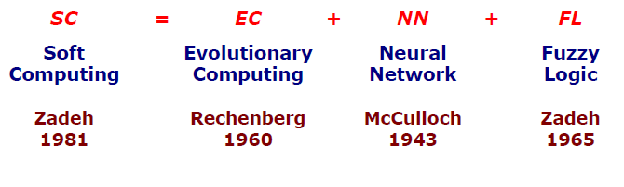
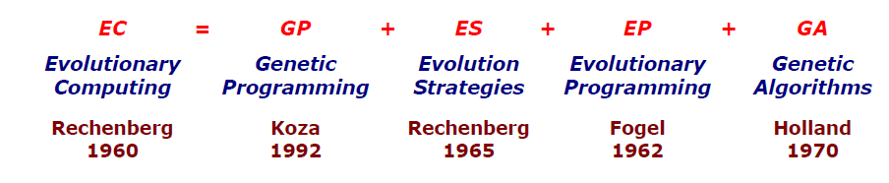
SC development history

Slide 8
Fuzzy logic is mainly associated to imprecision, approximate reasoning and computing with words, neurocomputing to learning and curve fitting (also to classification), and probabilistic reasoning to
uncertainty and belief propagation (belief networks). These methods have in common that they:
1. are nonlinear,
2. have ability to deal with non linearities,
3. follow more human-like reasoning paths than classical methods,
4. utilize self-learning,
5. utilize yet-to-be-proven theorems,
6. are robust in the presence of noise or errors.

Slide 9
Kosko lists the following similarities between fuzzy logic systems and neural networks
estimate functions from sample data
do not require mathematical model
are dynamic systems
can be expressed as a graph which is made up of nodes and edges
convert numerical inputs to numerical outputs
process inexact information inexactly
have the same state space
produce bounded signals
a set of n neurons defines n -dimensional fuzzy sets
learn some unknown probability function " p (x)
can act as associative memories
can model any system provided the number of nodes is sufficient.

Slide 10
The main dissimilarity between fuzzy logic system (FLS) and neural network is that FLS uses heuristic knowledge to form rules and tunes these rules using sample data, whereas NN forms “rules” based entirely on data.

Slide 11
Soft computing methods have been applied to many real-world problems. Applications can be found in:
Signal Processing,
Pattern Recognition,
Quality Assurance and Industrial Inspection,
Business Forecasting,
Speech Processing,
Credit Rating,
Adaptive Process Control,
Robotics Control,
Natural Language Understanding,
Programming Languages,
User Friendly Application Interfaces,
Automaticized Programming,
Computer Networks,
Database Management,
Fault Diagnostics and Information Security

Slide 12
Hard Vs Soft Computing Paradigms
Hard computing
Based on the concept of precise modelling and analyzing to yield accurate results.
Works well for simple problems, but is bound by the NP-Complete set.
Soft computing
Aims to surmount NP-complete problems.
Uses inexact methods to give useful but inexact answers to intractable problems.
Represents a significant paradigm shift in the aims of computing - a shift which reflects the human mind.
Tolerant to imprecision, uncertainty, partial truth, and approximation.
Well suited for real world problems where ideal models are not available.

Slide 13
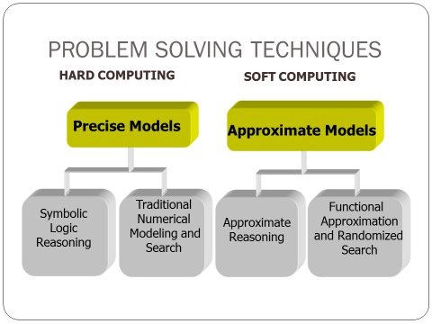

Slide 14
Difference Between Soft and Hard Computing
Hard Computing | Soft Computing
Conventional computing requires a precisely stated analytical model. | Soft computing is tolerant of imprecision.
Often requires a lot of computation time. | Can solve some real world problems in reasonably less time.
Not suited for real world problems for which ideal model is not present. | Suitable for real world problems.
It requires full truth | Can work with partial truth
It is precise and accurate | Imprecise.
High cost for solution | Low cost for solution
Require programs to be written | Can evolve its own programs
Deterministic | Stochastic
Require exact input | Can deal with ambiguous and noisy data
Produce precise answer | Produce approximate answers

Slide 15
Unique Features of Soft Computing
Soft Computing is an approach for constructing systems which are
Computationally intelligent,
Possess human like expertise in particular domain,
Can adapt to the changing environment and can learn to do better
Can explain their decisions

Slide 16
Components of Soft Computing
Components of soft computing include:
Fuzzy Logic (FL)
Evolutionary Computation (EC) - based on the origin of the species
Genetic Algorithm
Swarm Intelligence
Ant Colony Optimizations
Neural Network (NN)
Machine Learning (ML)

