Slide 1
M
ALIBABA CLOUD AI HACKATHON PAKISTAN 2026 , KARACHI REGIONAL ROUND
Muhafiz AI
Guarding 190 Million Phones from Fraud , in the Language Pakistan Actually Speaks
Real-time scam-message & scam-call detection , English , Roman Urdu , Urdu script , Mixed
01
Notes:
Open with energy but not rush. "Hi everyone, we're [team name], and this is Muhafiz AI." Pause. "Muhafiz means guardian in Urdu — and that's exactly the role this system plays for the 190 million-plus mobile connections in Pakistan." Let the title sit on screen for a beat before advancing. This slide's only job is to make the judges curious and to plant the tagline ("in the language Pakistan actually speaks") — you'll return to that idea in the problem slide.

Slide 2
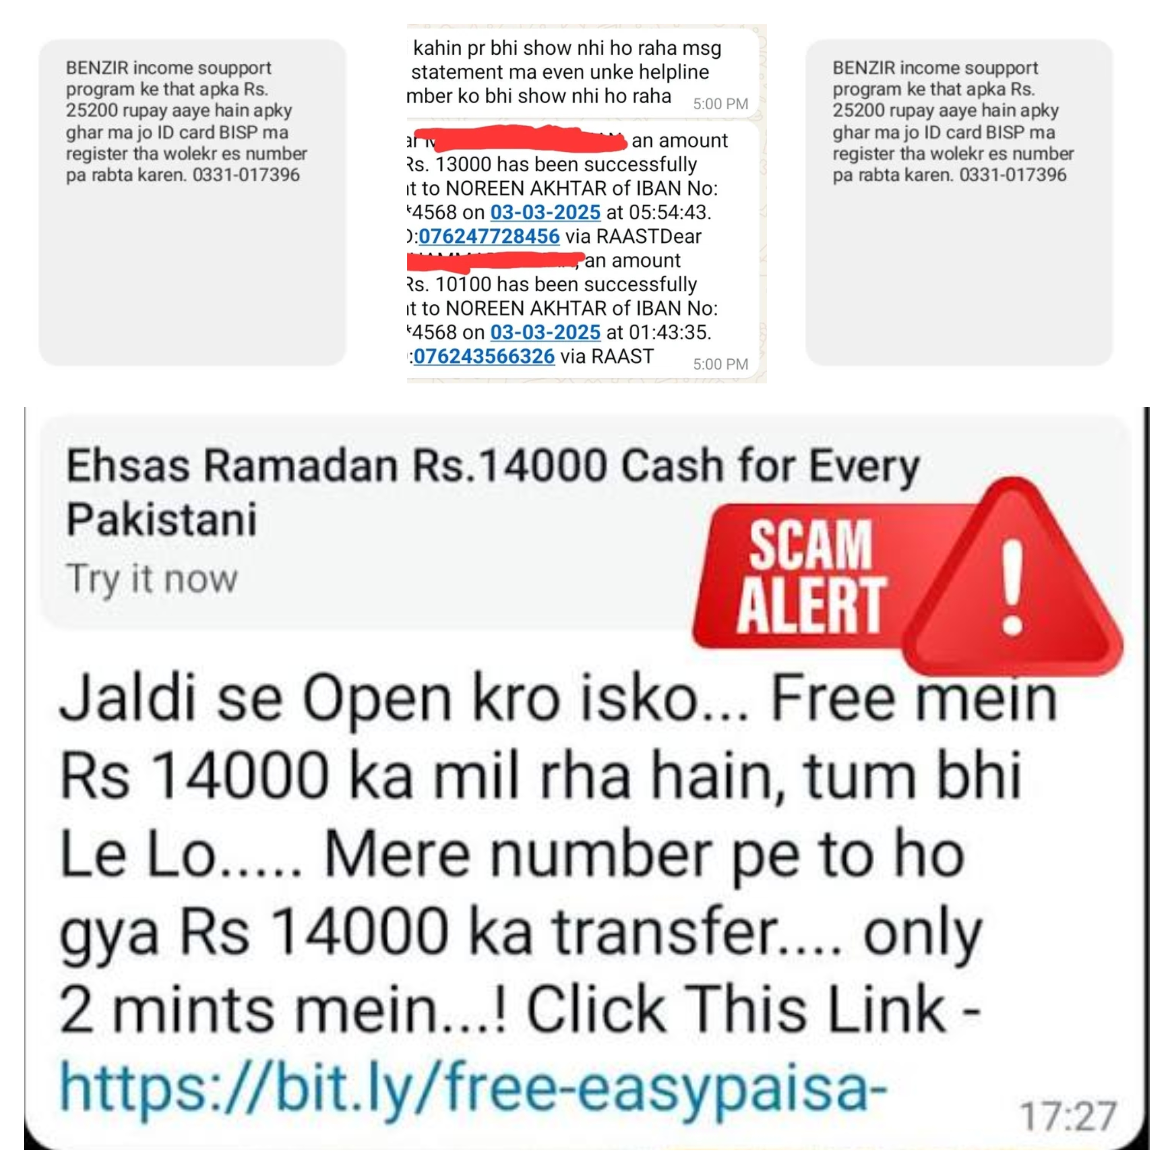
THE PROBLEM, AND WHO IT AFFECTS
Fraud Is Winning Because It Speaks Roman Urdu , and We Don't
Fake BISP/Ehsaas payment notices, prize-lottery "processing fees," fraudulent overseas job offers, bank phishing links, fake PTA SIM-block threats, and live callers who social engineer OTP codes out of victims.
Pakistan loses billions of rupees a year to phone- and message-based fraud.
The most common victims: the elderly, rural communities, and people with limited digital literacy exactly the groups least equipped to "just Google it."
The core failure: almost every scam-detection tool on the market is built for English. Most Pakistani scam traffic is in Roman Urdu, Urdu script, or a mix of both , so mainstream filters simply don't read it.
02
Notes:
"Every day, people across Pakistan get messages like 'you've won a lottery, just pay a small fee to claim it' — or fake BISP payment alerts, or bank phishing links. And it's not just texts — callers trick people into reading out their OTP over the phone." Slow down for the next line: "This isn't rare. Pakistan loses billions of rupees a year to this, and it disproportionately hits the elderly, rural communities, and people with less digital experience." Then land the real insight: "Here's the gap nobody's solving: these scams are written in Roman Urdu or Urdu script, and almost every spam filter out there is built for English. It literally cannot read what's being sent to Pakistani phones." Gesture to the 190M number and pause — that's the scale of who's exposed.

Slide 3
Our SOLUTION, AND THE AUDIENCE IT SERVES
One Guardian, Two Ways In: Paste a Message, or Upload a Call
Text Analysis
Call Audio Analysis
Paste any SMS / WhatsApp message
Instant Scam / Safe verdict + 0–100 risk score
Detected language shown (EN / Roman Urdu / Urdu / Mixed)
Transparent red flags, not a black box
Under 10 milliseconds per message
Upload or record a phone call
Transcribed automatically (local speech-to-text)
Every segment scored individually
Call-level High / Medium / Low verdict
Catches live OTP social-engineering, not just texts
Who it serves:
Everyday phone users double-checking a suspicious text · Families protecting parents & grandparents · Journalists & researchers tracking scam campaigns · Banks, telecoms & NGOs needing an accessible fraud-awareness layer
03
Notes:
"So we built Muhafiz — 'guardian' in Urdu. It's a web app with two doors in. Door one: paste a suspicious message, get an instant verdict with a risk score and the specific red flags it found — not just a scary red light, an explanation. Door two: upload or record an actual phone call, because a lot of the worst scams — OTP theft — happen live, over voice, not in text." Then pivot to audience: "This isn't just for tech-savvy users. We built it so a family member can check a message on behalf of a parent, so journalists can track scam campaigns, and so banks, telecoms, or NGOs could eventually embed this directly into their own apps." Keep this slide brisk — the demo is next, and that's where the energy should peak.

Slide 4
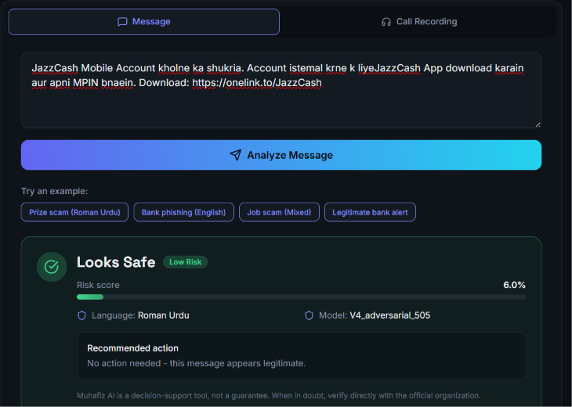
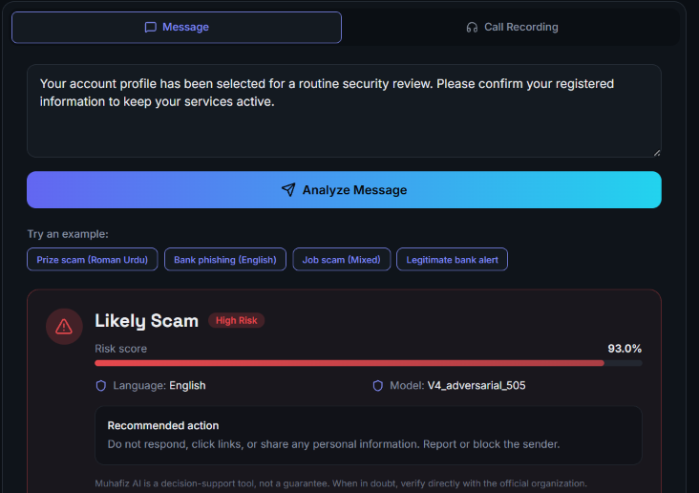
SEE IT WORK
Live Demo: Scam Caught. Legitimate Message Cleared.
04
Notes:
This is where you actually switch to the live app if you can (or narrate over this slide as backup). "Let me show you. I'm pasting in a real prize-scam message now..." [click / reveal]. "Within milliseconds it flags this as high risk, and shows exactly why — it caught the financial-request language and the prize/lottery pattern." Pause, then: "Now watch this — I'm going to paste something that also mentions money, but isn't a scam." [reveal second card] "And it correctly clears it as safe. That's the real test of a good fraud model — not just catching scams, but NOT crying wolf on ordinary life." If the live demo breaks: stay calm, say "looks like the server's waking up — let me walk you through a recording of this exact flow," and keep moving. Never apologize more than once.

Slide 5
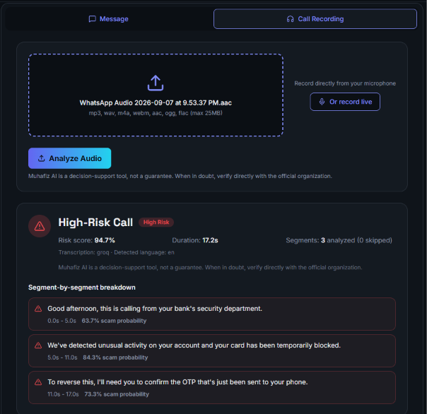
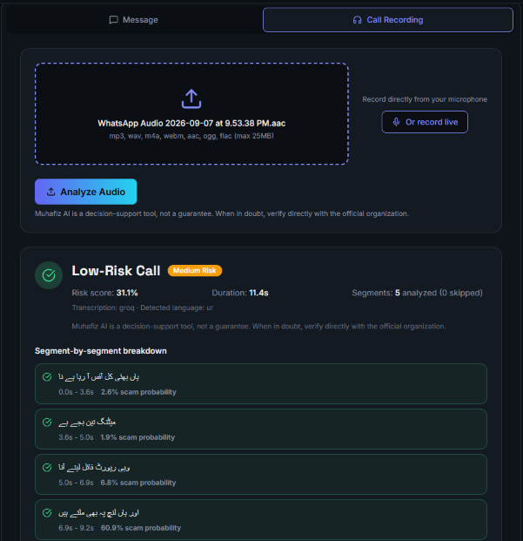
SEE IT WORK
Live Demo: Scam Caught. Legitimate Audio Cleared.
04
Notes:
This is where you actually switch to the live app if you can (or narrate over this slide as backup). "Let me show you. I'm pasting in a real prize-scam message now..." [click / reveal]. "Within milliseconds it flags this as high risk, and shows exactly why — it caught the financial-request language and the prize/lottery pattern." Pause, then: "Now watch this — I'm going to paste something that also mentions money, but isn't a scam." [reveal second card] "And it correctly clears it as safe. That's the real test of a good fraud model — not just catching scams, but NOT crying wolf on ordinary life." If the live demo breaks: stay calm, say "looks like the server's waking up — let me walk you through a recording of this exact flow," and keep moving. Never apologize more than once.

Slide 6
THE NEED IT ADDRESSES, AND THE IMPACT IT MAKES
A Decision-Support Layer for a Country That Texts in Roman Urdu
The need: people don't have a fast, trustworthy way to check a suspicious message before they act on it , especially not in their own language.
Muhafiz is deliberately positioned as decision support, not a legal authority , it gives an honest second opinion, explains its reasoning in plain language, and always tells the user to verify with the official organization when in doubt.
Because it's transparent (shows the exact red flags, not just a verdict), it builds trust with lower-literacy and elderly users , the group most targeted and least served today.
Because it's cheap and fast to run, it's realistic to embed inside a bank app, a telecom SMS gateway, or an NGO helpline tool , not just a hackathon demo.
Why this is a real product, not just a proof of concept:
Runs on a laptop or a free-tier cloud instance — no GPU needed
Honest error states — never fakes a verdict if the backend is unreachable
Accessible design — plain-language reasoning, not a black box
Every number in this deck comes from real, untouched test data — zero mock results
05
Notes:
"So why does this matter beyond 'cool demo'? The need is simple: people don't have a fast, trustworthy way to check a message before they act on it — in their own language. We built Muhafiz as decision support, not a verdict from God — it explains itself, and it always tells you to verify with the real organization when you're unsure. That transparency is what builds trust with the users who need this most: people who are less digitally confident." Point at the right card: "And critically, this isn't just a hackathon toy — it's cheap enough to run that a bank, telecom, or NGO could realistically deploy it tomorrow."

Slide 7
THE INNOVATION AND THE TECHNOLOGY BEHIND IT
How a Message Becomes a Verdict
Input: a raw SMS / WhatsApp message
1. Normalize
2. Extract Features
3. Classify
4. Calibrate
5. Threshold @ 0.63
Standardize Roman Urdu spelling, USSD codes, phone numbers, phrases
Word + character TF-IDF — catches disguised / misspelled scam words
LinearSVC decides scam vs. safe
Platt scaling turns the decision into an honest confidence %
Tuned cutoff → final Scam / Safe verdict
Pakistan-specific engineering: 15+ Roman Urdu spelling-normalization rules, 10+ phrase-normalization rules, USSD-code tagging (*786# → token), and URL/email masking so the model can't just memorize specific links.
Under 10 milliseconds per message on an ordinary CPU — no GPU required.
06
Notes:
"Here's what actually happens under the hood when you paste a message." Walk left to right with the diagram: "First we normalize the text — Roman Urdu spelling is wildly inconsistent, so 'batayen' and 'btaen' need to be recognized as the same word. Then we extract features using TF-IDF — basically turning words and word-fragments into numbers, at both the word level and the character level, which is what catches misspelled or disguised scam words. That feeds a classifier called LinearSVC, which makes the actual scam-or-safe decision. We calibrate that decision into an honest confidence score, and compare it against a tuned threshold — 0.63, not the obvious 50-50 — to produce the final verdict." Land the punchline: "All of that happens in under 10 milliseconds. No GPU, no cloud AI bill per message."

Slide 8
THE INNOVATION AND THE TECHNOLOGY BEHIND IT
One Core Model, Two Entry Points
1. Audio In
2. Transcribe
3. Segment
4. Classify each segment
5. Agregate
Scall Recording or live mic(mp3/mp4)
Faster Wisper(medium), runs locally on CPU
Ptime Spend chunks, filter words, filtered and merged
Platt scaling turns the decision into an honest confidence %
Weighted score : call level high/Medium/Low
Why this matters
• Live OTP social-engineering happens on calls, not texts
• We didn't build a second "brain" — we reused the trained text model per segment
• Segment-level detail shows exactly which part of the call raised the flag
Aggregation weights
• Max segment risk × 0.35
• Weighted-mean segment risk × 0.35
• Share of scam-flagged segments × 0.30 → risk score. High ≥ 0.60 · Medium ≥ 0.35 · Low < 0.35
06
Notes:
"Here's what actually happens under the hood when you paste a message." Walk left to right with the diagram: "First we normalize the text — Roman Urdu spelling is wildly inconsistent, so 'batayen' and 'btaen' need to be recognized as the same word. Then we extract features using TF-IDF — basically turning words and word-fragments into numbers, at both the word level and the character level, which is what catches misspelled or disguised scam words. That feeds a classifier called LinearSVC, which makes the actual scam-or-safe decision. We calibrate that decision into an honest confidence score, and compare it against a tuned threshold — 0.63, not the obvious 50-50 — to produce the final verdict." Land the punchline: "All of that happens in under 10 milliseconds. No GPU, no cloud AI bill per message."

Slide 9
THE INNOVATION AND THE TECHNOLOGY BEHIND IT
Why We Chose Lightweight Over Heavyweight
Factor | TF-IDF + LinearSVC (our choice) | Transformer (e.g. BERT-style)
Speed | < 10 ms / message on CPU | ~50–300ms+, often needs a GPU
Model size | ~3 MB | 100 MB – several GB
Infra cost | Runs on free-tier cloud | Usually needs paid GPU hosting
Data needed | Works well on ~1,600 labelled messages | Typically needs far more data / fine-tuning
Explainability | Exact words/phrases behind each verdict | Much harder to explain to an end user
Offline capability | Fully local, zero per-call API cost | Often depends on cloud APIs
A deliberate engineering trade-off for a real, deployable product , not a shortcut. A transformer benchmark (mBERT / XLM-R) is next on our roadmap.
08
Notes:
"You might ask — why not just use a big transformer model like BERT? We deliberately chose the lighter approach." Walk down the table by outcome, not row-by-row recitation: "It's over ten times faster, it's a fraction of the size, it needs no GPU, and — most importantly for a fraud tool — we can actually explain why it made a decision. That matters when you're asking someone to trust a warning about their own money." Close with the honest line: "This was a deliberate trade-off for a real, deployable product, not a shortcut — and a transformer comparison is explicitly next on our roadmap." This is one of the two things you should be able to say without notes.

Slide 10
THE INNOVATION AND THE TECHNOLOGY BEHIND IT
What Makes This Pakistan-First, Not Pakistan, Translated
1
Multilingual Normalization
2
Hard-Negative Mining
15+ Roman Urdu spelling rules & 10+ phrase rules — built for how Pakistanis actually type, not a generic English filter with translation bolted on.
We deliberately added safe messages that LOOK like scams — real bank deductions, genuine security alerts, legitimate OTPs — to cut false alarms.
3
Transparent Signal Detection
4
Leakage-Safe Splitting
Six rule-based flag categories (urgency, financial request, credential/OTP request, prize/lottery, threats, OTP-specific) shown separately from the model's verdict.
Group-aware train/test splitting with verified zero overlap — so every performance number in this deck is trustworthy, not inflated.
Proof it worked: hard-negative mining cut false positives from 48 → 1 on the 505-message adversarial test set — a 48x improvement.
09
Notes:
Move through these four quickly and confidently — each is a 10-second beat, not an essay. "Four things separate this from a generic filter. One: multilingual normalization built specifically for Roman Urdu spelling chaos. Two: hard-negative mining — we deliberately trained on safe messages that LOOK risky, like real bank alerts, to stop false alarms; that alone cut false positives forty-eight times over. Three: every verdict comes with transparent, plain-English red flags, not just a black-box score. Four: we verified zero overlap between our training and test data, so every number in this deck is earned, not inflated." If a judge later asks 'how do I know your numbers are real' — point back to bullet four.

Slide 11
THE INNOVATION AND THE TECHNOLOGY BEHIND IT
Our Hardest Problem: Teaching a Model to Read Roman Urdu
The Problem
• Roman Urdu has no fixed spelling. The same word can legitimately appear a dozen ways : “batayein,” “btaen,” “bta dena,” “bataen” , because it’s a spoken language typed phonetically, not a standardized written one.
• There was no ready-made Pakistani Roman Urdu scam dataset to train on , most of it had to be collected, labelled, and normalized by hand.
• Real messages constantly code-switch mid-sentence between English, Roman Urdu, and Urdu script, so the model couldn’t just be told “expect one language.”
• Early versions over-corrected , flagging harmless Roman Urdu texts just for sounding informal , which is exactly the false-positive problem hard-negative mining was later built to fix.
How we solved it
• Hand-built 15+ Roman Urdu spelling-normalization rules and 10+ phrase-normalization rules so spelling variants collapse to one form before the model even sees them.
• Combined word-level AND character, level TF-IDF, so even a misspelling the rules didn’t anticipate still shares recognizable letter patterns with known scam words.
• Iteratively expanded the dataset specifically with hard Roman Urdu and mixed-language examples across three model versions (V1 → V3 → V4).
• Result: 99.4% accuracy on Roman Urdu / mixed messages , nearly matching English, despite this being the messiest, least standardized input we handle.
10
Notes:
"Zoom out for a second. Pakistan has over 190 million mobile connections — that's the scale of people this could protect. And because the model is this cheap to run — under 10 milliseconds, no GPU, 3 megabytes — it's not just large enterprises who could deploy this. A regional bank, a mid-size telecom, an NGO helpline — all of them could realistically run this." This is the slide where you connect the technical choices back to the human mission — say it with conviction, this is your closing emotional beat before the roadmap.

Slide 12
FEASIBILITY, AND WHAT WE HAVE ACTUALLY BUILT
Tested Four Independent Ways. Never Once Faked.
Headline: 97.48% accuracy on the toughest test : 318 never-before-seen multilingual messages (All-4 External).
10
Notes:
"We didn't test this once and call it done — we ran it against four completely independent test sets the model had never seen. Across the board, accuracy sits between 93 and 100 percent." Point to the All-4 External bar: "The one that matters most is this one — 318 brand-new multilingual messages, mixing English, Roman Urdu, and Urdu script — and we hit 97.48% accuracy. Pause here. This is your other must-know number alongside the TF-IDF answer. If you remember one stat, remember 97.48%.

Slide 13
THE NEED IT ADDRESSES, AND THE IMPACT IT MAKES
Built Cheap Enough to Actually Reach 190 Million People
190M+
<10ms
~3MB
Mobile connections in Pakistan
Per-message cost, no GPU required
Total model size , easy to deploy
Banks & fintechs : embed as a fraud-warning layer in mobile banking apps
Telecoms : screen inbound SMS traffic at the gateway level
NGOs & helplines : give field workers an instant second opinion for elderly or rural clients
Why cost matters for reach
Most fraud-detection AI requires GPU hosting that only well-funded institutions can afford. Because Muhafiz runs on free-tier infrastructure, it's realistic for smaller telecoms, regional banks, and non-profits , not just large enterprises , to deploy real protection for their users.
13
Notes:
"Zoom out for a second. Pakistan has over 190 million mobile connections — that's the scale of people this could protect. And because the model is this cheap to run — under 10 milliseconds, no GPU, 3 megabytes — it's not just large enterprises who could deploy this. A regional bank, a mid-size telecom, an NGO helpline — all of them could realistically run this." This is the slide where you connect the technical choices back to the human mission — say it with conviction, this is your closing emotional beat before the roadmap.

Slide 14
FEASIBILITY, AND WHAT WE HAVE ACTUALLY BUILT
What's Shipped, and What's Next
Binary Scam/Safe text classification
Shipped
Audio call analysis (transcription + segment classification)
Shipped
Multilingual support : EN / Urdu / Roman Urdu / Mixed
Shipped
Full web app with public API
Shipped
Scam-category classifier (bank / job / BISP / lottery...)
Next
Live SMS / browser-extension interception
Planned
Continuous learning from user reports
Planned
Transformer benchmark (mBERT / XLM-R vs. TF-IDF+SVM)
Planned
14
Notes:
"We're proud that four major pieces are already shipped, not promised — text classification, audio analysis, full multilingual support, and a real deployed web app with a public API. What's next: teaching the model to name the scam category, not just flag it; catching things automatically via SMS interception instead of copy-paste; and benchmarking against transformer models to see if there's a meaningful accuracy gain worth the extra cost." Keep this slide fast — it's a credibility beat, not a deep dive.

Slide 15
FEASIBILITY, AND WHAT WE HAVE ACTUALLY BUILT
This Is Shipped, Not Sketched
Full-Stack, Deployed
Production Behaviors
Zero Mock Data
Next.js 16 frontend on Vercel · FastAPI backend on Render · auto-deploys on every git push · public REST API (/api/health, /api/analyze-text, /api/analyze-audio)
Honest error states , never fakes a verdict if the backend is down · server-side 5-minute call-length limit · configurable audio on/off per deployment tier
Every verdict on screen is produced by the real, trained V4_adversarial_505 model in real time , nothing hardcoded, nothing scripted for the demo
Full stack, named:
Next.js 16 · React 19 · TypeScript 5 · Tailwind CSS 4 · Three.js (interactive 3D shield UI) , FastAPI · scikit-learn · faster-whisper (Whisper medium, INT8, CPU) · pydub
12
Notes:
"Feasibility isn't a promise here — it's already true." Walk the three cards briefly: "It's fully deployed — real frontend on Vercel, real backend on Render, auto-deploying on every push, with a public API. It has real production behaviors — if the backend goes down, the app tells you honestly instead of faking a result. And there is zero mock data anywhere in this project — every verdict you've seen today came from the live model." If a judge asks 'is this just a demo or could it actually run,' this is the slide you return to.

Slide 16
FEASIBILITY, AND WHAT WE HAVE ACTUALLY BUILT
Consistent Across Languages. Not Just Memorizing.
Overfitting Check
99.15%
97.33%
Cross-validation accuracy
Held-out test accuracy
< 2% gap — considered a healthy, non-overfit result. The model is generalizing, not memorizing.
Training data: 1,637 messages (879 scam / 758 safe) across 10+ Pakistan-specific scam categories : job scams, lottery scams, bank phishing, OTP extraction, fake SIM-block threats, and fake BISP / Ehsaas / NADRA / FBR notices.
11
Notes:
"It's not enough to be accurate overall — it has to work in every language people actually use. English: 100%. Urdu script: 100%. Roman Urdu and mixed — the hardest, messiest case — still 99.4%." Then address the skeptical judge before they ask: "We also specifically checked this isn't overfitting — cross-validation accuracy was 99.15%, real held-out test accuracy was 97.33%. Under a 2% gap is considered healthy — this model generalizes, it doesn't memorize." Close with the training data line to show scope: 1,637 messages across 10+ real Pakistani scam categories.

Slide 17
M
Thank You
Muhafiz AI : one guardian, every Pakistani language.
Questions welcome.
15
Notes:
"That's Muhafiz AI — thank you, and we'd love to take your questions." Stand still, smile, look at the judges (not the slide). If a question stumps you, use the three-step move: acknowledge honestly, share what you DO know that's adjacent, then hand off to your teammate if needed. Don't guess at a specific number you're not sure of.

