Slide 1
Lecture 03 Introduction to C Programming
CSE115: Computing Concepts

Slide 2
Semantics and Syntax
Semantics – the meaning of the language within a given context
Syntax - Syntax are the rules to join words
together in forming a correct expression or phrase.
In natural languages it is often possible to assemble a sentence in more than one correct ways.

Slide 3
C Programming Language
Why 'C' ?
Because based on 'B'; developed at Bell Laboratories
Developed by Dennis Ritchie at Bell Laboratories in the 1960s
In cooperation with Ken Thomson it was used for Unix systems
The C Language was only vaguely defined, not standardized, so that almost everyone had his own perception of it, to such an extend that an urgent need for a standard code was creeping up

Slide 4
A Simple Program in C
#include <stdio.h>
#include <stdlib.h>
int main()
{
printf("Hello world!\n");
return 0;
}

Slide 5
A Simple Program in C
#include <stdio.h>
#include <stdlib.h>
int main()
{
printf("Hello world!\n");
return 0;
}
standard Library, input-output, header-file

Slide 6
A Simple Program in C
#include <stdio.h>
#include <stdlib.h>
int main()
{
printf("Hello world!\n");
return 0;
}
Beginning of program

Slide 7
A Simple Program in C
#include <stdio.h>
#include <stdlib.h>
int main()
{
printf("Hello world!\n");
return 0;
}
Start of Segment
End of Segment

Slide 8
A Simple Program in C
#include <stdio.h>
#include <stdlib.h>
int main()
{
printf("Hello world!\n");
return 0;
}
Function for printing text
End of statement
Insert a new line

Slide 9
Output
Hello world!

Slide 10
General Form of a C Program
preprocessor directives
main function heading
{
declarations
executable statements
}

Slide 11
A Simple Program in C
#include <stdio.h>
#include <stdlib.h>
int main()
{
printf("Hello world!\n");
return 0;
}

Slide 12
A Simple Program in C
#include <stdio.h>
#include <stdlib.h>
int main()
{
printf("Hello world!\n");
return 0;
}
standard Library, input-output, header-file
Beginning of program
Start of Segment
Function for printing text
End of statement
Insert a new line
End of Segment

Slide 13
Preprocessor Directives
A C program begins with # which provides an instruction to the C preprocessor
It is executed before the actual compilation is done.
Two most common directives :
#include
#define
In our example (#include<stdio.h>) identifies the header file for standard input and output operations.

Slide 14
Function main()
Identify the start of the program
Every C program has a main( )
'main' is a C keyword. We must not use it for any other purpose.
4 common ways of main declaration
int main(void)
{
return 0;
}
void main(void)
{
}
main(void)
{
}
main( )
{
}

Slide 15
The curly braces { }
Identify a segment / body of a program
The start and end of a function
The start and end of the selection or repetition block.
Since the opening brace indicates the start of a segment with the closing brace indicating the end of a segment, there must be just as many opening braces as closing braces (this is a common mistake of beginners)

Slide 16
Statement
Specifying an action to be taken by the computer as the program executes.
Each statement in C needs to be terminated with semicolon (;)
Example:
#include <stdio.h>
int main()
{
printf(“I love programming\n”);
printf(“You will love it too once ”);
printf(“you know the trick\n”);
return 0;
}
statement
statement
statement
statement

Slide 17
Statement
Statement has two parts :
Declaration
The part of the program that tells the compiler the names of memory cells in a program
Executable statements
Program lines that are converted to machine language instructions and executed by the computer

Slide 18
An Example
/*
Converts distance in miles
to kilometres.
*/
#include <stdio.h> //printf, scanf definitions
#define KMS_PER_MILE 1.609 //conversion constant
int main(void) {
float miles, // input – distance in miles
kms; // output – distance in kilometres
//Get the distance in miles
printf("Enter distance in miles: ");
scanf("%f", &miles);
//Convert the distance to kilometres
kms = KMS_PER_MILE * miles;
//Display the distance in kilometres
printf("That equals %f km.\n", kms);
return 0;
}

Slide 19
An Example
/*
Converts distance in miles
to kilometres.
*/
#include <stdio.h> //printf, scanf definitions
#define KMS_PER_MILE 1.609 //conversion constant
int main(void) {
float miles, // input – distance in miles
kms; // output – distance in kilometres
//Get the distance in miles
printf("Enter distance in miles: ");
scanf("%f", &miles);
//Convert the distance to kilometres
kms = KMS_PER_MILE * miles;
//Display the distance in kilometres
printf("That equals %f km.\n", kms);
return 0;
}
standard header file
preprocessor directives
constant
reserved words
variables
comments
functions
special symbols
punctuations

Slide 20
An Example
/*
Converts distance in miles
to kilometres.
*/
#include <stdio.h> //printf, scanf definitions
#define KMS_PER_MILE 1.609 //conversion constant
int main(void) {
float miles, // input – distance in miles
kms; // output – distance in kilometres
//Get the distance in miles
printf("Enter distance in miles: ");
scanf("%f", &miles);
//Convert the distance to kilometres
kms = KMS_PER_MILE * miles;
//Display the distance in kilometres
printf("That equals %f km.\n", kms);
return 0;
}
declarations
Executable statements

Slide 21
An Example
/*
Converts distance in miles
to kilometres.
*/
#include <stdio.h> //printf, scanf definitions
#define KMS_PER_MILE 1.609 //conversion constant
int main(void) {
float miles, // input – distance in miles
kms; // output – distance in kilometres
//Get the distance in miles
printf("Enter distance in miles: ");
scanf("%f", &miles);
//Convert the distance to kilometres
kms = KMS_PER_MILE * miles;
//Display the distance in kilometres
printf("That equals %f km.\n", kms);
return 0;
}
Sample Run
Enter distance in miles: 10.5
That equals 16.89 km.

Slide 22
An Example
What happens in the computer memory?
memory
memory
memory
MileToKm.exe
MileToKm.exe
MileToKm.exe
miles
miles
miles
?
10.5
10.5
kms
kms
kms
?
?
16.89
At the beginning
After user enters: 10.5 to
scanf("%f", &miles);
After this line is executed:
kms = KMS_PER_MILE * miles;
Do not assume that uninitialised variables contain zero! (Very common mistake.)

Slide 23
Variables
Variable → a name associated with a memory cell whose value can change
Variable Declaration: specifies the type of a variable
Example: int num;
Variable Definition: assigning a value to the declared variable
Example: num = 5;

Slide 24
Basic Data Types
There are 4 basic data types :
int
float
double
char
int
used to declare numeric program variables of integer type
whole numbers, positive and negative
keyword: int
int number;
number = 12;
….
…
number = 7;

Slide 25
Basic Data Types
float
fractional parts, positive and negative
keyword: float
float height;
height = 1.72;
double
used to declare floating point variable of higher precision or higher range of numbers
exponential numbers, positive and negative
keyword: double
double valuebig;
valuebig = 12E-3; (is equal to 12X10⁻³)

Slide 26
Basic Data Types
char
A single symbol that can be typed using the keyboard
Example of characters:
Numeric digits: 0 - 9
Lowercase/uppercase letters: a - z and A - Z
Space (blank)
Special characters: , . ; ? “ / ( ) [ ] { } * & % ^ < > etc
single character
keyword: char
char d;
d = 128;
In addition, there are void, short, long, etc.
The declared character must be enclosed within a single quote!

Slide 27
Data types (summary)
Type | Storage size | Value range | Precision
char | 1 byte | -128 to 127 or 0 to 255 | n/a
int | 4 bytes | -2,147,483,648 to 2,147,483,647 | n/a
unsigned int | 4 bytes | 0 to 4,294,967,295 | n/a
float | 4 byte | 1.2E-38 to 3.4E+38 | 6 decimal places
double | 8 byte | 2.3E-308 to 1.7E+308 | 15 decimal places
Here unsigned is a modifier; a modifier is a C keyword that can be used in front of a data type to modify the behavior of that data type

Slide 28
A closer look at variables
Memory

Slide 29
A closer look at variables
int a = 139, b = -5;
Memory

Slide 30
A closer look at variables
int a = 139, b = -5;
Memory
a
139
b
-5

Slide 31
A closer look at variables
int a = 139, b = -5;
Memory
a
139
b
-5
0 | 0 | 0 | 0 | 0 | 0 | 0 | 0 | 0 | 0 | 0 | 0 | 0 | 0 | 0 | 0 | 0 | 0 | 0 | 0 | 0 | 0 | 0 | 0 | 1 | 0 | 0 | 0 | 1 | 0 | 1 | 1
32 bits

Slide 32
A closer look at variables
int a = 139, b = -5;
Memory
a
139
b
-5
1 | 1 | 1 | 1 | 1 | 1 | 1 | 1 | 1 | 1 | 1 | 1 | 1 | 1 | 1 | 1 | 1 | 1 | 1 | 1 | 1 | 1 | 1 | 1 | 1 | 1 | 1 | 1 | 1 | 0 | 1 | 1
32 bits
← ------------------------------------ 2’s complement of 5 ------------------------→

Slide 33
A closer look at variables
char c = ‘H’;
0 | 1 | 0 | 0 | 1 | 0 | 0 | 0
8 bits

Slide 34
A closer look at variables
char c = ‘H’;
0 | 1 | 0 | 0 | 1 | 0 | 0 | 0
8 bits
?

Slide 35
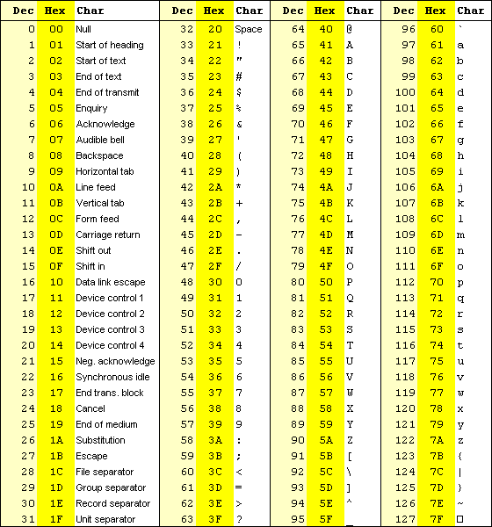

Slide 37
A closer look at variables
char c = 0x2A;//stores (00101010)₂=(2A)₁₆
1001000₂ = 72₁₀
0 | 1 | 0 | 0 | 1 | 0 | 0 | 0
8 bits
?

Slide 38
Input/Output Operations
Input operation
an instruction that copies data from an input device into memory
Output operation
an instruction that displays information stored in memory to the output devices (such as the monitor screen)

Slide 39
Input/Output Functions
A C function that performs an input or output operation
A few functions that are pre-defined in the header file stdio.h such as :
printf()
scanf()
getchar() & putchar()

Slide 40
The printf function
Used to send data to the standard output (usually the monitor) to be printed according to specific format.
General format:
printf(“string literal”);
A sequence of any number of characters surrounded by double quotation marks.
printf(“format string”, variables);
Format string is a combination of text, conversion specifier and escape sequence.

Slide 41
The printf function
Example:
printf(“Thank you”);
printf (“Total sum is: %d\n”, sum);
%d is a placeholder (conversion specifier)
marks the display position for a type integer variable
\n is an escape sequence
moves the cursor to the new line

Slide 42
Placeholder / Conversion Specifier
No | Conversion Specifier | Output Type | Output Example
1 | %d | Signed decimal integer | 76
2 | %i | Signed decimal integer | 76
3 | %o | Unsigned octal integer | 134
4 | %u | Unsigned decimal integer | 76
5 | %x | Unsigned hexadecimal (small letter) | 9c
6 | %X | Unsigned hexadecimal (capital letter) | 9C
7 | %f | Integer including decimal point | 76.0000
8 | %e | Signed floating point (using e notation) | 7.6000e+01
9 | %E | Signed floating point (using E notation) | 7.6000E+01
10 | %g | The shorter between %f and %e | 76
11 | %G | The shorter between %f and %E | 76
12 | %c | Character | ‘7’
13 | %s | String | ‘76'

Slide 43
Escape Sequence
Escape Sequence | Effect
\a | Beep sound
\b | Backspace
\n | New line
\t | Tab
\v | Vertical tab
\\ | Backslash
\” | “ sign

Slide 44
Formatting output
int meters = 21, feet = 68 , inches = 11;
printf("Results:%3d meters=%4d ft.%2d in.\n", meters, feet, inches);
printf("Results:%03d meters=%04d ft.%02d in.\n", meters, feet, inches);
R | e | s | u | l | t | s | : |  | 2 | 1 |  | m | e | t | e | r | s | = |  |  | 6 | 8 |  | f | t | . | 1 | 1 |  | i | n | .
R | e | s | u | l | t | s | : | 0 | 2 | 1 |  | m | e | t | e | r | s | = | 0 | 0 | 6 | 8 |  | f | t | . | 1 | 1 |  | i | n | .

Slide 45
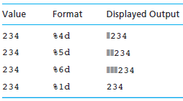
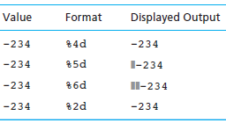
Formatting output

Slide 46
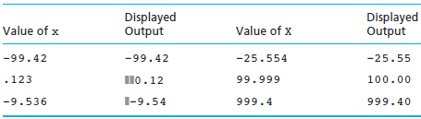
Formatting output
Displaying x Using Format String Placeholder %6.2f

Slide 47
The scanf function
Read data from the standard input device (usually keyboard) and store it in a variable.
General format:
scanf(“Format string”, &variable);
Notice ampersand (&) operator :
C address of operator
it passes the address of the variable instead of the variable itself
tells the scanf() where (in the RAM) to find the variable to store the new value

Slide 48
The scanf function
Example :
int age;
printf(“Enter your age: “);
scanf(“%d”, &age);
Common Conversion specifier used in printf and scanf functions.
 | printf | scanf
int | %d | %d
float | %f | %f
double | %lf | %lf
char | %c | %c
string | %s | %s

Slide 49
The scanf function
If you want the user to enter more than one value, you serialize the inputs.
Example:
float height, weight;
printf(“Please enter your height and weight:”);
scanf(“%f%f”, &height, &weight);

