Slide 1
Lecture 05 Operators and Expressions
CSE115: Computing Concepts

Slide 2
Expressions
An expression is any valid set of literals, variables, operators, operands and expressions that evaluates to a single value.
This value can be a number, a string or a logical value.
For instance a = b + c; denotes an expression in which there are 3 operands a, b, c and two operator + and =.
The number of operands of an operator is called its arity.
Based on arity, operators are classified as nullary (no operands), unary (1 operand), binary (2 operands), ternary (3 operands).

Slide 3
Arithmetic Operators
Operation | Operator | Example (a=5,b=3) | Value of expression
Addition | + | a+b | 8
Subtraction | - | b-a | -2
Multiplication | * | a*b | 15
Integer Division | / | a/b | 1
Modulus | % | a%b | 2
Division | / | a*1.0/b | 1.666666

Slide 4
Arithmetic Operators
If both of the operands are int types, then the result of the expression is an int too. If you want the result to be any other type, you have to use typecasting.
int a = 3, b = 5;
double c;
c = 1/5; //value of c is 0.0
c = 1.0/5; //value of c is 0.2
c = a/b; //value of c is 0.0
c = (double)a/b; //value of c is 0.6
modulus (%) operators works only when both of its operands are int variables/values.

Slide 5
Assignment Operators
Assignment operators are used to combine the '=' operator with one of the binary arithmetic operators
In the following table, assume that c = 9 for all the examples
Operator | Example | Equivalent Statement | Value of c is
+= | c += 7 | c = c + 7 | 16
-= | c -= 8 | c = c – 8 | 1
*= | c *= 10 | c = c * 10 | 90
/= | c /= 5 | c = c / 5 | 1
%= | c %= 5 | c = c % 5 | 4

Slide 6
Unary Operators
C Operation | Operator | Example
Positive | + | a = +3;
Negative | - | b = -a;
The first assigns positive 3 to a.
The second assigns the negative value of a to b.

Slide 7
Operator Precedence
When an expression contains more than one operator, the meaning of the expression may not be immediately clear:
Does i + j * k mean (i + j) * k or
i + (j * k) ?
In C, this potential ambiguity is resolved by operator precedence.
Precedence of the arithmetic operators:
Highest: + - (unary)
* / %
Lowest: + - (binary)

Slide 8
Operator Precedence
Examples:
i + j * k means i + (j * k)
-i * -j means (-i) * (-j)
+i + j / k means (+i) + (j / k)

Slide 9
Associativity
Operator precedence rules alone aren’t enough when an expression contains two or more operators at the same level of precedence. The associativity of the operators now comes into play.
The binary arithmetic operators are all left associative (they group from left to right); the unary operators are right associative.
Examples of associativity:
i - j - k means (i - j) - k
i * j / k means (i * j) / k
i - j * i + k means (i - (j * i)) + k
- - i means -(-i)

Slide 10
Increment and Decrement Operators
The ++ and -- operators increment and decrement variables.
Both operators have the same precedence as negation.
Either operator can be prefix or postfix:
++i (same as i = i + 1)
i++ (same as i = i + 1)
--i (same as i = i - 1)
i-- (same as i = i - 1)
When used as a prefix operator, ++ increments the variable before its value is fetched:
i = 1;
printf("i is %d\n", ++i); /* prints "i is 2" */

Slide 11
Increment and Decrement Operators
When used as a postfix operator, ++ increments the variable after its value is fetched:
i = 1;
printf("i is %d\n", i++); /* prints "i is 1" */
printf("i is %d\n", i); /* prints "i is 2" */
The -- operator has similar properties:
i = 1;
printf("i is %d\n", --i); /* prints "i is 0" */
i = 1;
printf("i is %d\n", i--); /* prints "i is 1" */
printf("i is %d\n", i); /* prints "i is 0" */

Slide 12
Increment and Decrement Operators
int R = 10, count=10;
Statement | Equivalent Statements | R value | Count value
R = count++; | R = count; count = count + 1; | 10 | 11
R = ++count; | count = count + 1; R = count; | 11 | 11
R = count --; | R = count; count = count – 1; | 10 | 9
R = --count; | Count = count – 1; R = count; | 9 | 9

Slide 13
Partial List of C Operators
Precedence | Operator | Associativity
2 | ++ (prefix) -- (prefix) + (unary) - (unary) | Right
3 | * / % | Left
4 | + - | Left
5 | = *= /= %= += -= | Right
6 | ++ (postfix) -- (postfix) | Left

Slide 14
Programming Exercise
Try to predict the output of the following program and see if you can get it right.
#include <stdio.h>
int main()
{
int x = 3;
printf("%d\n", 3 -2 / 4);
printf("%f\n", 3 -2.0 / 4);
printf("%d\n", -27 / -5 + 4 / 3);
printf("%d\n", 16 % -5 + 7 * 6);
printf("%d\n", -12 * 3 % 5 * -23 / +6 - 5 * 2);
printf("%d\n", x-- * 2 + 5);
printf("%d\n", x);
printf("%d\n", --x * 2 + 5);
printf("%d\n", 3 % 5 / (5 % 3));
return 0;
}

Slide 15
Bitwise Operators
& | bitwise AND
| | bitwise OR
^ | bitwise XOR
~ | 1’s compliment
<< | Shift left
>> | Shift right
All these operators (except ~) can be suffixed with =
For instance a &= b; is the same as a = a & b;

Slide 16
Bitwise Operators
Truth table
~a | a^b | a|b | a&b | b | a
1 | 0 | 0 | 0 | 0 | 0
1 | 1 | 1 | 0 | 1 | 0
0 | 1 | 1 | 0 | 0 | 1
0 | 0 | 1 | 1 | 1 | 1

Slide 17
Bitwise Operators
Examples
11010011
&
10001100
------------
10000000
11010011
|
10001100
------------
11011111
11010011
^
10001100
------------
01011111
~11010011
------------
00101100

Slide 18
Bitwise Operators
Examples: int a = 33333, b = -77777;
Expression | Representation | Value
a | 00000000 00000000 10000010 00110101 | 33333
b | 11111111 11111110 11010000 00101111 | -77777
a & b | 00000000 00000000 10000000 00100101 | 32805
a ^ b | 11111111 11111110 01010010 00011010 | -110054
a | b | 11111111 11111110 11010010 00111111 | -77249
~ ( a | b ) | 00000000 00000001 00101101 11000000 | 77248
~ a & ~ b | 00000000 00000001 00101101 11000000 | 77248

Slide 19
Bitwise Operators
Examples
11010011>>3
------------
00011010
11010011<<3
------------
10011000

Slide 20
Bitwise Operators
char c = 130;
int a = 1 << 31; /* shift 1 to the high bit */
unsigned int b = 1 << 31;
Expression | Representation | Action
c | 10111100 | unshifted
c << 4 | 11000000 | left shifted 4
c >> 4 | 00001011 | right shifted 4
a | 10000000 00000000 00000000 00000000 | unshifted
a >> 3 | 11110000 00000000 00000000 00000000 | right shifted 3
b | 10000000 00000000 00000000 00000000 | unshifted
b >> 3 | 00010000 00000000 00000000 00000000 | right shifted 3

Slide 21

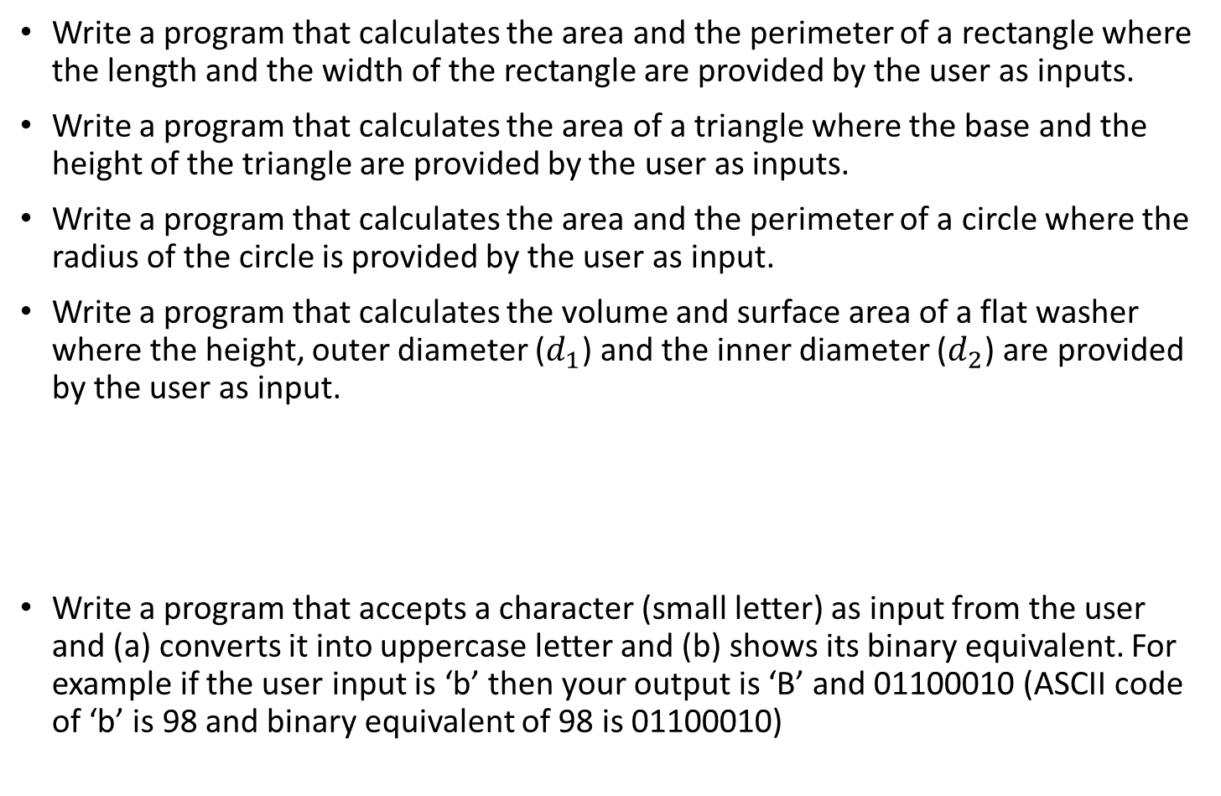

Home-works
Write a program that calculates the area and the perimeter of a rectangle where the length and the width of the rectangle are provided by the user as inputs.
Write a program that calculates the area of a triangle where the base and the height of the triangle are provided by the user as inputs.
Write a program that calculates the area and the perimeter of a circle where the radius of the circle is provided by the user as input.
Write a program that calculates the volume and surface area of a flat washer where the height, outer diameter ($d_{1}$) and the inner diameter ($d_{2}$) are provided by the user as input.
Write a program that accepts a character (small letter) as input from the user and (a) converts it into uppercase letter and (b) shows its binary equivalent. For example if the user input is ‘b’ then your output is ‘B’ and 01100010 (ASCII code of ‘b’ is 98 and binary equivalent of 98 is 01100010)
$$d_{2}$$
$$d_{1}$$

