Slide 1
Lecture 08 Repetition Structures
CSE115: Computing Concepts

Slide 2

Example
Calculate the sum of the following series ($x$ and $m$ are user inputs).
$$x^{0}+x^{1}+x^{2}+x^{3}+⋯+x^{m}$$

Slide 3
Example
Calculate the sum of the following series ($x$ and $m$ are user inputs).
$$x^{0}+x^{1}+x^{2}+x^{3}+⋯+x^{m}$$
#include <stdio.h>
int main()
{
int x, m, term = 1, sum = 1;
scanf("%d%d", &x, &m);
for(i=1; i<=m; i++)
{
term = term * x;
sum = sum + term;
}
printf("Sum = %d", sum);
return 0;
}

Slide 4

Example
Calculate the sum of the following series ($n$ is user input).
$$\frac{1}{1}+\frac{1}{2}+\frac{1}{3}+⋯+\frac{1}{n}$$

Slide 5

Example
Calculate the sum of the following series ($n$ is user input).
$$\frac{1}{1}−\frac{1}{2}+\frac{1}{3}−\frac{1}{4}+\frac{1}{5}−\frac{1}{6}+\frac{1}{7}−⋯±\frac{1}{n}$$

Slide 6
Example
Calculate the sum of the following series ($n$ is user input).
$$\frac{1}{1}−\frac{1}{2}+\frac{1}{3}−\frac{1}{4}+\frac{1}{5}−\frac{1}{6}+\frac{1}{7}−⋯±\frac{1}{n}$$
#include <stdio.h>
int main()
{
int n, i;
double term, sum = 0;
scanf("%d", &n);
for(i=1; i<=n; i++)
{
term = 1.0 / i;
if(i%2 == 0)
sum = sum - term;
else
sum = sum + term;
}
printf("Sum = %lf", sum);
return 0;
}

Slide 7
Selection Inside Loop
Read a positive integer and determine if it is a prime number.
Pseudo-code:
Read integer and store it in number
Set flag to 1
For i = 2 to (number-1)
If number is divisible by i then
Set flag to 0
If flag equals 1, then the number is a prime number, otherwise not

Slide 8
Selection Inside Loop
Read a positive integer and determine if it is a prime number.
#include <stdio.h>
int main()
{
int number, i, flag = 1;
scanf("%d", &number);
for(i=2; i<number; i++)
{
if(number % i == 0)
flag = 0;
}
if(flag == 1)
printf("%d is a prime number",number);
else printf("%d is not a prime number",number);
return 0;
}

Slide 9
Using break Inside Loop
In the prime number example, we do not need to continue the loop till the end once the value of flag is set to zero.
#include <stdio.h>
int main()
{
int number, i, flag = 1;
scanf("%d", &number);
for(i=2; i<number; i++)
{
if(number % i == 0)
{
flag = 0;
break;
}
}
if(flag == 1)
printf("%d is a prime number",number);
else printf("%d is not a prime number",number);
return 0;
}
The break statement makes the loop terminate prematurely.

Slide 10
Using continue Inside Loop
Read 10 integers from the user and calculate the sum of the positive numbers.
#include <stdio.h>
int main()
{
int number, i, sum = 0;
for(i=0; i<10; i++)
{
printf("Enter a number: ");
scanf("%d", &number);
if(number < 0)
continue;
sum = sum + number;
printf("%d is added\n", number);
}
printf("Total = %d",sum);
return 0;
}
The continue statement forces next iteration of the loop, skipping any remaining statements in the loop

Slide 11
Using continue Inside Loop
Read 10 integers from the user and calculate the sum of the positive numbers.
Output:
Enter a number: 1
1 is added
Enter a number: 2
2 is added
Enter a number: 3
3 is added
Enter a number: -4
Enter a number: -5
Enter a number: 6
6 is added
Enter a number: 7
7 is added
Enter a number: 8
8 is added
Enter a number: -9
Enter a number: 10
10 is added
Total = 37
#include <stdio.h>
int main()
{
int number, i, sum = 0;
for(i=0; i<10; i++)
{
printf("Enter a number: ");
scanf("%d", &number);
if(number < 0)
continue;
sum = sum + number;
printf("%d is added\n", number);
}
printf("Total = %d",sum);
return 0;
}

Slide 12
Example: A Travelling Man
Suppose a man (say, A) stands at (0, 0) and waits for user to give him the direction and distance to go.
User may enter N E W S for north, east, west, south, and any value for distance.
When user enters 0 as direction, stop and print out the location where the man stopped
N
W
E
S

Slide 13
float x=0, y=0;
char dir;
float mile;
while (1) {
printf("Please input the direction as N,S,E,W (0 to exit): ");
scanf("%c", &dir); fflush(stdin);
if (dir=='0'){ /*stop input, get out of the loop */
break;
}
if (dir!='N' && dir!='S' && dir!='E' && dir!='W') {
printf("Invalid direction, re-enter \n");
continue;
}
printf("Please input the mile in %c direction: ", dir);
scanf ("%f",&mile); fflush(stdin);
if (dir == 'N'){ /*in north, compute the y*/
y+=mile;
} else if (dir == 'E'){ /*in east, compute the x*/
x+=mile;
} else if (dir == 'W'){ /*in west, compute the x*/
x-=mile;
} else if (dir == 'S'){ /*in south, compute the y*/
y-=mile;
}
}
printf("\nCurrent position of A: (%4.2f,%4.2f)\n",x,y); // output

Slide 14
Nested Loop
What is the output of the following program?
for (i=1; i<=5; i++)
{
for (j=1; j<=4; j++)
{
printf("*");
}
printf("\n");
}

Slide 15
Nested Loop
What is the output of the following program?
Output
****
****
****
****
****
for (i=1; i<=5; i++)
{
for (j=1; j<=4; j++)
{
printf("*");
}
printf("\n");
}

Slide 16
Nested Loop
What is the output of the following program?
for (i=1; i<=5; i++)
{
for (j=1; j<=i; j++)
{
printf("*");
}
printf("\n");
}

Slide 17
Nested Loop
What is the output of the following program?
Output
*
**
***
****
*****
for (i=1; i<=5; i++)
{
for (j=1; j<=i; j++)
{
printf("*");
}
printf("\n");
}

Slide 18
Nested Loop
Write a program that generates the following pattern.
Output
*
++
***
++++
*****

Slide 19
Nested Loop
Write a program that generates the following pattern.
Output
*
++
***
++++
*****
int i, j;
for(i=1; i<=5; i++)
{
for(j=1; j<=i; j++)
{
if (i % 2 == 0)
printf("+");
else
printf("*");
}
printf("\n");
}

Slide 20
Nested Loop
Write a program that generates the following pattern.
Output
*
*+
*+*
*+*+
*+*+*
int i, j;
for(i=1; i<=5; i++)
{
for(j=1; j<=i; j++)
{
if (j % 2 == 0)
printf("+");
else
printf("*");
}
printf("\n");
}

Slide 21
Nested Loop
Write a program that generates the following pattern.
Output
*
**
***
****
*****

Slide 22
Nested Loop
Write a program that generates the following pattern.
Output (for n=5)
*
**
***
****
*****
scanf(“%d”, &n);
for(i=1; i<=n; i++)
{
for(j=1; j<=n-i; j++)
printf(" ");
for(j=1; j<=i; j++)
printf("*");
printf("\n");
}

Slide 23
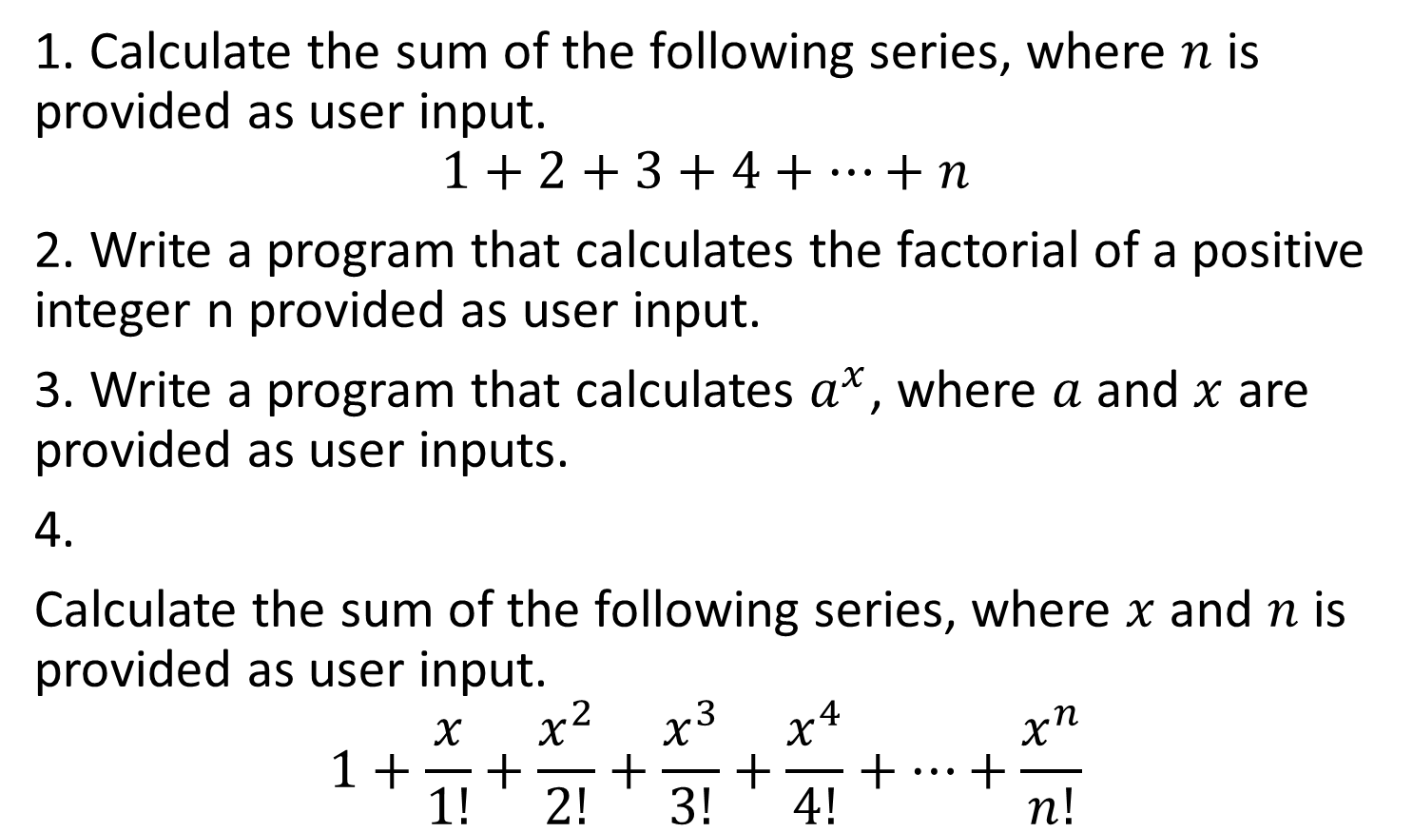
Home-works
1. Calculate the sum of the following series, where $n$ is provided as user input.
$$1+2+3+4+…+n$$
2. Write a program that calculates the factorial of a positive integer n provided as user input.
3. Write a program that calculates $a^{x}$, where $a$ and $x$ are provided as user inputs.
4.
Calculate the sum of the following series, where $x$ and $n$ is provided as user input.
$$1+\frac{x}{1!}+\frac{x^{2}}{2!}+\frac{x^{3}}{3!}+\frac{x^{4}}{4!}+⋯+\frac{x^{n}}{n!}$$

Slide 24
Home-works
5. Write programs that generate the following patterns. In each case, the number of lines is the input.
*****
****
***
**
*
*
***
*****
*******
*********
*********
*******
*****
***
*
**********
**** ****
*** ***
** **
* *
** **
*** ***
**** ****
**********
*
* *
* *
* *
* *
* *
* *
* *
*
*
**
***
****
*****
****
***
**
*

