Slide 1
Lecture 10 Functions
CSE115: Computing Concepts

Slide 2
Functions with Multiple Parameter
A function can have any number of parameters (zero or more)
We have seen functions with no parameter (recall draw)
void draw_rectangle()
{
printf(" ****** \n");
printf(" * * \n");
printf(" * * \n");
printf(" * * \n");
printf(" ****** \n");
}
We have seen function with one parameter
int factorial(int x)
{
int fact = 1, i;
for(i=1;i<=x;i++)
fact *= i;
return fact;
}

Slide 3
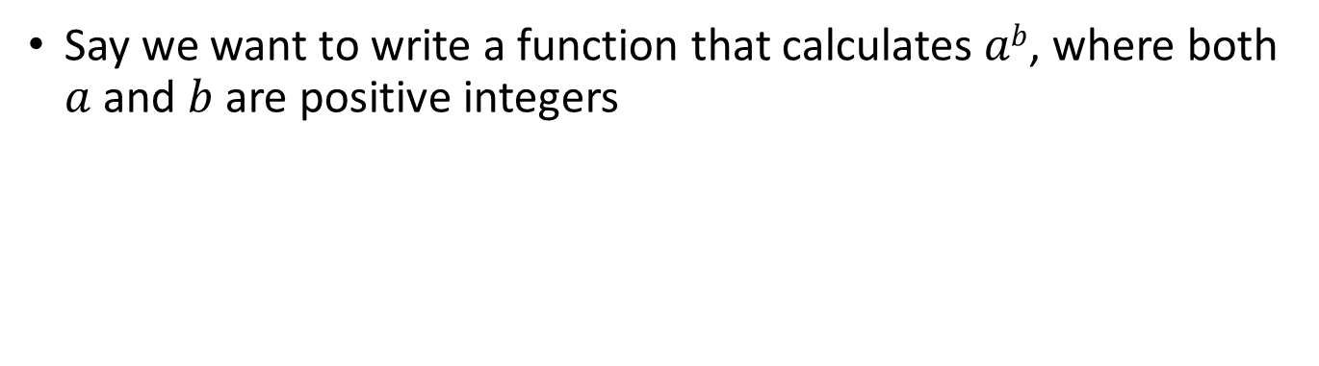
Functions with Multiple Parameter
Say we want to write a function that calculates $ab$, where both $a$ and $b$ are positive integers

Slide 4
Functions with Multiple Parameter
#include <stdio.h>
int power(int a, int b);
int main()
{
int x = 2, y = 8, z;
z = power(x, y);
printf("%d\n",z);
return 0;
}
int power(int a, int b)
{
int i, result = 1;
for(i=1; i<=b; i++)
{
result *= a;
}
return result;
}

Slide 5
Scopes
#include <stdio.h>
void power(int a, int b);
int main()
{
int x = 2, y = 8, z;
power(x, y);
printf("%d\n",result);
return 0;
}
void power(int a, int b)
{
int i, result = 1;
for(i=1; i<=b; i++)
{
result *= a;
}
}
Can we do this?
No, result is defined here (local to the power function), not inside main

Slide 6
Scopes
#include <stdio.h>
void power(int a, int b);
int main()
{
int x = 2, y = 8, z;
power(x, y);
printf("%d\n",result);
return 0;
}
void power(int a, int b)
{
int i, result = 1;
for(i=1; i<=b; i++)
{
result *= a;
}
}
Different scopes. Variable from one scope is not visible inside another
Local variable

Slide 7
Scopes
#include <stdio.h>
void power(int a, int b);
int result;
int main ()
{
int x = 2, y = 8, z;
power(x, y);
printf("%d\n",result);
return 0;
}
void power(int a, int b)
{
int i;
for(i=1, result=1; i<=b; i++)
{
result *= a;
}
}
How about this?

Slide 8

Scopes
#include <stdio.h>
void power(int a, int b);
int result;
int main ()
{
int x = 2, y = 8, z;
power(x, y);
printf("%d\n",result);
return 0;
}
void power(int a, int b)
{
int i;
for(i=1, result=1; i<=b; i++)
{
result *= a;
}
}
How about this?

Slide 9
Scopes
#include <stdio.h>
void power(int a, int b);
int result;
int main ()
{
int x = 2, y = 8, z;
power(x, y);
printf("%d\n",result);
return 0;
}
void power(int a, int b)
{
int i;
for(i=1, result=1; i<=b; i++)
{
result *= a;
}
}
Global variable (declared in the global scope) is visible in both scopes

Slide 10
An Example
Lets find if N is a prime number, where N will be provided by the user

Slide 11
An Example
int is_prime(int a)
{
int i;
for(i=2; i<a; i++)
{
if(a%i == 0)
return 0;
}
return 1;
}

Slide 12
Another Example
Take a number N as input from the user and print this pyramid of asterisk. N is the number of asterisk in the last row (you can assume that N will always be a positive odd number).
*
***
*****
*******
*********

Slide 13
Another Example
void pyramid(int n)
{
int i, j;
for(i=1; i<=n; i+=2)
{
for(j=1; j<=i; j++)
{
printf("*");
}
printf("\n");
}
}

Slide 14
Another Example
Will it work?
void pyramid(int n)
{
int i, j;
for(i=1; i<=n; i+=2)
{
for(j=1; j<=i; j++)
{
printf("*");
}
printf("\n");
}
}

Slide 15
Another Example
Will it work?
void pyramid(int n)
{
int i, j;
for(i=1; i<=n; i+=2)
{
for(j=1; j<=i; j++)
{
printf("*");
}
printf("\n");
}
}
Output for n = 9:
*
***
*****
*******
*********

Slide 16
Another Example
Will it work?
void pyramid(int n)
{
int i, j;
for(i=1; i<=n; i+=2)
{
for(j=1; j<=i; j++)
{
printf("*");
}
printf("\n");
}
}
We should print spaces before doing this
Output for n = 9:
*
***
*****
*******
*********

Slide 17
Another Example
void pyramid(int n)
{
int i, j;
for(i=1; i<=n; i+=2)
{
for(j=1; j<=(n-i)/2; j++)
{
printf(" ");
}
for(j=1; j<=i; j++)
{
printf("*");
}
printf("\n");
}
}

Slide 18
Another Example
void pyramid(int n)
{
int i, j;
for(i=1; i<=n; i+=2)
{
for(j=1; j<=(n-i)/2; j++)
{
printf(" ");
}
for(j=1; j<=i; j++)
{
printf("*");
}
printf("\n");
}
}
Output for n = 9:
*
***
*****
*******
*********

Slide 19
ALT. Solution
void pyramid(int n)
{
int i, j, nsp = n-1, nst = 1;
for(i=1; i<=n; i++)
{
for(j=1; j<=nsp; j++)
{
printf(" ");
}
for(j=1; j<=nst; j++)
{
printf("*");
}
nsp --;
nst += 2;
printf("\n");
}
}
Output for n = 9:
*
***
*****
*******
*********

Slide 20
Yet Another Example
Take a number N as input from the user and print this diamond of asterisk. N is the number of asterisk in the middle row (you can assume that N will always be a positive odd number).
*
***
*****
*******
*********
*********
*******
*****
***
*

Slide 21
Yet Another Example
void upper_pyramid(int n)
{
int i, j;
for(i=1; i<=n; i+=2)
{
for(j=1; j<=(n-i)/2; j++)
{
printf(" ");
}
for(j=1; j<=i; j++)
{
printf("*");
}
printf("\n");
}
}
void lower_pyramid(int n)
{
int i, j;
for(i=n; i>=1; i-=2)
{
for(j=1; j<=(n-i)/2; j++)
{
printf(" ");
}
for(j=1; j<=i; j++)
{
printf("*");
}
printf("\n");
}
}

Slide 22
Yet Another Example
void upper_pyramid(int n)
{
int i, j;
for(i=1; i<=n; i+=2)
{
for(j=1; j<=(n-i)/2; j++)
{
printf(" ");
}
for(j=1; j<=i; j++)
{
printf("*");
}
printf("\n");
}
return 1;
}
void lower_pyramid(int n)
{
int i, j;
for(i=n; i>=1; i-=2)
{
for(j=1; j<=(n-i)/2; j++)
{
printf(" ");
}
for(j=1; j<=i; j++)
{
printf("*");
}
printf("\n");
}
return 1;
}

Slide 23
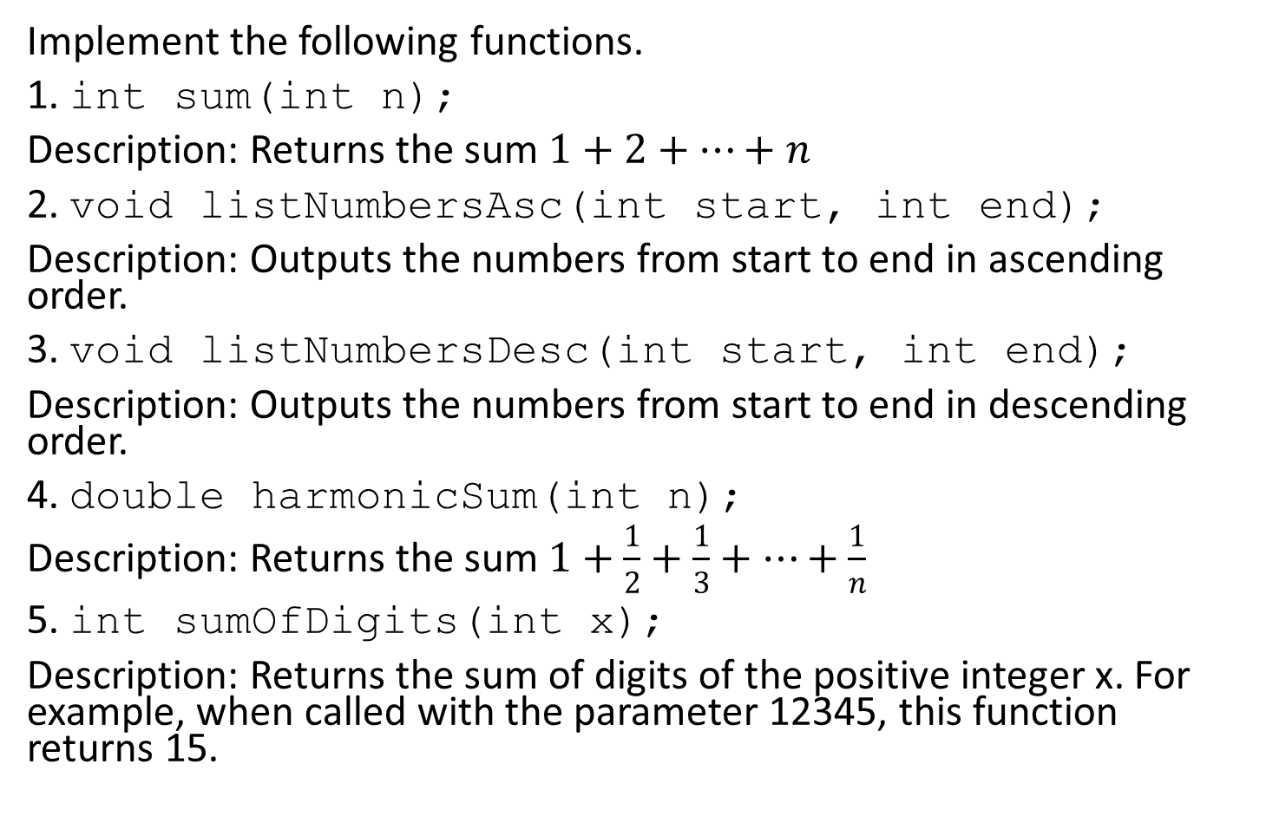
Home-works
Implement the following functions.
1. int sum(int n);
Description: Returns the sum $1+2+…+n$
2. void listNumbersAsc(int start, int end);
Description: Outputs the numbers from start to end in ascending order.
3. void listNumbersDesc(int start, int end);
Description: Outputs the numbers from start to end in descending order.
4. double harmonicSum(int n);
Description: Returns the sum $1+\frac{1}{2}+\frac{1}{3}+…+\frac{1}{n}$
5. int sumOfDigits(int x);
Description: Returns the sum of digits of the positive integer x. For example, when called with the parameter 12345, this function returns 15.

