Slide 1
A Project Update on
Mystery Solver Application
By Group 8 CSE440 (Section-1)

Slide 2
Work Distribution
Serial No. | Student ID | Student Name | Completed Tasks
1. | 2121913042 | Saif Mohammed | Bayesian Network Model & Bayesian Inference Devlopment, Update Project Report Writing
2. | 2121128042 | Humayra Rahman Nipa | Back-End Implementation using Python (Streamlit), Presentation Slide
3. | 2011615042 | Mainul Kaysar | Front-End Development: (Figma Design) Web Pages: User Input, User Output
4. | 2014159642 | Jannatul Islam | Front-End Development: (Figma Design) Web Pages: Profile, SignUp, LogIn
5. | 1931587042 | Saif Uz Zaman | Back-End Model Prototyping.
Project Group-8: Saif Mohammed, Humayra Rahman Nipa, Mainul Kaysar, Jannatu; Islam, Saif Uz Zaman

Slide 3
Problem Statement & Solution
Problem Statement
Create a "Mystery Solver" application utilizing Bayesian networks for solving fictional mystery scenarios. Users input clues and evidence, and the system infers probabilities of various suspects being guilty based on Bayesian inference.
Proposed Solution
Web based Application: Provide User-friendly web interface
Bayesian Network: Models relationships between clues, evidence, and suspects.
Inference Engine: Dynamically updates guilt probabilities using Bayesian inference.
Results Display: Visualizes suspect probabilities with explanations.
Project Group-8: Saif Mohammed, Humayra Rahman Nipa, Mainul Kaysar, Jannatu; Islam, Saif Uz Zaman

Slide 4
Key Features
Adaptable Mystery Scenarios: Works with different fictional settings.
Clue & Evidence Input: Users provide clues and evidence for the case.
Interactive UI: Simple and intuitive interface for engaging with cases.
Graphical Representation: Factor Graph for Visual Insights to determine suspect guilt.
Bayesian Inference: Uses probability-based reasoning to determine suspect guilt.
Project Group-8: Saif Mohammed, Humayra Rahman Nipa, Mainul Kaysar, Jannatu; Islam, Saif Uz Zaman

Slide 5
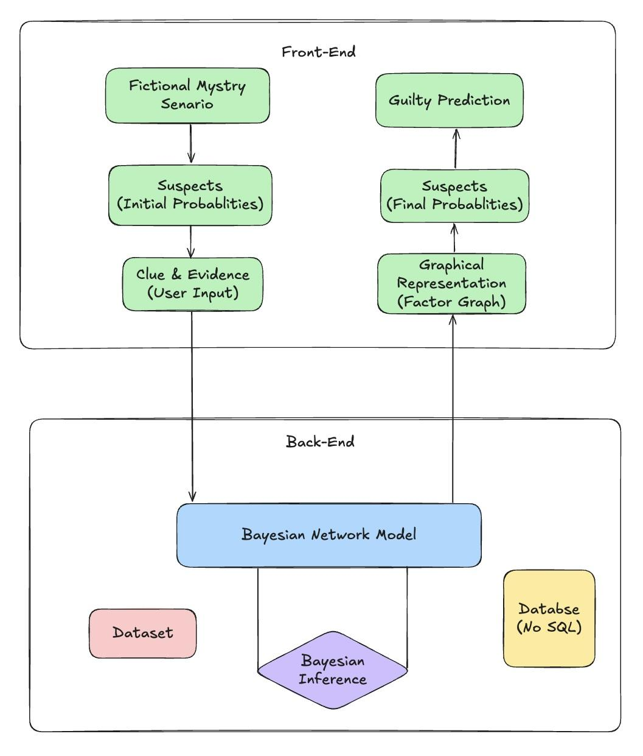
Project Diagram
Project Group-8: Saif Mohammed, Humayra Rahman Nipa, Mainul Kaysar, Jannatu; Islam, Saif Uz Zaman

Slide 6
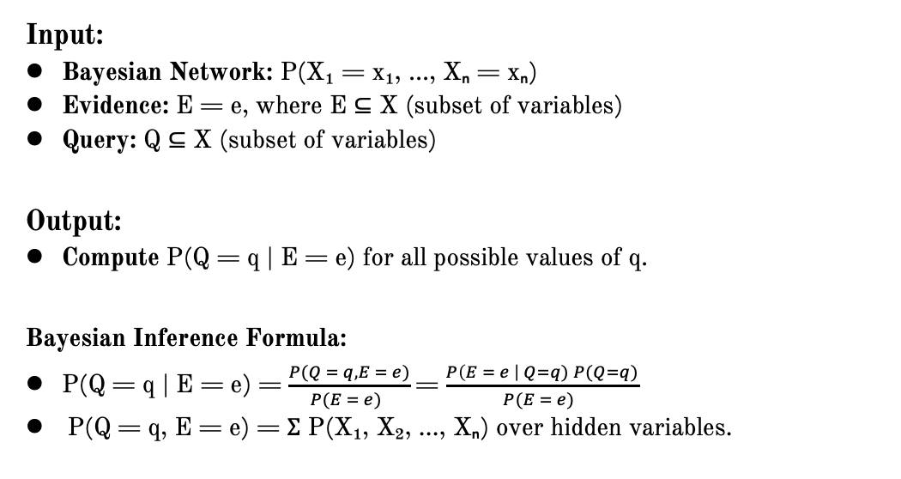
Baysian Network & Inference
Input:
Bayesian Network: P(X₁ = x₁, ..., Xₙ = xₙ)
Evidence: E = e, where E ⊆ X (subset of variables)
Query: Q ⊆ X (subset of variables)
Output:
Compute P(Q = q | E = e) for all possible values of q.
Bayesian Inference Formula:
P(Q = q | E = e) = $\frac{P(Q = q, E = e)}{P(E = e) }$ = $\frac{P\left(E = e \right| Q=q) P(Q=q)}{P(E = e) }$
P(Q = q, E = e) = Σ P(X₁, X₂, ..., Xₙ) over hidden variables.
Project Group-8: Saif Mohammed, Humayra Rahman Nipa, Mainul Kaysar, Jannatu; Islam, Saif Uz Zaman

Slide 7
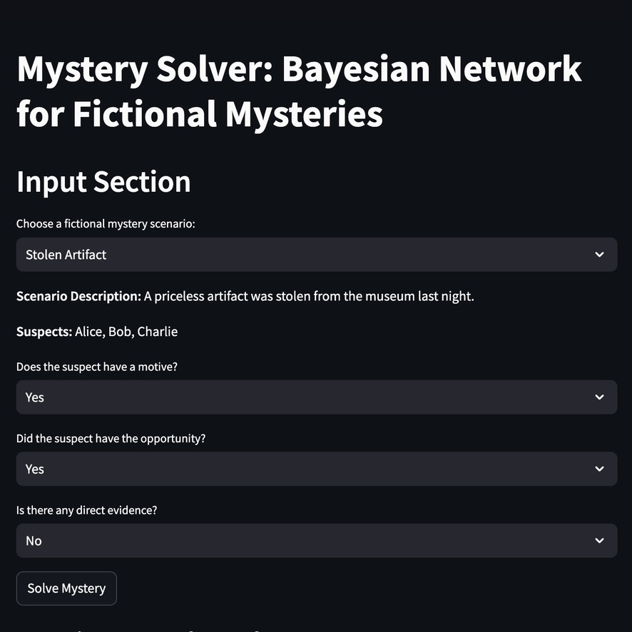
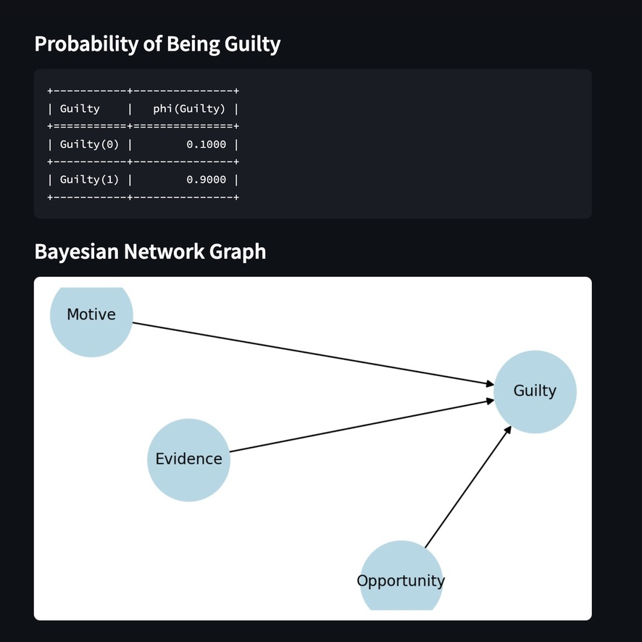
Baysian Network Model Prototyping
Figure 1: Input using Streamlit
Figure 2: Output using Streamlit
Project Group-8: Saif Mohammed, Humayra Rahman Nipa, Mainul Kaysar, Jannatu; Islam, Saif Uz Zaman

Slide 8
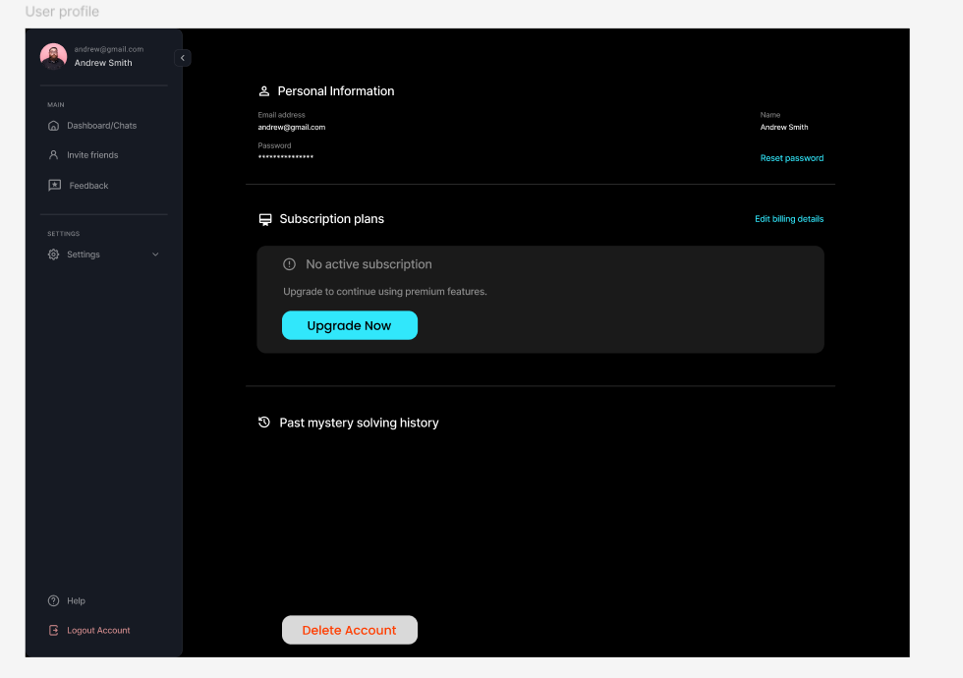
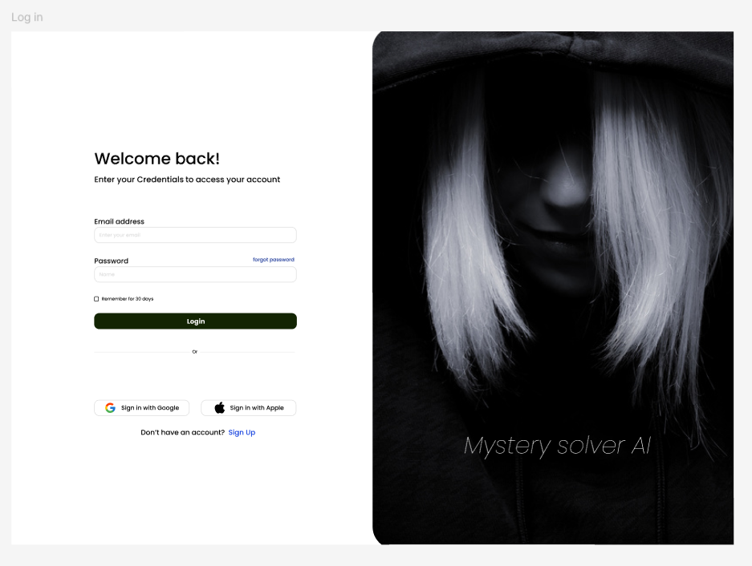
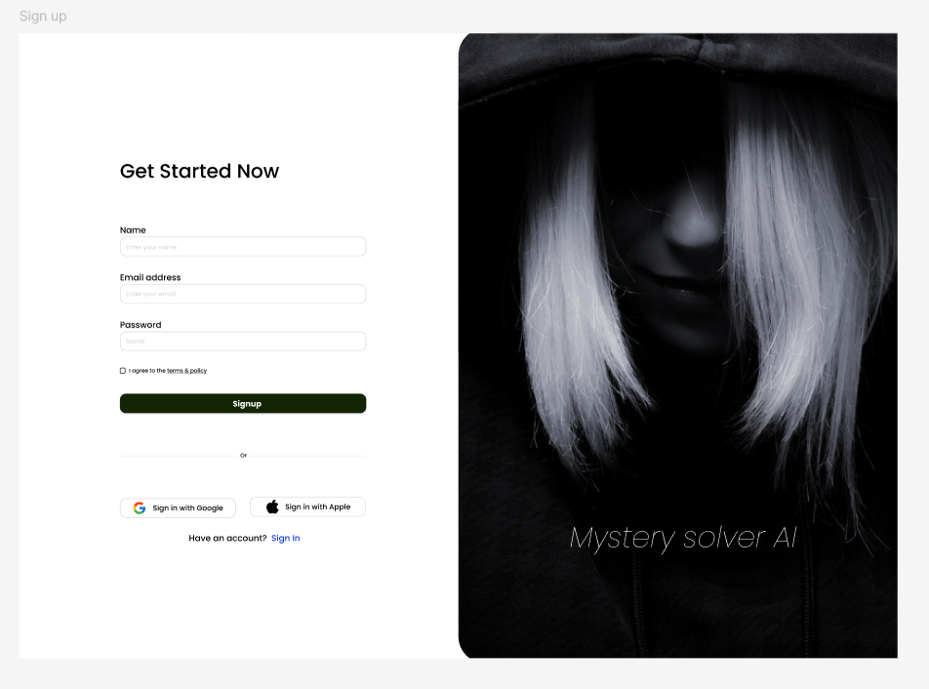
Front-End (Figma Design)
Figure 3: User Profile, SignUp, & LogIn Page
Project Group-8: Saif Mohammed, Humayra Rahman Nipa, Mainul Kaysar, Jannatu; Islam, Saif Uz Zaman

Slide 9
Technology Stack
Front-End
Language: HTML, CSS, JavaScript
Framework: Java Springboot
Visualization: Chart.js
Back-End
Language: Python
Bayesian Network Implementation: pgmpy (Probablistic Graphical Model)
Framework: Django
Database: MongoDB (NoSQL)
Project Group-8: Saif Mohammed, Humayra Rahman Nipa, Mainul Kaysar, Jannatu; Islam, Saif Uz Zaman

Slide 10
Progress & Achievements
Developed Bayesian Network model and used Bayesian Inference.
Implemented UI Design (Figma) for clue input and results visualization.
Tested initial mystery scenarios with sample dataset.
Optimized performance for quick probability calculations.
Next Steps:
Improve accuracy of Bayesian Inference.
Expand the library of mystery scenarios.
Implement Web-UI with more interactive elements Front-End.
Connect Database (NoSQL) for multiple users
Project Group-8: Saif Mohammed, Humayra Rahman Nipa, Mainul Kaysar, Jannatu; Islam, Saif Uz Zaman

Slide 11
References
1. Stanford University, ”Bayesian Networks 1 - Inference — Stanford CS221: AI (Autumn 2019),” YouTube, Oct. 2019. [Online]. Available: https://youtu.be/U23yuPEACG0?si=ifV8mUMcd-86-rmL. [Accessed: 24-Feb-2025].
2. P. Bercker, ”Who is guilty? Another look at a puzzle with Bayesian networks,” Medium, [Online]. Available: https://medium.com/@pbercker/who-is-guilty-another-look-at-a-puzzle-with-bayesian-networks-d1d2369ac9ce. [Accessed: Feb. 24, 2025].
3. “Evidence in Context: Bayes’ Theorem and Investigations,” YouTube, [Online]. Available: https://youtu.be/EC6bf8JCpDQ?si=vzAoYaC-O6bckkdI. [Accessed: Feb. 24, 2025].
4. P. Blair and D. K. Rossmo, “Evidence in Context: Bayes’ Theorem and Investigations,” Police Quarterly, vol. 13, no. 2, pp. 123-135, 2010. [On-line]. Available: https://doi.org/10.1177/1098611110365686. [Accessed:Feb. 24, 2025].
5. D. K. Rossmo, “Using Bayesian Networks in Crime Inves-tigations,” Divaportal, [Online]. Available: https://www.divaportal.org/smash/get/diva2:1265471/FULLTEXT01.pdf. [Accessed: Feb. 24, 2025
Project Group-8: Saif Mohammed, Humayra Rahman Nipa, Mainul Kaysar, Jannatu; Islam, Saif Uz Zaman

