Slide 1
ClueChain: A Bayesian Network-Based Mystery Solver Application
By Group 8 CSE440 (Section-1)

Slide 2
Introduction & Motivation
CSE440.1 Saif Mohammed | Humayra Rahman Nipa Group-08 Mainul Kaysar | Jannatul Islam | Saif Uz Zaman
Problem: Reasoning under uncertainty is crucial but challenging, especially when integrating diverse, incomplete evidence (e.g., investigations, diagnostics).
Solution Approach: Bayesian Networks (BNs) provide a powerful framework for modeling probabilistic relationships and updating beliefs based on evidence.
Project Goal: To develop ClueChain, an interactive application demonstrating the practical use of BNs for solving a fictional mystery, making probabilistic inference accessible.
Key Contribution: An educational tool illustrating evidence integration and belief updating using BNs.

Slide 3
Background: Bayesian Networks
CSE440.1 Saif Mohammed | Humayra Rahman Nipa Group-08 Mainul Kaysar | Jannatul Islam | Saif Uz Zaman
What are BNs? Probabilistic Graphical Models.
Nodes = Random Variables (e.g., Suspect, Evidence Type)
Edges = Direct Dependencies (Causal links, e.g., Guilty Party → Fingerprints Found)
Structure = Directed Acyclic Graph (DAG)
Key Concepts:
Conditional Probability Distributions (CPDs): Quantify dependencies (P(Evidence | GuiltyParty)).
Conditional Independence: Structure encodes assumptions (Evidence items are independent given the Guilty Party).
Inference: Calculating probabilities of interest given evidence (P(GuiltyParty | Evidence)).
Why BNs for this problem? Excellent for modeling causal relationships and updating beliefs as new evidence arrives.

Slide 4
The Mystery Scenario: Case of the Missing Manuscript
CSE440.1 Saif Mohammed | Humayra Rahman Nipa Group-08 Mainul Kaysar | Jannatul Islam | Saif Uz Zaman
Context: Valuable manuscript stolen from a locked library room.
Goal: Determine the most likely culprit based on gathered clues.
Suspects (Hypothesis Variable - GuiltyParty):
A: The Scholar (Access, rivalry motive)
B: The Butler (Keys, claims ignorance)
C: The Cat Burglar (Known thief, monetary motive)
Potential Evidence (Evidence Variables):
Forced Entry (Yes/No)
Alibi A, Alibi B, Alibi C (Verified/Not Verified/Unknown)
Fingerprints (A/B/C/None/Unknown)
Security Footage (Useful/Obscured/Unknown)

Slide 5
Bayesian Network Design
CSE440.1 Saif Mohammed | Humayra Rahman Nipa Group-08 Mainul Kaysar | Jannatul Islam | Saif Uz Zaman
Bayesian Model Structure:
Root Node: GuiltyParty (States: A, B, C) - Uniform Prior (1/3 each initially).
Evidence Nodes: ForcedEntry, AlibiA, AlibiB, AlibiC, Fingerprints, SecurityFootage.
Edges: GuiltyParty → Each Evidence Node.
Assumption: Evidence variables are conditionally independent given the GuiltyParty.
Parameterization (CPDs):
Defined using "knowledge engineering" based on scenario logic.
Example: P(ForcedEntry=Yes | GuiltyParty=C) = 0.9 (Cat Burglar likely forces entry).
Example: P(AlibiA=No | GuiltyParty=A) = 0.8 (Guilty Scholar likely lacks alibi).
Implemented using pgmpy's TabularCPD.

Slide 6
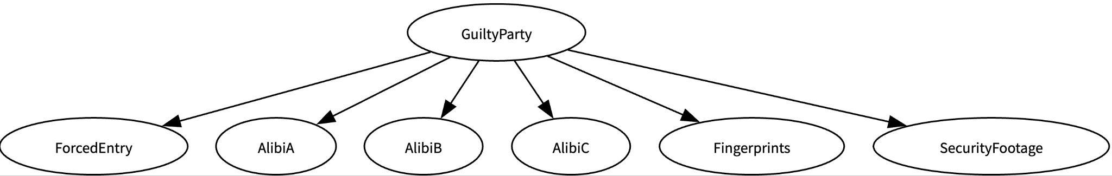
Bayesian Network Model
CSE440.1 Saif Mohammed | Humayra Rahman Nipa Group-08 Mainul Kaysar | Jannatul Islam | Saif Uz Zaman

Slide 7
Results: Initial State
CSE440.1 Saif Mohammed | Humayra Rahman Nipa Group-08 Mainul Kaysar | Jannatul Islam | Saif Uz Zaman
Show:
Sidebar with evidence inputs set to 'Unknown'.
Main panel showing the BN graph (if available).
Table/Bar chart showing PRIOR probabilities:
P(GuiltyParty) = {A: 33.3%, B: 33.3%, C: 33.3%}.
Point: Establishes the baseline belief before any evidence

Slide 8
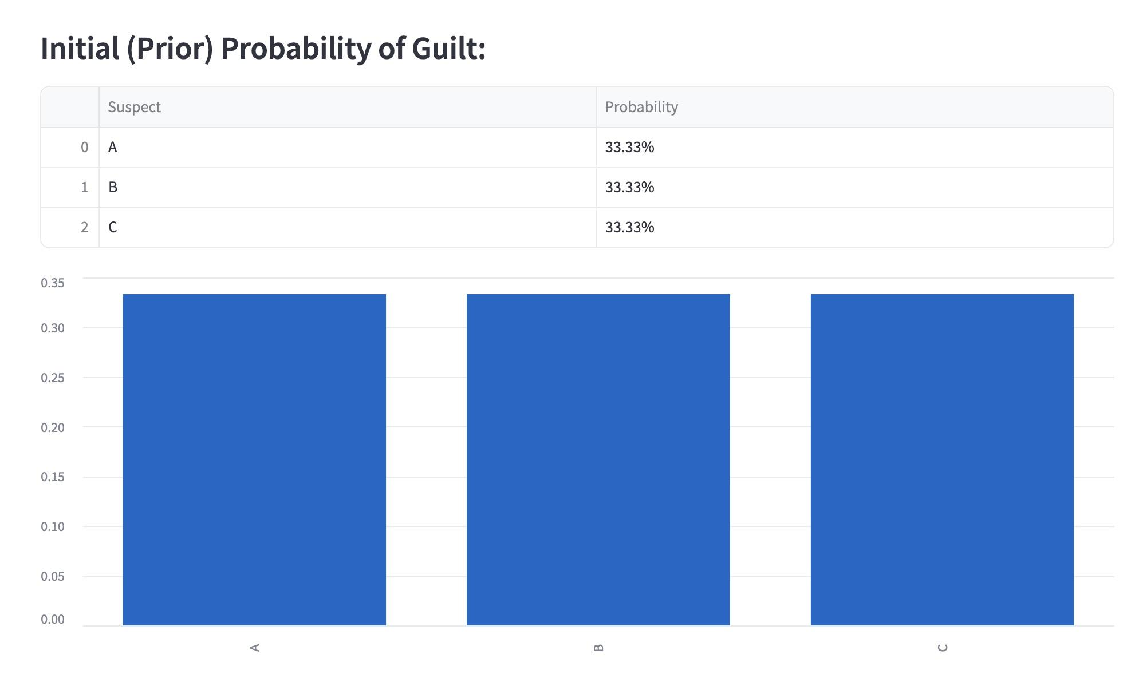
Results: Initial State (Screenshot)
CSE440.1 Saif Mohammed | Humayra Rahman Nipa Group-08 Mainul Kaysar | Jannatul Islam | Saif Uz Zaman

Slide 9
Application Demo: Scenario 1 (Strong Evidence)
CSE440.1 Saif Mohammed | Humayra Rahman Nipa Group-08 Mainul Kaysar | Jannatul Islam | Saif Uz Zaman
Input Evidence:
Forced Entry: Yes
Alibi A: Yes, Alibi B: Yes, Alibi C: No
Fingerprints: C
Show:
Updated Table/Bar chart showing POSTERIOR probabilities.
Expected Result: High probability for Suspect C (e.g., > 95%), very low for A and B.
Explain: How the evidence (Forced Entry, No Alibi C, FP=C) strongly supports C based on the defined CPDs, leading to belief update.

Slide 10
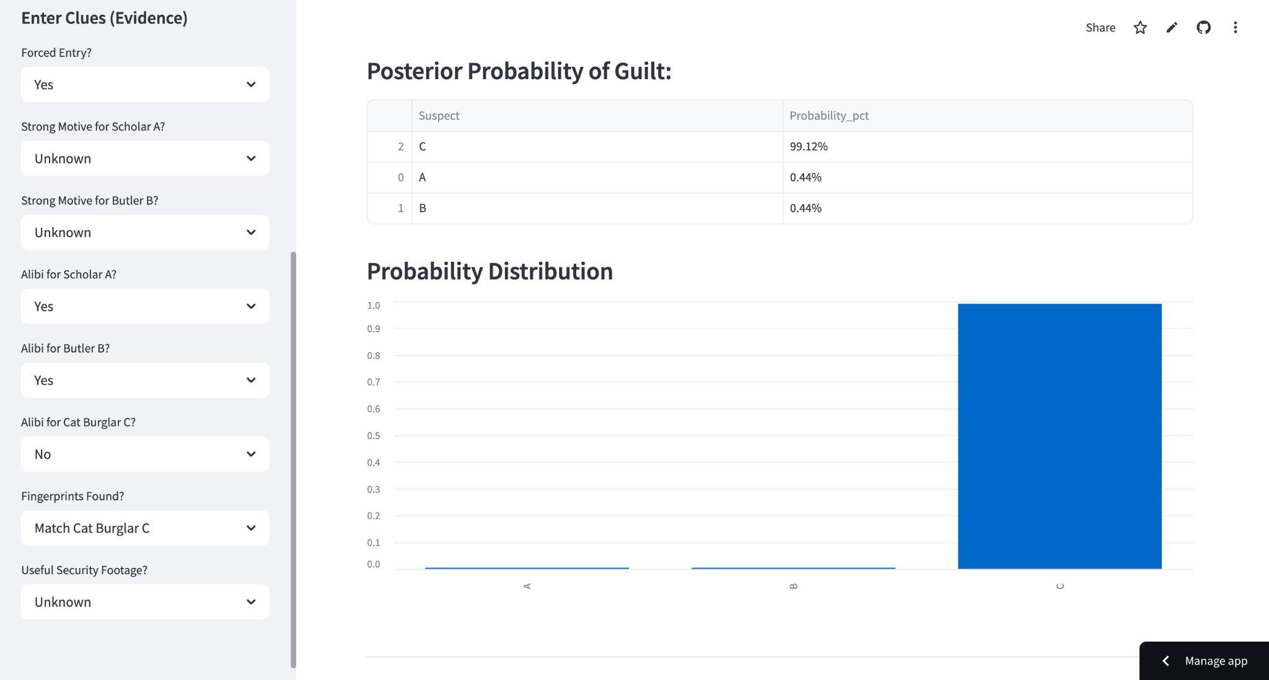
Application Demo: Scenario 1 (Strong Evidence)
CSE440.1 Saif Mohammed | Humayra Rahman Nipa Group-08 Mainul Kaysar | Jannatul Islam | Saif Uz Zaman

Slide 11
Application Demo: Scenario 2 (Ambiguous Evidence)
CSE440.1 Saif Mohammed | Humayra Rahman Nipa Group-08 Mainul Kaysar | Jannatul Islam | Saif Uz Zaman
Input Evidence:
Forced Entry: Unknown
Alibi A: Yes, Alibi B: No, Alibi C: No
Fingerprints: NoneFound
Show:
Updated Table/Bar chart showing POSTERIOR probabilities.
Expected Result: More distributed probabilities, perhaps C is most likely (due to no alibi), but A/B retain some probability. (e.g., A: 10%, B: 30%, C: 60%).
Explain: How conflicting/weak evidence leads to less certainty in the conclusion. Highlights the quantitative nature of belief.

Slide 12
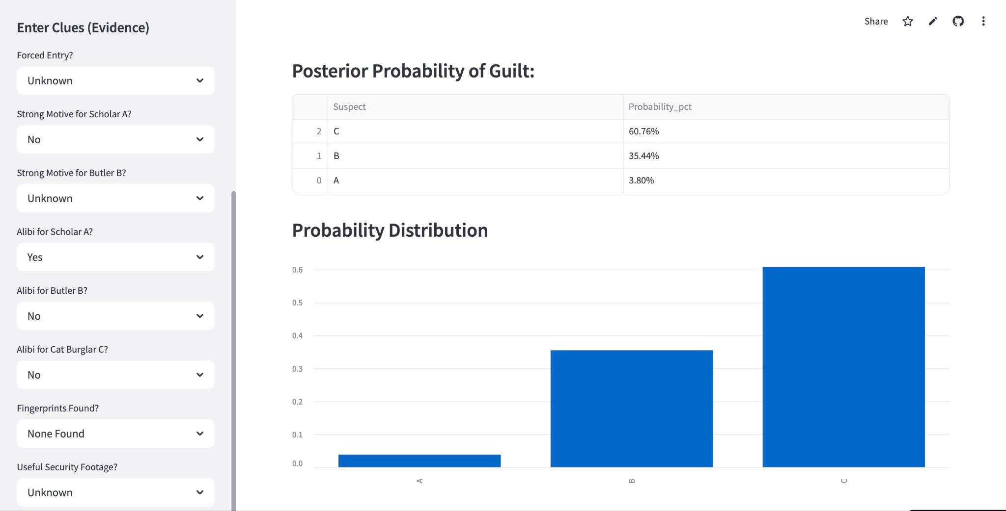
Application Demo: Scenario 2 (Ambiguous Evidence)
CSE440.1 Saif Mohammed | Humayra Rahman Nipa Group-08 Mainul Kaysar | Jannatul Islam | Saif Uz Zaman

Slide 13
System Architecture & Implementation
CSE440.1 Saif Mohammed | Humayra Rahman Nipa Group-08 Mainul Kaysar | Jannatul Islam | Saif Uz Zaman
Core Engine: Python + pgmpy library
Defining BN Structure (DiscreteBayesianNetwork)
Defining CPDs (TabularCPD)
Performing Inference
Inference Algorithm: Variable Elimination (VE)
Why VE? Exact inference, efficient for this network's polytree structure.
Computes: P(GuiltyParty | Evidence)
User Interface: Streamlit
Web-based, interactive.
Widgets (st.selectbox) for evidence input (includes 'Unknown' option).
Displays results (tables, charts).
Visualization: graphviz - Renders the BN graph.

Slide 14
Discussion
CSE440.1 Saif Mohammed | Humayra Rahman Nipa Group-08 Mainul Kaysar | Jannatul Islam | Saif Uz Zaman
Strengths:
Successfully demonstrates BN principles interactively.
Clear visualization of belief updating based on evidence.
Intuitive UI makes complex concepts accessible.
Shows practical application of pgmpy and Streamlit.
Effective educational tool for probabilistic reasoning.
Interpretation: Probabilities are conditional on the model structure (DAG) and parameters (CPDs) AND the evidence. They represent reasoned belief, not absolute fact

Slide 15
Limitations
CSE440.1 Saif Mohammed | Humayra Rahman Nipa Group-08 Mainul Kaysar | Jannatul Islam | Saif Uz Zaman
Dependence on Priors: Requires accurate prior probabilities; bias can affect results.
Independence Assumptions: Real-world clues may not be conditionally independent.
Scalability Issues: Complexity grows with more clues and suspects.
Structure Learning: Hard to define accurate networks without expert input.
Missing Data: Incomplete clues reduce inference accuracy.
No Temporal Modeling: Struggles with sequences or time-based events.
Interpretability: Probabilistic outputs may confuse non-expert users.

Slide 16
Future Work
CSE440.1 Saif Mohammed | Humayra Rahman Nipa Group-08 Mainul Kaysar | Jannatul Islam | Saif Uz Zaman
Enhance Priors: Use real case data or user feedback to refine priors.
Advanced Models: Incorporate dynamic Bayesian networks for temporal reasoning.
Automated Structure Learning: Apply ML algorithms to learn network structure.
Scalability Solutions: Use approximate inference for faster computation.
Handle Missing Data: Implement robust imputation techniques.
Improve UX: Visualize probabilities clearly for better user understanding.
Contextual Awareness: Integrate NLP to interpret complex clues.

Slide 17
Conclusion
CSE440.1 Saif Mohammed | Humayra Rahman Nipa Group-08 Mainul Kaysar | Jannatul Islam | Saif Uz Zaman
Summary: Developed ClueChain, an interactive application using Bayesian Networks to solve a fictional mystery.
Achievements:
Implemented BN model using pgmpy.
Used Variable Elimination for exact inference.
Created an intuitive UI with Streamlit.
Successfully demonstrated evidence integration and Bayesian belief updating.
Significance: Provides a valuable tool for understanding and illustrating the power of probabilistic reasoning in AI.

Slide 18
Thank You

