Slide 1

OOPS (JAVA)
Lec-36
Saif Nalband

Slide 2
Contents :
Graphical User Interface (GUI)
AWT
Swing
Event handling

Slide 3
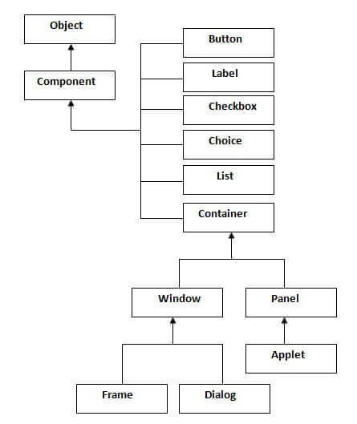

Slide 4
JAVA Swing
Java Swing tutorial is a part of Java Foundation Classes (JFC) that is used to create window-based applications. It is built on the top of AWT (Abstract Windowing Toolkit) API and entirely written in java.
Unlike AWT, Java Swing provides platform-independent and lightweight components.
The javax.swing package provides classes for java swing API such as JButton, JTextField, JTextArea, JRadioButton, JCheckbox, JMenu, JColorChooser etc

Slide 5
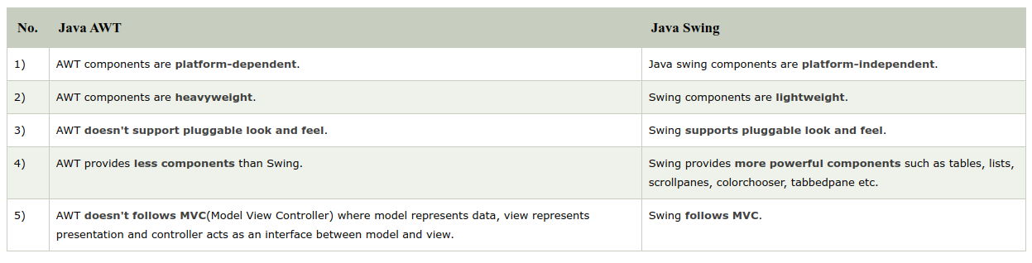
AWT Vs Swing

Slide 6
Commonly used Methods of Component class
The methods of Component class are widely used in java swing that are given below.
Method | Description
public void add(Component c) | add a component on another component.
public void setSize(int width, int height) | sets size of the component.
public void setLayout(LayoutManager m) | sets the layout manager for the component.
public void setVisible(boolean b) | sets the visibility of the component. It is by default false.

Slide 7
Java Swing Examples
There are two ways to create a frame:
By creating the object of Frame class (association)
By extending Frame class (inheritance)
We can write the code of swing inside the main(), constructor or any other method.
Demo350

Slide 8
Java JButton
The JButton class is used to create a labeled button that has platform independent implementation. The application result in some action when the button is pushed. It inherits AbstractButton class.
JButton() : It creates a button with no text and icon.
JButton(String s) : It creates a button with the specified text.
JButton(Icon i) : It creates a button with the specified icon object.
Demo351/2

Slide 9
Event Handling
What is Event Handling?
Event Handling is the mechanism that controls the event and decides what should happen if an event occurs. This mechanism has a code which is known as an event handler, that is executed when an event occurs.
Java uses the Delegation Event Model to handle the events. This model defines the standard mechanism to generate and handle the events.

Slide 10
Event handling
A source generates an event and it goes to one or more listeners.
In other words, a listeners is watchful to receive an event
Java provides a several classes and interfaces to handle several events.

Slide 11
Event Handling
The Delegation Event Model has the following key participants.
Source − The source is an object on which the event occurs. Source is responsible for providing information of the occurred event to it's handler. Java provide us with classes for the source object.
Listener − It is also known as event handler. The listener is responsible for generating a response to an event. From the point of view of Java implementation, the listener is also an object. The listener waits till it receives an event. Once the event is received, the listener processes the event and then returns.

Slide 12
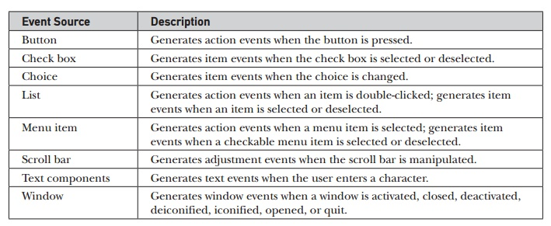
Different Source of Events

Slide 13
Events and Components relation
Event Name | Component
ActionEvent | Button, List MenuItem
ItemEvent | CheckBox, Choice, CheckboxMenu Item,List
Component Event | Component (When Component is hidden/ moved/ resized/visible)
ContainerEvent | Container (When Component is hidden/ moved/ resized/visible) to/ from container
AdjustmentEvent | Scrollbar
TextEvent | Textfield
FocusEvent | When a component gain or lose keyboard/ mouse focus
WindowEvent | When a window is activated, closed/ deactivated
KeyEvent | When an input is done from keyboard to a component
MouseEvent | When mouse is clicked/ fragged/ moved/ released / a component

Slide 14
Event Classes | Description | Listener Interface
ActionEvent | generated when button is pressed, menu-item is selected, list-item is double clicked | ActionListener
MouseEvent | generated when mouse is dragged, moved,clicked,pressed or released and also when it enters or exit a component | MouseListener
KeyEvent | generated when input is received from keyboard | KeyListener
ItemEvent | generated when check-box or list item is clicked | ItemListener
TextEvent | generated when value of textarea or textfield is changed | TextListener
MouseWheelEvent | generated when mouse wheel is moved | MouseWheelListener
WindowEvent | generated when window is activated, deactivated, deiconified, iconified, opened or closed | WindowListener
ComponentEvent | generated when component is hidden, moved, resized or set visible | ComponentEventListener
ContainerEvent | generated when component is added or removed from container | ContainerListener
AdjustmentEvent | generated when scroll bar is manipulated | AdjustmentListener
FocusEvent | generated when component gains or loses keyboard focus | FocusListener

Slide 15
Steps to perform Event Handling
Following steps are required to perform event handling:
Register the component with the Listener

Slide 16
For registering the component with the Listener, many classes provide the registration methods.
Button: public void addActionListener(ActionListener a){}
MenuItem: public void addActionListener(ActionListener a){}
TextField: public void addActionListener(ActionListener a){}
public void addTextListener(TextListener a){}
TextArea: public void addTextListener(TextListener a){}

Slide 17
Checkbox: public void addItemListener(ItemListener a){}
Choice: public void addItemListener(ItemListener a){}
List : public void addActionListener(ActionListener a){}
public void addItemListener(ItemListener a){}

Slide 18
Java Event Handling Code
We can put the event handling code into one of the following places:
Within class
Other class
Anonymous class
DemoEvent1
DemoEvent2
DemoEvent3

Slide 19
Anonymous Inner Class in Java
It is an inner class without a name and for which only a single object is created.
An anonymous inner class can be useful when making an instance of an object with certain “extras” such as overloading methods of a class or interface, without having to actually subclass a class.
Anonymous inner classes are useful in writing implementation classes for listener interfaces in graphics programming.

Slide 20
Anonymous inner class are mainly created in two ways:
Class (may be abstract or concrete)
Interface

Slide 21
Syntax: Anonymous Inner Class
Syntax: The syntax of an anonymous class expression is like the invocation of a constructor, except that there is a class definition contained in a block of code.
// Test can be interface,abstract/concrete class
Test t = new Test()
{
// data members and methods
public void test_method()
{
........
........
}
}; DemoAn1/An2

Slide 22
Java JButton Example with ActionListener
The Java ActionListener is notified whenever you click on the button or menu item. It is notified against ActionEvent.
The ActionListener interface is found in java.awt.event package.
It has only one method: actionPerformed().
Demo353

Slide 23
actionPerformed() method
The actionPerformed() method is invoked automatically whenever you click on the registered component.
public abstract void actionPerformed(ActionEvent e);

Slide 24
Java JLabel
The object of JLabel class is a component for placing text in a container. It is used to display a single line of read only text. The text can be changed by an application but a user cannot edit it directly. It inherits JComponent class.
JLabel() : Creates a JLabel instance with no image and with an empty string for the title.
JLabel(String s): Creates a JLabel instance with the specified text.
JLabel(Icon i): Creates a JLabel instance with the specified image.
JLabel(String s, Icon i, int horizontalAlignment): Creates a JLabel instance with the specified text, image, and horizontal alignment. Demo355/6

Slide 25
Methods
String getText() : t returns the text string that a label displays.
void setText(String text): It defines the single line of text this component will display.
void setHorizontalAlignment(int alignment) It sets the alignment of the label's contents along the X axis.
Icon getIcon() It returns the graphic image that the label displays.
int getHorizontalAlignment() It returns the alignment of the label's contents along the X axis.

Slide 26
Java JTextField
The object of a JTextField class is a text component that allows the editing of a single line text. It inherits JTextComponent class
public class JTextField extends JTextComponent implements SwingConstants
Demo357

Slide 27
Common Constructors
JTextField() Creates a new TextField
JTextField(String text) Creates a new TextField initialized with the specified text.
JTextField(String text, int columns) Creates a new TextField initialized with the specified text and columns.
JTextField(int columns) Creates a new empty TextField with the specified number of columns.

Slide 28
Commonly used Methods:
void addActionListener(ActionListener l) It is used to add the specified action listener to receive action events from this textfield.
Action getAction() It returns the currently set Action for this ActionEvent source, or null if no Action is set.
void setFont(Font f) It is used to set the current font.
void removeActionListener(ActionListener l) It is used to remove the specified action listener so that it no longer receives action events from this textfield.
Demo358

Slide 29
Java JTextArea
The object of a JTextArea class is a multi line region that displays text. It allows the editing of multiple line text. It inherits JTextComponent class
public class JTextArea extends JTextComponent
Demo359/10

Slide 30
Common Constructors
JTextArea() Creates a text area that displays no text initially.
JTextArea(String s) Creates a text area that displays specified text initially.
JTextArea(int row, int column) Creates a text area with the specified number of rows and columns that displays no text initially.
JTextArea(String s, int row, int column) Creates a text area with the specified number of rows and columns that displays specified text.

Slide 31
Common Methods
void setRows(int rows) It is used to set specified number of rows.
void setColumns(int cols) It is used to set specified number of columns.
void setFont(Font f) It is used to set the specified font.
void insert(String s, int position) It is used to insert the specified text on the specified position.
void append(String s) It is used to append the given text to the end of the document.
Demo359/Demo3510

Slide 32
Thank you and
Stay Home and Stay safe

