Slide 1
OOPS using JAVA
Saif Nalband

Slide 2
JAVA I/O
Java I/O (Input and Output) is used to process the input and produce the output.
Java uses the concept of a stream to make I/O operation fast. The java.io package contains all the classes required for input and output operations.
We can perform file handling in Java by Java I/O API.

Slide 3
Stream
A stream is a sequence of data. In Java, a stream is composed of bytes. It's called a stream because it is like a stream of water that continues to flow.
In Java, 3 streams are created for us automatically. All these streams are attached with the console.
1) System.out: standard output stream
2) System.in: standard input stream
3) System.err: standard error stream

Slide 4
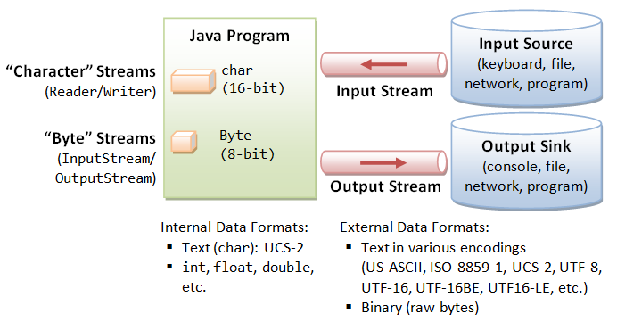
InputStream
Java application uses an input stream to read data from a source; it may be a file, an array, peripheral device or socket
OutputStream class is an abstract class. It is the superclass of all classes representing an output stream of bytes. An output stream accepts output bytes and sends them to some sink.

Slide 5
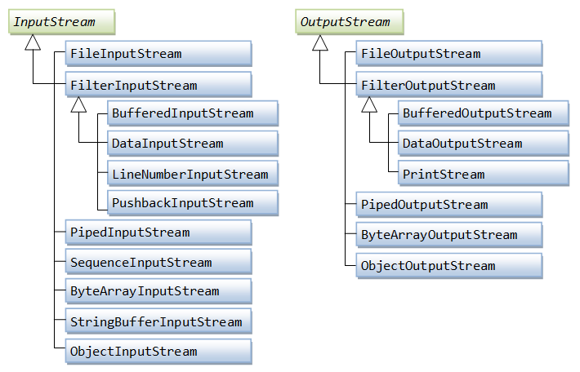
Streams: Input and OutputStreams
Demo3702-3708

Slide 6
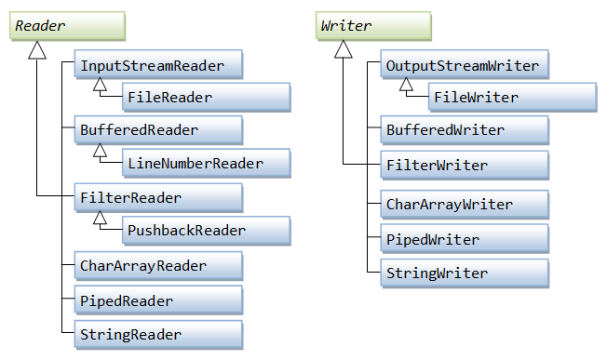
Character-Based I/O & Character Streams

Slide 7
Buffered I/O Character-Streams
- BufferedReader & BufferedWriter Demo3709
BufferedReader and BufferedWriter can be stacked on top of FileReader/FileWriter or other character streams to perform buffered I/O, instead of character-by-character

