Slide 1

Welcome To
Object Oriented Programming System (JAVA)
Dr. Saif Nalband

Slide 2
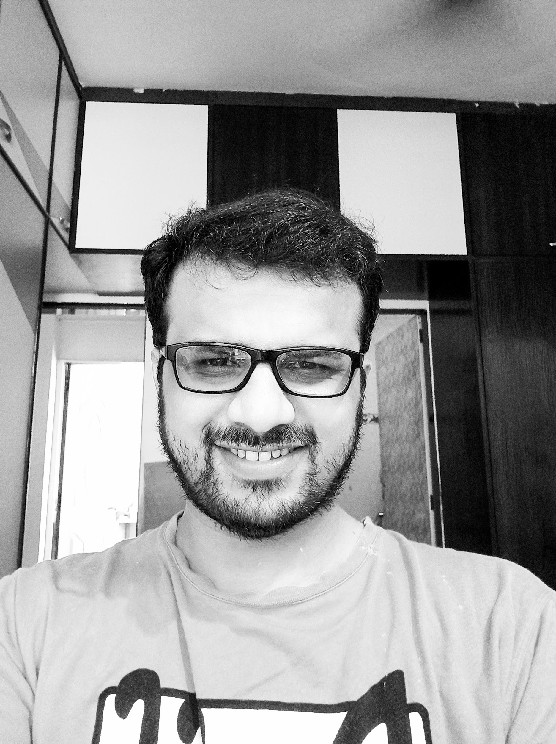
About Myself
90’s Kid From Mumbai
Completed my PhD BITS-Pilani, Goa Campus (YUP, I studied in GOA)
Taught at IIIT Pune
Went for Post-Doctoral Researcher at Cork, Ireland for a year
Pandemic
Here at DYPIU as Assistant Professor in School of Engineering & Technology.
Social Acitve on Linkdin, twitter
Hobbies ; Football, MUFC, binge watch some series, courses

Slide 3
About Course
Understand fundamentals of programming such as variables, conditional and iterative execution, methods, etc.
Introduction to object-oriented programming...
...with a strong software engineering foundation...
...aimed at producing and maintaining large, high-quality software systems.

Slide 4
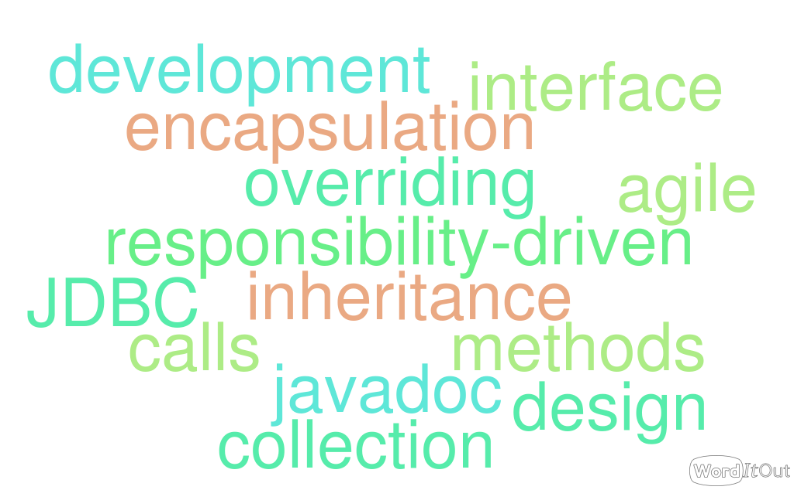
BuzzWord That you will be using

Slide 5
Contents
An Introduction to Java
Objects and Classes
Inheritance and Interface
Exception Handling and File Handling
Applets and Swings

Slide 6
OutCome of Course
Programming paradigm
Initial Steps for Software development.

Slide 7
How to pass this course
Will keep you update on this. Regarding the weightage of marking scheme
Attendance is MUST!!! (marks weightage : Free marks based on attendance )
DO NOT MUG THE PROGRAMS.
PRACTICE CODING .. It’s FUN.

Slide 8
Weightage Scheme : Theory : 100 marks
Modules | Weightage
Surprise Quiz ( 3 / 4 ) | 20
Mid term | 20
Final Exam | 30
Attendance | 10
Assignment | 10

Slide 9
Weightage Scheme : Practical : 50 marks
Modules | Weightage
Lab Attendance | 10
Lab Experiments | 20
Project (team of 5) | 20

Slide 10
Resources to help
Text Book :
Head First Java-Kathy Sierra,Bert Bates, O’Reilly
Java –A Beginners’s Guide ,7th Edition-Herbert Schildt, Oracle Press
Complete reference Java by Herbert Schildt(10th edition)
Java 2 programming black books, Steven Horlzner
Programming with Java , A primer ,Forth edition , By E. Balagurusamy
Online Resources :
Large number of tutorials,
HackerRank, Code Chief, Leecode etc.
Download JAVA 8

Slide 11
Online Class
Keeping the class interesting
Humor breaks
Actually helps with attention span!
Not surprisingly, most of it will be computer humor!

Slide 12
Contact
Preference on EMAILS:
Email: saif.nalband@dypiu.ac.in

Slide 13
Classes
Course starts from next class
Lab would be starting from 2nd or third week after we have covered enough for conducting labs

Slide 14
Thank you and
Stay Home and Stay safe

