Slide 1
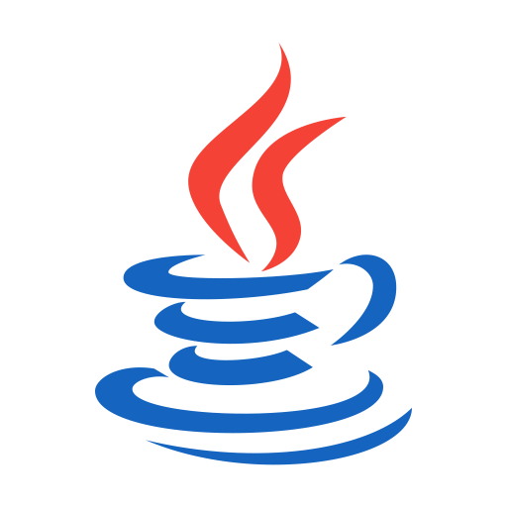
OOPS (JAVA)
Lec-18
Saif Nalband

Slide 2
Contents :
Stack Data Structure
Access Control
Keyword finalize() Method,
Static variable and method

Slide 3
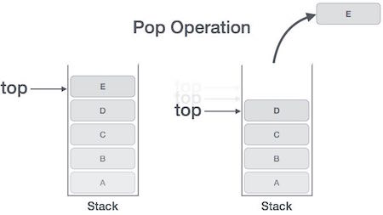
Stack Data Structure : LIFO
Mainly the following three basic operations are performed in the stack:
Push: Adds an item in the stack. If the stack is full, then it is said to be an Overflow condition.
Pop: Removes an item from the stack. The items are popped in the reversed order in which they are pushed. If the stack is empty, then it is said to be an Underflow condition.
Peek or Top: Returns top element of stack.
isEmpty: Returns true if stack is empty, else false. Demo182

Slide 4
Reading File Contents : Buffered Streams
Buffered input streams read data from a memory area known as a buffer; the native input API is called only when the buffer is empty.
Similarly, buffered output streams write data to a buffer, and the native output API is called only when the buffer is full.
Example
inputStream = new BufferedReader(new FileReader("xanadu.txt"));
outputStream = new BufferedWriter(new FileWriter("characteroutput.txt"));
Demo180

Slide 5
Access Control
Public
Then member can be accessed by any other code.
Private
Then member can be only accessed by other members of its class.
Protected
Used in inheritance (next week)
So far we have used default ( public) access to data, which should not be allowed.
Demo181

Slide 6
finalize() method
Sometimes an object's needs to perform some action before it gets destroyed.
Eg like file handles
Just like destructors in C++
Before the garbage collectors destroys certain objects. ~ finalization
You can define the specific operation that will occur when an object is about to be reclaim.
Define finalize method and specify the steps
protected void finalize(){
// codes
}

Slide 7
Thank you and
Stay Home and Stay safe

