Slide 1

OOPS (JAVA)
Lec - 2
Saif Nalband

Slide 2
Contents
Why programming
Programming language working
Functional vs Object oriented
History of JAVA
Application
Java popularity
Features of JAVA

Slide 3
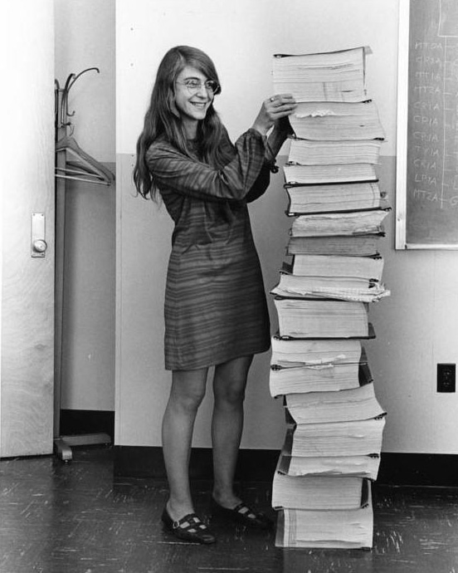
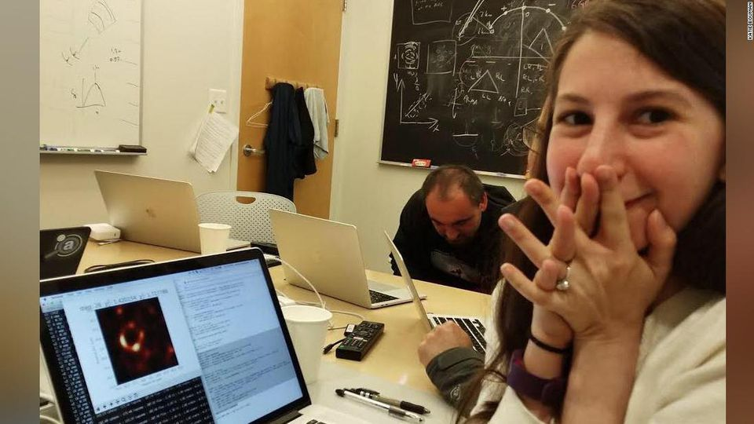
Programming ? why
Why Do we Write codes ?
Notes:
Margaret Hamilton :

Slide 4
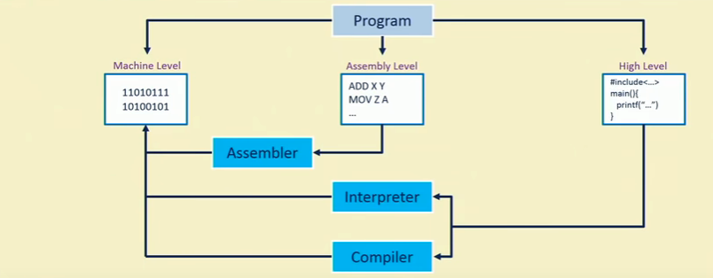
Programing Language

Slide 5
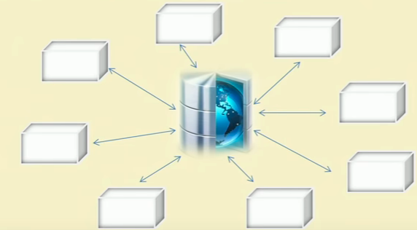
Function-oriented programing

Slide 6
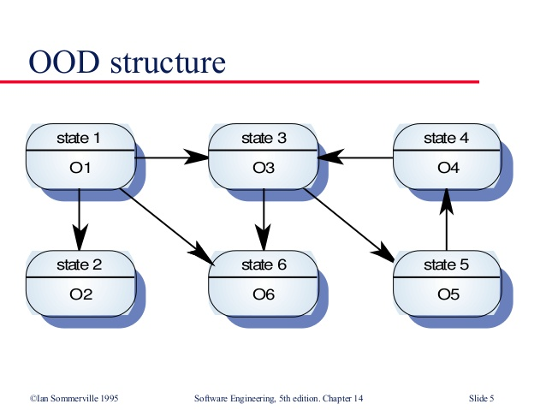
Object - Oriented programming

Slide 7
FOP Vs OOP
 | Function Oriented Programing | Object Oriented Programing
Program organization | Programs is divided into small functions | Program is divided into parts called objects
Importance | Importance give to function not data | Importance is given to data rather procedures
Approach | FOP follows top down approach | OOP follows bottom up approach
Access specifiers | Does not have any access specifier | Has three : public , private protected
Data Moving | Data can be moved freely from one function to another in the system | Objects can move and communicate with each other
Maintainability | To add data or function : not easy | Provides any easy way to add new data and function
Data Access | Function uses global data for sharing | Objects uses local data, and can be accessed in control manner.
Data hiding | No data hiding is possible | Provides data hiding , hence secured programing is possible
Overloading | Polymorphism is not possible | Polymorphism is possible
Example | C, VB, FORTRAN, Pascal | C++, JAVA, C#

Slide 8
Thats 70’s era From C to C++
It revolutions the era of computers especially with creation of C
It provided structure way of programing which previous programming language such as BASIC, FORTRAN lacked
C++ to solve the program’s complexity since it become more complex and bigger: Object Oriented Programming
So Finally in late 1980’s and early 90’s : JAVA
Computer Language evolves for two reasons
To adapt to the changes in environment
To implement advances in the art of programming

Slide 9
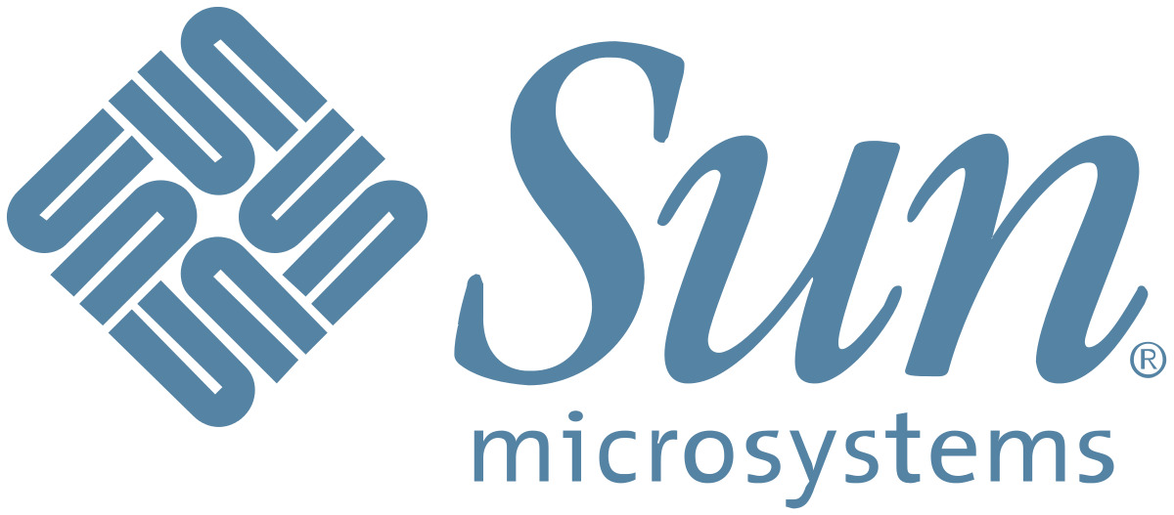
History of JAVA
James Gosling, Mike Sheridan and Patrick Naughton in June 1991: Green Team from
JAVA was originally designed for small, embedded system in electronics appliances like set-top boxes, multimedia
It was named Oak initially: copyright issues.
Surprised by its inspiration from coffee found in Indonesia.
JDK ( Java Development Kit ) 1.0 released in January 1996

Slide 10
Application
According to Sun, 3 billion devices run Java. There are many devices where Java is currently used. Some of them are as follows:
Desktop Applications such as acrobat reader, media player, antivirus, etc.
Web Applications such as irctc.co.in, javatpoint.com, etc.
Enterprise Applications such as banking applications.
Mobile
Embedded System
Smart Card
Robotics
Games, etc

Slide 11
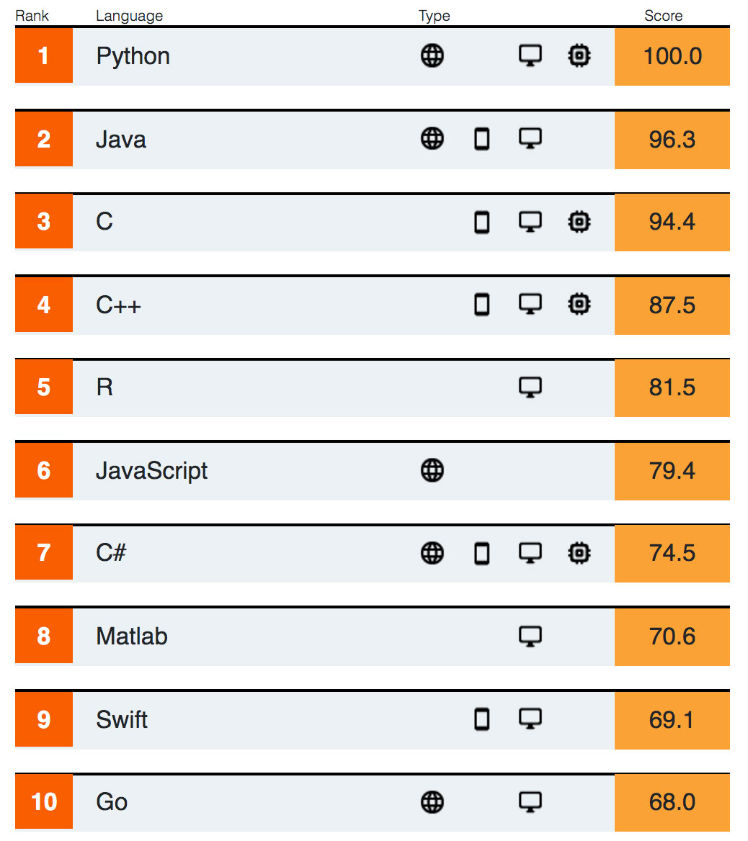
JAVA leading the way in Software Development

Slide 12
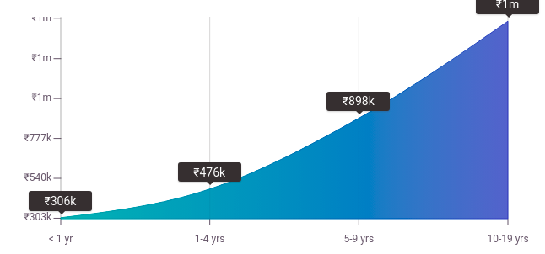
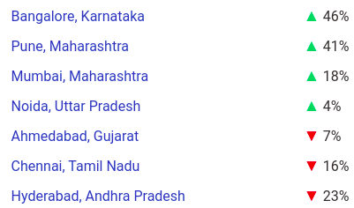
Payscale Pay Difference by Location

Slide 13
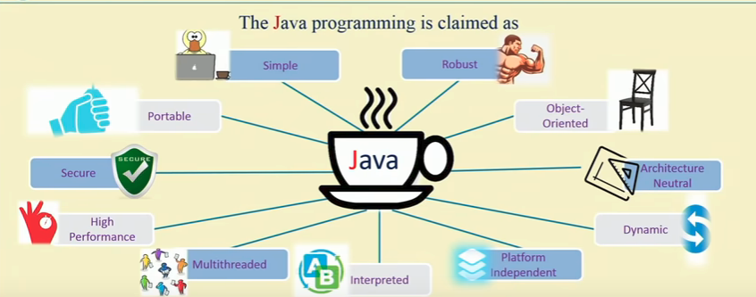
Features of JAVA

Slide 14
JAVA programing paradigms
Center of it all is an object. Objects contains both data and functionality that operates on that data.
Class
Objects
Encapsulation
Inheritance
Information hiding
Polymorphism

Slide 15
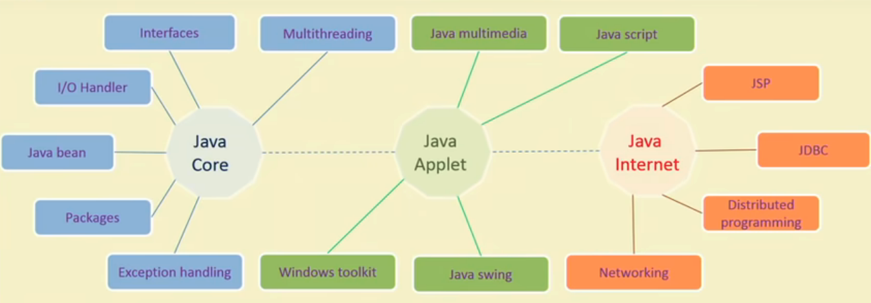
Features of Java Programming

Slide 16
Thank You

