Slide 1

OOPS (JAVA)
Lec-21
Saif Nalband

Slide 2
Contents :
String

Slide 3
Strings
Strings, which are widely used in Java programming, are a sequence of characters.
In the Java programming language, strings are objects.
The Java platform provides the String class to create and manipulate strings.

Slide 4
Creating String
The most direct way to create a string is to write:
String greeting = "Hello world!";
"Hello world!" is a string literal—a series of characters in your code that is enclosed in double quotes.
Whenever it encounters a string literal in your code, the compiler creates a String object with its value—in this case, Hello world!.
String objects by using the new keyword and a constructor.
char[] helloArray = { 'h', 'e', 'l', 'l', 'o', '.' };
String helloString = new String(helloArray);
System.out.println(helloString);

Slide 5
String is immutable
The String class is immutable, so that once it is created a String object cannot be changed.
An immutable object is an object whose internal state remains constant after it has been entirely created. This means that once the object has been assigned to a variable, we can neither update the reference nor mutate the internal state by any means.
The key benefits of keeping this class as immutable are caching, security, synchronization, and performance.

Slide 6
Introduce to String Pool
The String is the most widely used data structure. Caching the String literals and reusing them saves a lot of heap space because different String variables refer to the same object in the String pool. String intern pool serves exactly this purpose.
Java String Pool is the special memory region where Strings are stored by the JVM. Since Strings are immutable in Java, the JVM optimizes the amount of memory allocated for them by storing only one copy of each literal String in the pool. This process is called interning:

Slide 7
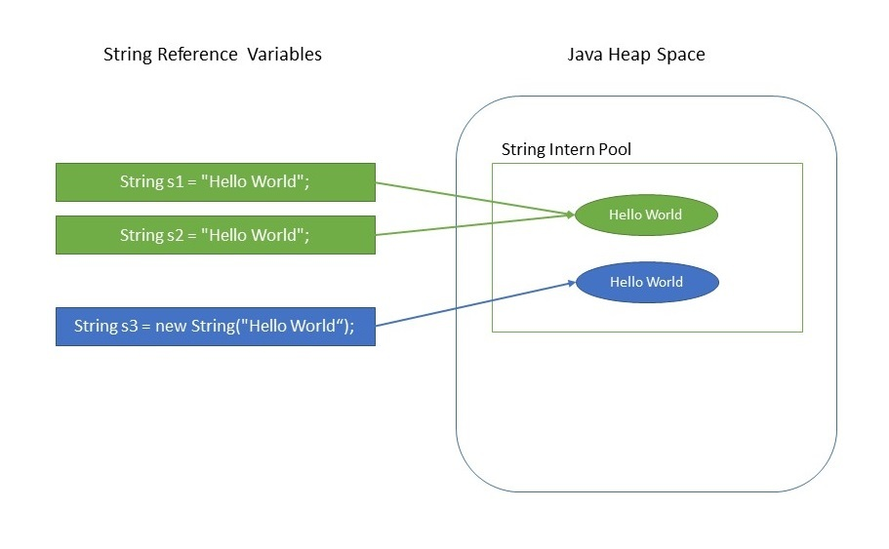
String literal
String s1 = "Hello World";
String s2 = "Hello World";
assertThat(s1 == s2).isTrue();
Because of the presence of the String pool in the preceding example, two different variables are pointing to same String object from the pool, thus saving crucial memory resource

Slide 8
Wrong Assumption !!
If String is immutable, why is the following statement allowed?
String a = “Generic Class”;
a = “www.genericclass.com”;

Slide 9
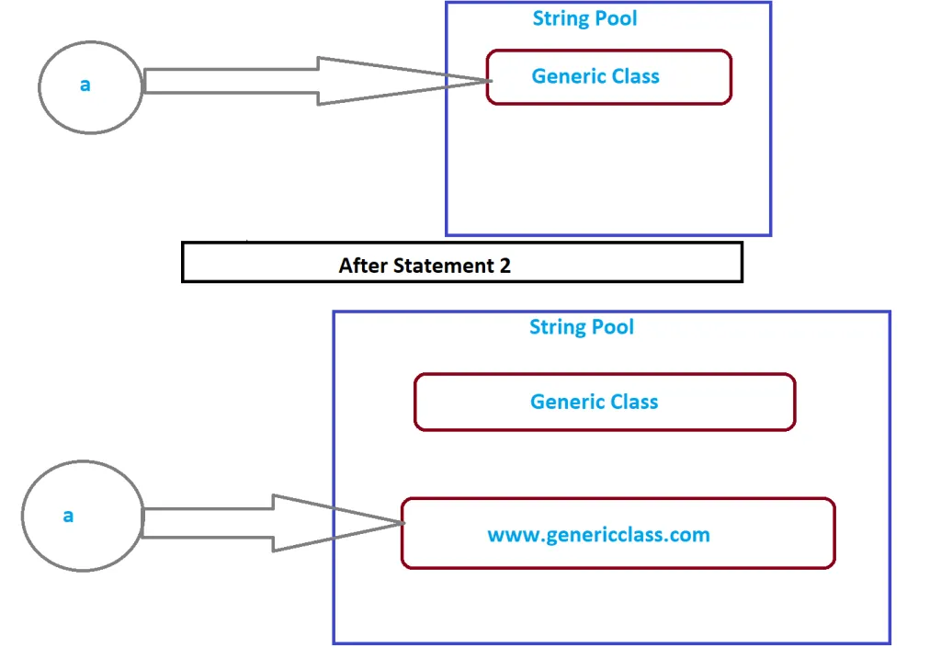

Slide 10
String Methods
Demos

Slide 11
Thank you and
Stay Home and Stay safe

