Slide 1

OOPS (JAVA)
Lec-22
Saif Nalband

Slide 2
Contents :
Inheritance

Slide 3
Inheritance in Java
Inheritance in Java is a mechanism in which one object acquires all the properties and behaviors of a parent object.
Super Class A
Super Class A
Super Class B
Base Sub Class B
Sub Class C
Single Inheritance
Multiple Inheritance

Slide 4
Concept of Inheritance (IS-A)
Animal
Herbivore
Carnivore
omnivore
Rabbit
Lion
Hyena
Man

Slide 5
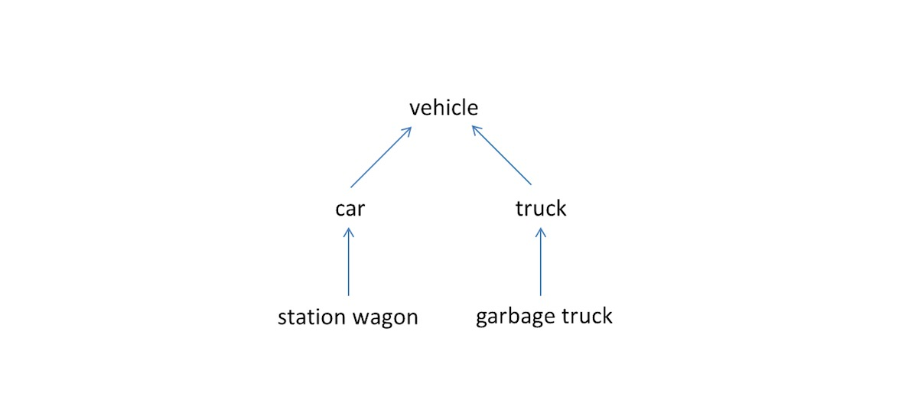
Inheritance in JAVA
Inheritance is one of the pillars of OOPS because it allows the creation of hierarchical classification.
Using inheritance, one can create a general class that include some common set of items.
This class then can be used to create more specific classes which has all the items from the base class , in additional to some items of its own.

Slide 6
Terms used in inheritance
Superclass: A class that is inherited is called a superclass
Subclass: The class that does inheriting is called a subclass.
A subclass is specialised version of a superclass
It inherits all the instance variables and method defined by the superclass and add its own, unique elements (i.e variables and methods)
Reusability: Its is a mechanism which facilitates you to rescue the data and methods of the existing class when one create w new class
One can use the same data and methods already defined.

Slide 7
Inheritance syntax
The extends keyword is used to define a new class that derives from an existing class
class < sub class> extends < superclass = name>{
// data and methods of sub class
}

Slide 8
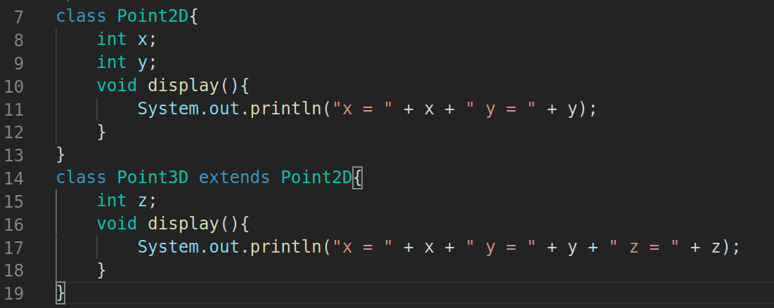
Example of Simple Inheritance
2D Point
3D Point

Slide 9
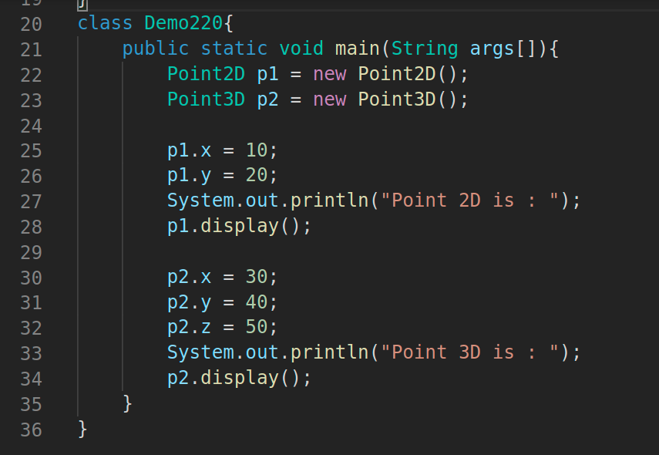
Example of Simple Inheritance
2D Point
3D Point

Slide 10
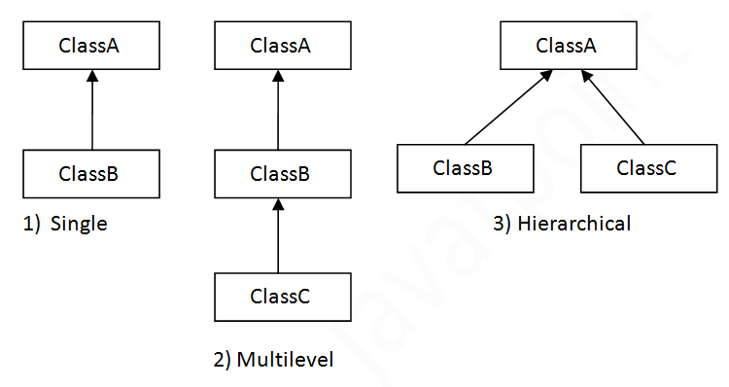
Inheritance types : Allowed in JAVA

Slide 11
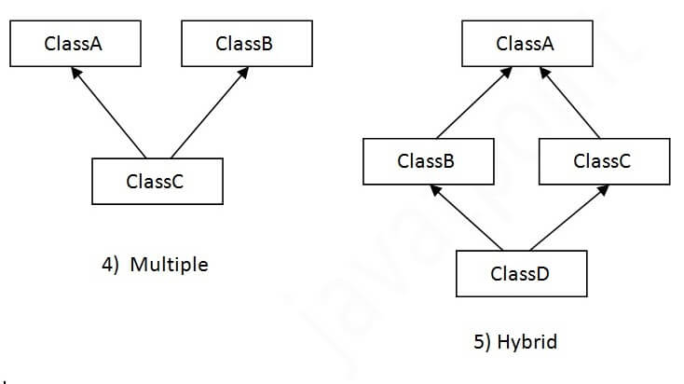
Inheritance types : Not Allowed in JAVA

Slide 12
Single Inheritance : An Example
Person
Student
Employee

Slide 13
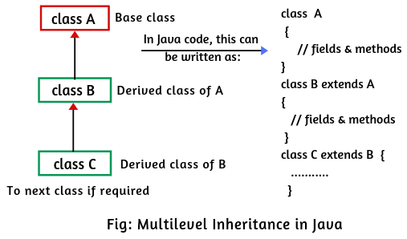
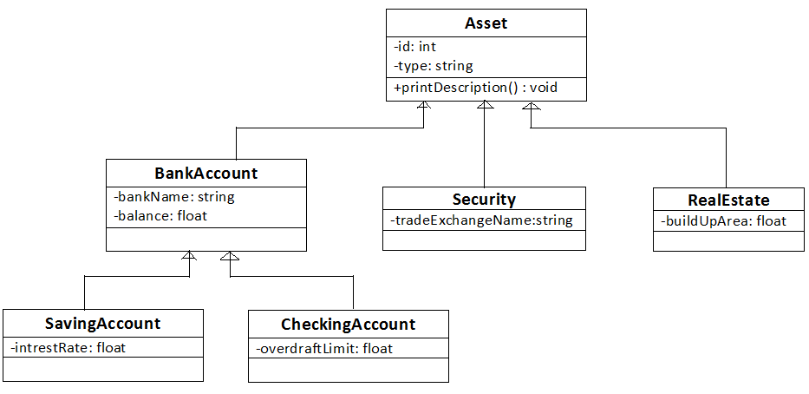
Multilevel Inheritance

Slide 14
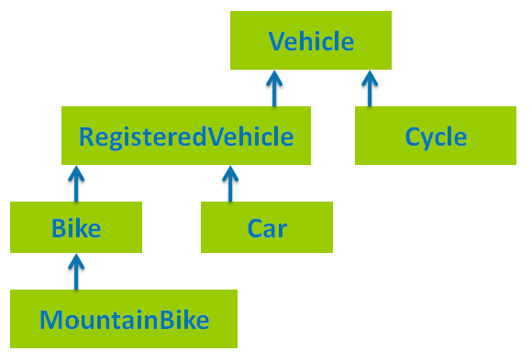
Multilevel Inheritance

Slide 15
Method Overriding !!
Happens in Different Class ( especially in case of inheritance )

Slide 16
Next Class
Super keyword

Slide 17
Thank you and
Stay Home and Stay safe

