Slide 1

OOPS (JAVA)
Lec-23
Saif Nalband

Slide 2
Contents :
Inheritance
Super

Slide 3
Note : Inheritance
A subclass Object can reference a superclass variable or method if it is not overridden.
A super class object cannot reference a variable or method which is explicit to subclass object.

Slide 4
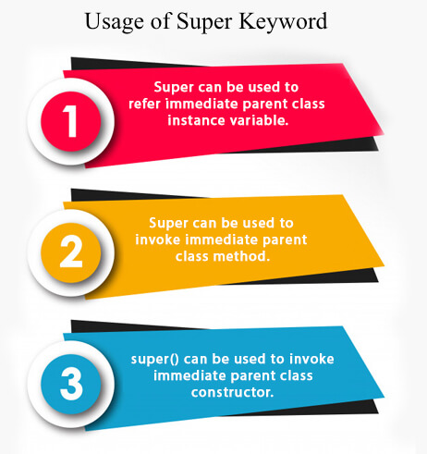
Super Keyword
The super keyword in Java is a reference variable which is used to refer immediate parent class object.
Whenever you create the instance of subclass, an instance of parent class is created implicitly which is referred by super reference variable.

Slide 5
super : Referring parent class instance variable
Demo230

Slide 6
super : Invoking parent class method
Demo231

Slide 7
super: Invoking parent class constructor
Demo232

Slide 8
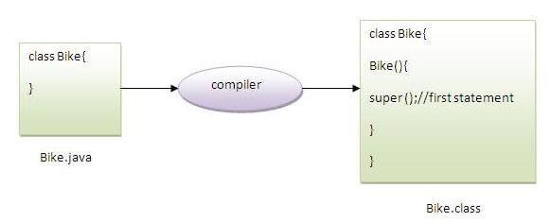
Note:
super() is added in each class constructor automatically by compiler if there is no super() or this().

Slide 9
Super : default
Another example of super keyword where super() is provided by the compiler implicitly.
Demo233

Slide 10
Aggregation in Java
If a class have an entity reference, it is known as Aggregation.
Aggregation represents HAS-A relationship.
Consider a situation, Employee object contains many informations such as id, name, email Id etc. It contains one more object named address, which contains its own informations such as city, state, country, zipcode etc. as given below.
class Employee{
int id;
String name;
Address address;//Address is a class
...
}
In such case, Employee has an entity reference address, so relationship is Employee HAS-A address.

Slide 11
When to use Aggregation?
Code reuse is also best achieved by aggregation when there is no is-a relationship.
Inheritance should be used only if the relationship is-a is maintained throughout the lifetime of the objects involved; otherwise, aggregation is the best choice.
Demo235

Slide 12
Thank you and
Stay Home and Stay safe

