Slide 1

OOPS (JAVA)
Lec-24
Saif Nalband

Slide 2
Contents :
Aggregation
Run-Time polymorphism

Slide 3
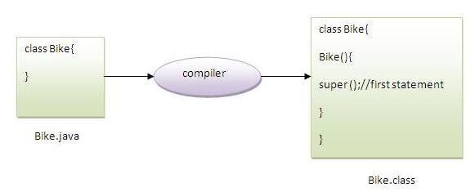
Note:
super() is added in each class constructor automatically by compiler if there is no super() or this().

Slide 4
Super : default
Another example of super keyword where super() is provided by the compiler implicitly.
Demo233

Slide 5
Aggregation in Java
If a class have an entity reference, it is known as Aggregation.
Aggregation represents HAS-A relationship.
Consider a situation, Employee object contains many informations such as id, name, email Id etc. It contains one more object named address, which contains its own informations such as city, state, country, zipcode etc. as given below.
class Employee{
int id;
String name;
Address address;//Address is a class
...
}
In such case, Employee has an entity reference address, so relationship is Employee HAS-A address.

Slide 6
When to use Aggregation?
Code reuse is also best achieved by aggregation when there is no is-a relationship.
Inheritance should be used only if the relationship is-a is maintained throughout the lifetime of the objects involved; otherwise, aggregation is the best choice.
Demo240

Slide 7
Thank you and
Stay Home and Stay safe

