Slide 1

OOPS (JAVA)
Lec-27
Saif Nalband

Slide 2
Contents :
Information hiding (Access modifiers)
Packages
Interface

Slide 3
Concept of access modifiers : Types
Access modifier
Default
Public
Protected
Private

Slide 4
Access levels of modifiers
Levels -> | Class | Package | Sub Class | Everyone
Public | Yes | Yes | Yes | Yes
Protected | Yes | Yes | Yes | NO
Default | Yes | Yes | NO | NO
Private | Yes | NO | NO | NO

Slide 5
Default access modifier
If you don’t use any modifier, it is treated as default by default
The default modifier is accessible only with in a package.
demo 270, Demo271

Slide 6
Public
The public access modifier is accessible everywhere
It has the widest scope among all other modifiers
Demo272
Demo273

Slide 7
Private
The private access modifiers is accessible only within the class
Demo274
Demo275
Demo276
Demo277

Slide 8
Protected
The protected access modifiers is accessible within a package or from outside a package but through inheritance only
The protected access modifiers can be applied on the data member, method and constructors.
It can’t be applied on the class

Slide 9
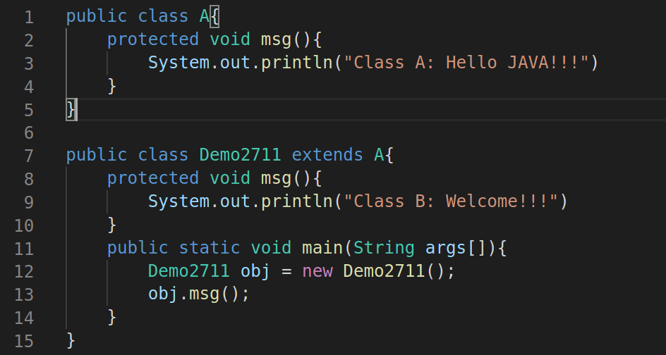
Java access modifiers with method overriding
If you overriding any method, overridden method(i.e) declared in sub class) must not be more restrictive
The default modifier is more restrictive than protected
What will happen if the msg() in class Demo2711 is declared as public or protected ?

Slide 10
Thank you and
Stay Home and Stay safe

