Slide 1

OOPS (JAVA)
Lec-28
Saif Nalband

Slide 2
Contents :
Information hiding (Access modifiers) Last Class
Packages
Interface (next week)

Slide 3
Concept of access modifiers : Types
Access modifier
Default
Public
Protected
Private

Slide 4
Access levels of modifiers
Levels -> | Class | Package | Sub Class | Everyone
Public | Yes | Yes | Yes | Yes
Protected | Yes | Yes | Yes | NO
Default | Yes | Yes | NO | NO
Private | Yes | NO | NO | NO

Slide 5
Protected
The protected access modifiers is accessible within a package or from outside a package but through inheritance only
The protected access modifiers can be applied on the data member, method and constructors.
It can’t be applied on the class

Slide 6
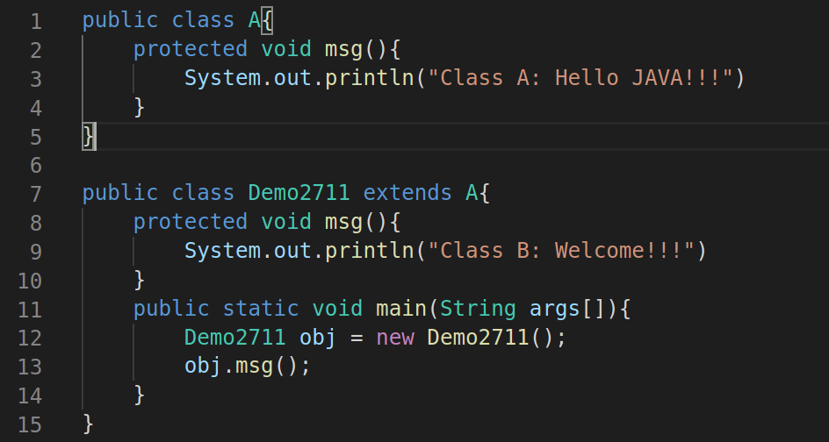
Java access modifiers with method overriding
If you overriding any method, overridden method(i.e) declared in sub class) must not be more restrictive
The default modifier is more restrictive than protected
What will happen if the msg() in class Demo2711 is declared as public or protected ?

Slide 7
Two unique features
Package
interface

Slide 8
What is package
A package is a container for the classes that used to keep the class name space compartmentalized
we can write we can compartmentalize all the entire space, the programming space into the different packages.
Example You can contain all classes related to all sorting programs in your own package

Slide 9
Why package
It allows flexibility to give same name but ti many classes , that is to avoid namespace collision.
The packages in JAVA provides mechanism for partitioning the class space into more manageable chunks
In fact, package is both naming and a visibility control mechanism
It supports reusability and maintainability.

Slide 10
Advantages of Packages
Packages provide code reusability, because a package contains group of classes
It helps in resolving naming collision when multiple packages have classes with the same name.
Packages also provide hiding of class facility. Thus, other programs cannot use the classes from hidden package.
Access limitation can be applied with the help of packages
Nesting of a package , i.e, one package can be defined in another package in a hierarchy fashion.

Slide 11
Built - in packages in JAVA
Packages are nothing more than the way we organize files into different directories according to their functionality, usability as well as category they should belong to. A JAVA package is a JAVA programing language mechanism for organizing classes name spaces.
In JAVA, already many predefined packages are available, those are to help programmers to develop their software in an easy way.
Example : javax.swing is a package in JAVA providing all basic supports in developing GUI programs

Slide 12
Packages in JAVA
Code reusability is the main philosophy of Object- Oriented Programing
To power this advanges, JAVA has a number of packages called API bundled with the JDK.
Packages are collection of classes and interfaces to facilitate a number of ready made solution.
A great knowledge of packages helps a JAVA developed to master in JAVA solution.
In addition to the API, user can maintain their own packages.

Slide 13
API the Build in Java packages
API
Core Packages
Window Toolkit & Applet
java.lang
java.io
java.util
java.net
java.awt
java.awt.image
java.applet

Slide 14
Using API packages
A packages is a collection of classes and each class is a collection of members and methods
Any class as well as any member and method in a package are accessible from a JAVA program
This can be achieved in JAVA by import statement
There are two ways of using import statement
With fully quantifies class name
When it required to access a particular class
Example java.lang.String;
With default (.*) quantification
When it required to access a number of classes
Example java.lang.*;

Slide 15
Using API packages
However, instead of import whole package or a class it possible to refer a class in order to instantiate an object
Example :
java.util.Date today = new java.util.Date();
The same thing but with import statement can be done as follows
import java.util.Date;
Date today = new Date();

Slide 16
User Defined packages
User can maintain their own packages.
JAVA uses file system directories to store packages
The package statement cane be used for the purpose with the following syntax
package myPackage;
public Class myClass{
…
}

Slide 17
User Defined packages
Use package statement at the beginning of the package file
Define the class that is to be put in the package and declare it as public
Create sub directory under the working directory with the same name as the package name
Store the file with same name as the className.java in the subdirectory created
Store the compiled version file to same sub directory.

Slide 18
Package design guidelines
Design guideline package cohesion
Only closely related classes should belong to same package
Classes that change together should belong to same package.
Classes that are not used together should not belong to same package.

Slide 19
More on user defined packages
Note:
We cannot put two or more public class together in a .java file; otherwise there will be ambiguity in naming the .java file
? How a package then contains multiple classes
package p;
public class A{
...
}
package p;
public class B{
...
}

Slide 20
More on user defined packages
package p;
public class A{
...
}
package p;
public class B{
...
}
Steps
Create a directory name P.
Store the class A in the file A.java in it
Compile A.java and place place in the directory P.
Store the class B in the file B.java in it
Compile B.java an place it in the directory P
Import P.*;
Will import all the classes in the package P

Slide 21
Thank you and
Stay Home and Stay safe

