Slide 1

OOPS (JAVA)
Lec - 3
Date:
Saif Nalband

Slide 2
Contents
Abstraction,
OOPS Concept
Encapsulation, Inheritance, Polymorphism
JAVA installation
First Program
Platform independent demo
C++ Vs Java

Slide 3
Abstraction
Abstraction is a process of hiding the implementation details and showing only functionality to the user.
Abstraction lets you focus on what the object does instead of how it does it.
Through use of hierarchical classification.
Example :
A motorcycle : which breaks down into smaller modules. Like break, accelerator etc
There are two ways to achieve abstraction in java
Abstract class
Interface

Slide 4
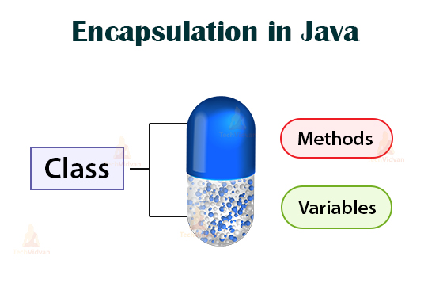
Encapsulation
Wrapping of code and data together into a single unit.
Objects are called as instance of a class.
Any entity that has state and behavior is known as an object. For example, a chair, pen, table, keyboard, bike, etc. It can be physical or logical.
A class is logical structure and object has physical reality

Slide 5

Example Books Library
borrower
Title
Author
Cost
DOI
Name
Roll No
Address
Books
DATA
issue()
Fine()
return()
Open()
Close()
request()
renew()
search()
Enroll()
methods

Slide 6
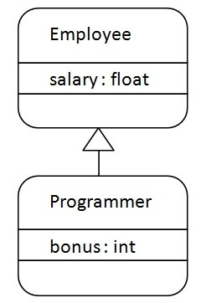
Inheritance
Inheritance is the process by which one object acquires the properties of another object.
Inheritance in Java is a mechanism in which one object acquires all the properties and behaviors of a parent object.

Slide 7
Polymorphism
It refers to many forms.
Example
dog’s smell() method
Cat: bark
Food : it will salivate

Slide 8
JAVA basic information
JDK(Java Development Kit) : JDK is intended for software developers and includes development tools such as the Java compiler, Javadoc, Jar, and a debugger.
JRE(Java Runtime Environment) : JRE contains the parts of the Java libraries required to run Java programs and is intended for end users. JRE can be view as a subset of JDK.
JVM: JVM (Java Virtual Machine): It is an abstract machine. It is a specification that provides runtime environment in which java bytecode can be executed. JVMs are available for many hardware and software platforms.

Slide 9
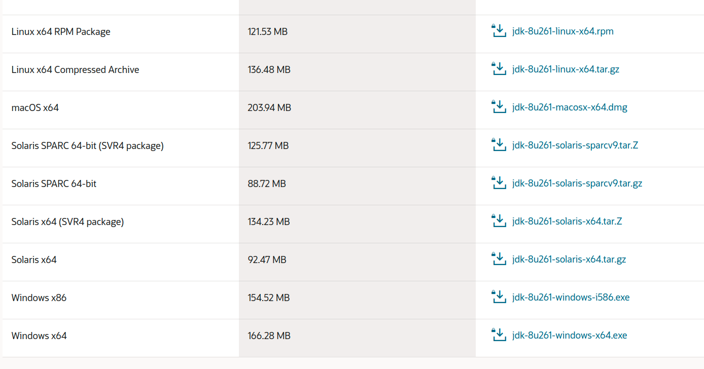
JAVA installation and setup kit
We would be using ORACLE JAVA 8
Download from here (Download according to your system).

Slide 10
JAVA Editor
You can use any editor, notepad, notepad ++, subline
IDE: ellipse, netbeans, etc..
Preference vs code

Slide 11
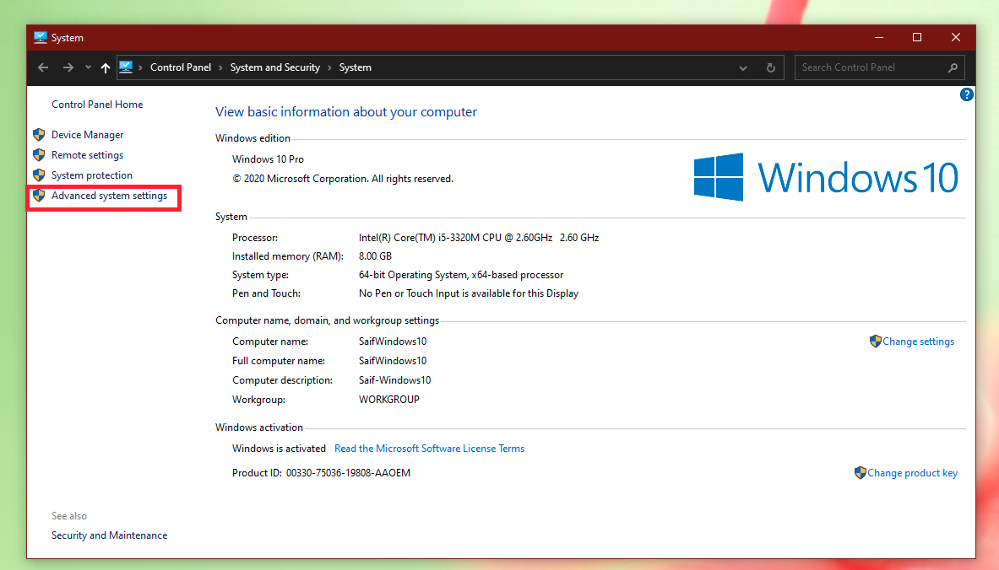
Setting up environment (Windows)
Right click on My PC → Properties → Advanced system settings

Slide 12
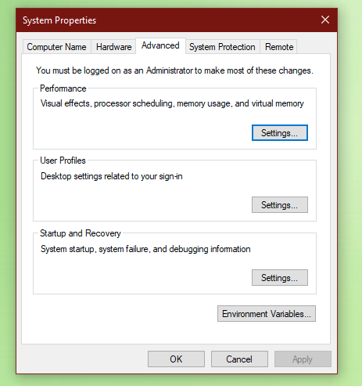
Setting up environment (Windows)

Slide 13
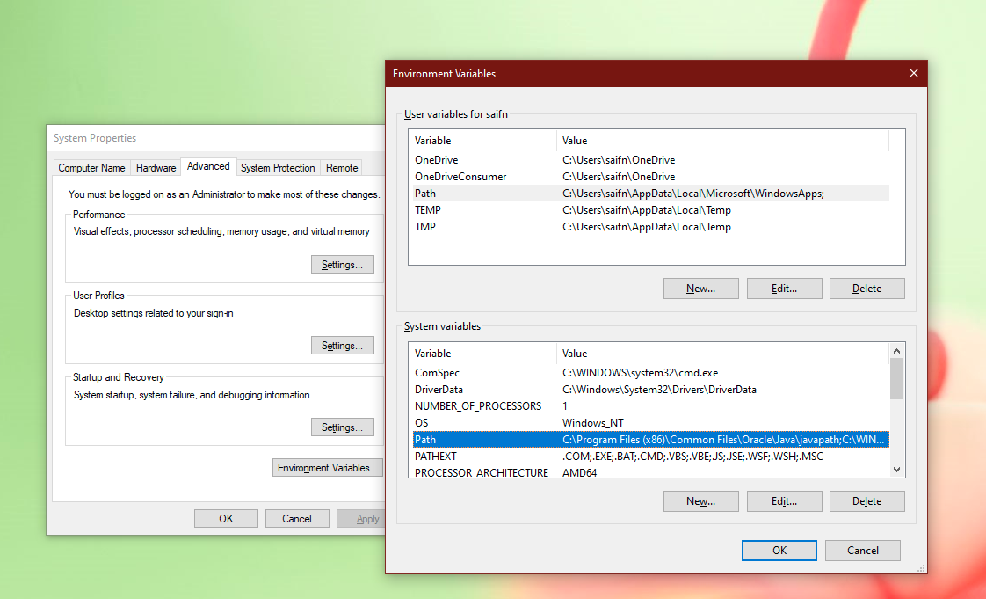
Setting up environment (Windows)

Slide 14
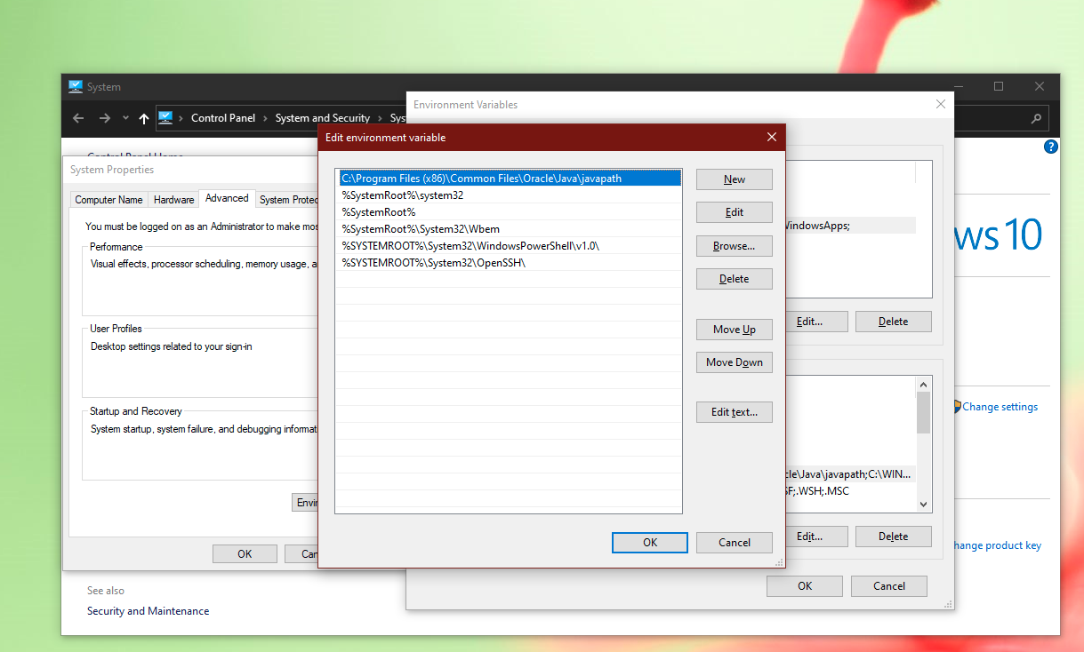
Setting up environment (Windows)

Slide 15
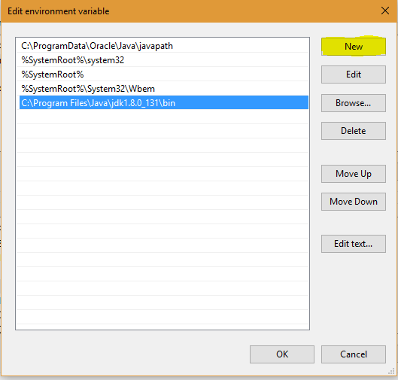
Setting up environment (Windows)
click on New button and then add path where java is installed. By default, java is installed in “C:\Program Files\Java\jdk\bin” folder OR “C:\Program Files(x86)\Java\jdk\bin”. In case, you have installed java at any other location,then add that path.

Slide 16
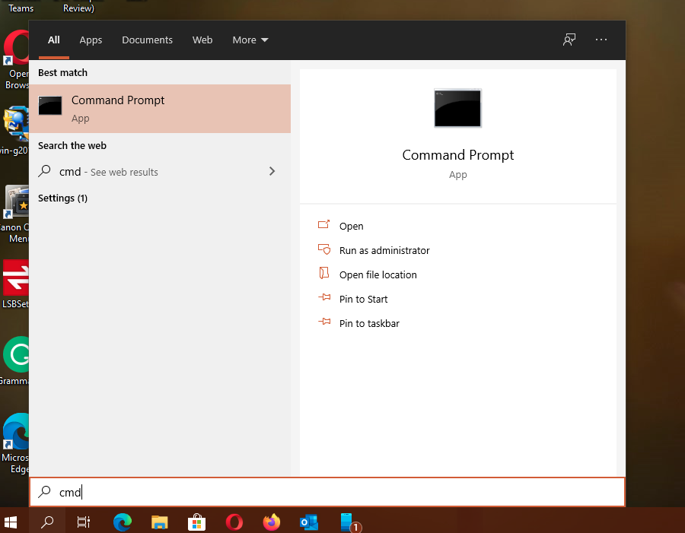
Set up for coding !
Search for cmd and
Click it.

Slide 17
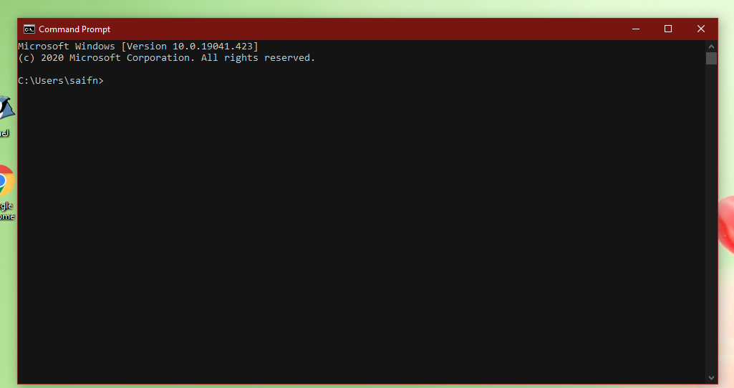
Set up for coding !
Go to directory where
You are going to write
The program.
Using cd command

Slide 18
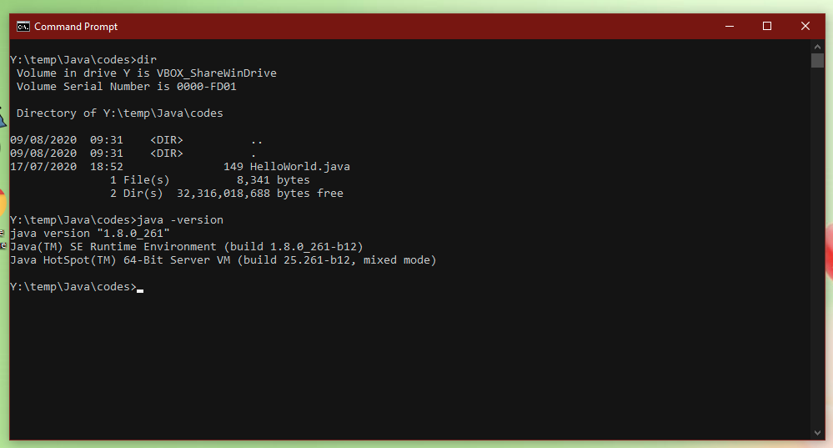
Set up for coding !
My working directory is Y
So in cmd prompt
c:\user\saif> Y:\
c:\user\saif> cd \temp\Java\codes
Then type
Java -version

Slide 19
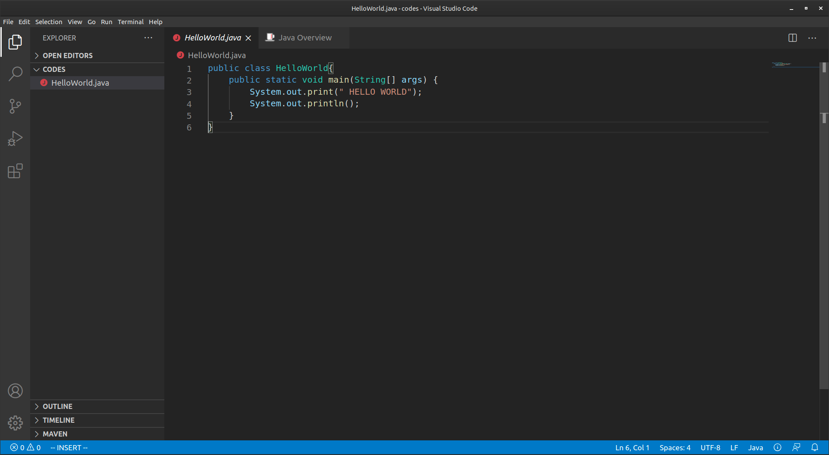
First JAVA program in vs code

Slide 20
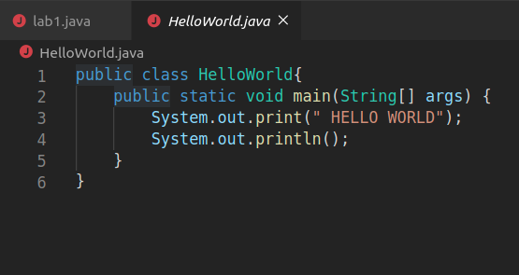
First JAVA program
Click on new files
write the name file(your filename and class name should be same)
Put the extension of filename.java
Example: HelloWorld.java

Slide 21
How to run First JAVA program
Compile
javac filename.java
Run
java filename

Slide 22
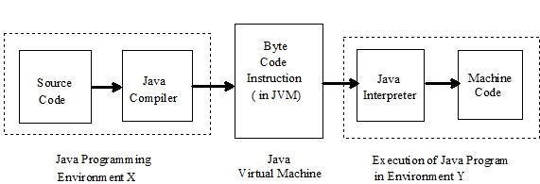
JAVA MAGIC

Slide 23
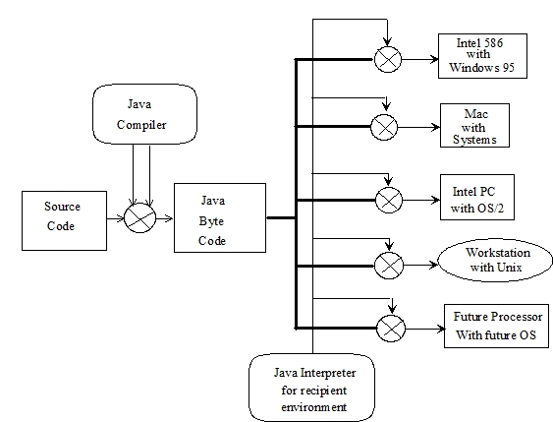
Platform Independent
Platform Independent

Slide 24
DEMO

Slide 25
Significance of main class
JAVA programs starts its execution from method belongs to a class only.
The main() method is the starting point of the execution of the main thread.
If there are multiple classes, method that contains main() method should be called or named.

Slide 26
Sample program Example
Access modifier
return type
String class
public static void main(String[] args){
}
keyword
method name
Array of string objects

Slide 27
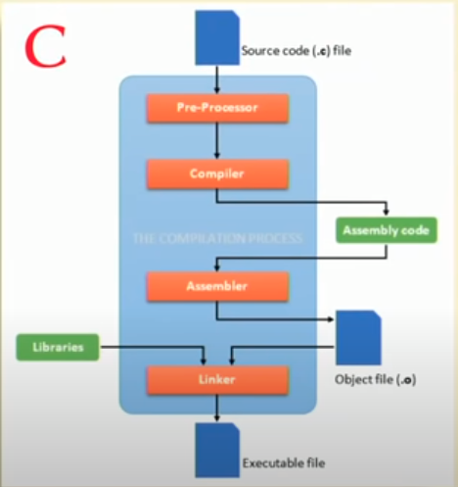
C / C++

Slide 28
C++ Vs Java Programming references
Features |  | C++ | JAVA
Data abstraction and encapsulation |  | Y | Y
Polymorphism |  | Y | Y
Binding | Static | Y | Y
 | Dynamic | Y | Y
Inheritance | Single Inheritance | Y | Y
 | Multiple Inheritance | Y | N
Operator Overloading |  | Y | N
Template Classes |  | Y | N
Global variables |  | Y | N
Header Files |  | Y | N
Pointers |  | Y | N
Interface and packages |  | N | Y
API (Application Programing Interface |  | N | Y

Slide 29
Next Classes
Primitive Data types
Loops
Conditions
Using JAVA

Slide 30
Thank You

