Slide 1

OOPS (JAVA)
Lec-31
Saif Nalband

Slide 2
Contents :
Interface I

Slide 3
Abstract class concept in JAVA
Suppose we want to have number of other shapes namely Ellipse, Rectangle, Triangle etc
All these shapes can be placed in a package : myShape
All these shape classes have basic operation namely area() and circumferences()
Let see , how the above can be better realised using abstract class concept in JAVA
Geometry
Demo300
Circle
Rectangle
Ellipse

Slide 4
Few Important facts about Abstract class
Any class with an abstract method is automatically abstract itself, And must be declare such.
A class may be declared abstract even if it has no abstract method. This prevents from being instantiated.
A sub-class of an abstract class can be instantiated if it overrides each of the abstract methods of its super class and provide an implementation.
If sub-class of an abstract class does not implements all of the abstract methods , it inherits that sub-class is itself abstract

Slide 5
Multiple inheritance in JAVA
Draw Shape
Geometry
Circle
However, this is not possible, as JAVA does not support multiple inheritance
JAVA’s solution to this problem interface

Slide 6
Multiple inheritance and interface
JAVA does not support multiple inheritance
JAVA supports an alternative approach to this OOP feature known as interface
What is an interface?
An interface is basically a kind of class. Like classes, an interface contains members and methods, unlike classes, in interface, all members are final and all methods are abstract.

Slide 7
Interface Concept
An interface define a protocol of behavior that can be implemented by any class anywhere in the class hierarchy.
An interface defines a set of method but does not implement then.
A class that implements the interface agrees to implement all the methods define in the interface, thereby agreeing to certain behavior.
An interface is a named collection of methods definition (without implementations)
Interface reserves behaviour for classes
Methods declared in an interface are always public and abstract, JAVA compiler will not complain if you omit both keywords.
Static methods cannot declared in the interfaces - these methods are never abstract and do not express behavior objects.

Slide 8
Basic concept of inheritance
Using the keyword interface, one can define an abstract class
Interface are syntactically similar to classes, but they lack instance variables and their methods are defined without any body.
Example:
interface callMe{
void call(int p);
}

Slide 9
Multiple inheritance in JAVA
Once an interface is defined, any number of classes can implement an interface.
Also, one can implement any number of interfacing class
Interface
Interface
Interface
Interface 1
Interface 2
Interface 3
Class

Slide 10
Interface : An Example
Shape
draw()
resize()
interface
Implements
Circle
draw()
resize()
Line
draw()
resize()
Rectangle
draw()
resize()
extends
Square
draw()
resize()

Slide 11
Properties of Interface
Interface must be declared with the keyword interface
All interface methods are implicitly public and abstract. In other words, you do not need to actually type the public or abstract modifiers in the method declaration, but method is still always public and abstract.
All variables define in an interface is public static and final. In other words, interface can declare only contracts , no instance variables.
Interface methods must not be static.

Slide 12
Properties of Interface
Because interface methods are abstract they cannot be marked final.
An interface can extend one or more other interface
An interface cannot implement another interface or class
Interface type can be used polymorphically.

Slide 13
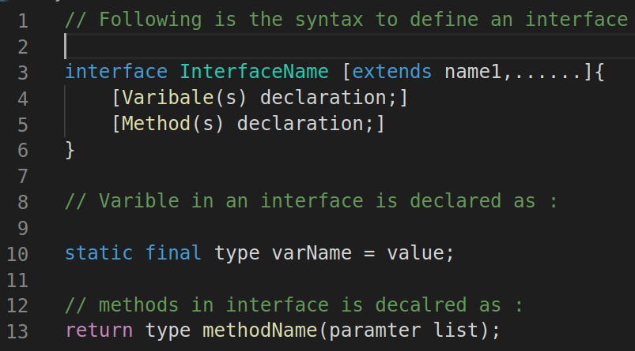
Syntax for defining interface

Slide 14
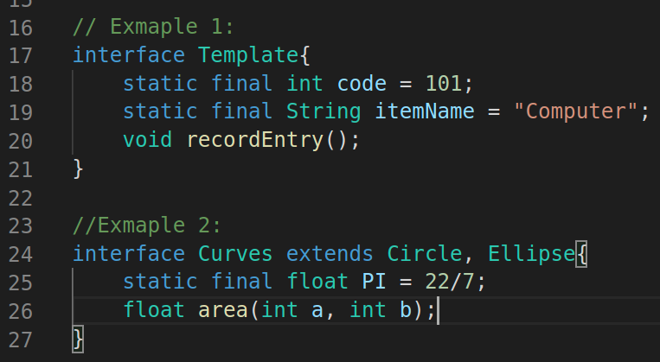
Defining an interface: Examples

Slide 15
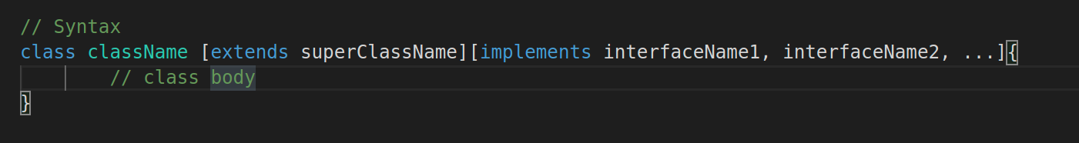
Implementation of classes with interface
Demo301

Slide 16
Implementation of classes with interface
GoeAnalyzer
PI
area()
perimeter()

Slide 17
Implementation of classes with interface Example
memberIEEE
membershopYear
regionIEE
memberProfile
Class Teacher
Class Student
Class Teacher

Slide 18
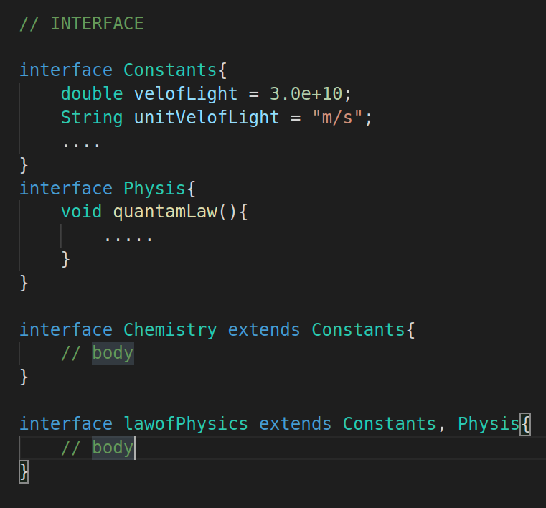
Extending interface
Interface can inherit from other interface
Interface can also multiply inherits.

Slide 19
Thank you and
Stay Home and Stay safe

