Slide 1

OOPS (JAVA)
Lec-32
Saif Nalband

Slide 2
Contents :
Interface III

Slide 3
Properties of Interface
Interface must be declared with the keyword interface
All interface methods are implicitly public and abstract. In other words, you do not need to actually type the public or abstract modifiers in the method declaration, but method is still always public and abstract.
All variables define in an interface is public static and final. In other words, interface can declare only contracts , no instance variables.
Interface methods must not be static.

Slide 4
Properties of Interface
Because interface methods are abstract they cannot be marked final.
An interface can extend one or more other interface
An interface cannot implement another interface or class
Interface type can be used polymorphically.

Slide 5
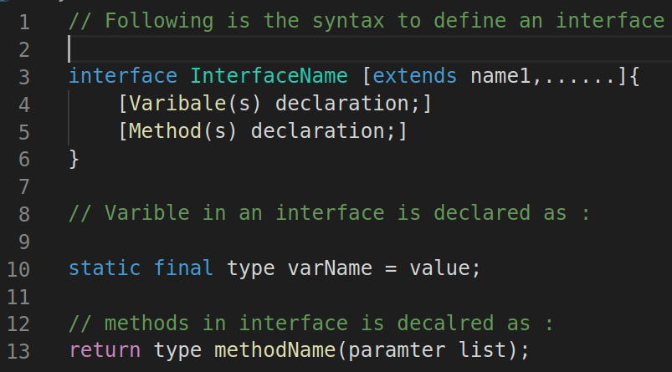
Syntax for defining interface

Slide 6
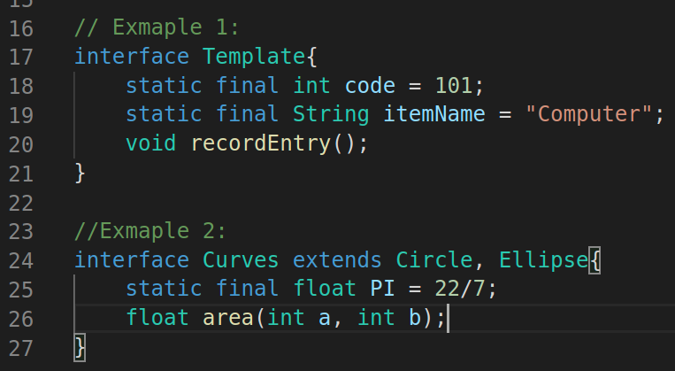
Defining an interface: Examples

Slide 7
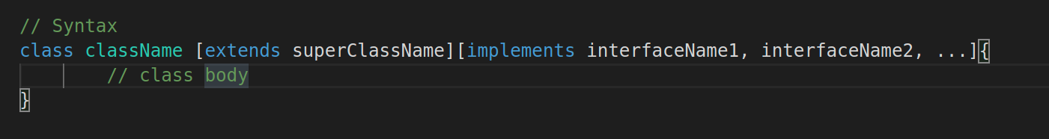
Implementation of classes with interface
Demo301

Slide 8
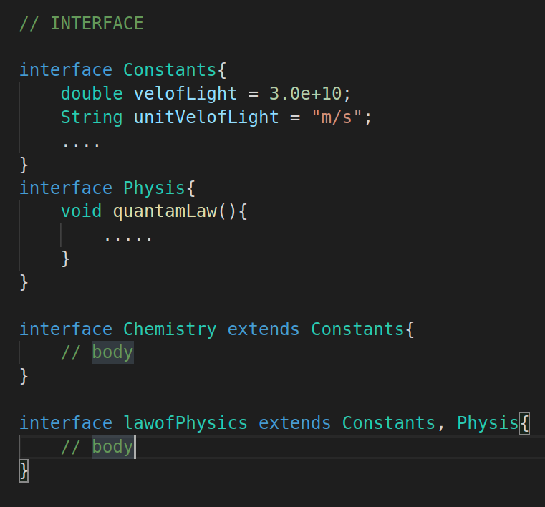
Extending interface
Interface can inherit from other interface
Interface can also multiply inherits.

Slide 9
Some of JAVA most used interface
Iterator: to run through a collection of objects without knowing how the objects are stored , for example in array, list bag or set.
Cloneable: to make a copy of an existing object via the clone() method on the class Object .
Serializable: pack a wb of objects such that can be send over network or stored to disk.
Comparable : To make a total order of objects

Slide 10
Cloneable
A class X that implements the CLoneable interface tells that the objects of class X can be cloned
The interface empty, that is, it has no method
Returns an identical copy an object
A shallow copy, by default
A deep copy is often preferable
Prevention of cloning
Necessary, if unique attribute , for example database lock or open file reference.
Not sufficient to omit to implement Cloneable
Sub classes might implement it.
Clone method should throw an exception (CloneNoteSupportedException)

Slide 11
Thank you and
Stay Home and Stay safe

