Slide 1

OOPS (JAVA)
Lec-33
Saif Nalband

Slide 2
Contents :
Exceptional handling

Slide 3
Error in JAVA programs : Compile Time Errors
Compile Time Errors
When programmers make mistake in syntax
Use methods which are not defined anywhere
Create objects of abstract classes
And many more

Slide 4
Errors in JAVA : Run Time Errors
Run Time Errors
Java programs are syntactically correct-> compilation is successful
Programs are running for some input but not all
Very difficult to decede while writing programs
Make the program unreliable and may damage system

Slide 5
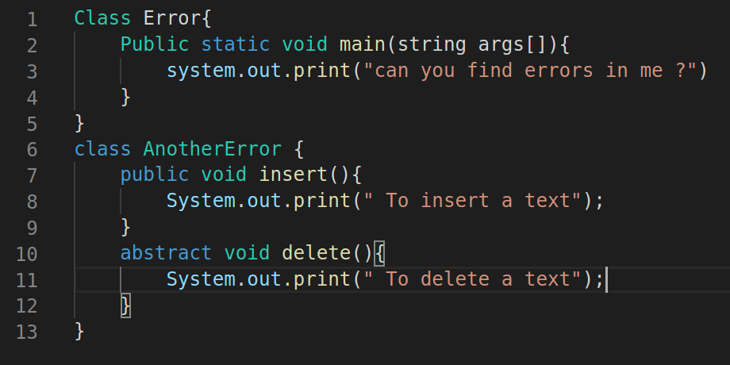
Compile Time Error: Examples

Slide 6
Some common compile time errors
Missing semicolons
Missing (or mismatch of brackets) in classes and methods
Misspelling of identifiers or keyword
Missing double quotes in strings
Use of undeclared variables
Incomplete types in assignment/ initialization
Bad references
Many more

Slide 7
Run Time Errors : Examples
Demo330

Slide 8
Some common Run Time errors
A user entered invalid data
Dividing an integer by zero
Accessing an element that is out of the bounds of an array
Trying a store a value into an array of an incomplete class or type
Trying to cast an instance of a class to one of its subclasses
Trying to illegally change the state of a thread
Attempting use a negative size for an array
NULL object references
A file that needs to be opened cannot be found
A network connection has been lost in the middle of communication memory.

Slide 9
Error and exceptions in JAVA
Whenever an Error or Exception occur, JAVA Run-Time Environment throws an object corresponding to that
Examples:
JAVA Run-Time Environment throws an object called IllegalArumentType
When a method m(int x, int y) is called as m(1.5, 4)
JAVA Run-Time Envoronrmnt throws an object ArthmeticException
When a = x/ (b - c) and b = c

Slide 10
Errors and exceptions in JAVA
To handle the common possible errors and exception, JAVA offers a class Hierarchy
Throwable
Error
Exception
IOException
RunTime Exception
All these classes (subclasses ) are defined in java.lang package

Slide 11
Exception handling in JAVA
JAVA provides Run Time Error Management to deal with errors and exceptions.
During the exception of a program, when an exception condition arises, an object of the respective exception classes is created and thrown in with method which caused the exception.
That method may choose to catch the exception and then can guard against premature exit or may have a block of code to execute.

Slide 12
Exception handling in JAVA
JAVA exception handling is managed via five keywords
try { ……}
catch { … }
throw { … }
throws { … }
finally { … }

Slide 13
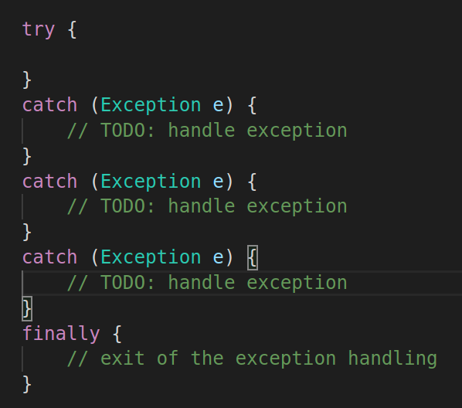
Exception handling in JAVA

Slide 14
Exception handling in JAVA
Simple try- catch: try with a single catch
try with multiple catch : try multiple catch
Multiple exception: multiple exception with one catch
Exception with exit code: try-catch with finally
Throwing own exception: throws/ throw in try - block
Nested try-catch block : try within try

Slide 15
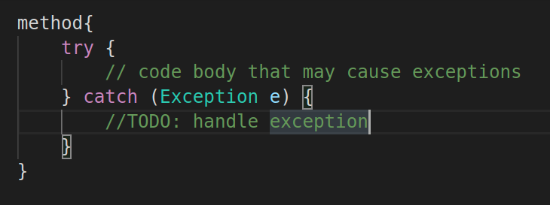
Simple try-catch
Demo331

Slide 16
Try-match: making program robust
Demo332

Slide 17
Demo333 main program
Robust Programs:
Demo334

Slide 18
Multiple try catch
Original programs:
Demo335
robust

Slide 19
Thank you and
Stay Home and Stay safe

