Slide 1
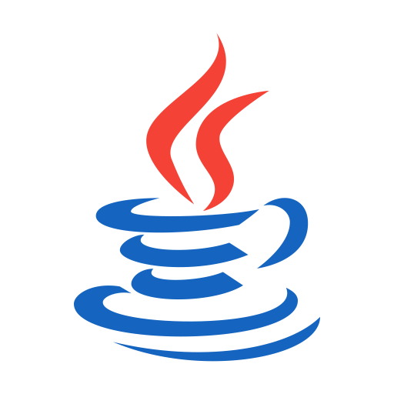
OOPS (JAVA)
Lec-34
Saif Nalband

Slide 2
Contents :
Exceptional handling

Slide 3
Some common compile time errors
Missing semicolons
Missing (or mismatch of brackets) in classes and methods
Misspelling of identifiers or keyword
Missing double quotes in strings
Use of undeclared variables
Incomplete types in assignment/ initialization
Bad references
Many more

Slide 4
Some common Run Time errors
A user entered invalid data
Dividing an integer by zero
Accessing an element that is out of the bounds of an array
Trying a store a value into an array of an incomplete class or type
Trying to cast an instance of a class to one of its subclasses
Trying to illegally change the state of a thread
Attempting use a negative size for an array
NULL object references
A file that needs to be opened cannot be found
A network connection has been lost in the middle of communication memory.

Slide 5
Exception handling in JAVA
JAVA exception handling is managed via five keywords
try { ……}
catch { … }
throw { … }
throws { … }
finally { … }

Slide 6
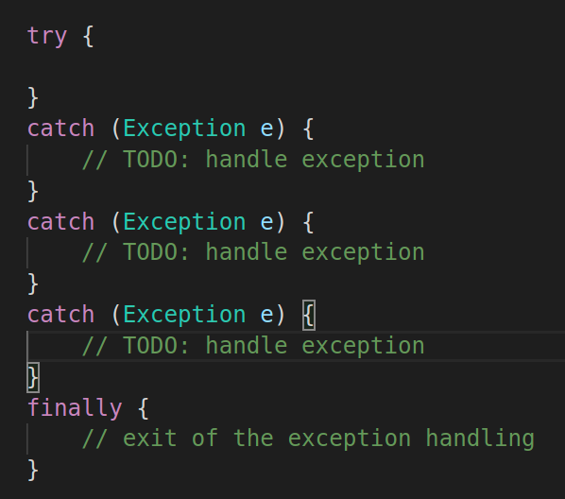
Exception handling in JAVA

Slide 7
Exception handling in JAVA
Simple try- catch: try with a single catch
try with multiple catch : try multiple catch
Multiple exception: multiple exception with one catch
Exception with exit code: try-catch with finally
Throwing own exception: throws/ throw in try - block
Nested try-catch block : try within try

Slide 8
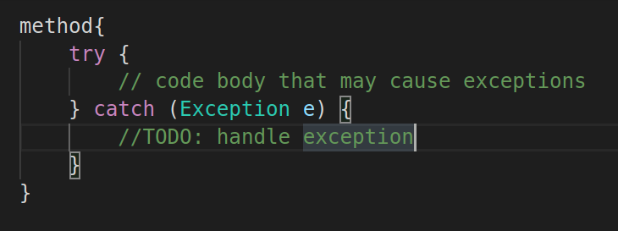
Simple try-catch
Demo331

Slide 9
Try-match: making program robust
Demo332

Slide 10
Try catch
Demo333 main program
Robust Programs:
Demo334

Slide 11
Multiple try catch
Original programs:
Demo335
Robust
Demo336

Slide 12
Multiple errors with single catch block
Demo337

Slide 13
finally
Exception handling is in fact built with try-catch-finally construct, although the finally clause is purely optional.
But in some cases, it is required to execute few codes regardless of whether an exception was caught or not.
For example, before exiting a program, it may have to close some open files and freeing up any other resources that might have been allocated at the beginning of a method.
The finally clause defines a block of code which will be executed always irrespective of any exception occurs or not.
Demo338

Slide 14
Throw
In Java, throw key word is known by which user can throw an exception of their own instead of automatic exception object generated by Java run time.
To use this, we have to create an instance of Throwable object.
Then the throw key word can be used to throw this exception.
2 ways of doing it
Using a parameter in a catch
Creating with new operator
Demo3310

Slide 15
Throws
throws is a keyword in Java which is used in the signature of method to indicate that this method might throw one of the listed type exceptions.
The caller to these methods has to handle the exception using a try-catch block.
Syntax:
type method_name(parameters) throws exception_list
exception_list is a comma separated list of all the
exceptions which a method might throw.
Demo339

Slide 16
Throw Vs Throws
throw | Throws
Java throw keyword is used to explicitly throw an exception. | Java throws keyword is used to declare an exception
Checked exception cannot be propagated using throw only. | Checked exception can be propagated with throws.
Throw is followed by an instance. | Throws is followed by class.
Throw is used within the method. | Throws is used with the method signature.
You cannot throw multiple exceptions. | You can declare multiple exceptions e.g. public void method()throws IOException,SQLException.

Slide 17
Thank you and
Stay Home and Stay safe

