Slide 1

OOPS (JAVA)
Lec-35
Saif Nalband

Slide 2
Contents :
Graphical User Interface (GUI)
AWT
Swing

Slide 3
Java AWT
Java AWT (Abstract Window Toolkit) is an API to develop GUI or window-based applications in java.
Java AWT components are platform-dependent i.e. components are displayed according to the view of operating system. AWT is heavyweight i.e. its components are using the resources of OS.
The java.awt package provides classes for AWT api such as TextField, Label, TextArea, RadioButton, CheckBox, Choice, List etc.

Slide 4
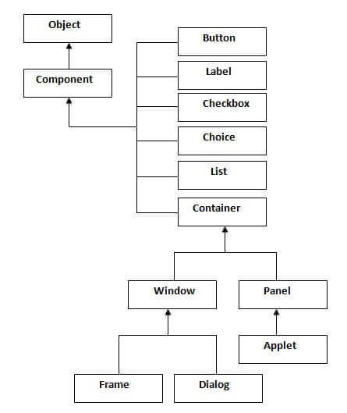

Slide 5
Terminology
Container : The Container is a component in AWT that can contain another components like buttons, textfields, labels etc. The classes that extends Container class are known as container such as Frame, Dialog and Panel.
Window : The window is the container that have no borders and menu bars. You must use frame, dialog or another window for creating a window.
Panel : The Panel is the container that doesn't contain title bar and menu bars. It can have other components like button, textfield etc.
Frame : The Frame is the container that contain title bar and can have menu bars. It can have other components like button, textfield etc.

Slide 6
JAVA Swing
Java Swing tutorial is a part of Java Foundation Classes (JFC) that is used to create window-based applications. It is built on the top of AWT (Abstract Windowing Toolkit) API and entirely written in java.
Unlike AWT, Java Swing provides platform-independent and lightweight components.
The javax.swing package provides classes for java swing API such as JButton, JTextField, JTextArea, JRadioButton, JCheckbox, JMenu, JColorChooser etc

Slide 7
The Java Foundation Classes (JFC) are a set of GUI components which simplify the development of desktop applications.

Slide 8
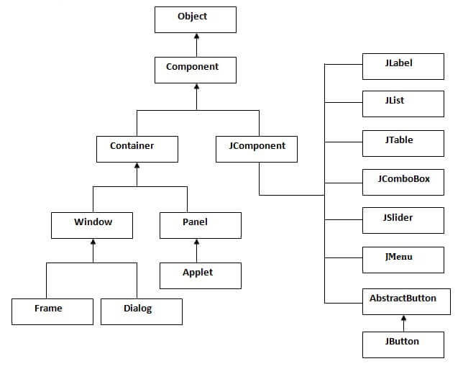

Slide 9
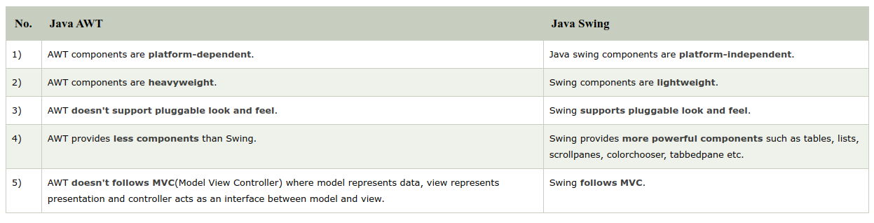
AWT Vs Swing

Slide 10
Commonly used Methods of Component class
The methods of Component class are widely used in java swing that are given below.
Method | Description
public void add(Component c) | add a component on another component.
public void setSize(int width, int height) | sets size of the component.
public void setLayout(LayoutManager m) | sets the layout manager for the component.
public void setVisible(boolean b) | sets the visibility of the component. It is by default false.

Slide 11
Thank you and
Stay Home and Stay safe

